Slide 1
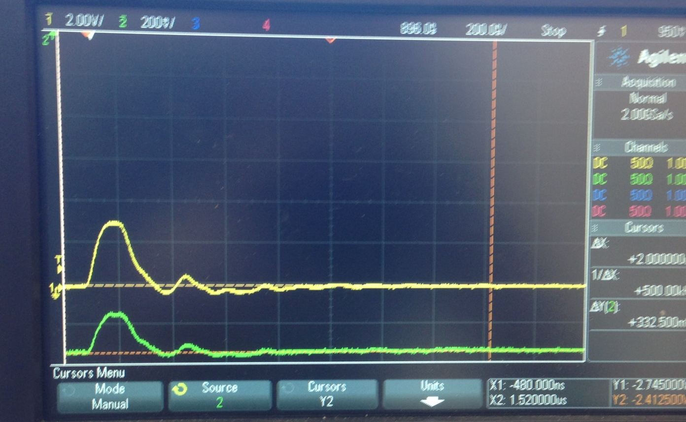
Pulse from current monitor (upper graph); optical monitor (lower graph).

Slide 2
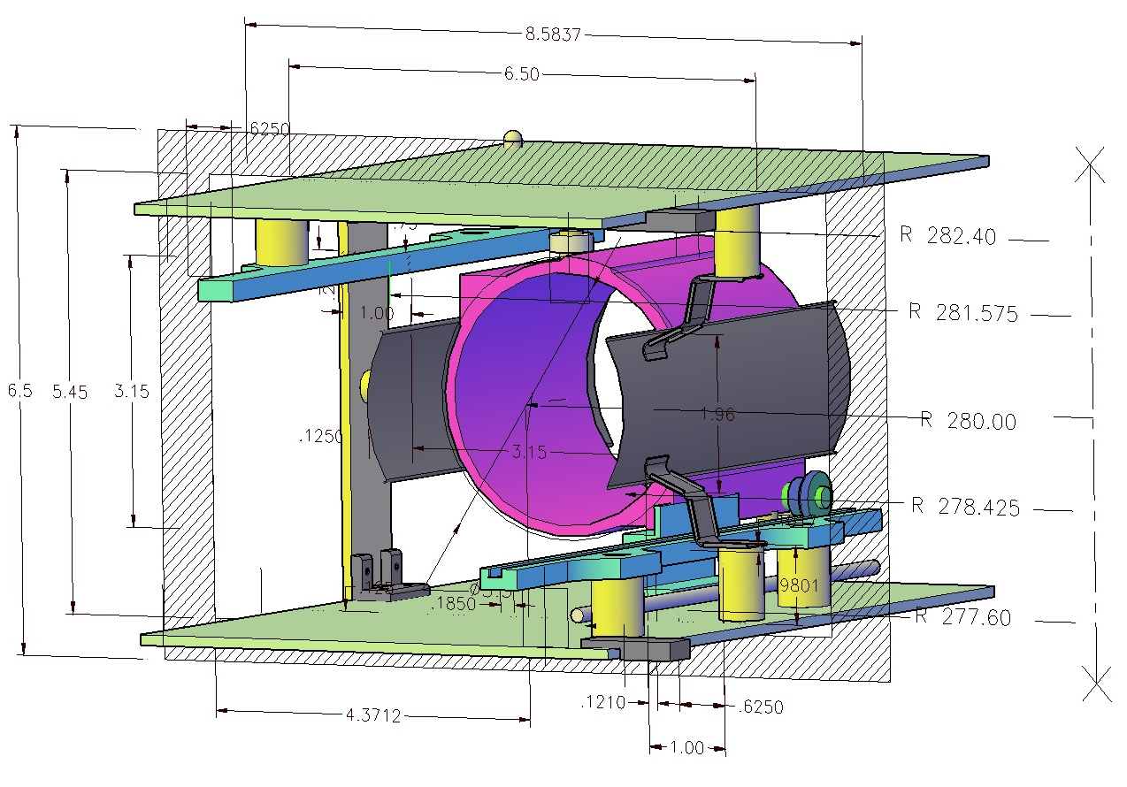
New cage for kicker plates

Slide 3
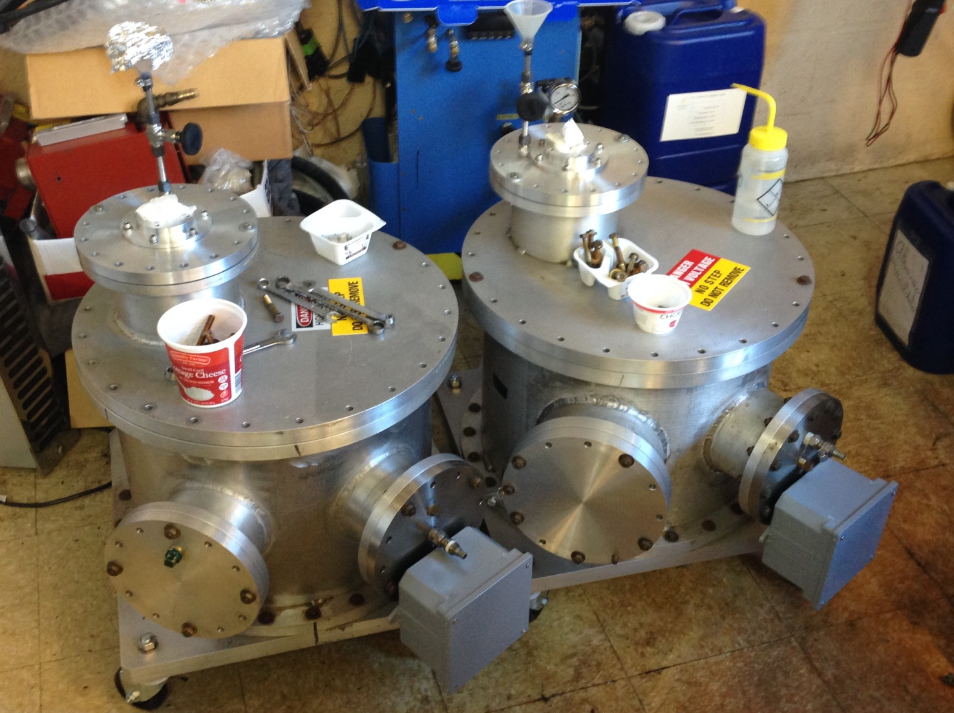
Two transformer tanks send by Fermilab

Slide 4
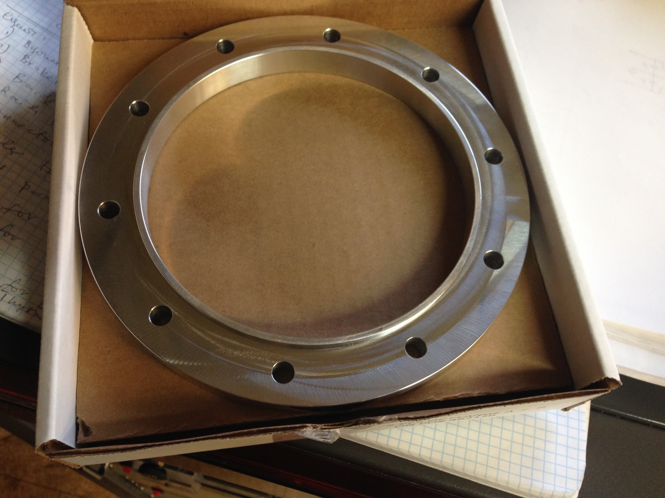
Flange

Slide 5
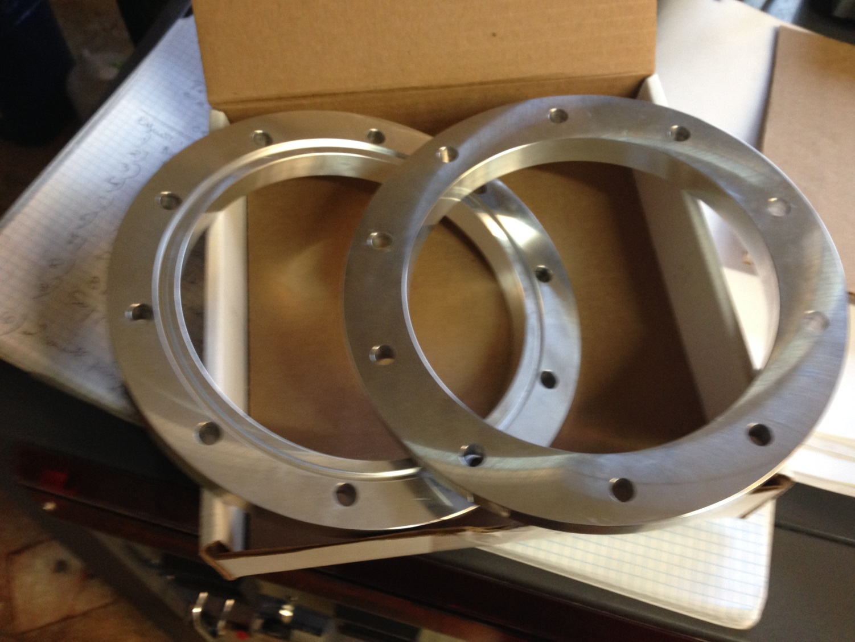
68 flanges manufactured in a Company

Slide 6
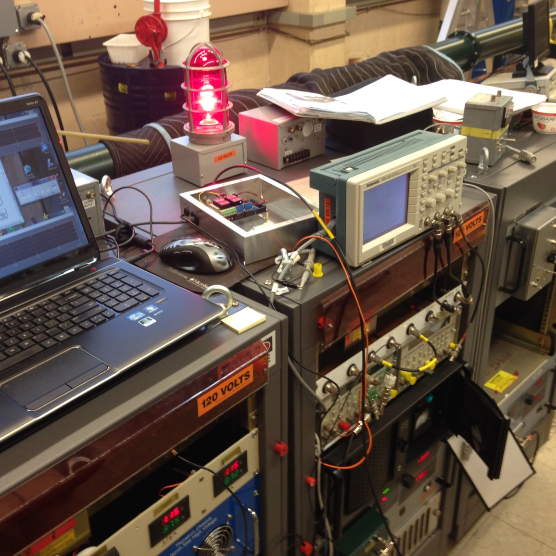
Pulser controlled from notebook through Arduino 2560

Slide 7
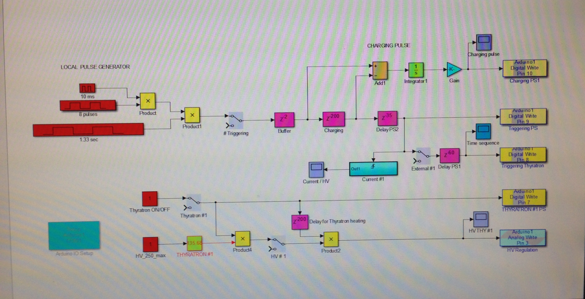
Operational panel

Slide 8
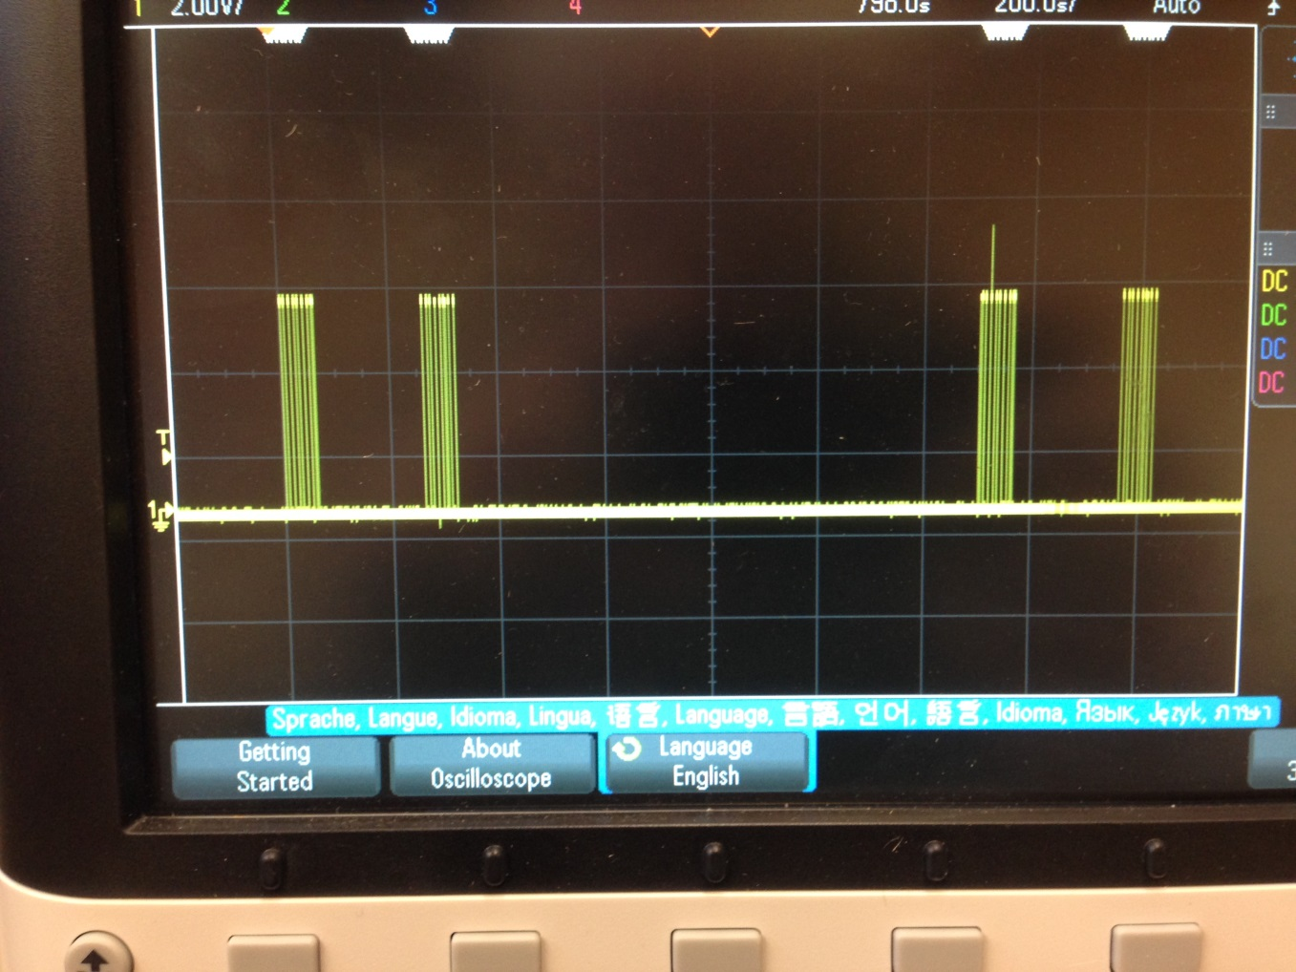

Slide 9
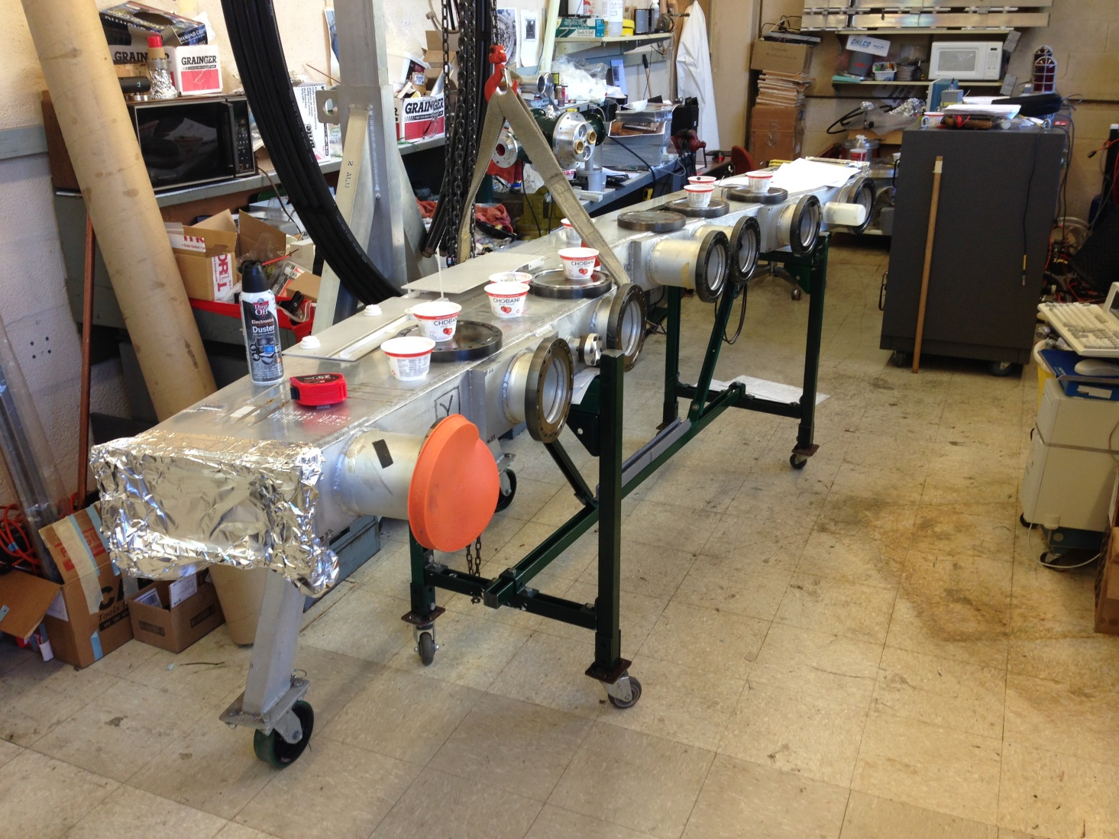
Vacuum chamber (one of two) arrived after milling the NMR grooves

Slide 10
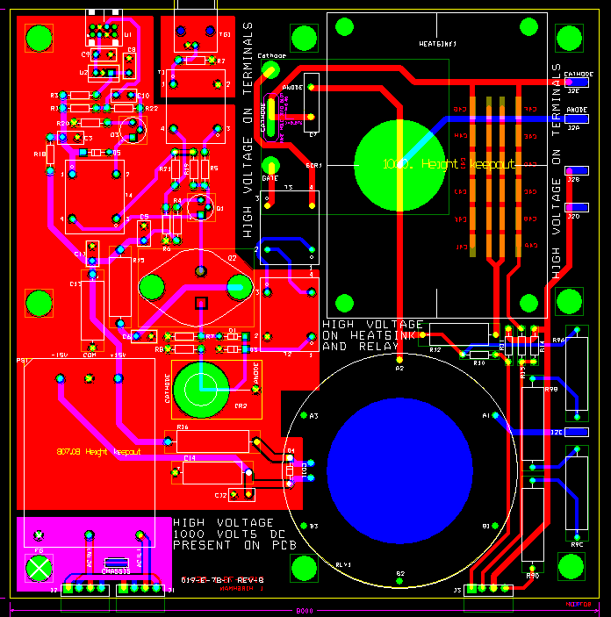
New pulser plate made for replacement of pulsed PS lost at Fermilab

