Slide 1
Kicker Status
A. Mikhailichenko, D. Rubin
Cornell
March 26, 2015

Slide 2
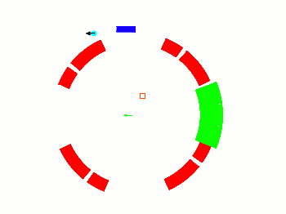


Slide 3
Kicker Magnet
10.8 mrad kick corresponds to 1114 kg-m
  292 G for each of 3 - 1.27m long kicker magnets
  0.4 mm thick plates
  Magnet geometry => 65G/kA
  => 4.5 kA/kicker magnet
  => 56 kV on each Blumlein
“New” larger aperture inflector” requires 12mrad kick
  => 62 kV / Blumlein

Slide 4
Current Generator
12.5 Ω Blumlein triaxial transmission line
Assembled from 6 – 60 inch sections (20 ns/section) (30 ft long)
Filled with Castor oil, ε=4.7, (pulse length τ α √ε) (as compared to Corning 561 silicon oil, ε=2.7)
Concentric tubes are separated with teflon standoffs (we plan to replace with macor)
Two grid(fast) thyratron – rated for up 70kV – 15kA (7.5 kA in load)
Coupled via 4 parallel 50Ω coaxial cables and resistors (12.5 Ω equivalent) to the kicker magnet

Slide 5
12.5 Ω Blumlein triaxial transmission line

Slide 6
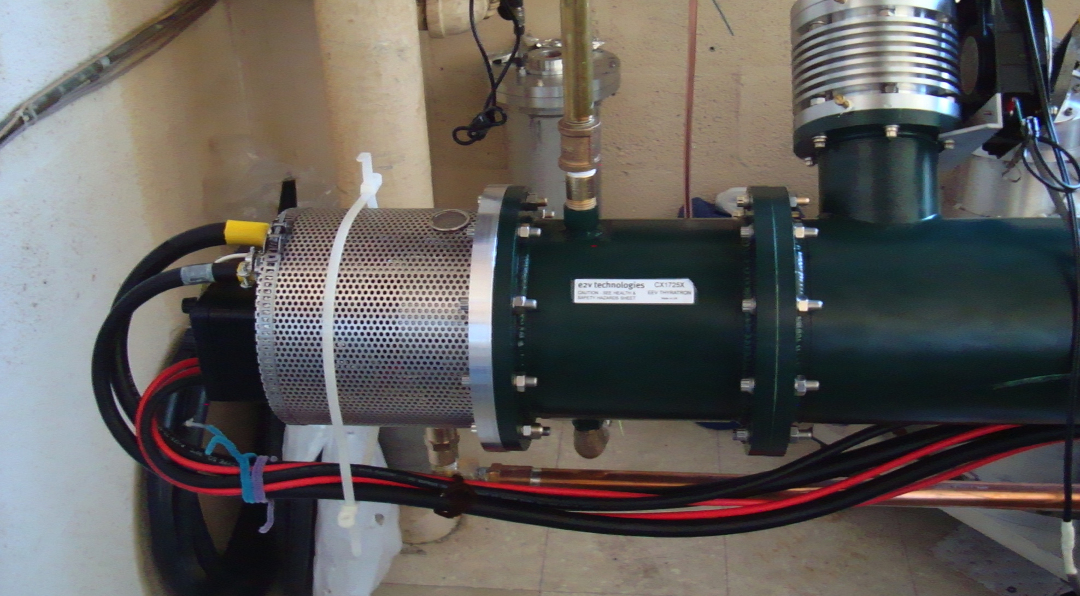
Thyratron switch

Slide 8
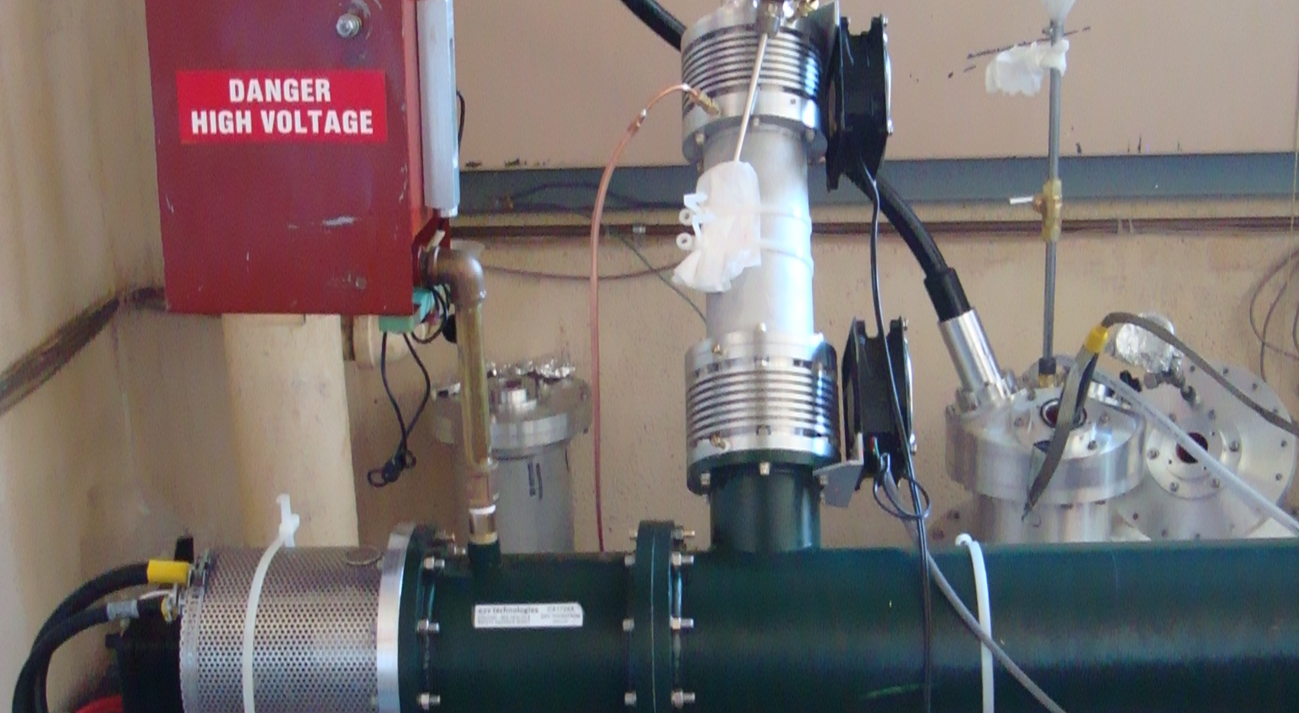
Thyratron and charging input

Slide 9
Blumlein schematic
12.5 Ohm Blumlein
Four parallel 50 Ω coaxial cables couple 12.5Ω
Blumlein to load
3500A X 12.5Ω = 43.75kV

Slide 11
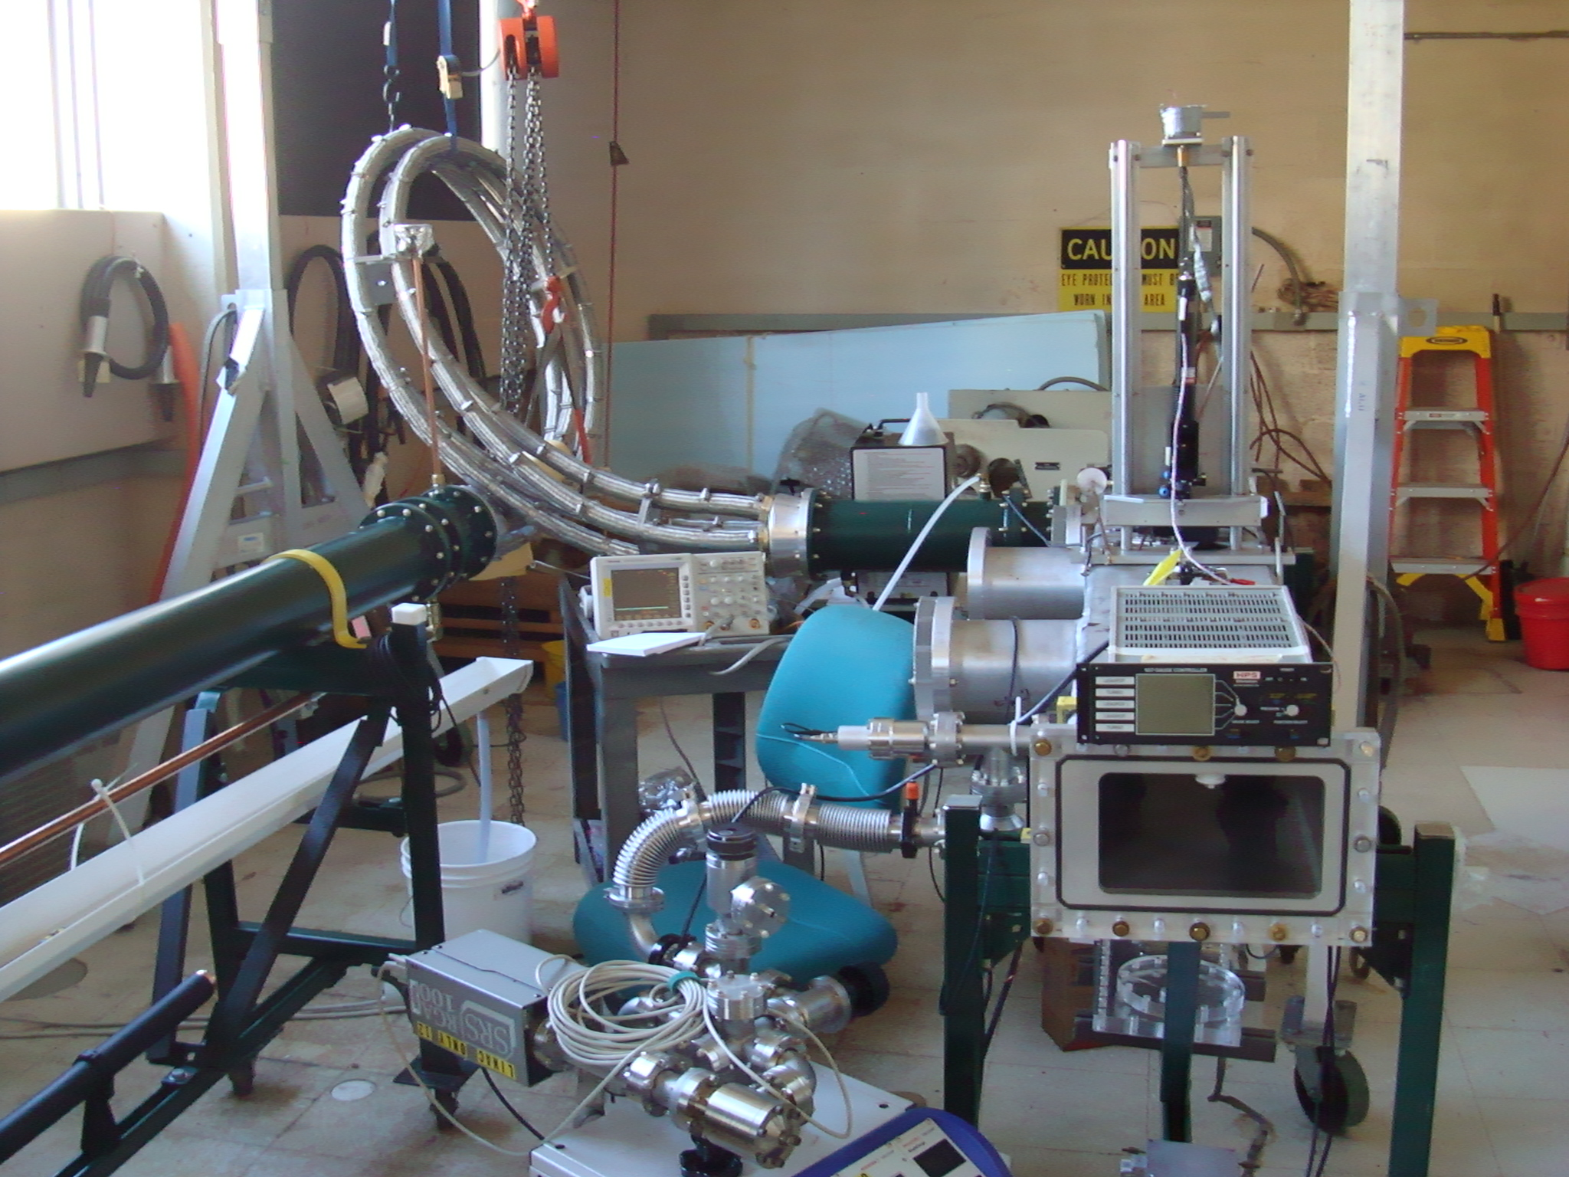
4 parallel 50Ω cables
Load resistors in flourinert
Magnetometer laser
Kicker chamber
Vacuum pump

Slide 12
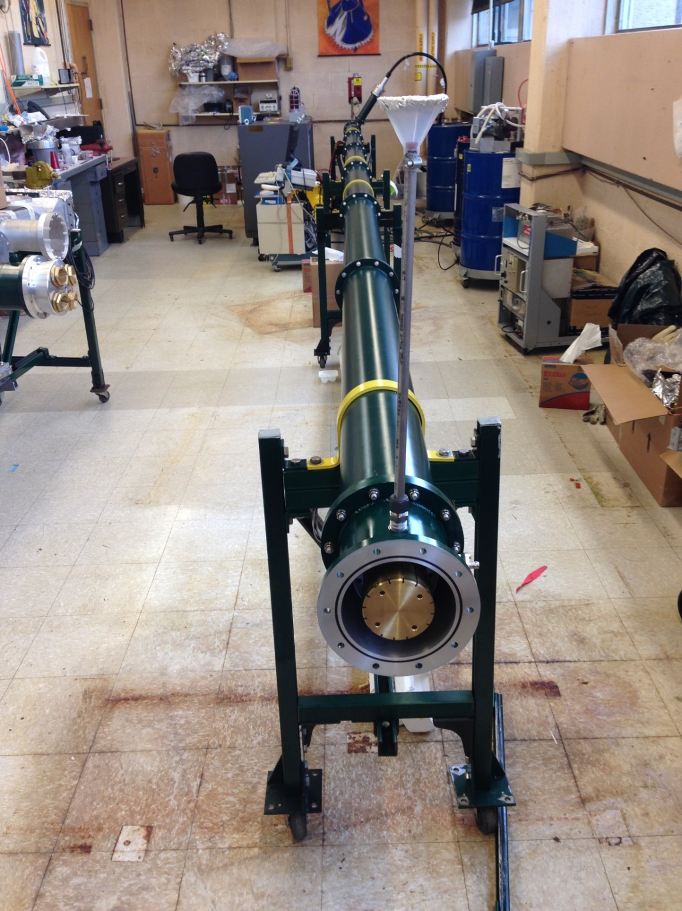
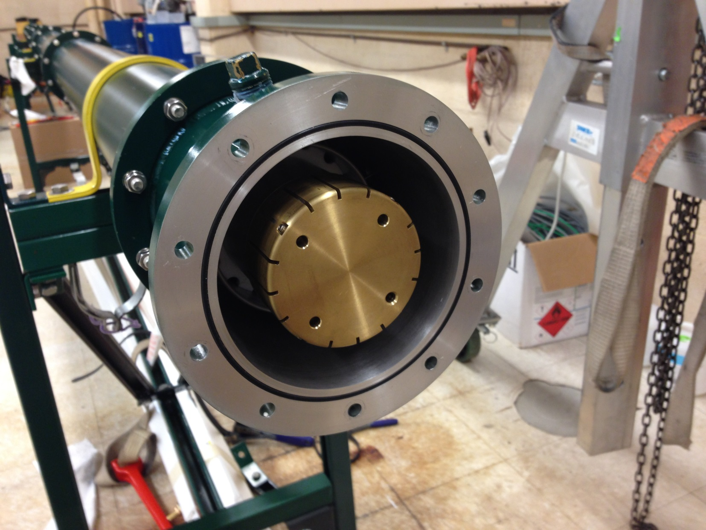
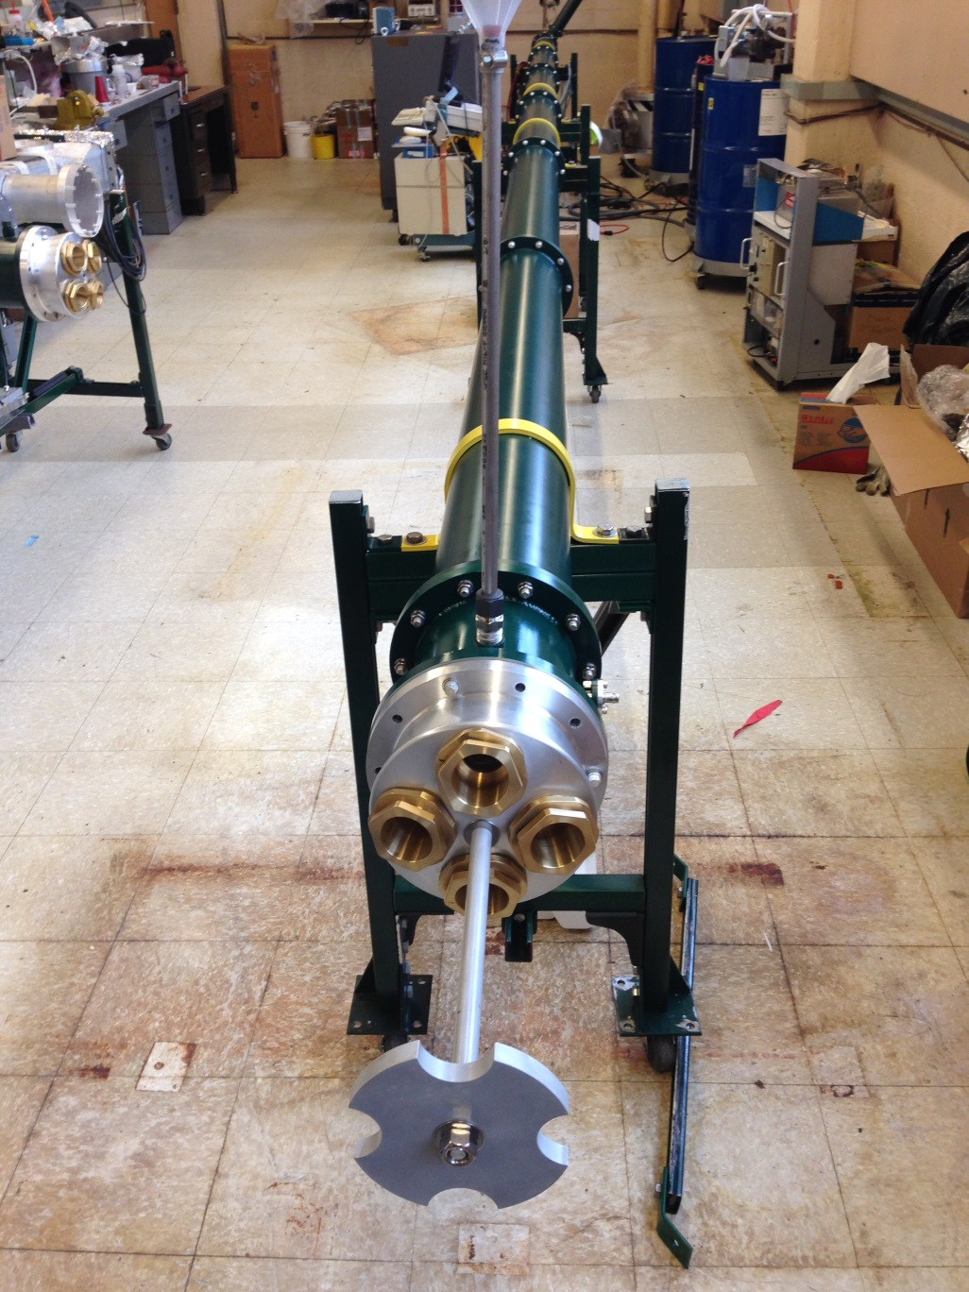
Blumlein business end

Slide 14
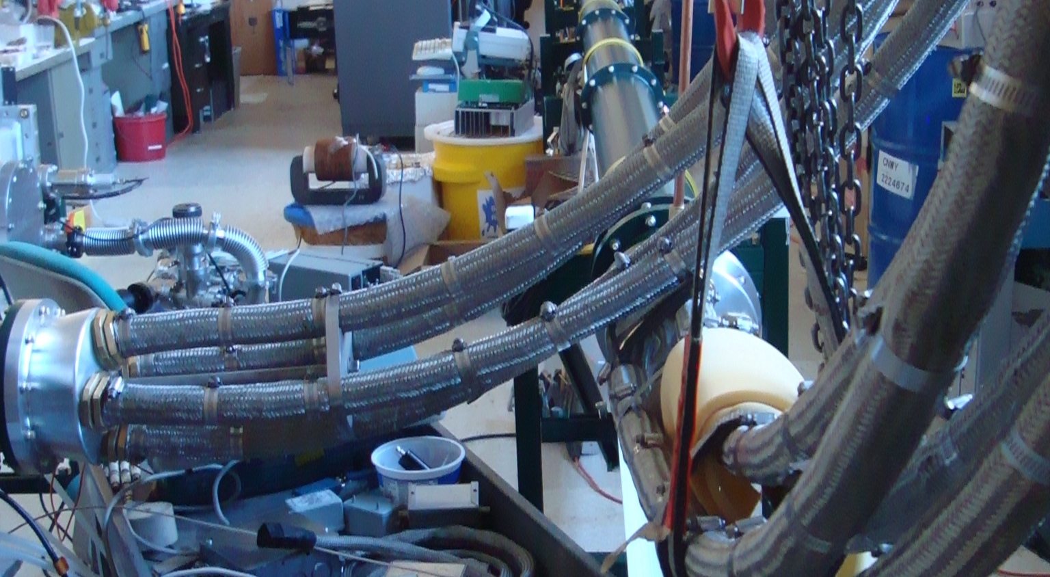
4 –parallel coax to load

Slide 15
Vacuum chamber
Resistors are cooled in flourinert

Slide 16
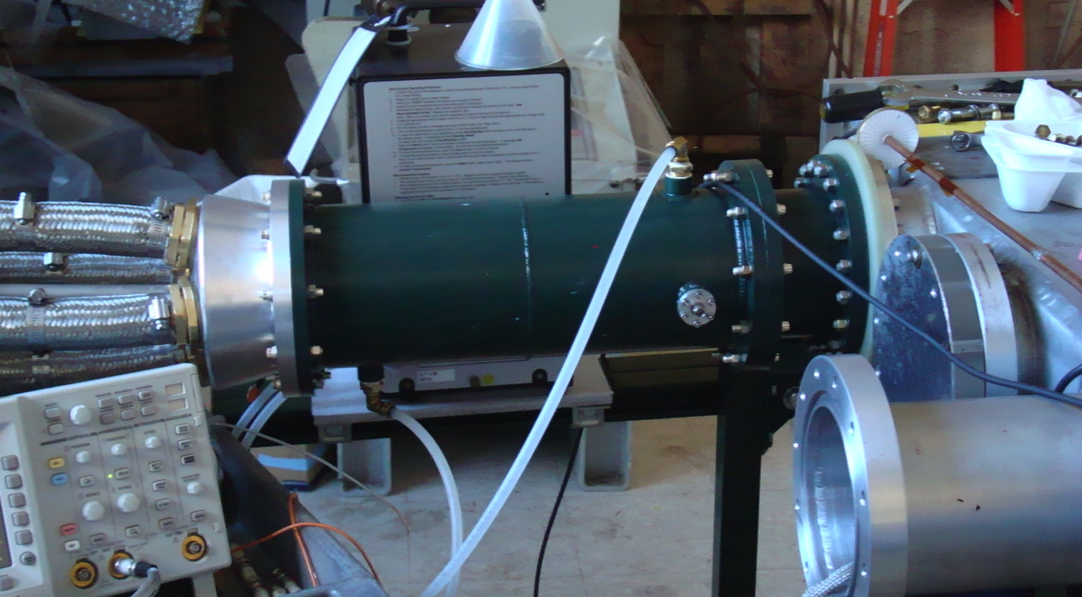
Coupling to magnet
flourinert
4 50Ω coaxial cables
4 load resistors
Vacuum chamber

Slide 17
Load resistors cooled in flourinert

Slide 19
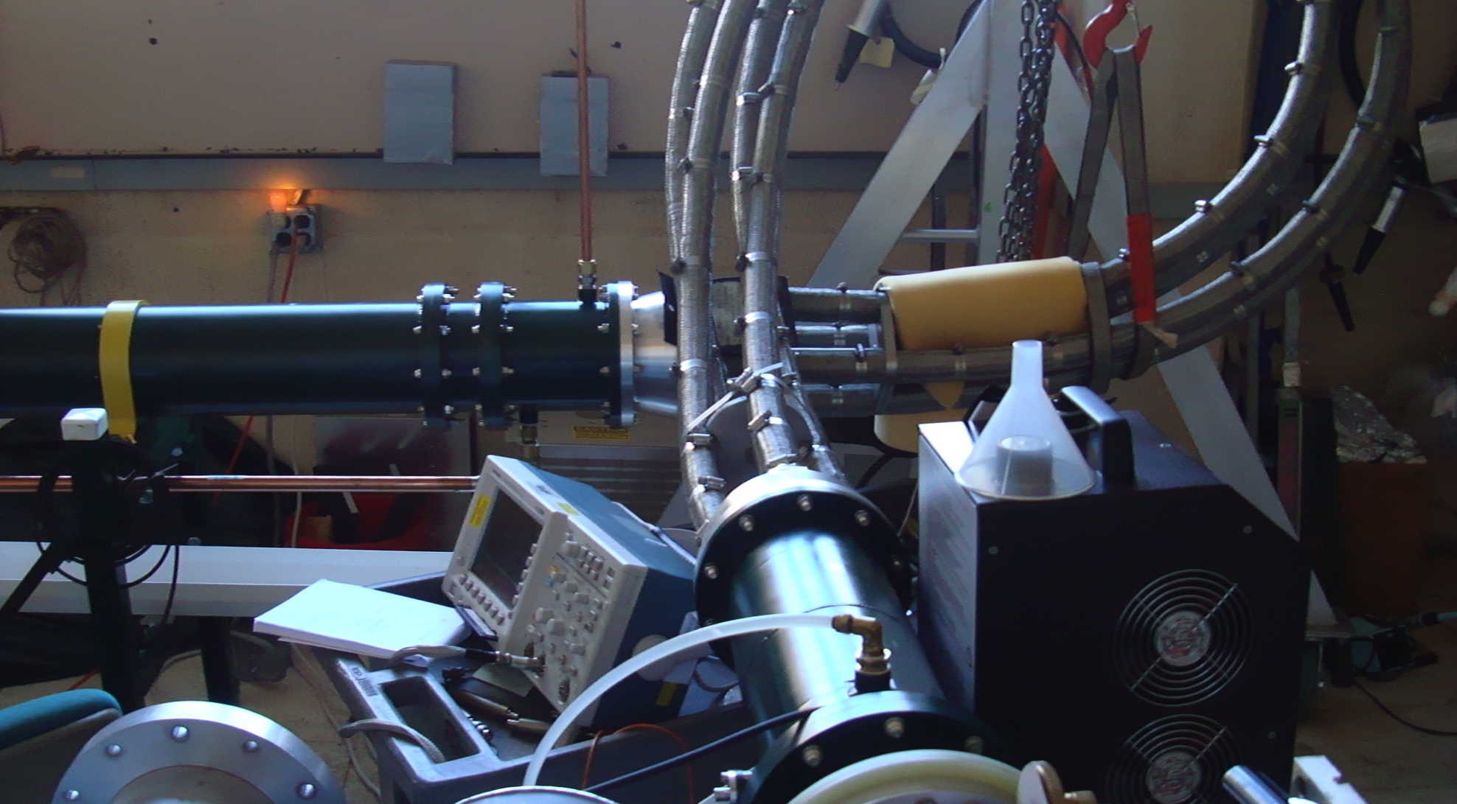
Coupling from Blumlein to Load

Slide 22
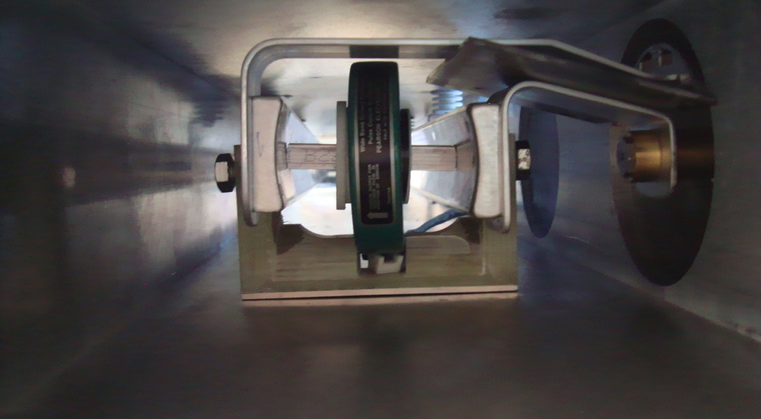

Slide 24
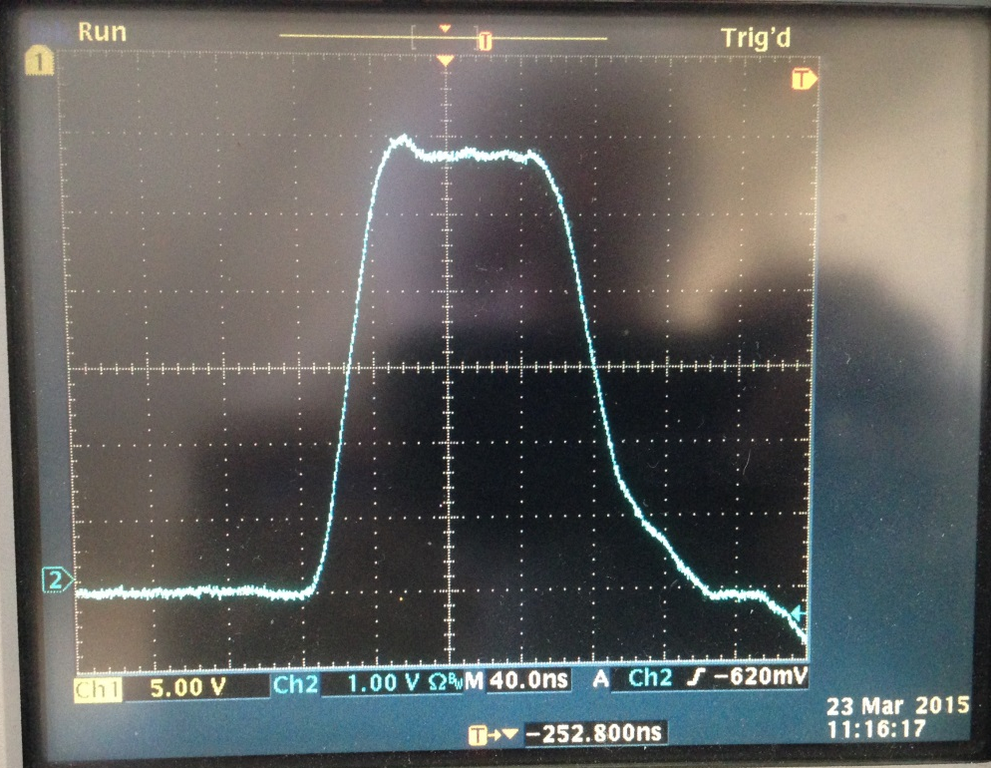
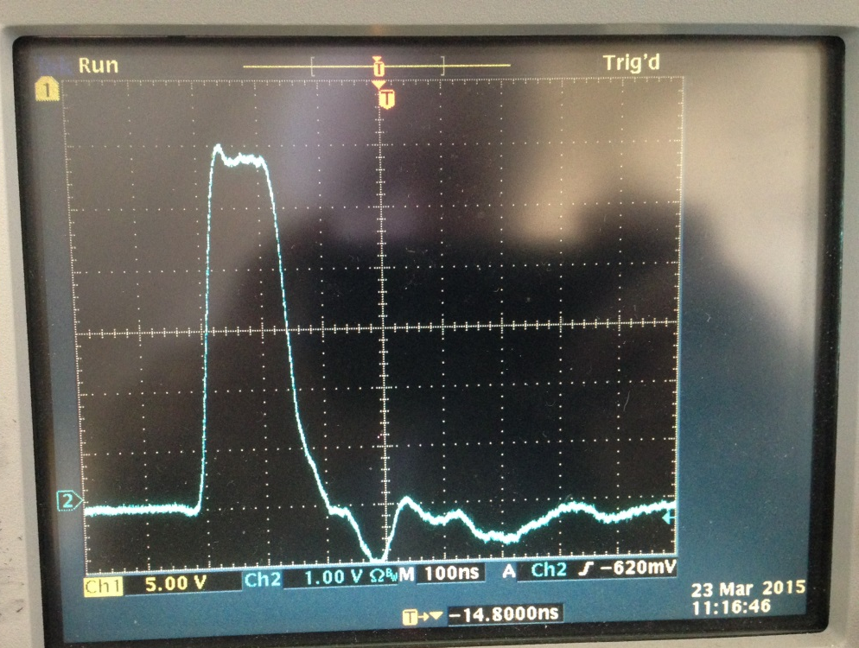
Pearson 3212 current monitor;
Current in a 40 –cm long kicker;
Current value ≈ 2.4 kA;
Charging Voltage≈30 kV;
40ns/div
Same pulse
different time scale
Pearson 3212 current monitor;
Current in a 40 –cm long kicker;
Current value ≈ 2.4 kA;
Charging Voltage≈30 kV;
100 ns/div

Slide 25
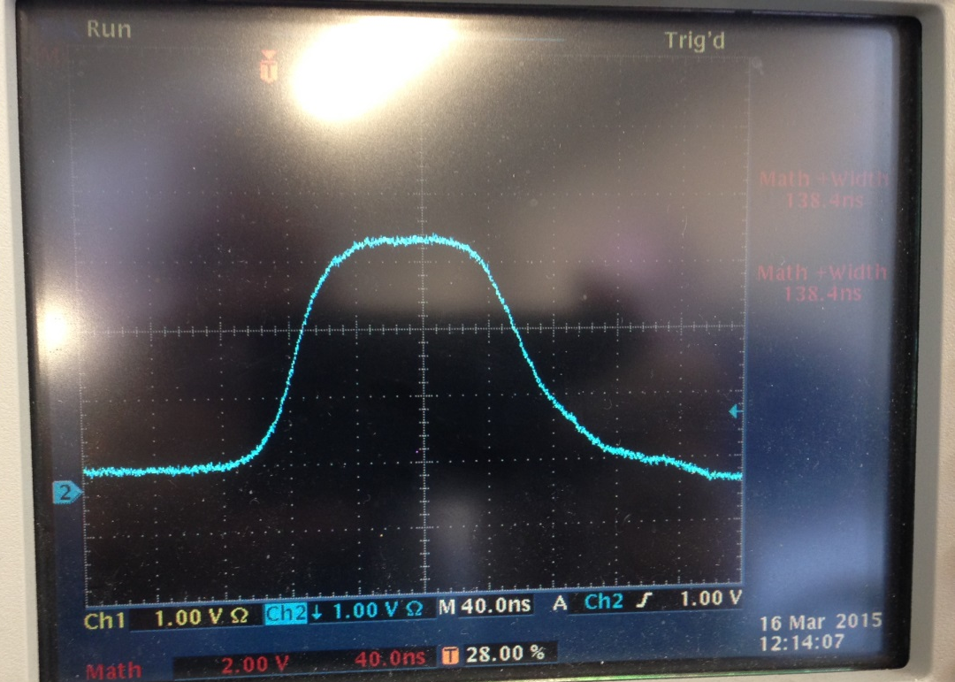
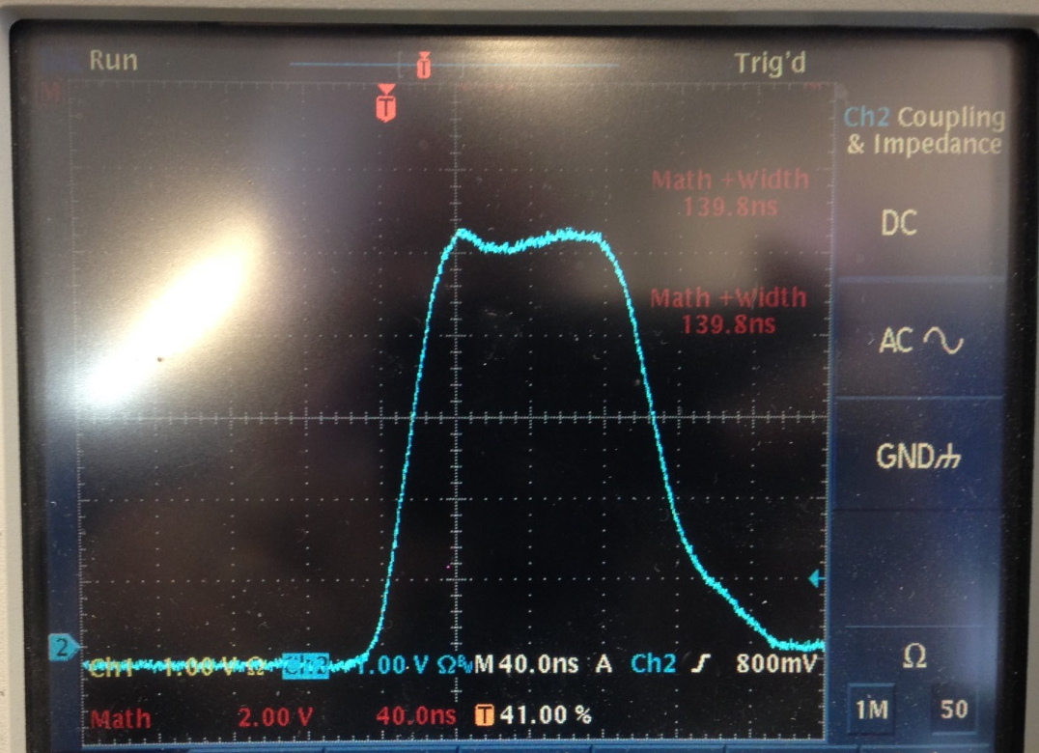
The same charging voltage, but different current monitors
Pearson 6600 current monitor;
Current ≈2 kA; V ≈25 kV
Kicker length ≈ 60 cm;
40 ns/div, 12 Hz
Max current allowed by Pearson 6600
is 2 kA
Pearson 3212 current monitor;
Current ≈2 kA; V ≈25 kV
Kicker length ≈ 60 cm;
40 ns/div; 12 Hz
Max current allowed by Pearson 3212 is 7.5 kA

Slide 26
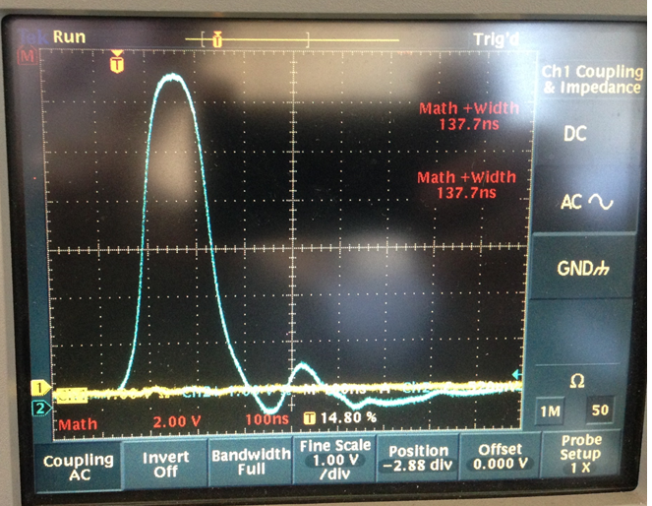
Pearson 3212; 50 kV; 4kA; 12 Hz, Kicker length ≈127 cm (50”)
The tail generated by slight mismatch of impedances.

Slide 27
Kicker pulse
Mismatch (Blumlein to coax)
  Impedance matching chamber
  Alternative high voltage coax
Tail
  Charging circuit
Rise and fall time
  Kicker length
Width
  Blumlein length

Slide 28
Impedance Match
Proposed Impedance matching tuner
Includes resistor ( ~ 500 Ω) and capacitance or diode

Slide 29
Impedance Match
Proposed Impedance matching tuner
Includes resistor ( ~ 500 Ω) and capacitance or diode
Match Blumlein impedance to cables

Slide 30
Impedance Match
Alternative coax ?
Fermilab cable
Cornell cable

Slide 31
Charging circuit
To Blumlein
HV transformer in oil

Slide 32
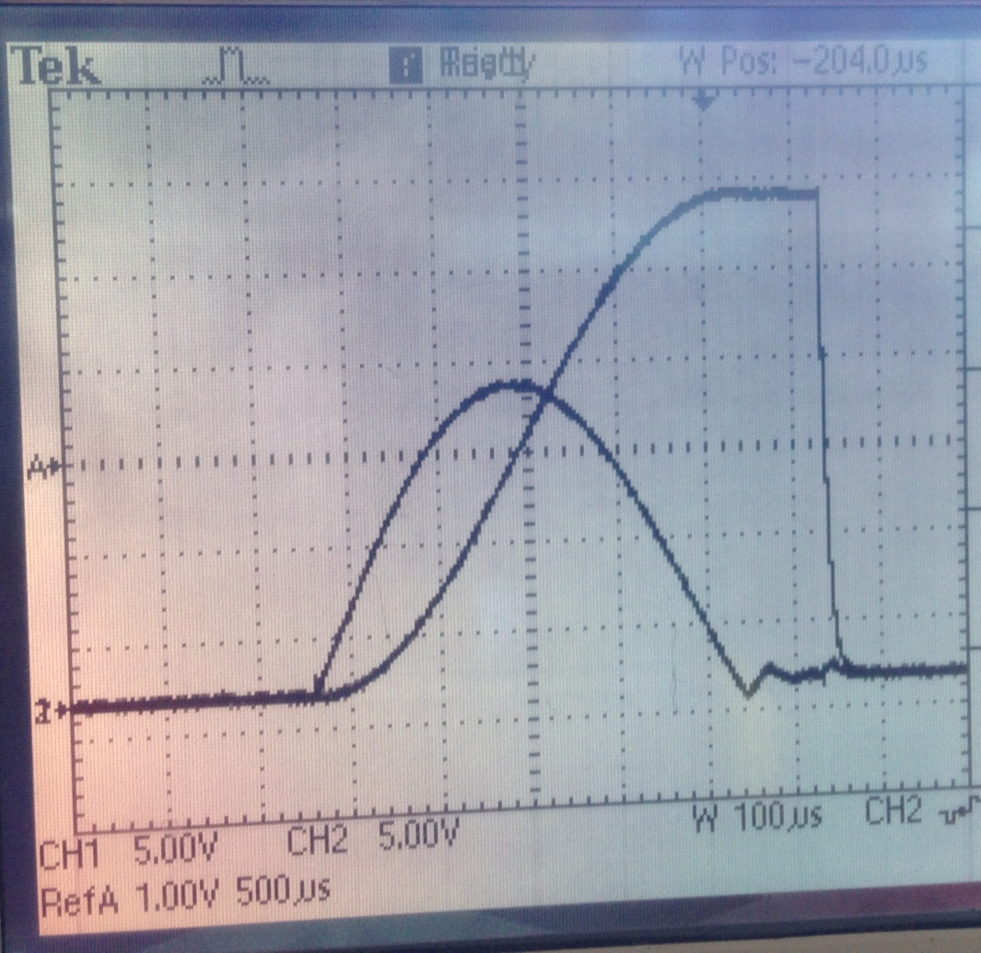
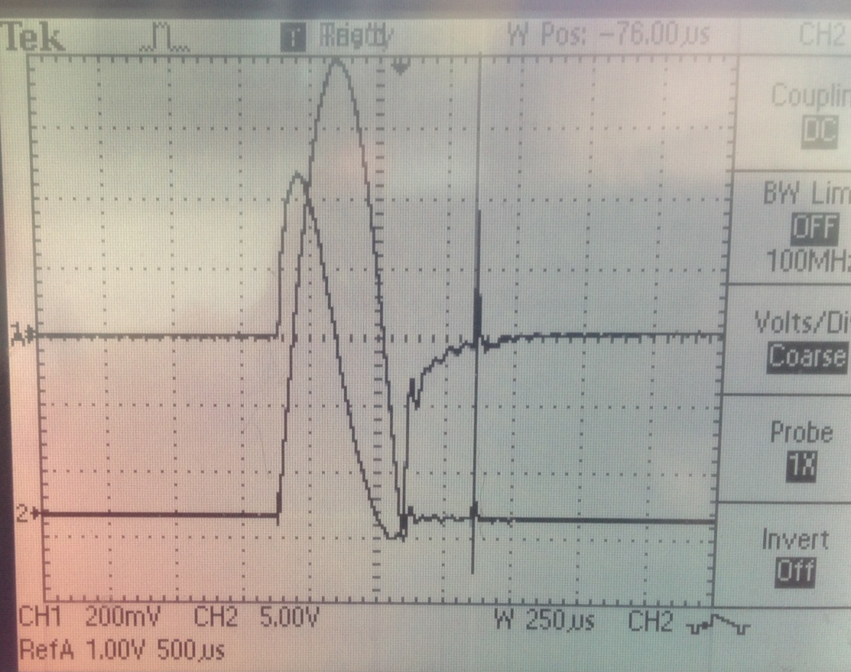
Charging circuit
Charging transformer characteristics contributing to signal after main pulse?
Voltage applied to Blumlein
(Voltage at secondary windings)
Current in primary windings
(Power Designs CVT-1A)
Moment of thyratron triggering
Current in secondary windings

Slide 33
Rise/fall and width
Kicker inductance limits rise and fall
  Inductance proportional to length
  E821 - 3 X 1.7m long magnets
  Requisite 1114 kG-m is realized with
  3 X 1.27 m kickers at 4.5 kA (56kV)
  (leaving 1.2 m of the kicker chambers is unoccupied)
  Faster rise and fall can be achieved by further reducing kicker length and adding additional units to maintain integrated field (access into vacuum chamber?)
Width can be increased by adding sections to Blumlein
(space ?)

Slide 34
Design for mounting kickers in cages

Slide 35
Summary
30 ft 12.5 Ω Blumlein tested
  To 4kA (50kV) into 1.27m long kicker (briefly at 12 Hz)
  To 70kV with shorter kicker
Impedance transformer to improve match designed
Charging circuit contribution to tail under investigation
Kicker pulse
  Sufficient amplitude with 1.27m kicker but slow rise and fall limit width at full field
  Solution: Longer Blumlein and/or additional shorter kickers

Slide 36
Current in primary windings
(Power Designs CVT-1A)
Current in secondary windings
(Pearson 410)
Moment of thyratron triggering

Slide 38
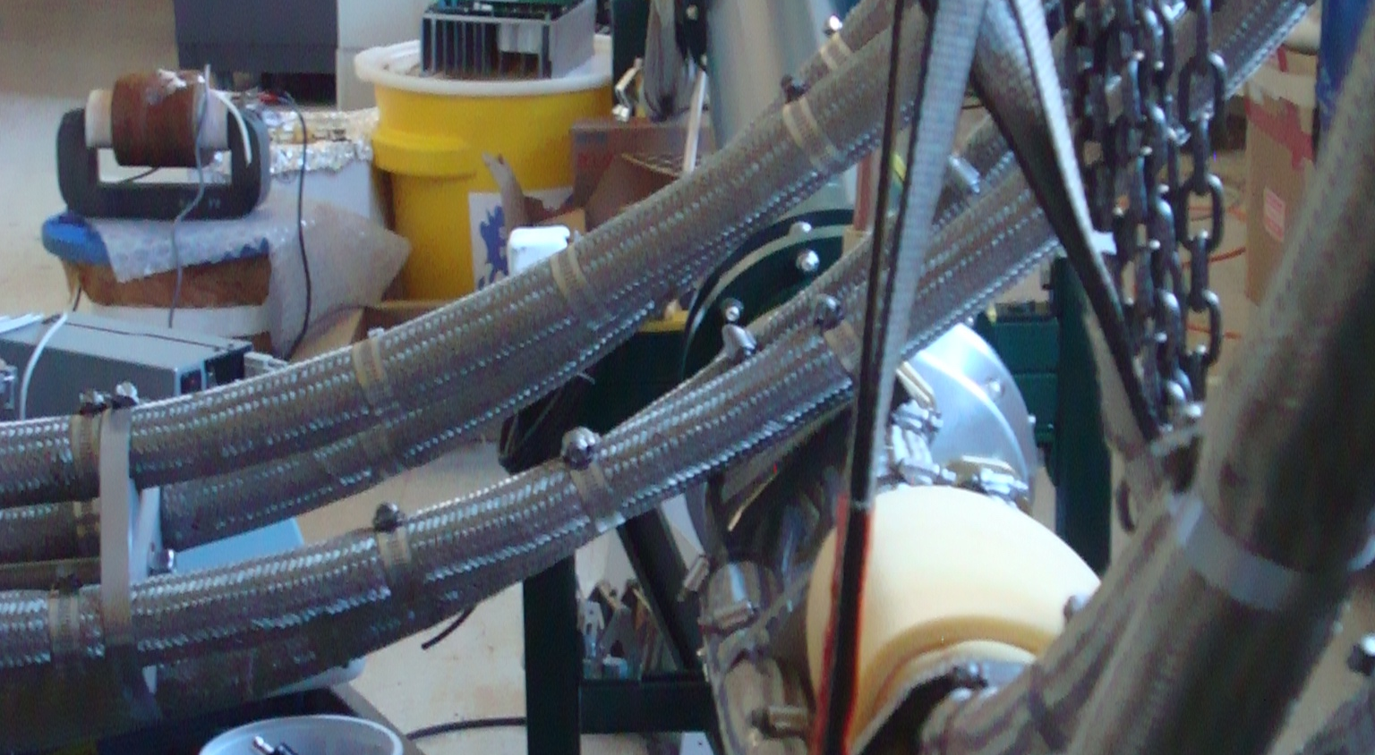

Slide 39
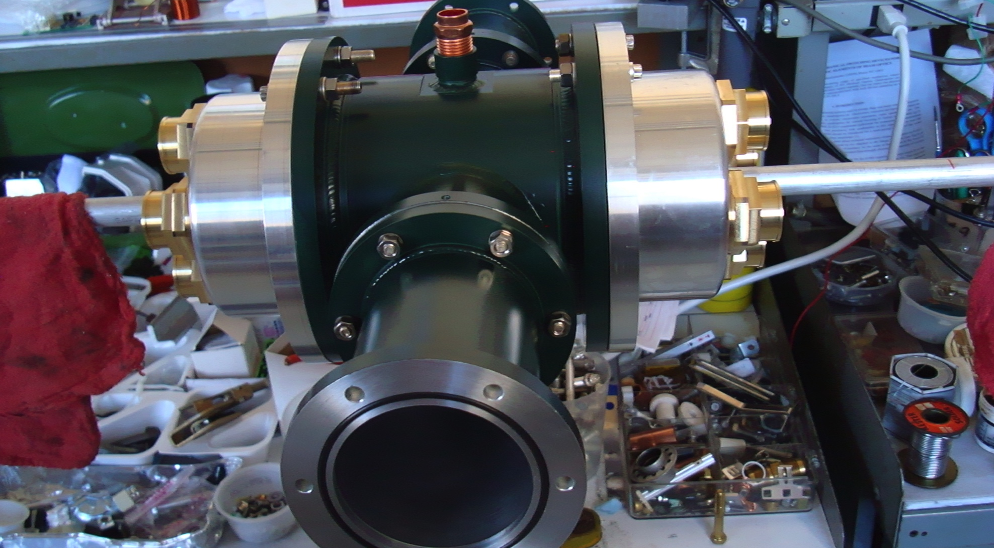

Slide 40
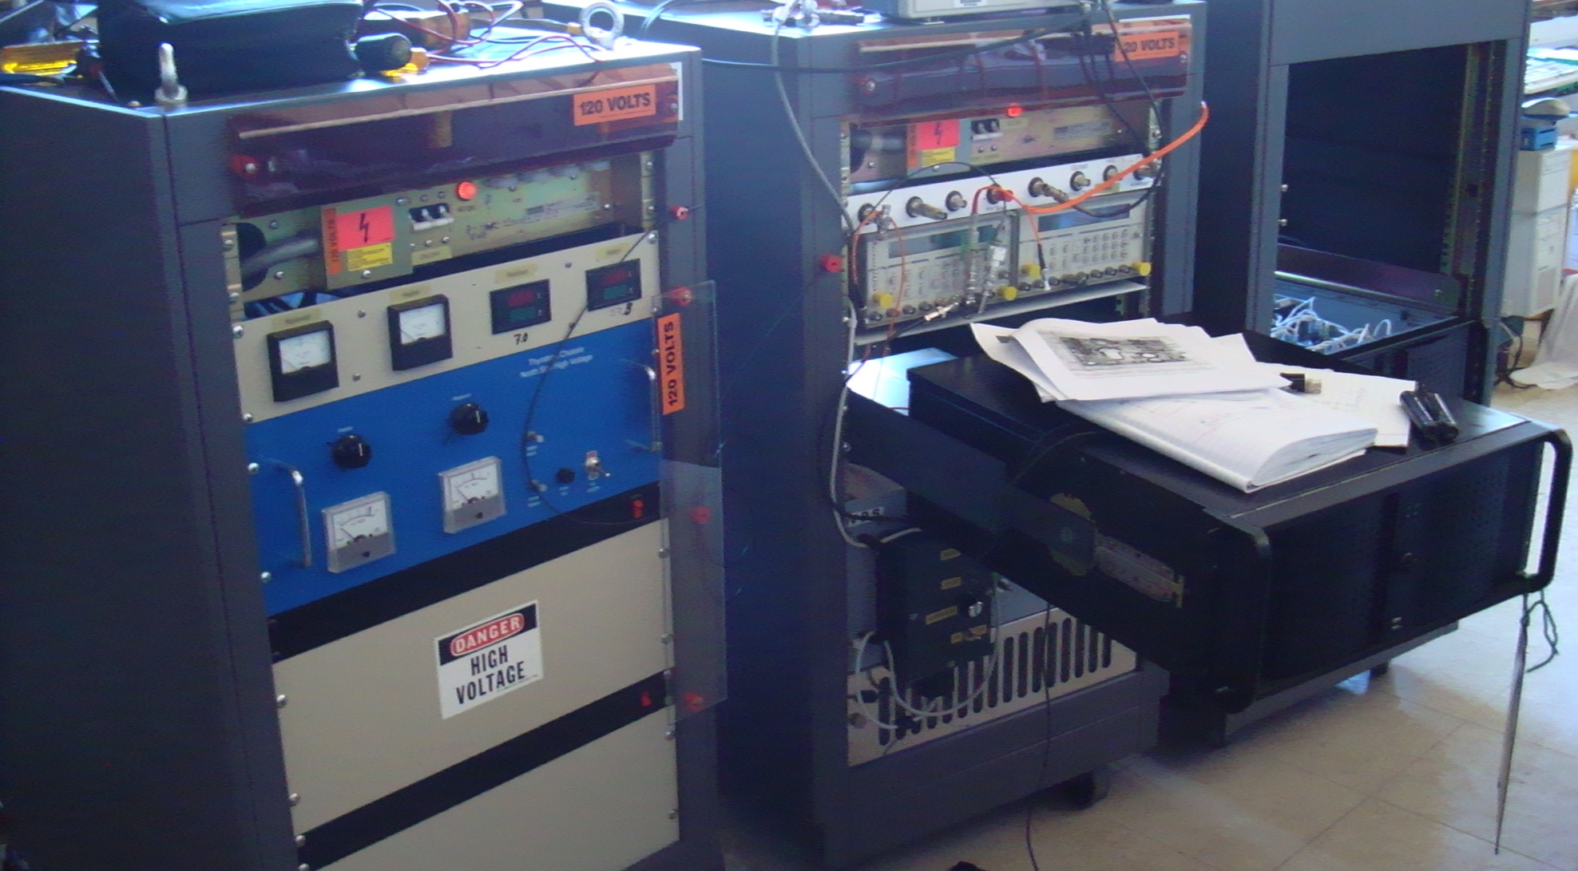

Slide 41
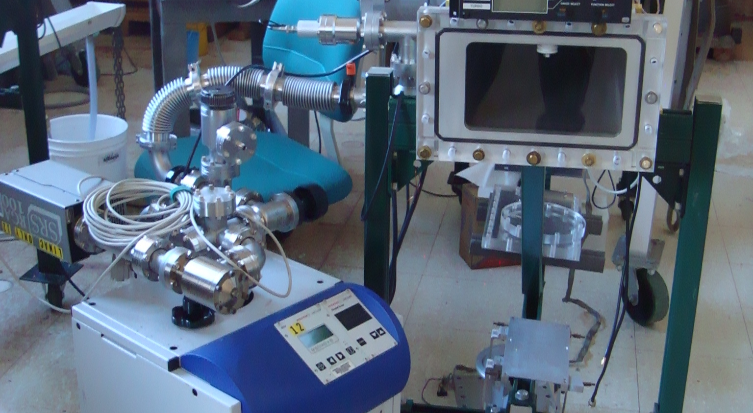

Slide 42
Storage Ring Kicker Requirements
Kickers steer injected muons onto the closed orbit of the storage ring
Requirements:
Kick angle ~ 10.8 to 12.1 mrad
Kicker B-field ~ 218 to 245 Gauss
Integrated B-field ~ 1.11 to 1.25 kG-m
Pulse width(τ_{wid})
120ns < τ_{wid} < 149ns
Repetition rate
~100Hz peak, 12Hz average
3 – 1.7m kickers
τ_{rev} = 149 ns
d = 77 mm, R=7112 mm
kick angle θ = d/R = 10.8 mrad

Slide 43
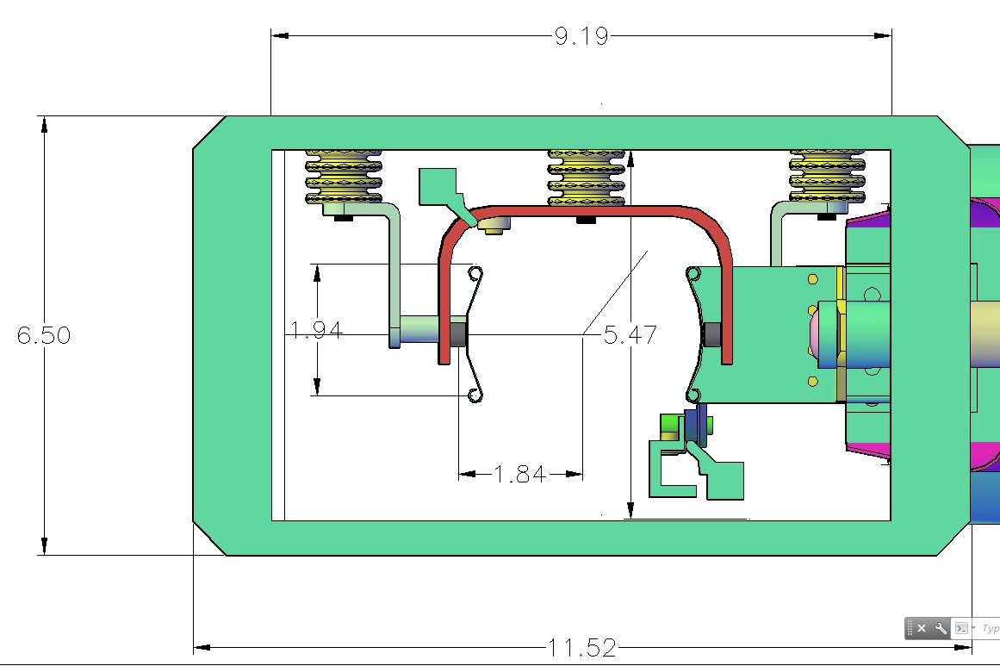
476.3.5.3 – Kicker Plate Design
E 989 plates
E989 plates and trolley rails
Crossover at end of strip line
Current feed from PFN
E 821 plates
3 sets of strip line kickers
Length = 1.7m each
Trolley rail
Kicker plates mounted in ring vacuum chamber

Slide 44
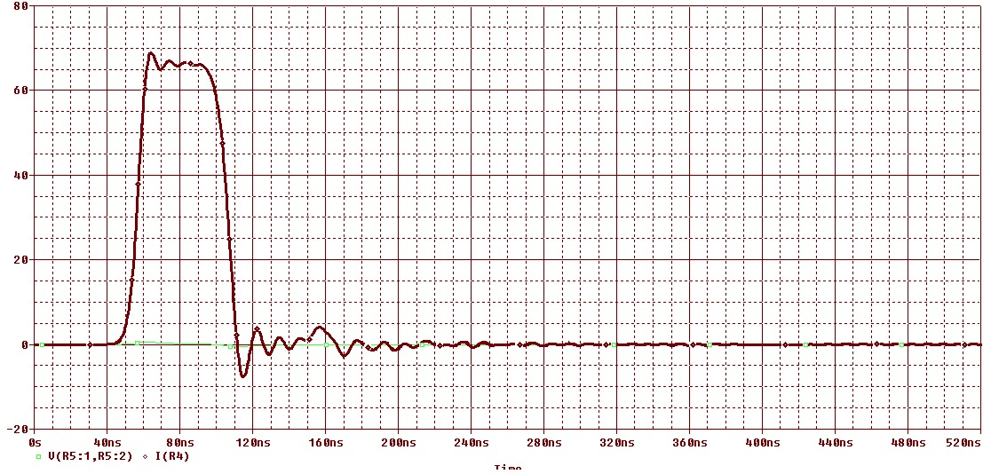
476.3.5.4 – Pulse Forming Network
Requirements:
3.5 kA
120ns width
Charging voltage
Blumlein pulse forming network
Load resistor matches impedance of Blumlein
Thyratron switch shorts middle conductor of triaxial line to outer conductor
Coax cable couples blumlein center conductor to load
40ns
Current pulse into a matched load computed with equivalent discrete circuit model
Width of pulse is proportional to length of Blumlein

Slide 45
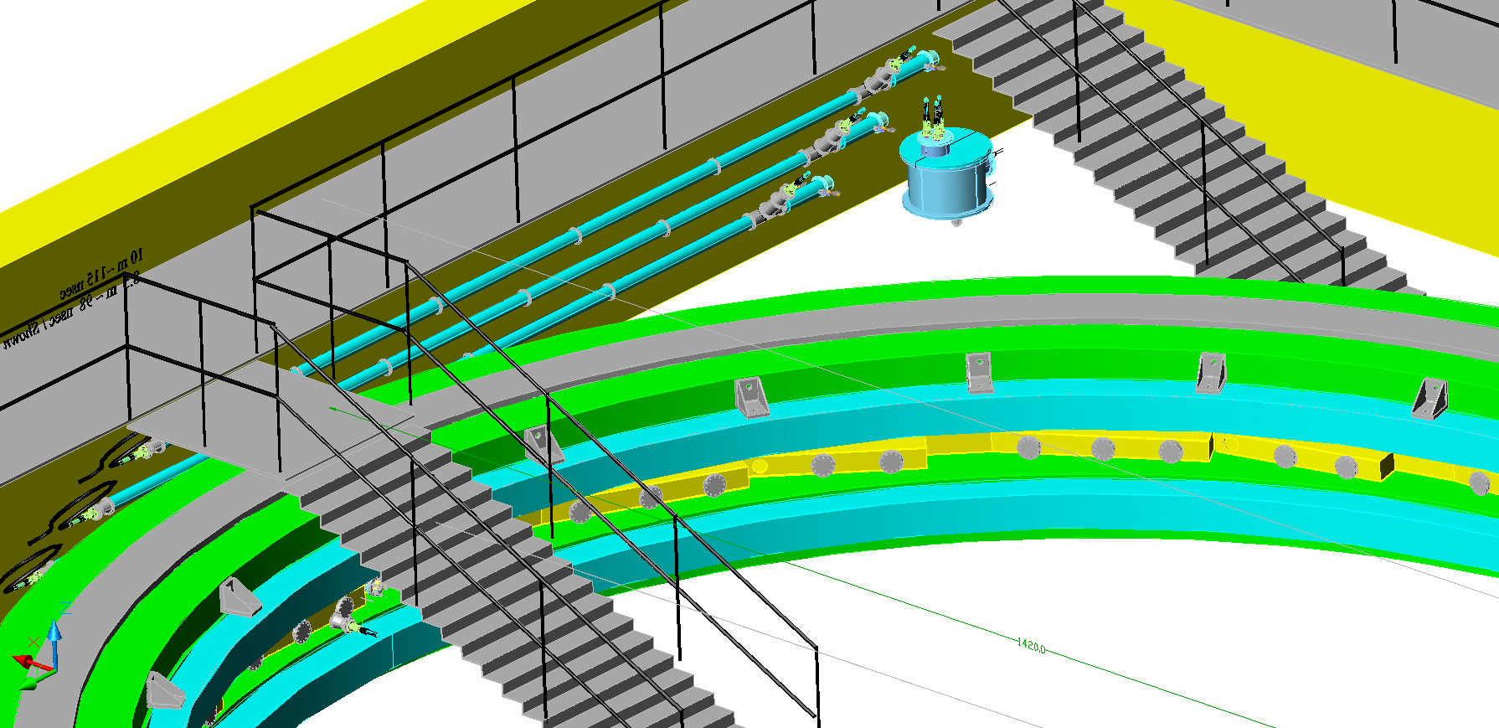
476.3.5.4 – Pulse Forming Network
Load resistor
thyratron
Blumlein
Load resistance matched to impedance of Blumlein
Kicker plates
Pulse width
L = 9m
= 4.7 (Castor oil)
=> τ = 120ns
Blumleins in storage ring hall

Slide 46
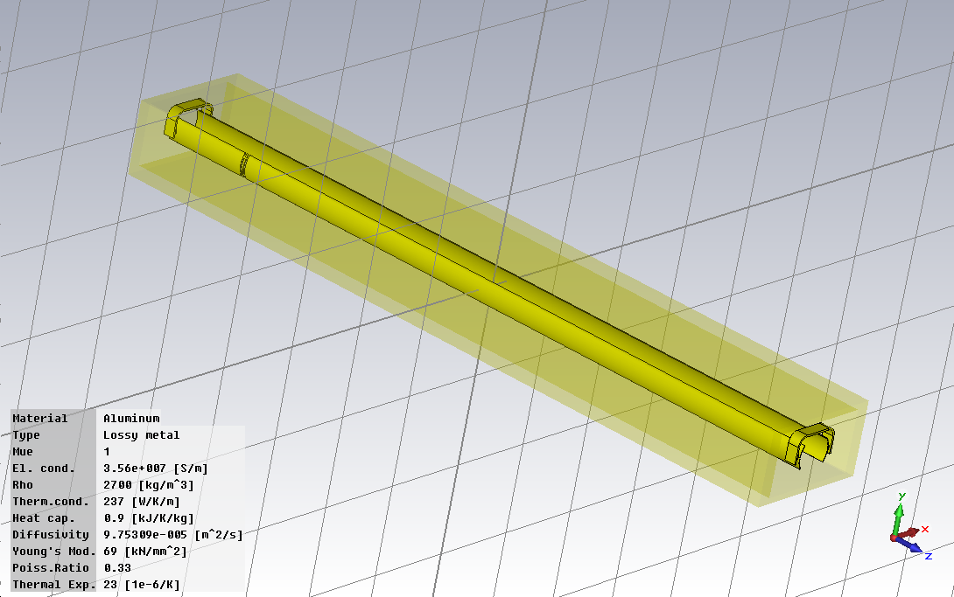
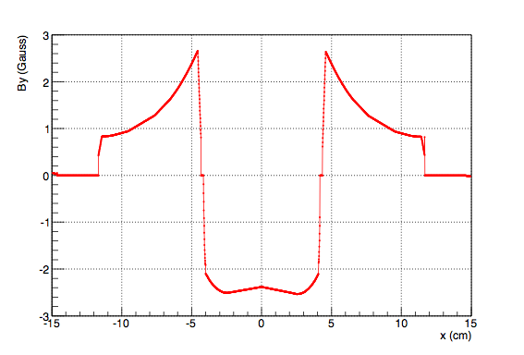
Modeling of Kicker-pulser
CST Microwave Studio
B field current ratio => 1kA = 65G

