Slide 1
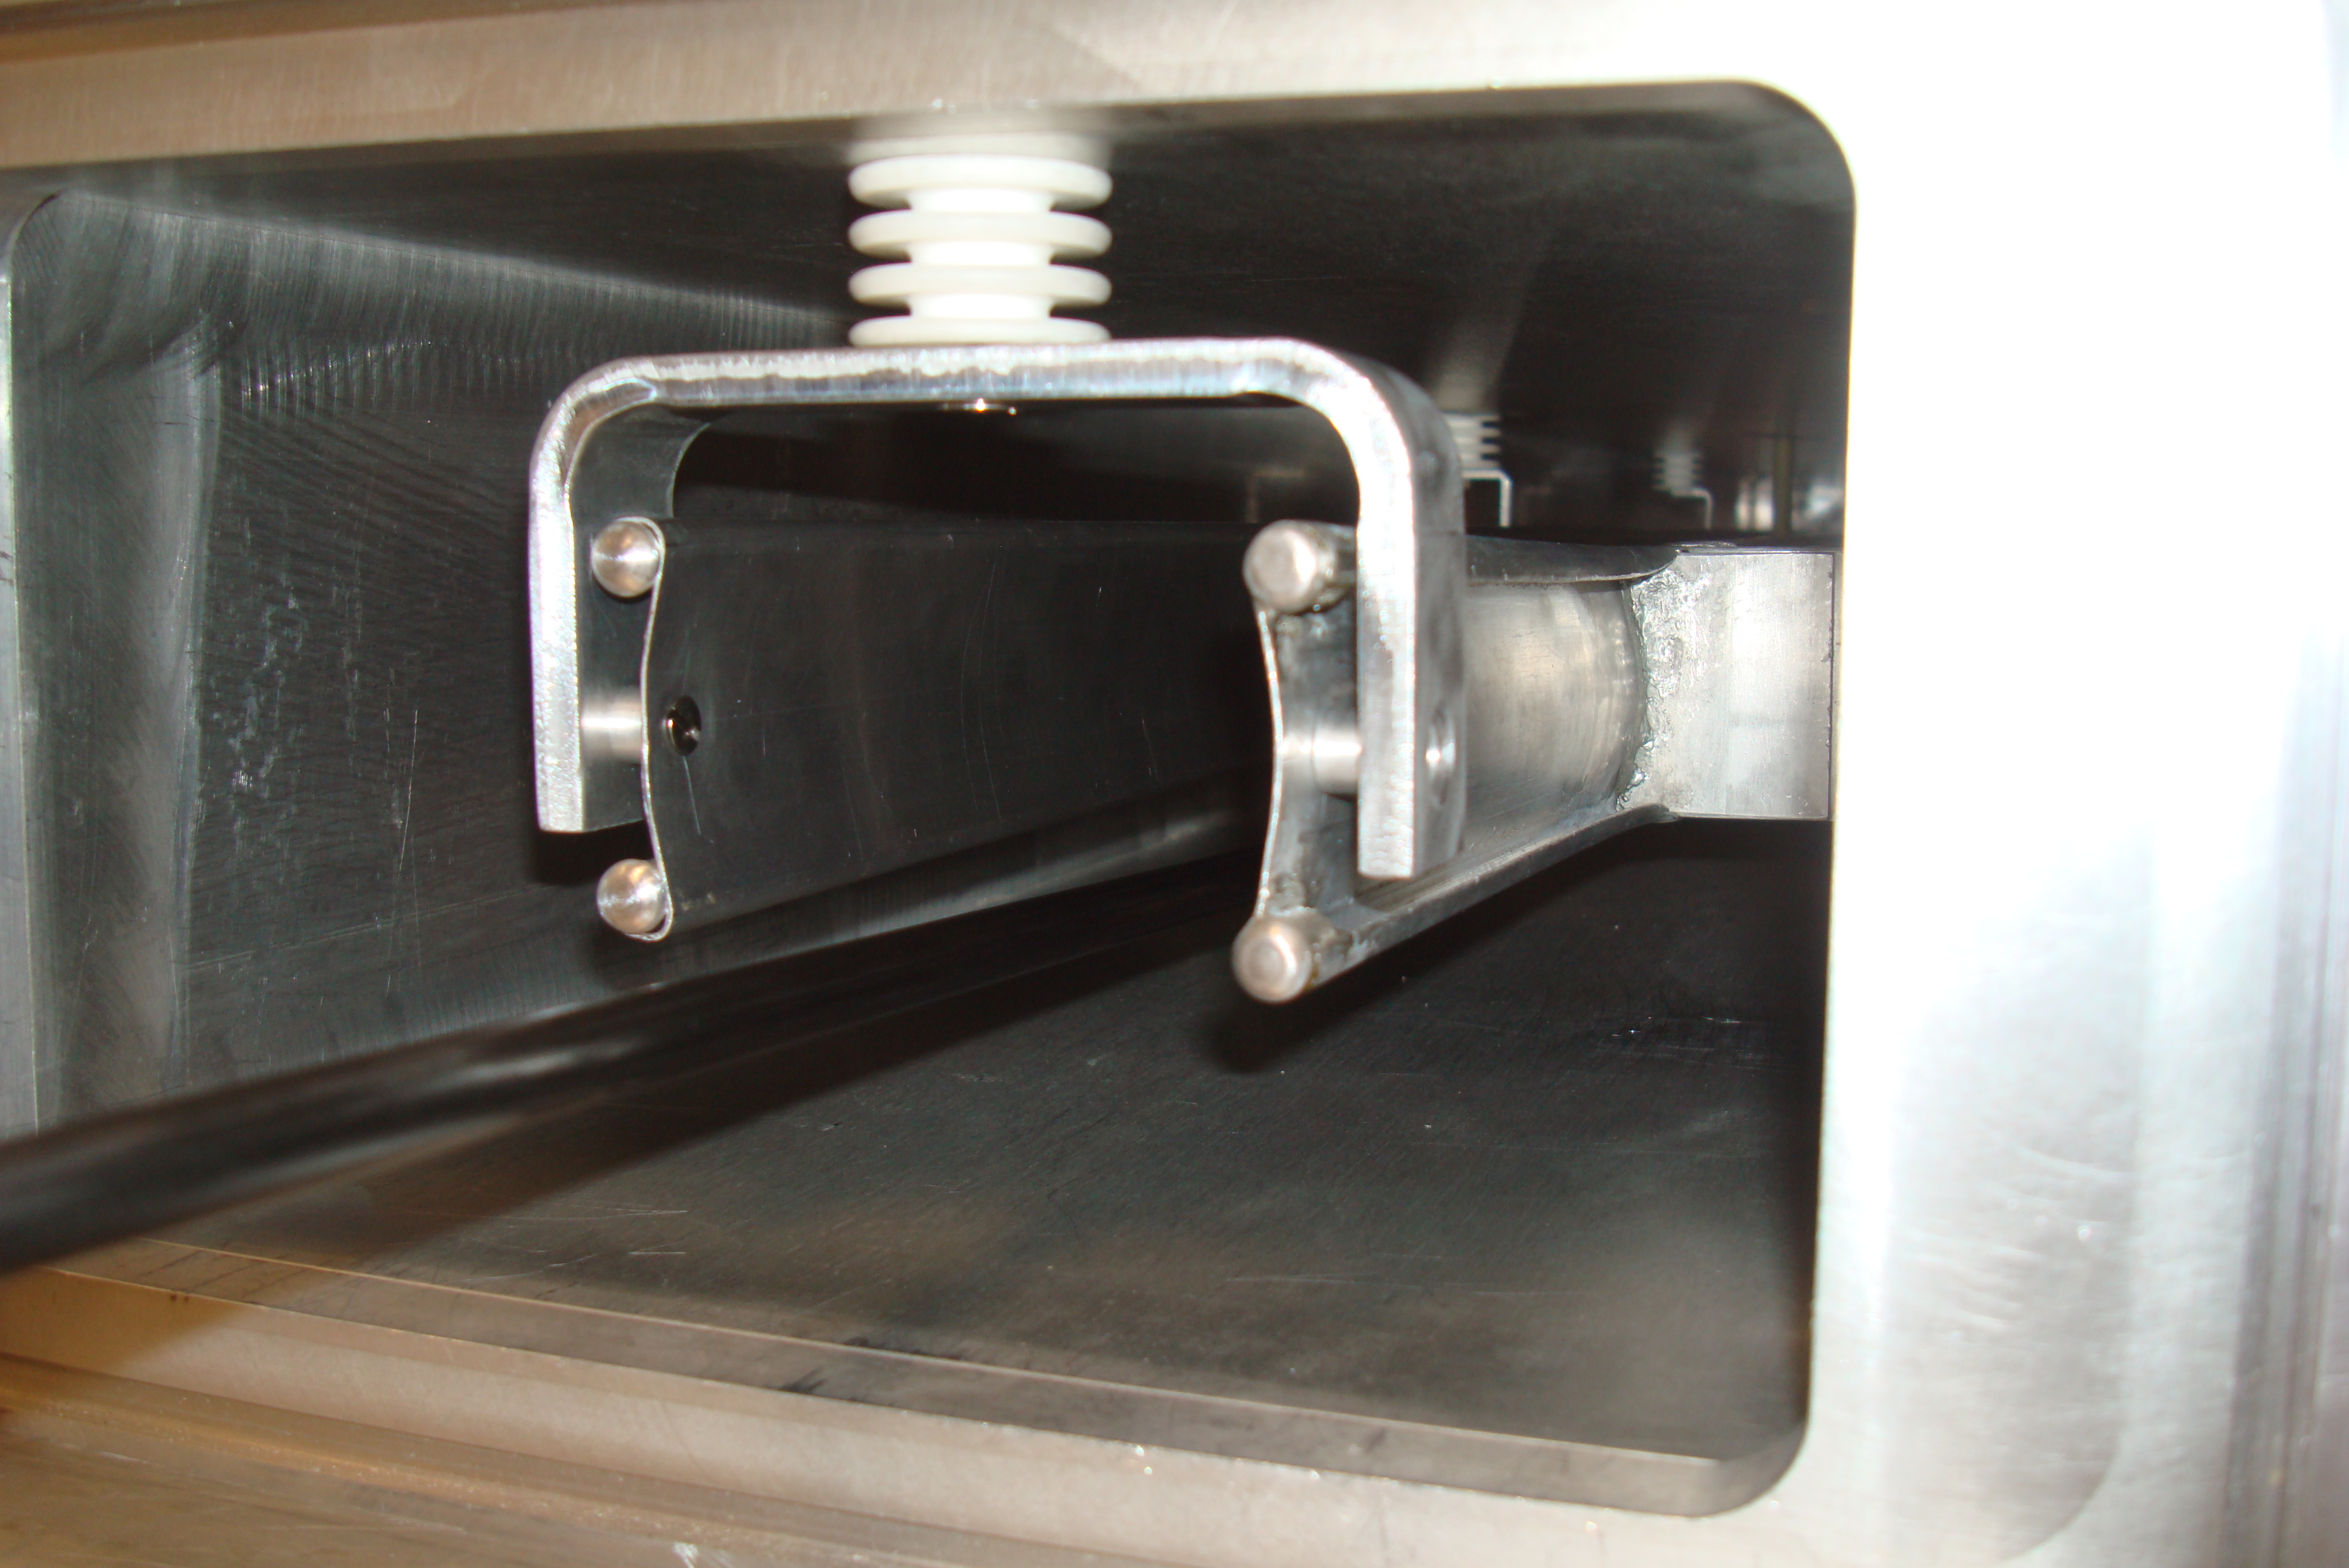
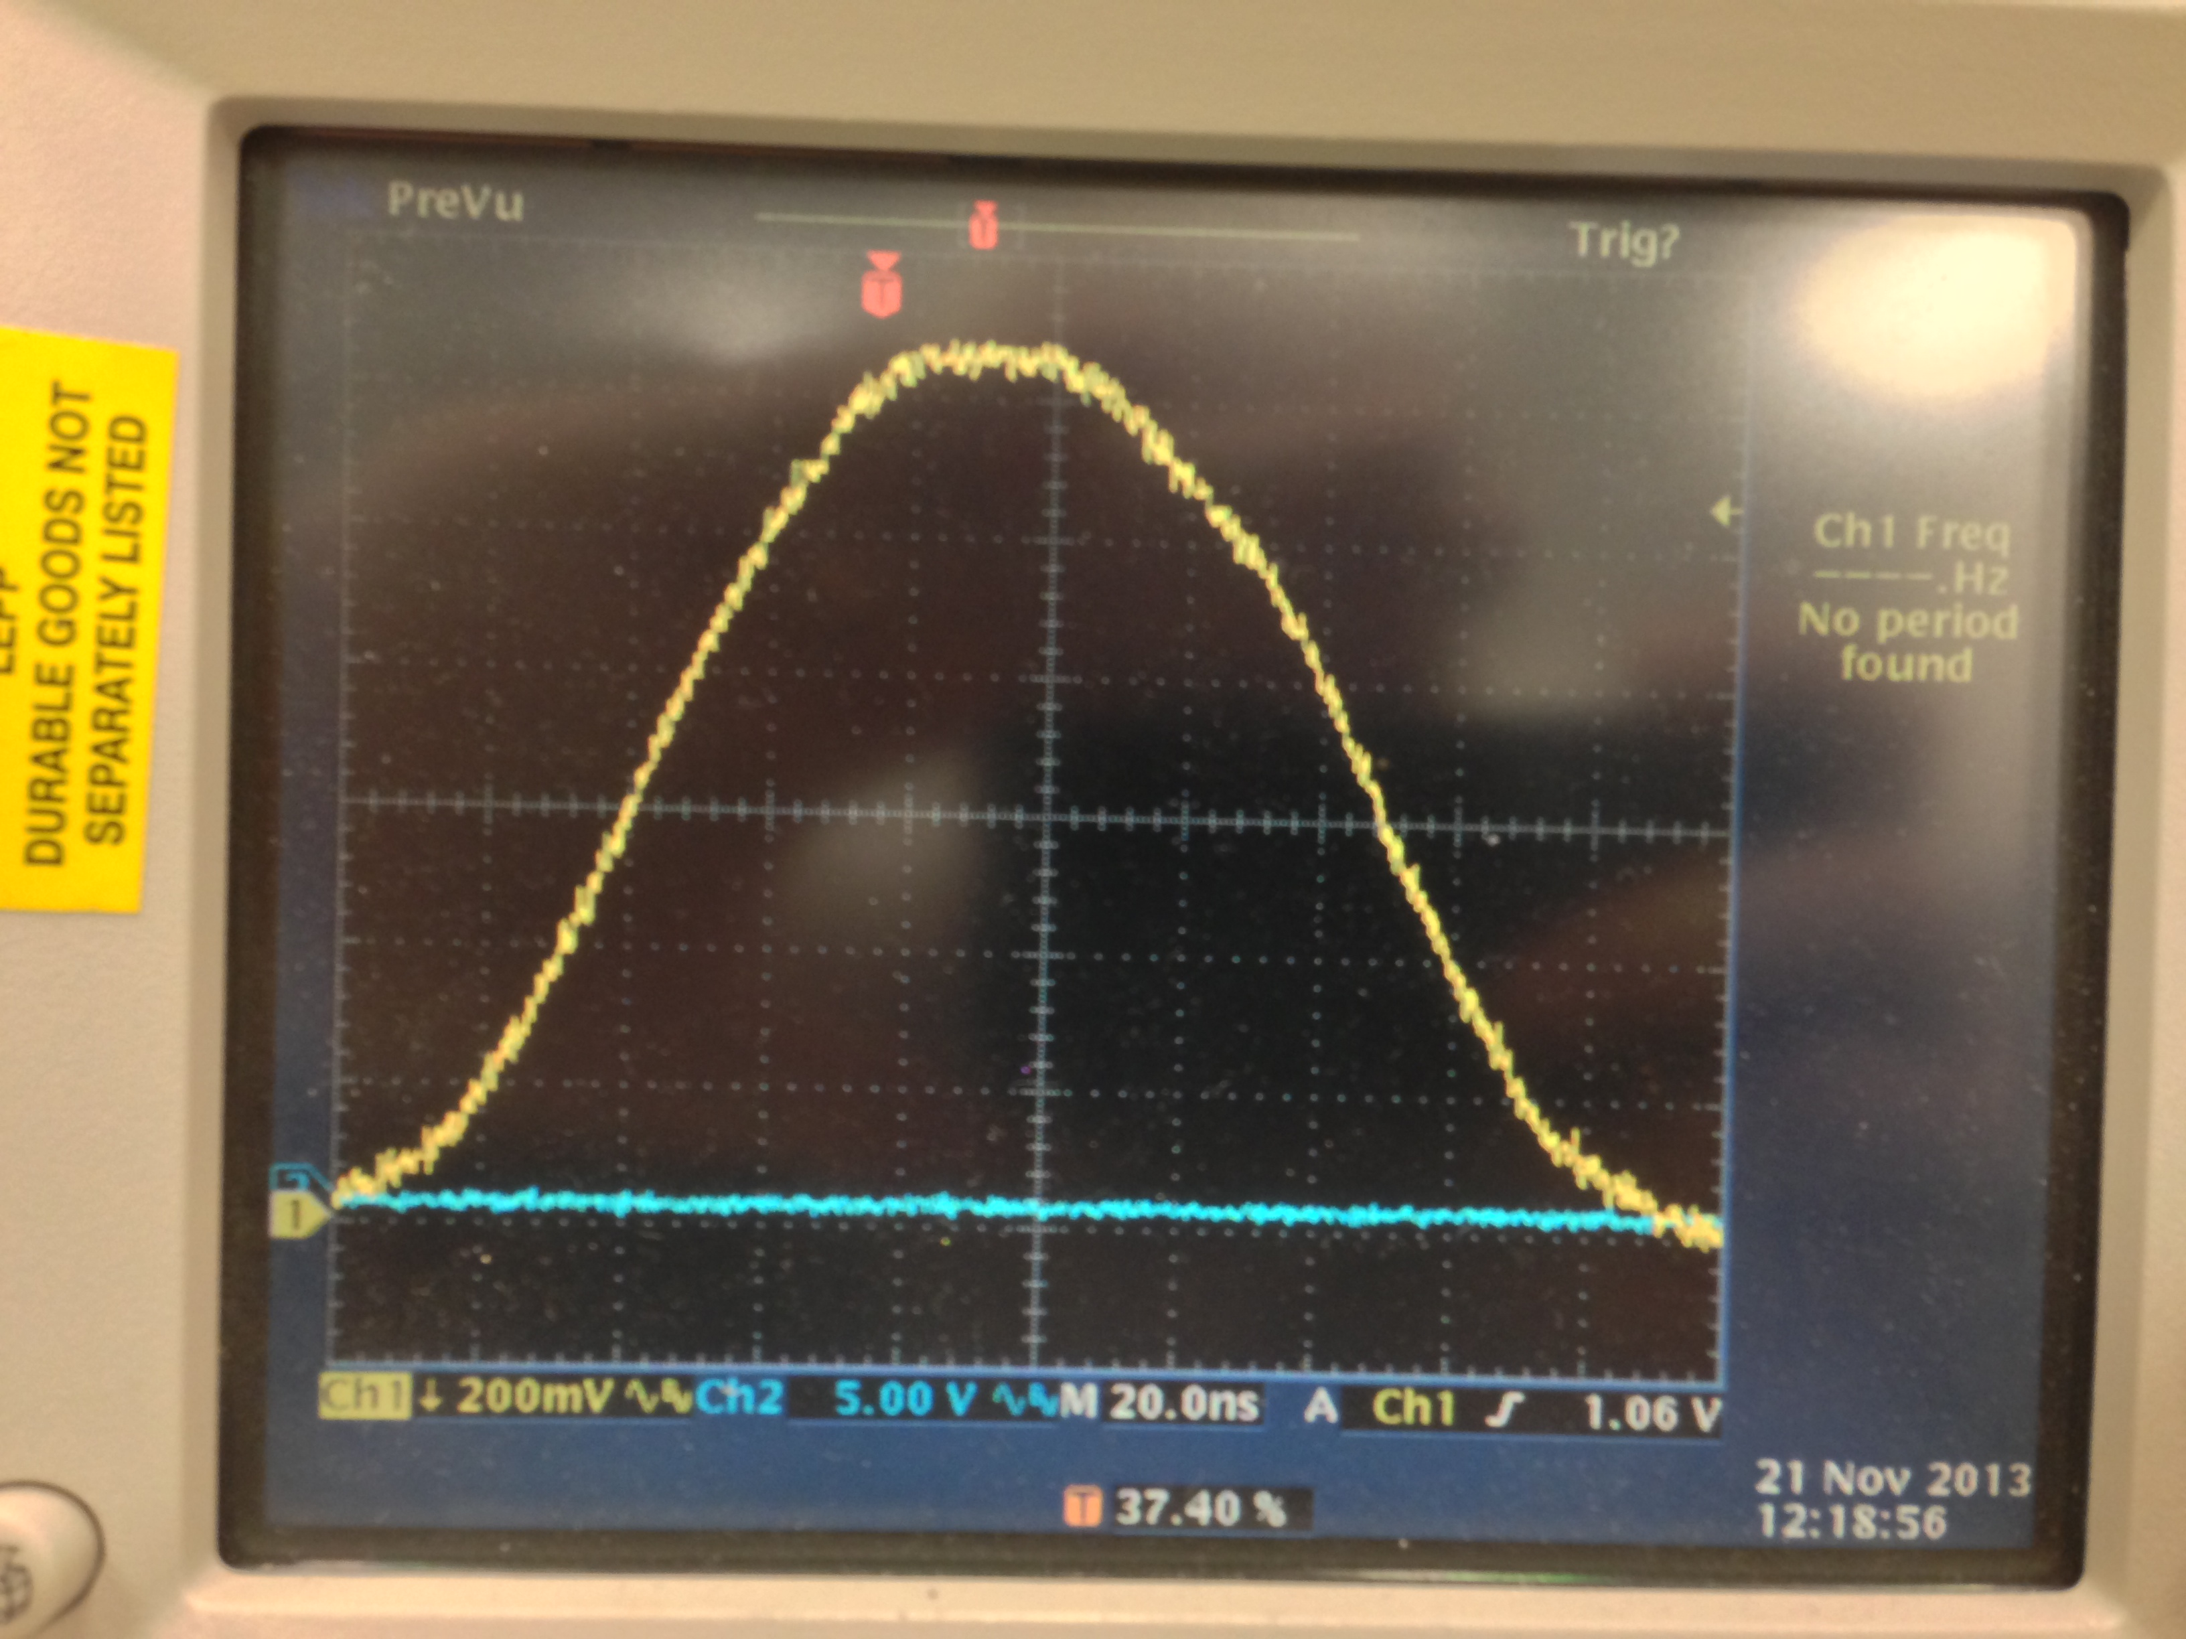
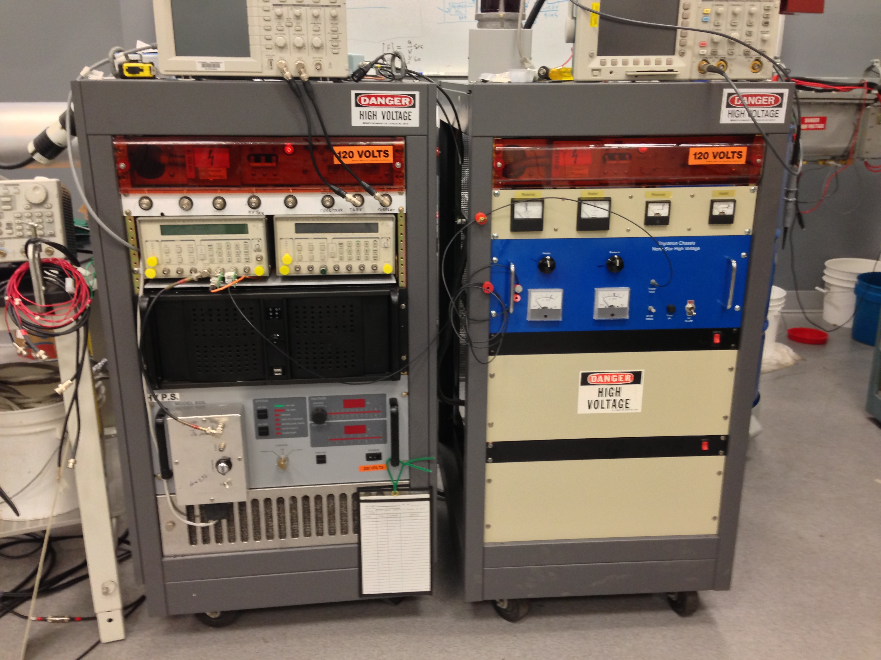
Kicker pulse
20ns/div
Kicker magnet
160 ns
Electronics for 3 kickers

