Slide 1
Injection through iron and fringe field
D. Rubin
January 15, 2014

Slide 2
Transport through M5 beam line to storage ring
Align ring/beam-line so that
Muon trajectory is centered in inflector (narrowest aperture), nominally tangent to storage ring and displaced 68mm + 9=77mm radially outward at inflector exit. Where x_i = 9mm (inflector half aperture)
What about a new inflector with a larger aperture (x_n)? Then the trajectory at the end of M5 line should be displaced Δ = x_n - x_i further outward. (Δ ∼ 2 cm)
Meanwhile, fringe fields steer beam near upstream end of inflector, thus requiring some compensating angle (with respect to tangent line) at end of M5 line.
(To determine the initial angle and offset that will place the trajectory at the center of a new larger aperture inflector, requires a more expansive field map.)
Fringe field focusing
Vertical field increases from 0 to 1.5T along trajectory through gap => horizontal defocus – with equivalent 1 m long quadrupole with k ~ 0.35 m⁻²
Difficult to compensate

Slide 4
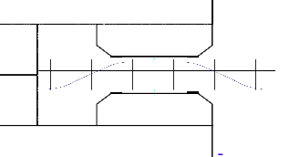
B

Slide 8
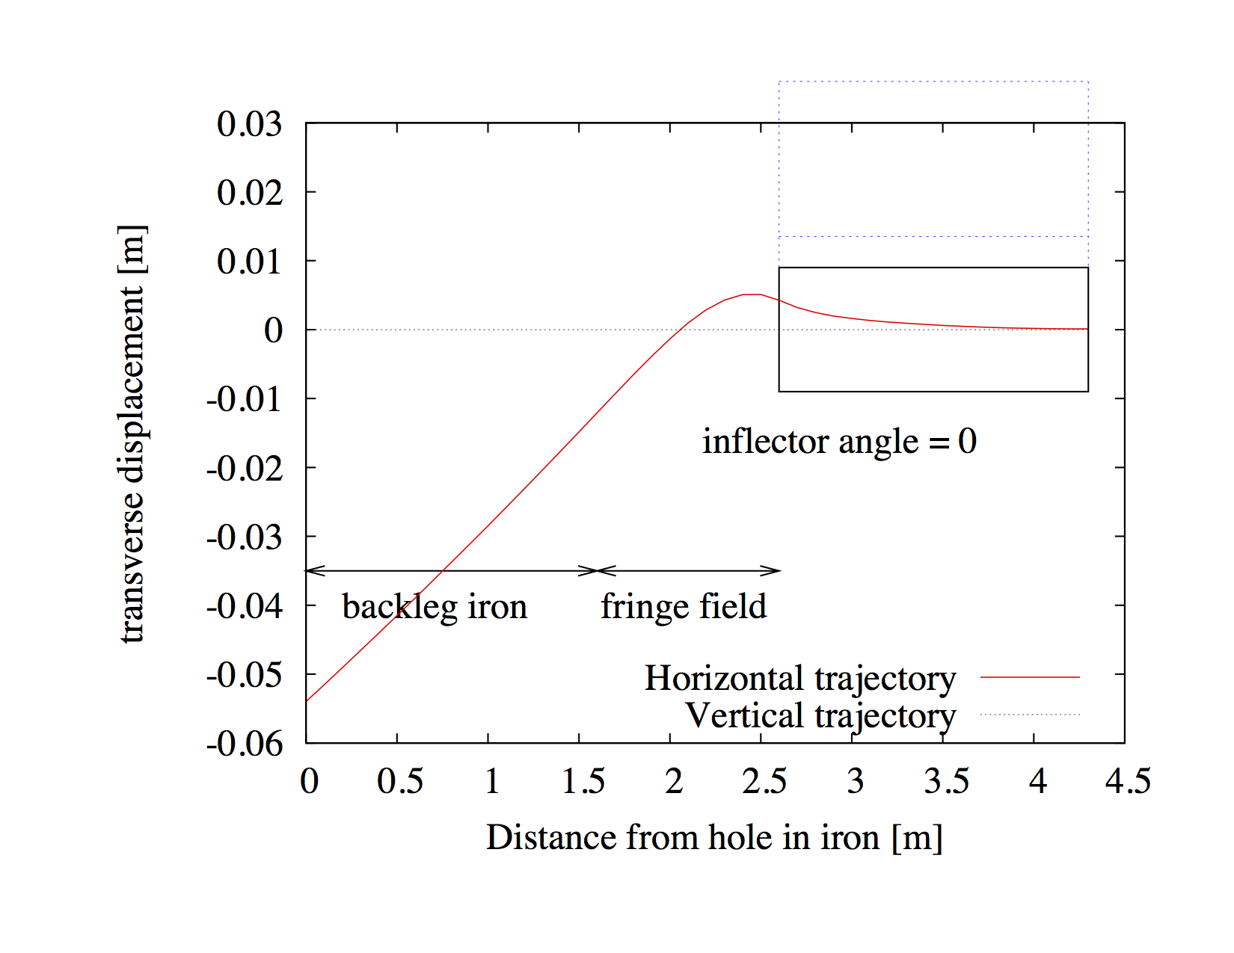
Larger aperture inflector
Existing inflector

Slide 10
B
Gradient due to fringe from main dipole
dB_{y} / dr = 1.45T / 40cm = 3.625 T/m => k = 0.35 m⁻²
Path length through the fringe L ~ 1.
Equivalent to the strongest quadrupole in the M5 line

Slide 12
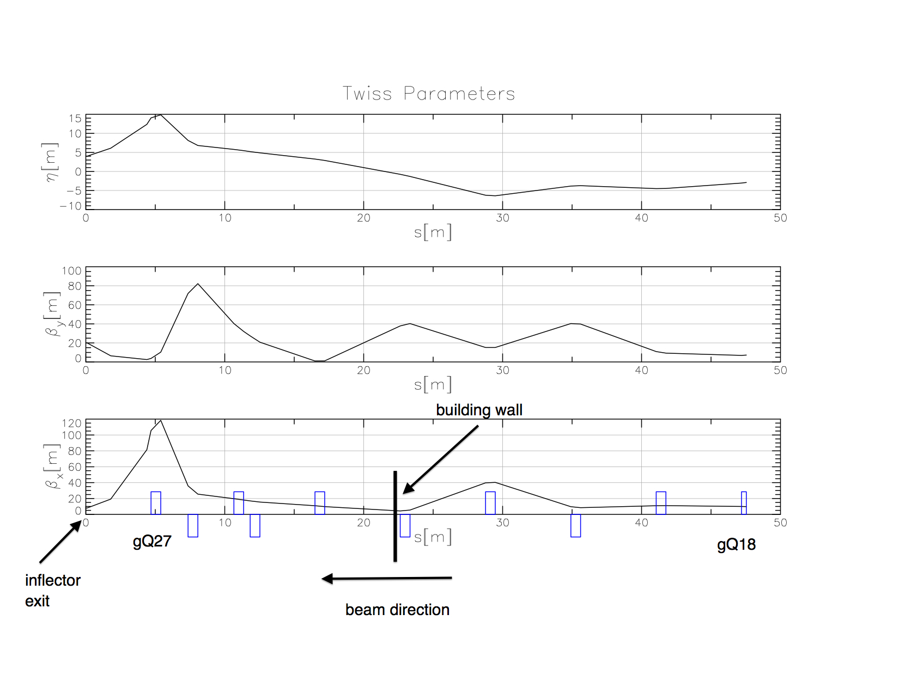
{
β_{x} = 8.0 m
β_{y} = 20.0 m
η = 4m
At inflector exit
For best match into ring
K(Q27) = 0.774 m⁻²

Slide 13
Questions?
How can we place the ring with respect to the M5 line, to accommodate the existing as well as a larger aperture inflector?
Do the final focus quadrupoles have sufficient aperture to clear a muon beam where both β and η are large?
Do the final focus quadrupoles have sufficient gradient? (Is if possible to place Q27 even closer to the iron?)

Slide 14
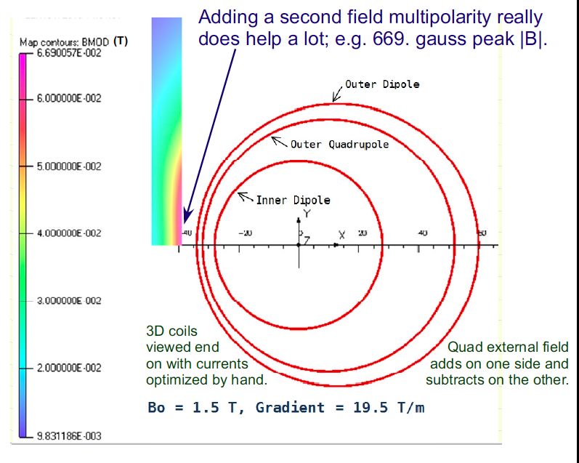

Slide 16
How do twiss parameters propagate through iron, cryostat, inflector into ring

Slide 17
What are the fields along the route of injected beam ?
From P. Debevec 2012

Slide 18
Width of backleg =544mm
Width of gap = 1394-544 = 850 mm
Distance from edge of iron to ideal orbit = 280mm
Width of pole = 2 x 280mm
From center of gap to backleg iron = 850-280=570mm
Radius of central orbit = 7.112 m
Field starts to fall off linearly 18cm from center of pole
This is 570-180mm =390mm
Then the gradient G = B_{max}/.39 = 1.4 T/.39m = 3.58 T/m
Inflector is 1.7m long. Tan (theta) = 1.7/(7.112 + 0.077)
Radius of upstream end of inflector = 7.189 - sqrt(7.189^2+1.7^2)=0.198
So the inflector goes from 77mm to 198+77mm =275mm from center of pole

Slide 19
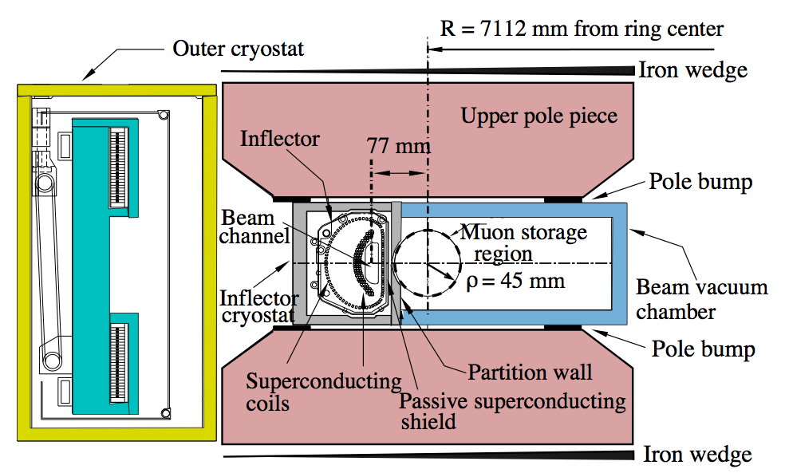
Radial beam motion
Beam exits yoke
Beam through outer coil
Beam through Inflector
Beam kicked onto orbit
B

Slide 20
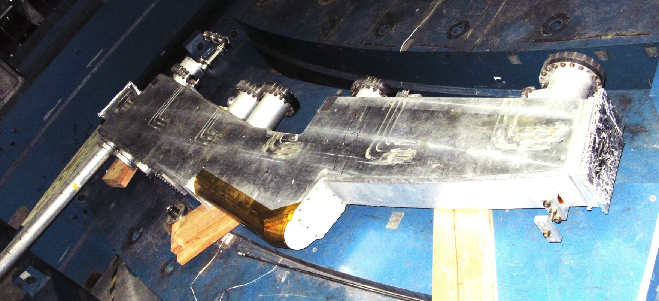
Inflector Geometry
μ
~1.7 m
central orbit

Slide 21
