Slide 1
Injection trajectories and focusing
D. Rubin
September 11, 2014

Slide 2
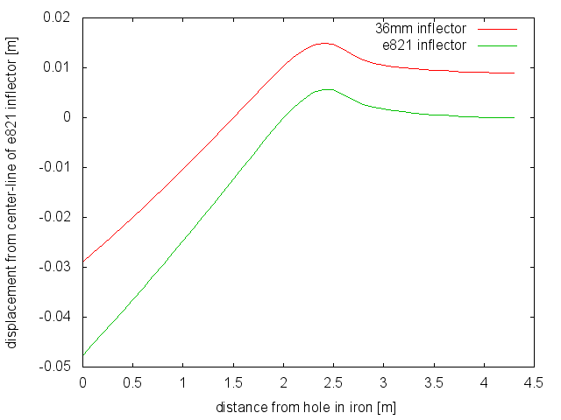
Trajectory
inflector | Offset[cm] | Angle[mrad]
e821 | -4.77 | 22.4
36mm | -2.90 | 17.9
30 cm upstream of yoke

Slide 3
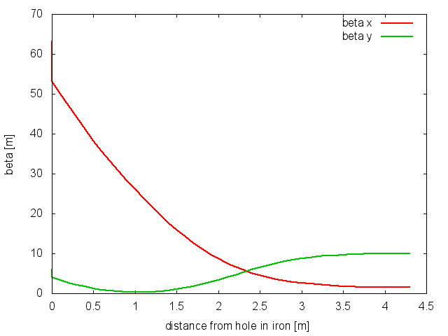
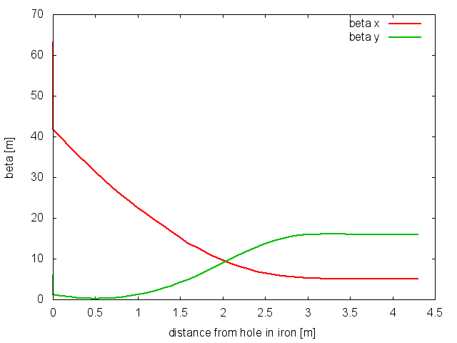
E821 inflector
36mm inflector
inflector | β_{x} (inc) | α_{x} (inc) | β_{y} (inc) | α_{y} (inc) | β_{x} (exit) | β_{y} (exit)
e821 | 53.1 m | 15.9 | 3.96 m | 3.53 | 1.5m | 10m
36mm | 41.8 m | 11.2 | 1.2 m | 2.0 | 5m | 16m

Slide 4
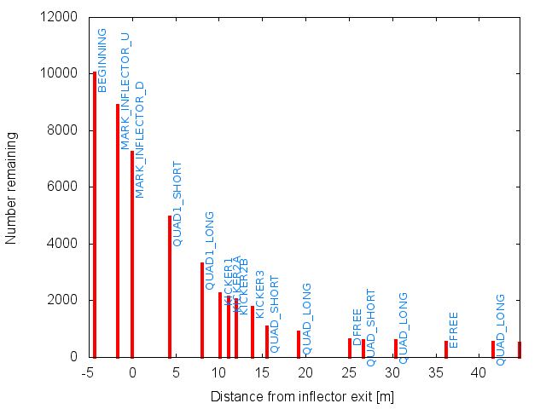
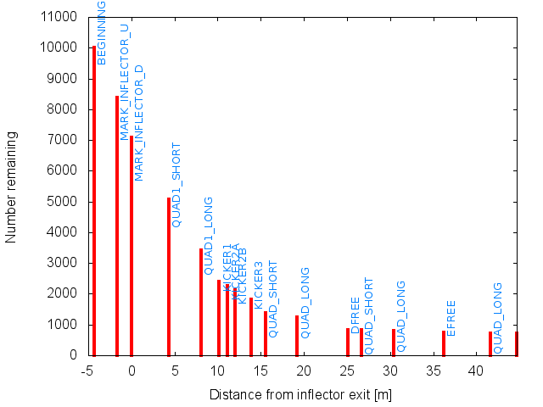
Lost muons
E821 inflector
36mm inflector

