Slide 1
Ring Simulations
D. Rubin & He He
February 26, 2015

Slide 2
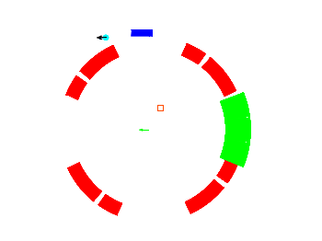
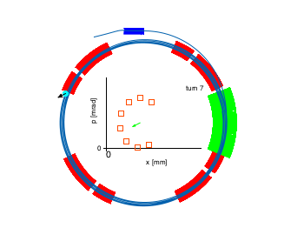
Ring model
Muon and spin
inflector
kicker
quad
http://www.lns.cornell.edu/~dlr/new_page/images/muon_2000steps.gif

Slide 3
Distribution at entrance to ring
Distribution at inflector exit

Slide 4
First 1000 turns

Slide 5
Number of decay positrons per time

Slide 6
126348 positrons
5091 above threshold

Slide 7
126348 positrons
41962 below threshold

Slide 8
Explore systematics with simulation ?
Dependence on amplitude on horizontal betatron oscillations
and vertical (pitch)
Dependence on muon beam energy width
Dependence on quadrupole voltage
Test fitting strategies?

