Slide 1
Phase space matching through injection channel
D. Rubin
April 11, 2013

Slide 2
How do twiss parameters propagate through iron, cryostat, inflector into ring

Slide 4
63.9 deg
Effective gradient G ≈ (1+cos(63.9))/2 (ΔB_{y}/ΔR)

Slide 6
Twiss parameters (A-matrix) is chosen to be single valued in ring

Slide 7
β,α at s=0 are chosen so that 40mm-mrad beam fits through inflector aperture.
Quads upstream of iron (F-quads and D-quads) optimized to achieve reasonable values at 120m
Second turn
First turn
(Energy aperture has not been optimized)
Hole through iron

Slide 8
Conclusion
There will significant horizontal defocusing in dipole fringe
Better estimate of effective gradient will be determined from OPERA calculation of B-field along injection channel
Place focusing quadrupole in the injection line as close to the iron as possible in order to most effectively compensate fringe defocusing

Slide 9
Suppose we choose β_{x} β_{y} at upstream end of inflector so that 40 mm-mrad
so that most of the beam fits through the inflector aperture
(Assuming ideal inflector: zero field, opened ends)
⬅

Slide 11
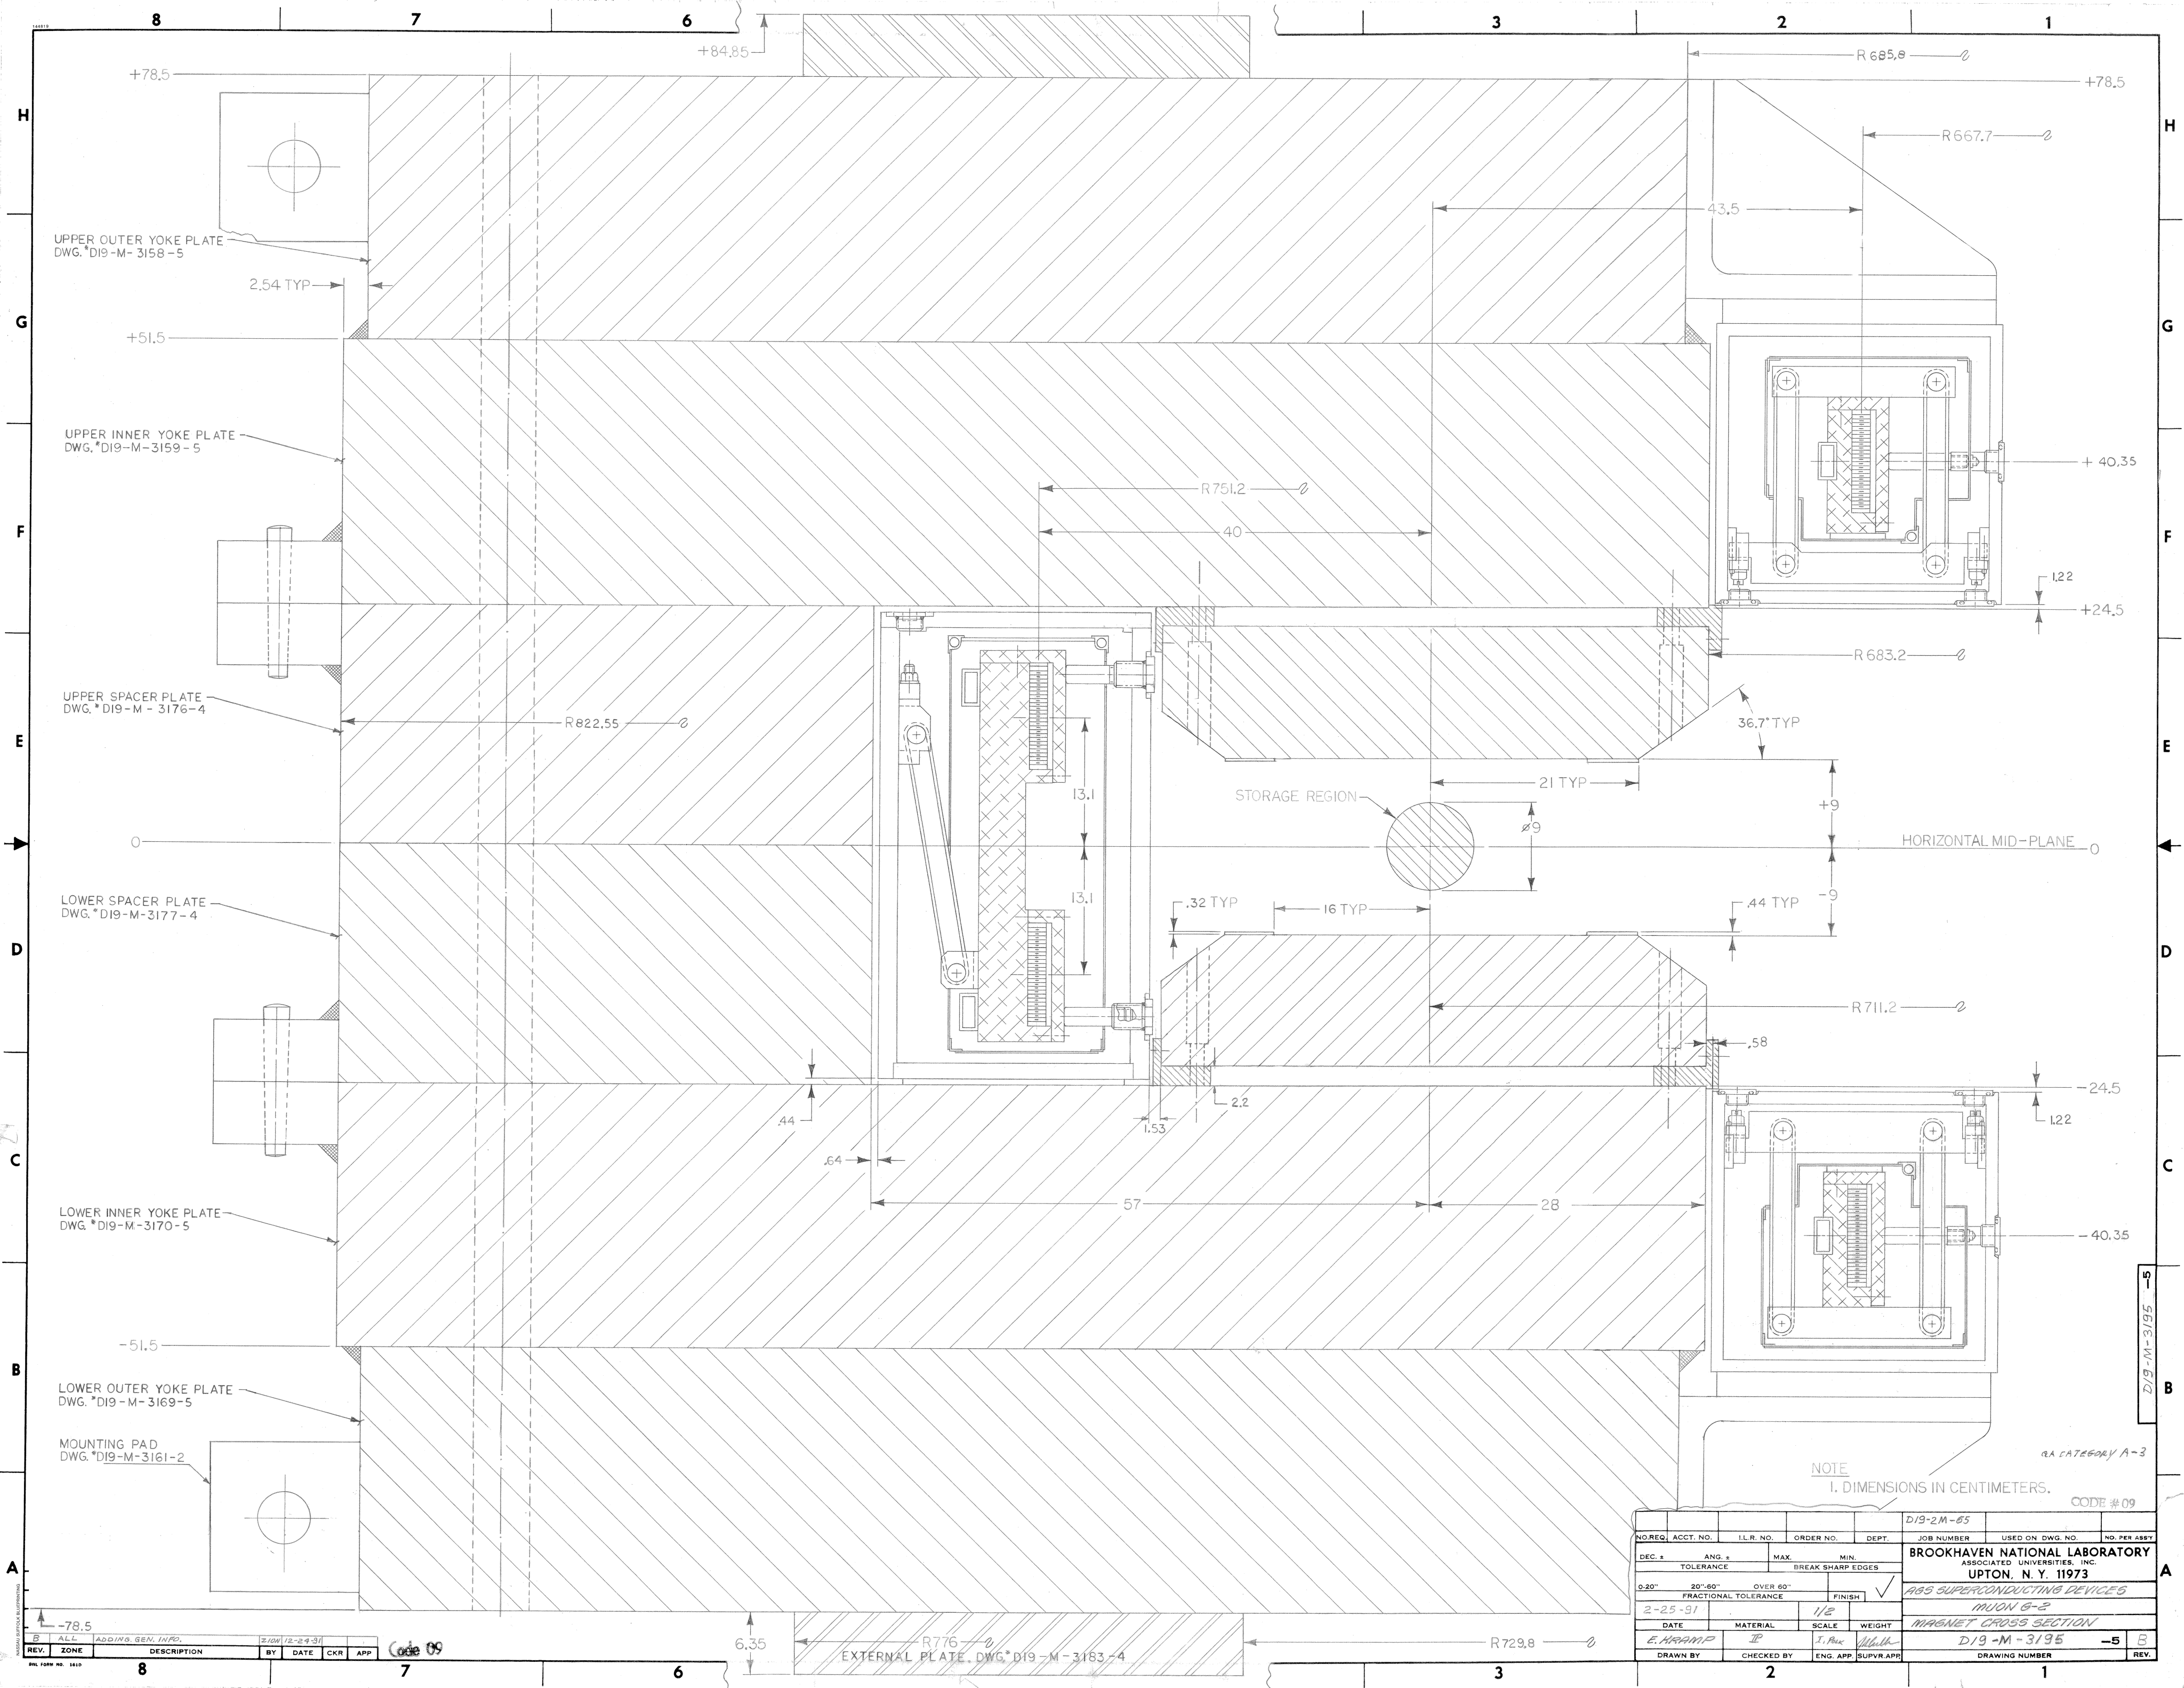

Slide 12
Propagate backwards once around ring (cc) and then through fringe with gradient 3.625 T/m
The effective focusing is very strong

Slide 13
In the other direction:
Use the same β_{x} β_{y} that got beam through ideal inflector but this time include focusing of fringe.

