Slide 1
Commissioning, and measuring the muon distribution
November 21, 2015
D.Rubin & He He

Slide 2
To understand systematics we need to measure the muon distribution
Our goal is to reconstruct the distribution based on measurements with fiber harps, calorimeters and trackers
What are the parameters of the distribution? How do we describe it?
width
If we knew ,
and we could measure
we could determine
Namely, the emittance and the momentum spread

Slide 3
The displacement of the centroid of the distribution
=
Measurement of centroid around the ring
yields (as long as are non-zero)
Insofar as the focusing is linear, knowledge of
(horizontal and vertical) is a complete description

Slide 4
and phase advance for closed ring are periodic
Beam width is therefore also periodic

Slide 5
Due to mismatch of beta and eta at inflector exit with ring, the effective beta in the ring is no longer periodic

Slide 6
Revisiting beam width
Constant
Frequency
Frequency
And displacement

Slide 7
S (and turn) dependence of centroid and width
No quad multipoles and no energy spread

Slide 8
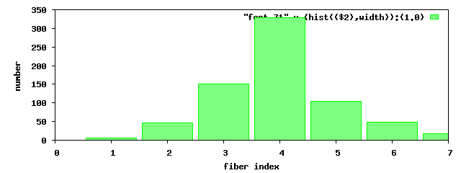
Fiber harp measures centroid and width directly
Fit
To data from a single fiber harp
Red – fiber harp data
Green - fit
Note that fit is predominantly at frequency . Width is dominated by energy oscillation
μ
Horizontal width
Fit gives us the tune, μ, two phases, and C₀ , C₁ , C₂

Slide 9
Fit to fiber harp
y
Vertical width
Fit is dominated by frequency (modulation of ) since the vertical dispersion = 0

Slide 10
Fits to a single fiber harp give no information about beta, eta, except at
The location of the detector.
The simultaneous fit to two harps tells us something about how beta, eta propagate
Calorimeters can in principle give a more complete picture, since they are distributed
Around the ring. The picture below will be reproduced by fitting calorimeter data ?

Slide 11
Nonlinearities and chromaticity

Slide 12
2000 turns
200 turns
“Damping” due to chromaticity
(tune depends on momentum)
No multipoles
Delta p/p = 0.00112

Slide 13
2000 turns
200 turns
“damping” due to amplitude
Dependence of tune
No energy spread
Quad multipoles included

Slide 14
2000 turns
Real life
200 turns
Energy and amplitude
dependent tunes
Delta E/E=0.00112
Quad multipoles included

Slide 15
Summary
Fiber harps measure parameters that define distribution at two points
Fitting linear functions is straightforward
Nonlinearities complicate interpretation for >200 turns
Calorimeters => local parameters

