Slide 1
476.03.05 Ring Injection Kickers
David Rubin
Cornell University
Muon g-2 CD1 Review
September 17-18

Slide 2
Outline
L3 Scope of Ring Kickers
Requirements
WBS L3 Organization
Design
Cost Summary
Value engineering and aternatives
Major Milestones
Risks and Mitigations
ES&H
Quality Assurance
Summary

Slide 3
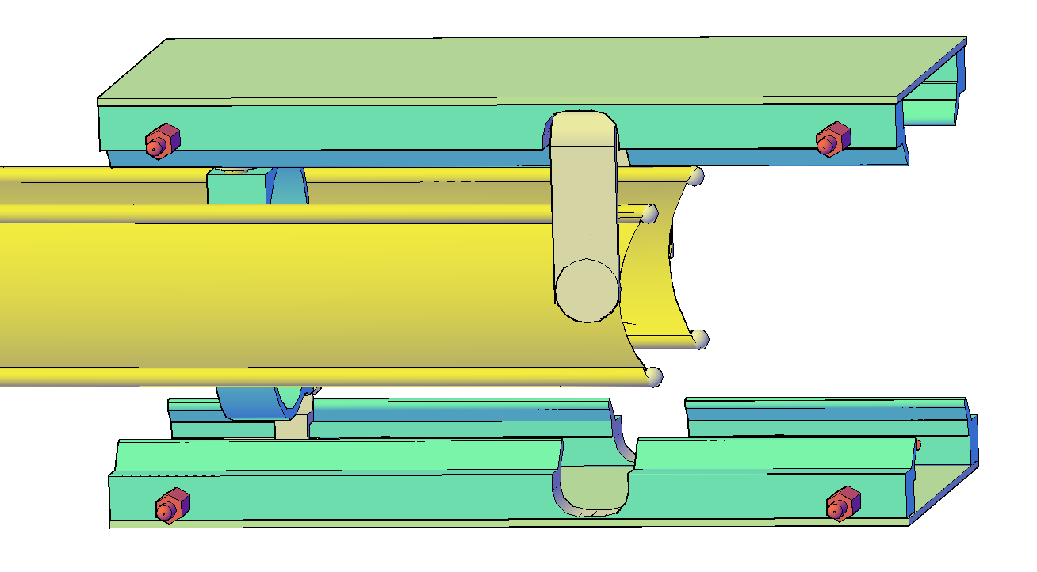
Ring Injection Kicker Scope
Kicker plates
Triaxial (Blumlein) PFN
thyratron
Muon beam
4.5m
High voltage charging transformer
Trolley rails
Description/Technical Objective/Scope: This L4 element includes design, analysis, procurement, assembly, acceptance testing, installation, commissioning and close-out activities for the ring injection kicker system. The kickers direct muons exiting the inflector onto to the closed orbit of the storage ring. The kickers are driven by a PFN (pulse forming network) at the repetition rate defined by the upstream accelerators. Deliverables: A set of 3 strip line kickers and 3 pulse forming networks including thyratron switches, high voltage power supply, control and monitoring electronics, hardware for installation in the ring vacuum chambers and for mounting PFNs in experimental hall. Interfaces/Relationships: The kickers are supported by the ring vacuum chambers.

Slide 4
Storage Ring Kicker Requirements
Kickers steer injected muons onto the ring closed orbit
Requirements:
Kick angle ~ 14 mrad
Kicker B-field ~ 280 Gauss
Integrated B-field ~ 1.4 kG-m
Pulse width(τ)
80ns < τ < 149ns
Repetition rate ~100 Hz
Field uniformity over storage volume ΔB/B < 10%
3 – 1.7m kickers
Ideal kicker pulse
E-821 kicker pulse
149 ns

Slide 5
WBS Areas Covered
3.5 Injection Kicker
476.03.05.02 Power Supply
Scope: Power supply and transformer for charging kicker pulse-forming network (PFN) to ~ 85 kV. Deliverable: System for charging all three kicker PFNs at muon injection repetition rate to ~85kV.
476.03.05.03 Plates
Scope: The magnetic field generated by current in the plates kicks the injected muons onto storage ring closed orbit. Deliverable: Three pairs of plates for installation in storage ring vacuum chamber, including hardware for mounting in chamber and high voltage feedthrough to high voltage source.
476.03.05.04 Pulse Forming Network
Scope: This L4 element provides a pulse forming network that delivers current pulse to kicker plates.
Deliverables: Three Blumlein, triaxial transmission line pulse forming networks, one for each of the three kickers.
476.03.05.05 Thyratron
Scope: Switch to discharge blumlein PFN - 100kV X 4KA.
Deliverable: Three thyratrons - max 100kV, 4KA, for each of three blumlein PFNs.
476.03.05.06 Controls and Instrumentation
Scope: Controls and monitoring interface for thyratrons, HV power supply, PFNs, interlocks. Deliverables; Drivers for thyratrons, current and voltage monitoring. Thyratron trigger amplifier and trigger pulse monitor. Power supply and HV transformer current and voltage monitoring.
3.5 Injection Kicker
3.5.2 Power Supply
3.5.3 Kicker plates
3.5.4 Pulse Forming Network
3.5.5 Thyratron
3.5.6 Controls and Instrumentation

Slide 6
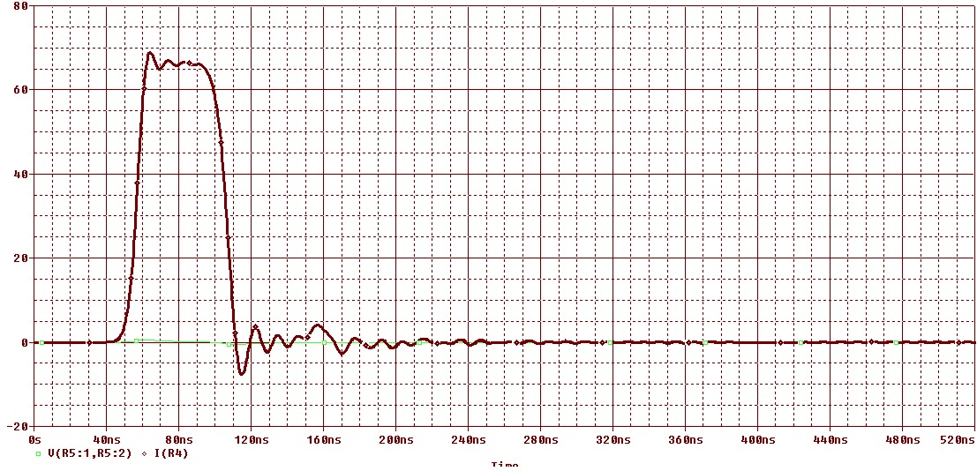
Ring Kicker PFN Design
Blumlein pulse forming network
Charging voltage
To kicker plates
Load resistor matches impedance of blumlein
Not to scale
Thyratron switch shorts middle conductor of triaxial line to outer conductor
Coax cable couples blumlein center conductor to load
Current pulse computed with equivalent discrete circuit model
40ns
Plunging motion
Width of pulse is proportional to length of blumlein
Considering adding a transverse motion

Slide 7
Ring kicker plates
NMR trolley
Proposed geometry yields 33%-50% more field per unit current than E821
Tracking studies will determine if field uniformity is optimal

Slide 8
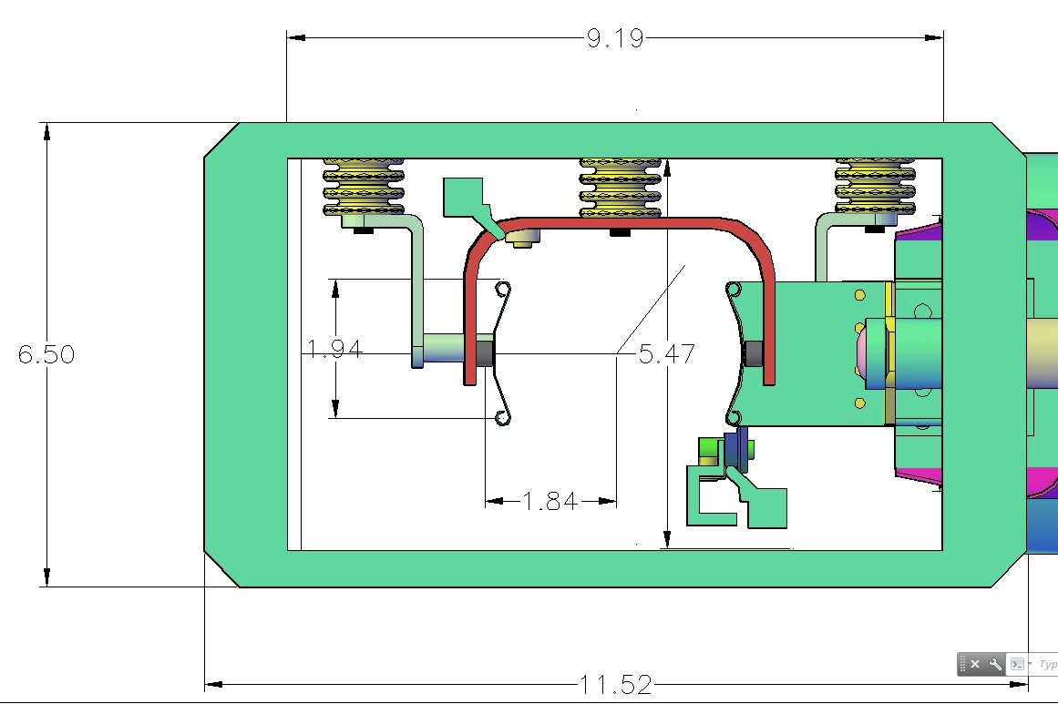

Ring Kicker Plates
Crossover at end of strip line
Current feed from PFN
3 sets of strip line kickers
Length = 1.7m each
Trolley rail
Kicker plates mounted in ring vacuum chamber
Kicker field lines

Slide 9
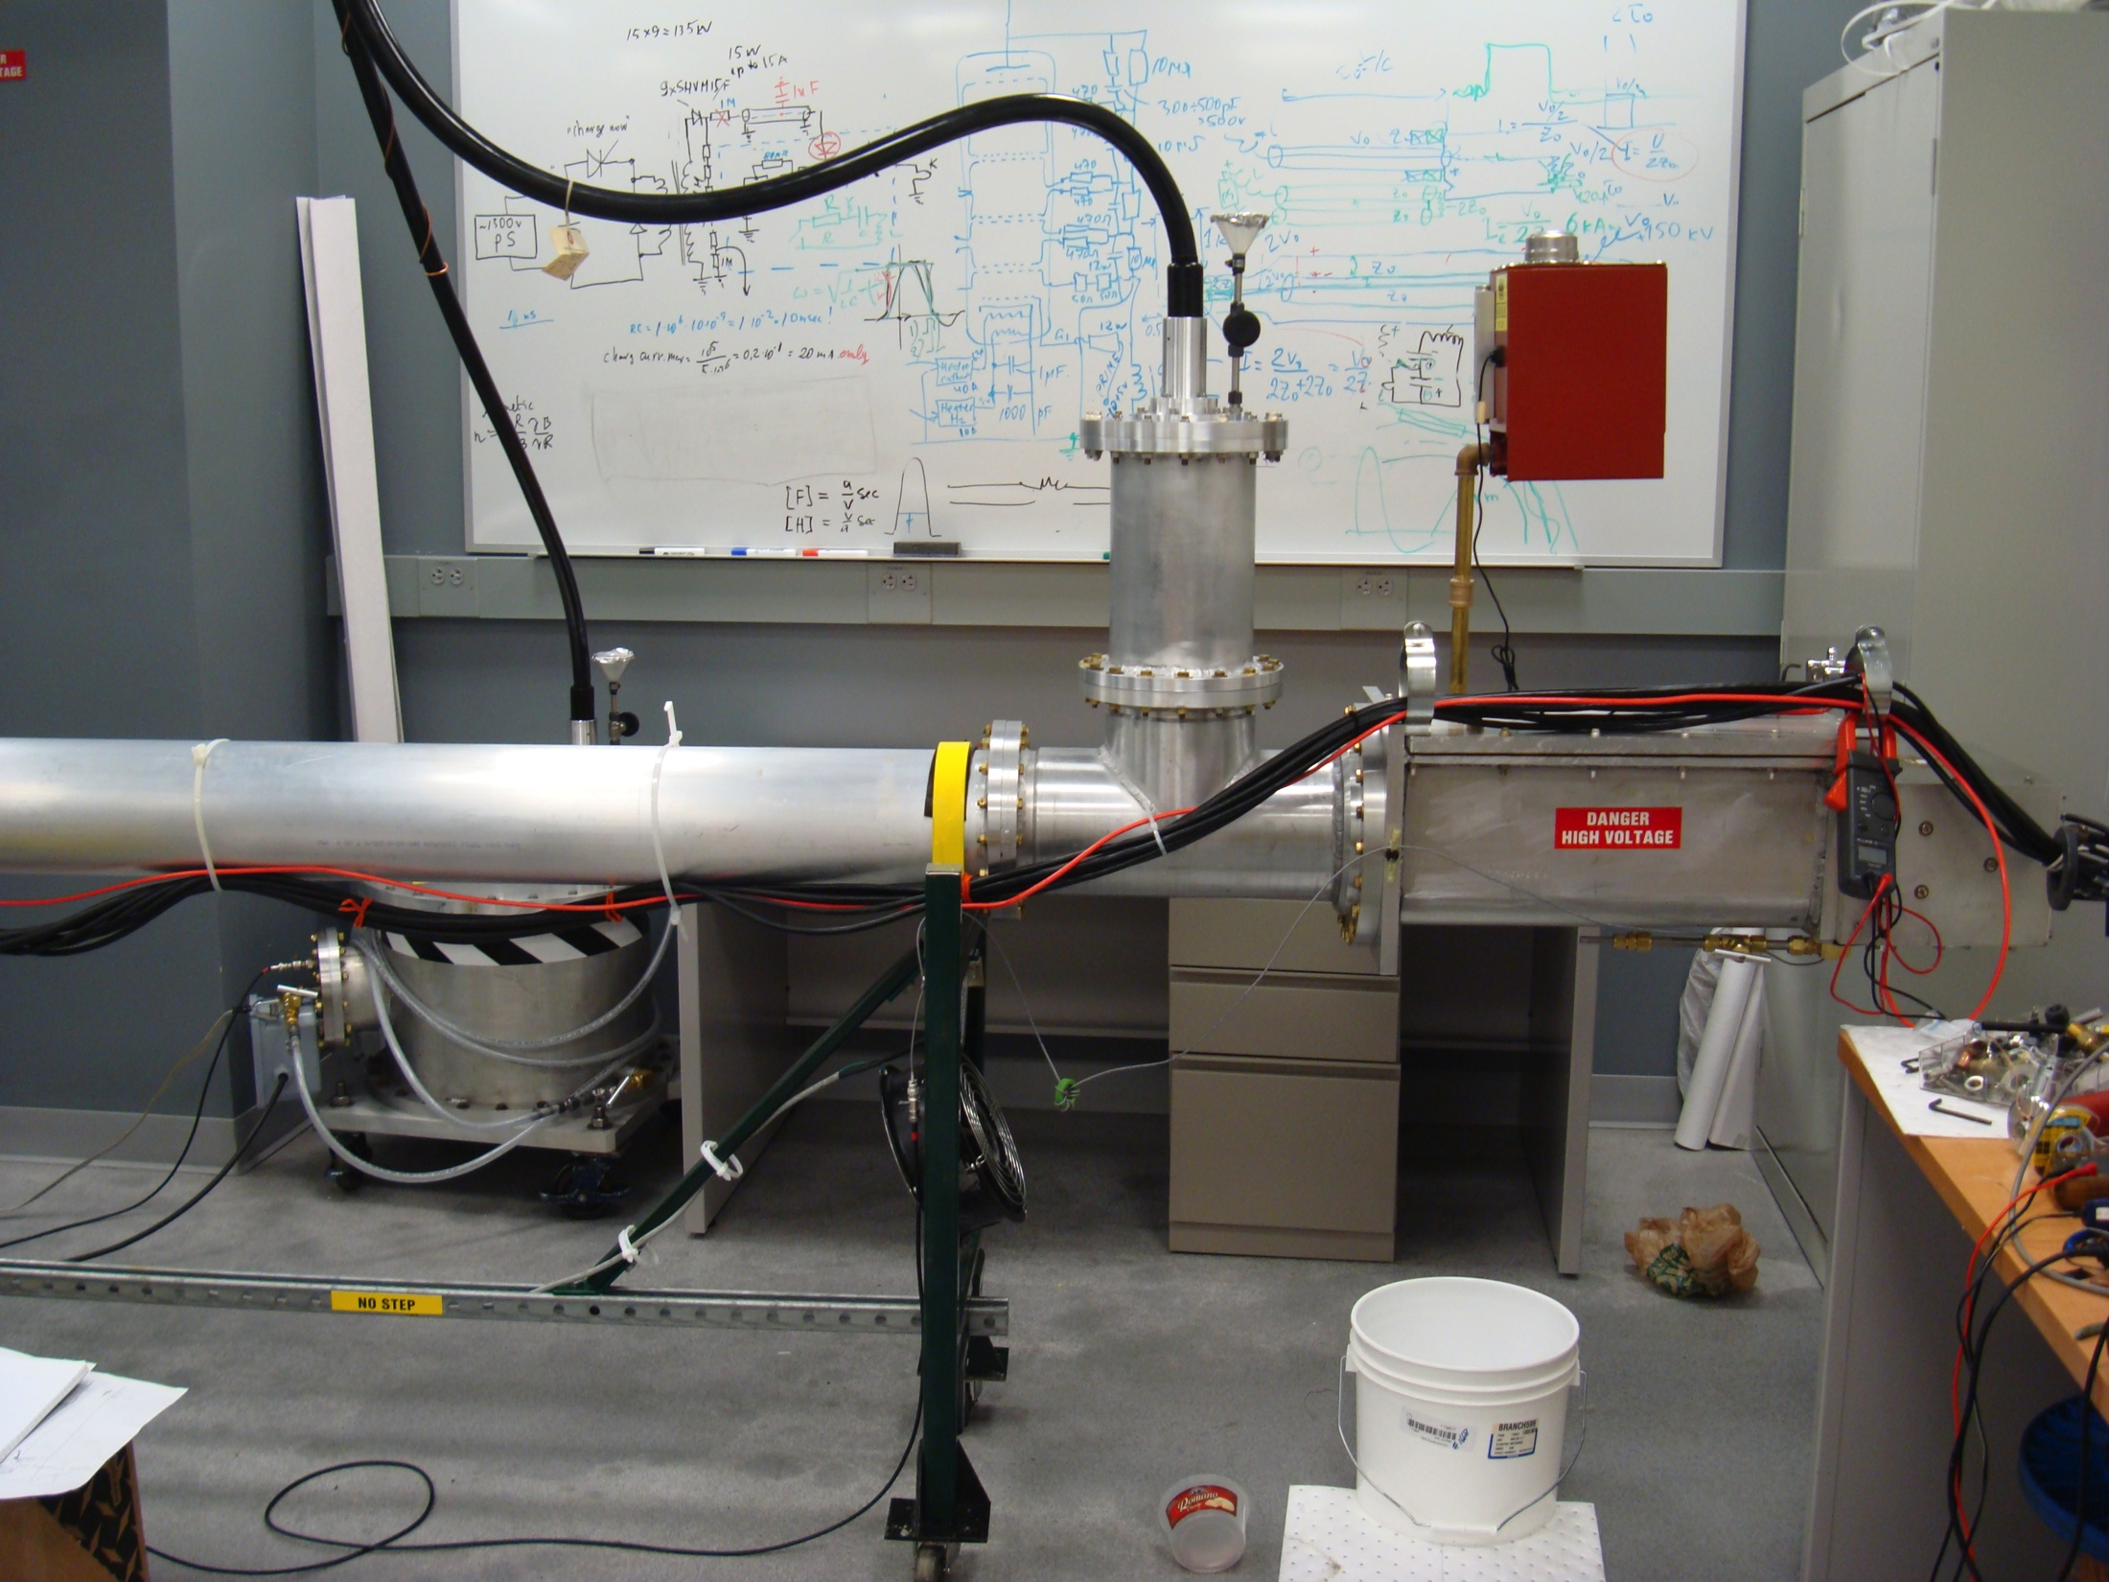
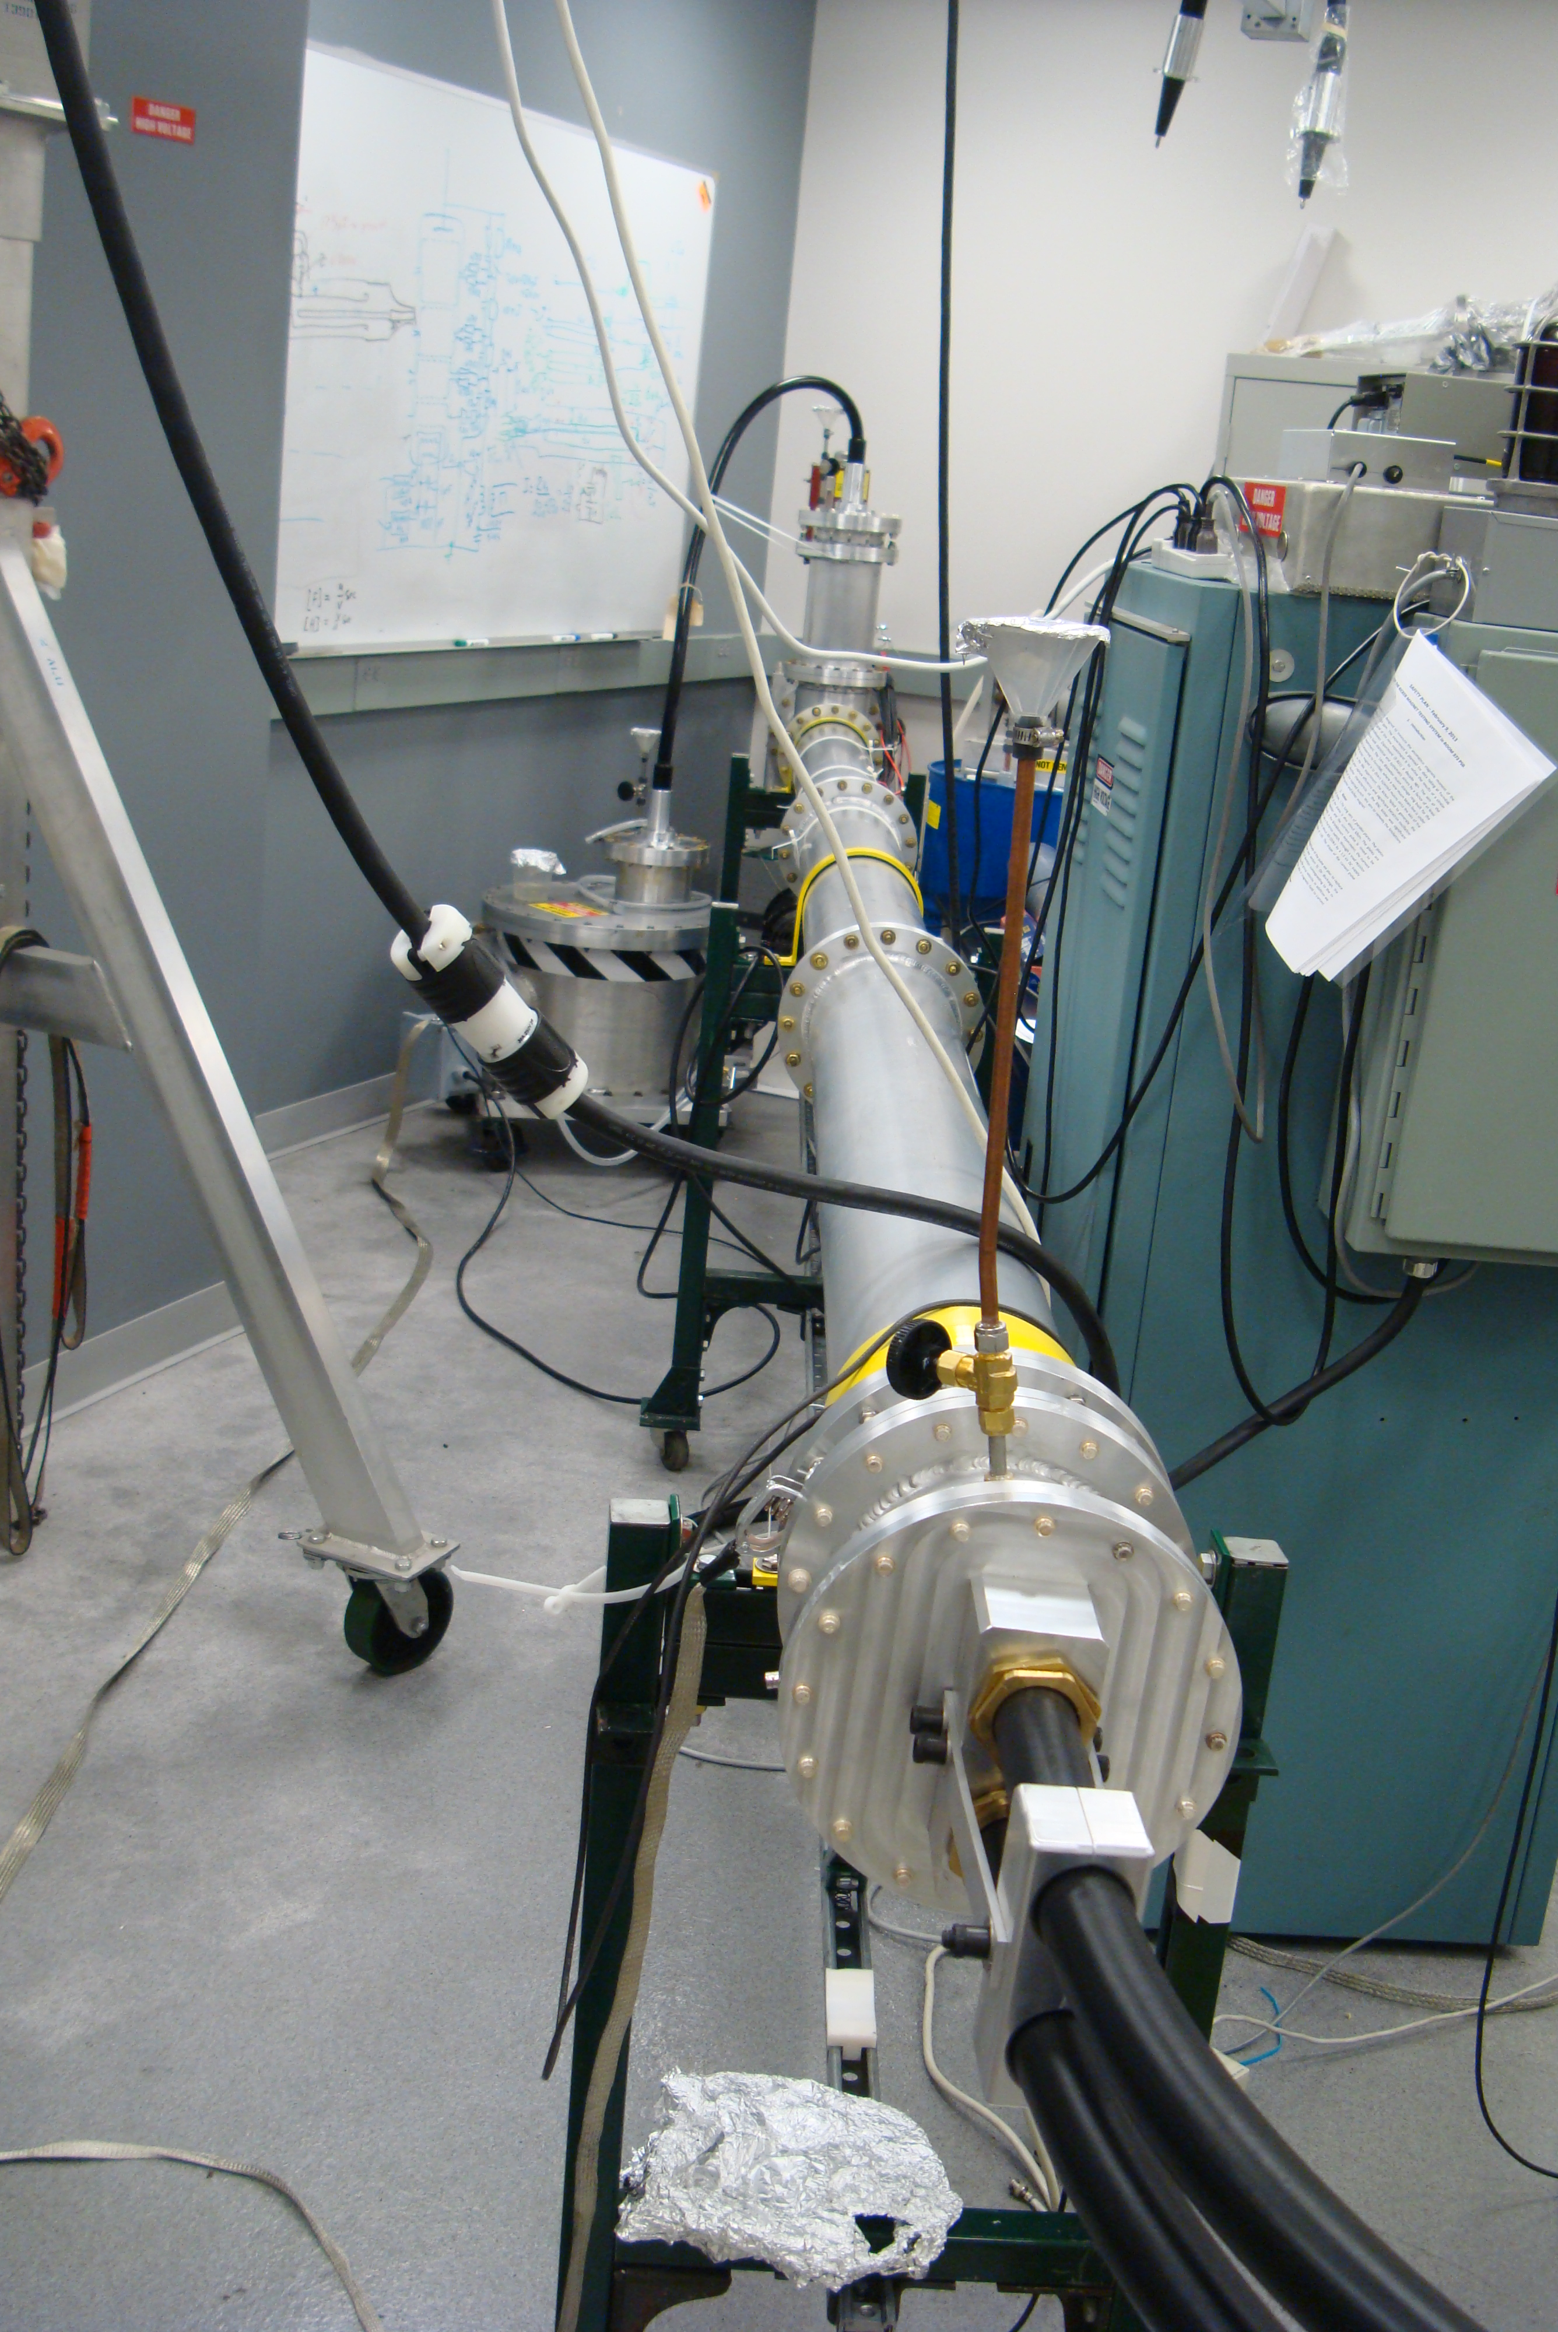
Kicker System R&D – Blumlein PFN
Charging HV
thyratron
HV transformer oil tank
thyratron
Blumlein prototype
Length – 5m
Pulse width – 50ns
Impedance – 25 ohms
561 Transformer oil – ε = 2.7
50 ohm coax

Slide 10
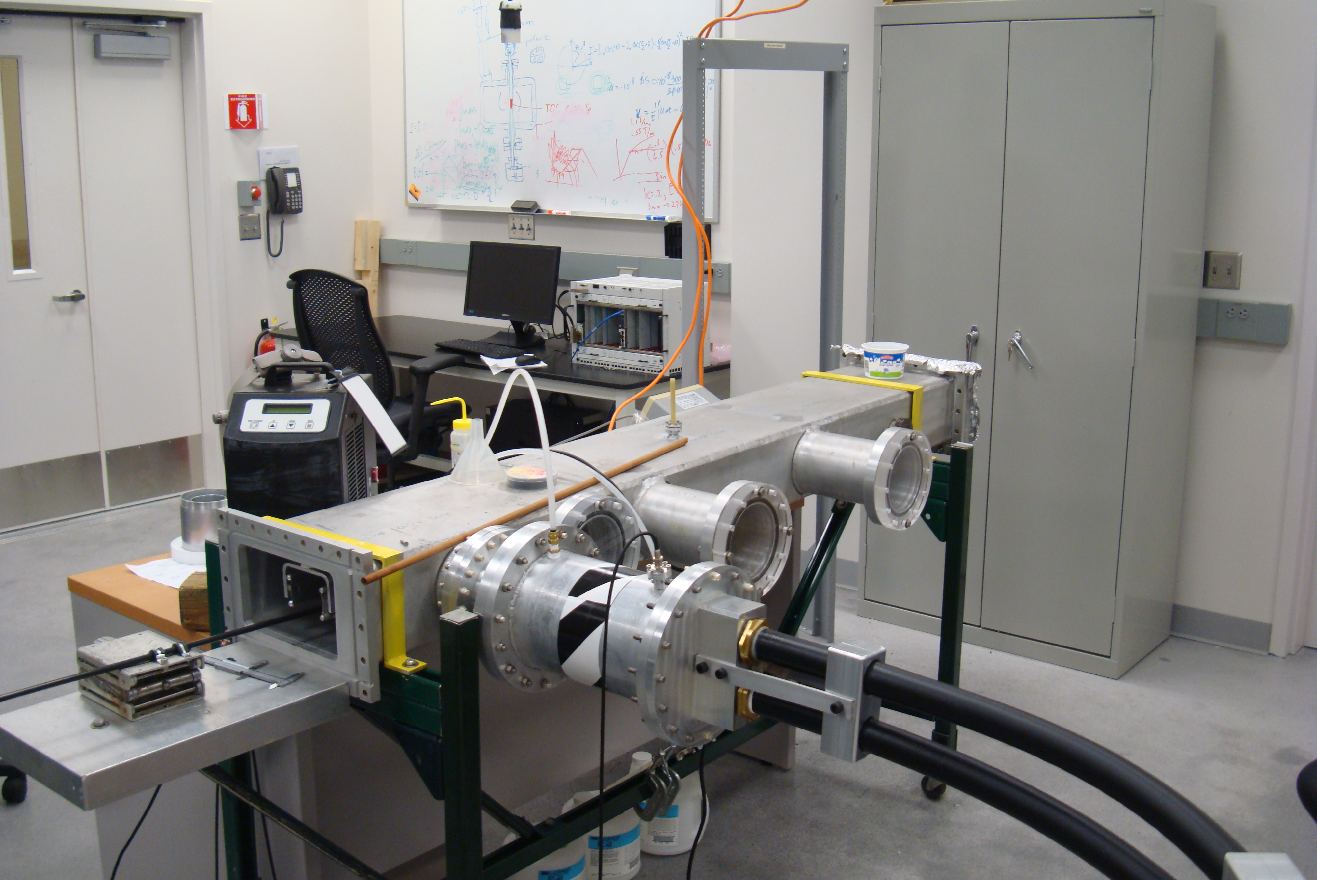
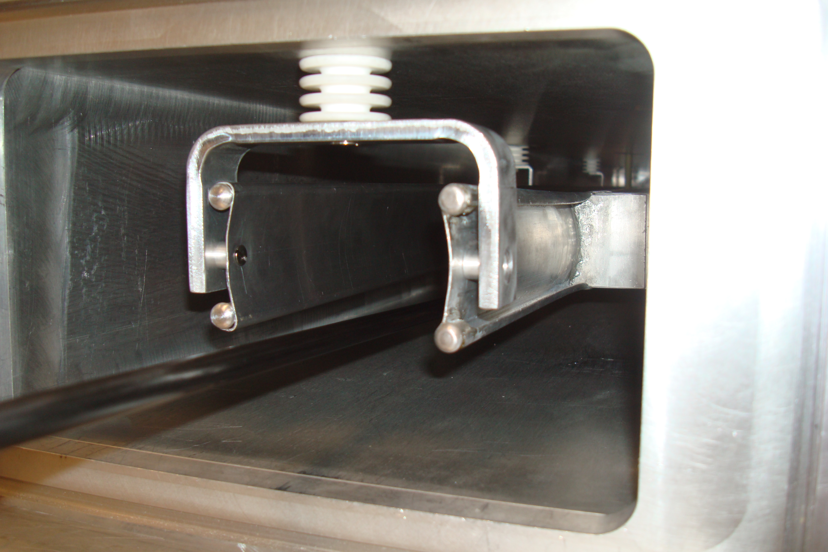
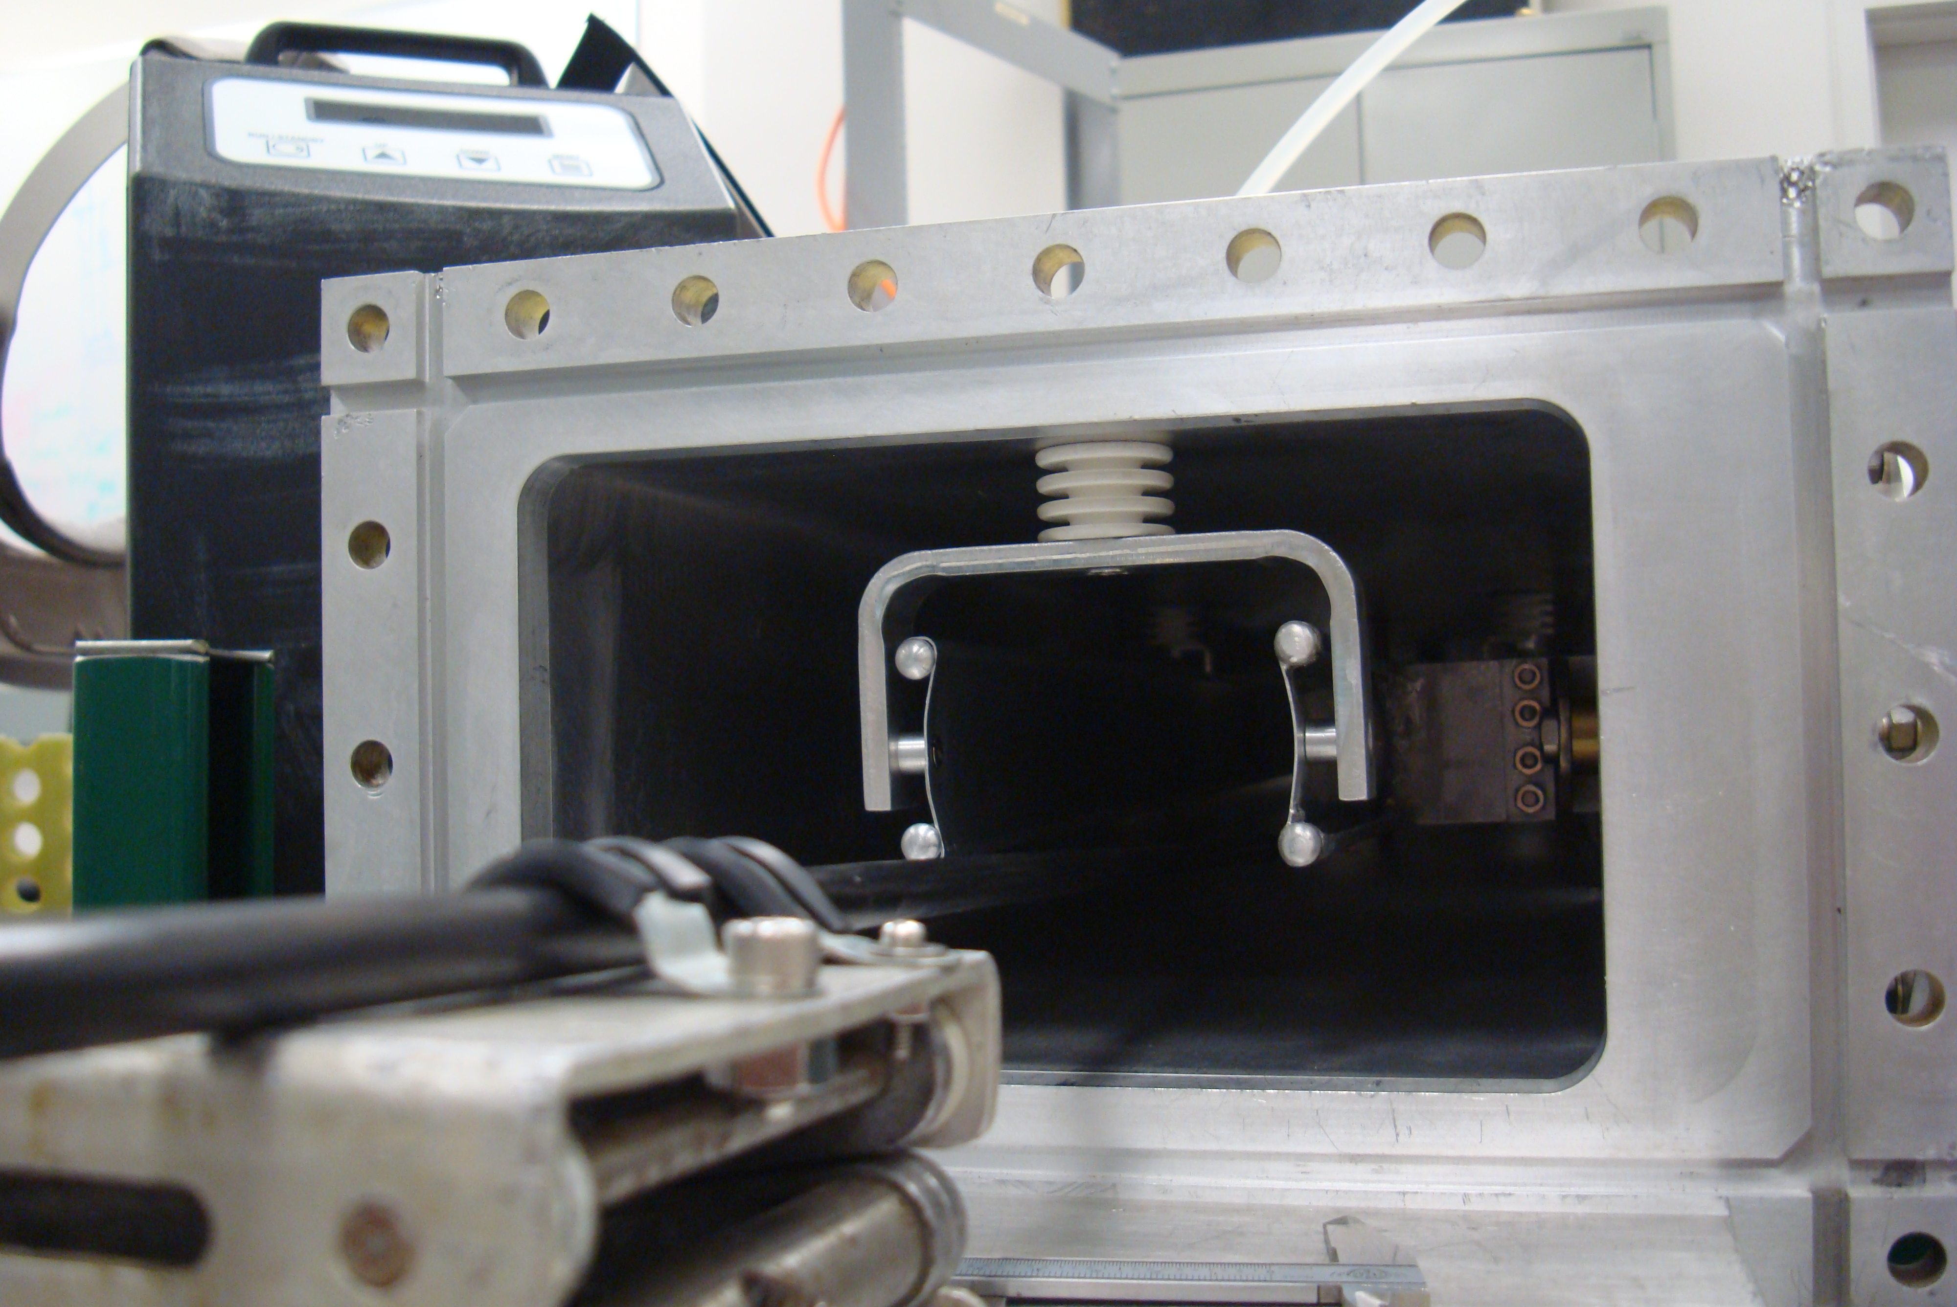
Kicker system R&D – kicker plates
Kicker plates
Coupling to PFN
Prototype vacuum chamber and kicker plates

Slide 11
Value engineering and alternatives
Plate geometry – (more field per unit current)
Re-use E821 components
  Thyratrons, thyratron housing, power supply, HV transformer
Faraday magnetometer – concept developed for E821 will be used to develop new instrument
Blumlein PFN – inexpensive aluminum tubing

Slide 12
Major Milestones
Milestones
Significance of Milestones
WBS | Milestone Description | Definition
476.03.05.03 | L4 - Preliminary Design of Kicker Plates Completed | Plate geometry of kicker plates defined
 | L4 - Prototype Test of Kicker Completed | Prototype kicker system has been tested using prototype PFN and required amplitude and time dependence demonstrated
 | L4 - Final Design of Kicker Completed | Engineering drawings for final kicker system. Ready to place orders for materials for kicker system.
 | L4- Final Design for vacuum chamber modifications | Engineering drawings of vacuum chamber modifications
 | L4 - Final Test and Certification of Kicker System Completed | Continuous operation at specified repitition rate and duty cycle
 | L4 -Design of trolley rails for Kicker chambers | Engineering drawings of trolley rails. Ready to place orders for materials
 | L4 - Trolley Rails Installed in Kicker Area | Trolley rails installed in kicker area of vacuum chamber
476.03.05.02 | L4- Test of power supply | Test with pulser at specified voltage, repitition rate and duty cycle
 | L4- Final test and certification | Test with full load (3 PFNs) at specified voltage, repitition rate and duty cycle
476.03.05.04 | L4-Preliminary Design of triaxial PFN Completed | Blumlein PFN concept defined
 | L4-Test of prototype PFN completed | Demonstrate required pulse characteristics with resistive load
 | L4- Final Design of PFN completed | Engineering drawings for final PFN. Ready to place orders for materials for PFN system
 | L4-Final Test and Certification of PFN system Completed | Continuous operation at specified voltage, repitition rate and duty cycle
476.03.05.05 | L4- Test inventory of E-821 tubes | Test operation of tubes from E821 with prototype PFN
 | L4-Decision to purchase faster tubes or re-use E-821 | Establish that rise and fall time is limited by thyratron
 | L4-Place order for faster thyratrons | If faster tubes are required to meet performance goals
476.03.05.06 | L4-Preliminary design of controls | Control and monitoring requirements defined
 | L4-Final design of control chassis | Engineering/electronics drawings of controls and monitors
 | L4-Final Test and Certification of kicker system Controls | Operation with power supply, PFN,thyratron, kicker magnet

Slide 13
Risks and Mitigations
Pulse too narrow –
  Width of the pulse is proportional to the length of the transmission line and easily adjusted
  Transformer oil with higher permittivity (castor oil vs silicon oil) can be used to reduce wave velocity
Breakdown in PFN or kicker or interconnections limit voltage
  Conservatively designed to operate up to 89 kV which corresponds to a 14 mrad kick
  Improve standoffs etc.
Impedance mismatch distorts pulse shape
  Impedance transformer
  Analysis with OPERA
Pulse width > 149ns with flat top < 80ns
  Use faster thyratron or reduce overall pulse width with some loss of capture efficiency

Slide 14
ES&H
High voltage
  No exposed HV
Large volume of transformer oil
  non-toxic and non flammable

Slide 15
Quality Assurance
  Complete mapping of field with pickup coil and measurement of temporal profile with Faraday magnetometer
  Testing of prototype in test stand at full voltage and current and at required pulse repetition rate
  Extended testing of three complete PFN/kicker units at 5-10% above operational voltage and at required repetition rate
  Monitoring of PFN voltage and current and of kicker field

Slide 16
Standard Cost Slides
Base Cost Distribution
Cost Profile by FY
Cost Labor Distribution
Uncosted Effort
Costed FTE by FY
Costed versus Uncosted FTEs by FY
Base Cost + Estimate Uncertainty Cost Summary

Slide 17
Base Cost Distribution
No MRI or NSF Contribution

Slide 18
Base Cost Distribution
Contract Labor: Technical and Engineering
Staff at Cornell

Slide 19
Cost Profile by FY

Slide 20
Costed Labor Distribution

Slide 21
Uncosted Effort

Slide 22
Costed FTEs by FY

Slide 23
Uncosted FTEs by FY

Slide 24
Base Cost and Estimate Uncertainty Summary

Slide 25
Summary
This system describes the ring injection kicker that will direct the muons exiting the inflector onto the closed orbit of the ring
The system traces back to higher level requirements.
The Base (Estimate uncertainty) cost is $1,150K ($370K) in At Year $
Between CD-1 and CD-2 we will focus on:
  Completion of prototyping and testing Blumlein PFN and kicker and optimization of pulse shape
  Completion of Faraday magnetometer for measuring time dependence of kicker pulse and induced fields
  Simulations: Eddy currents induced in kicker plates and vacuum chambers

Slide 26
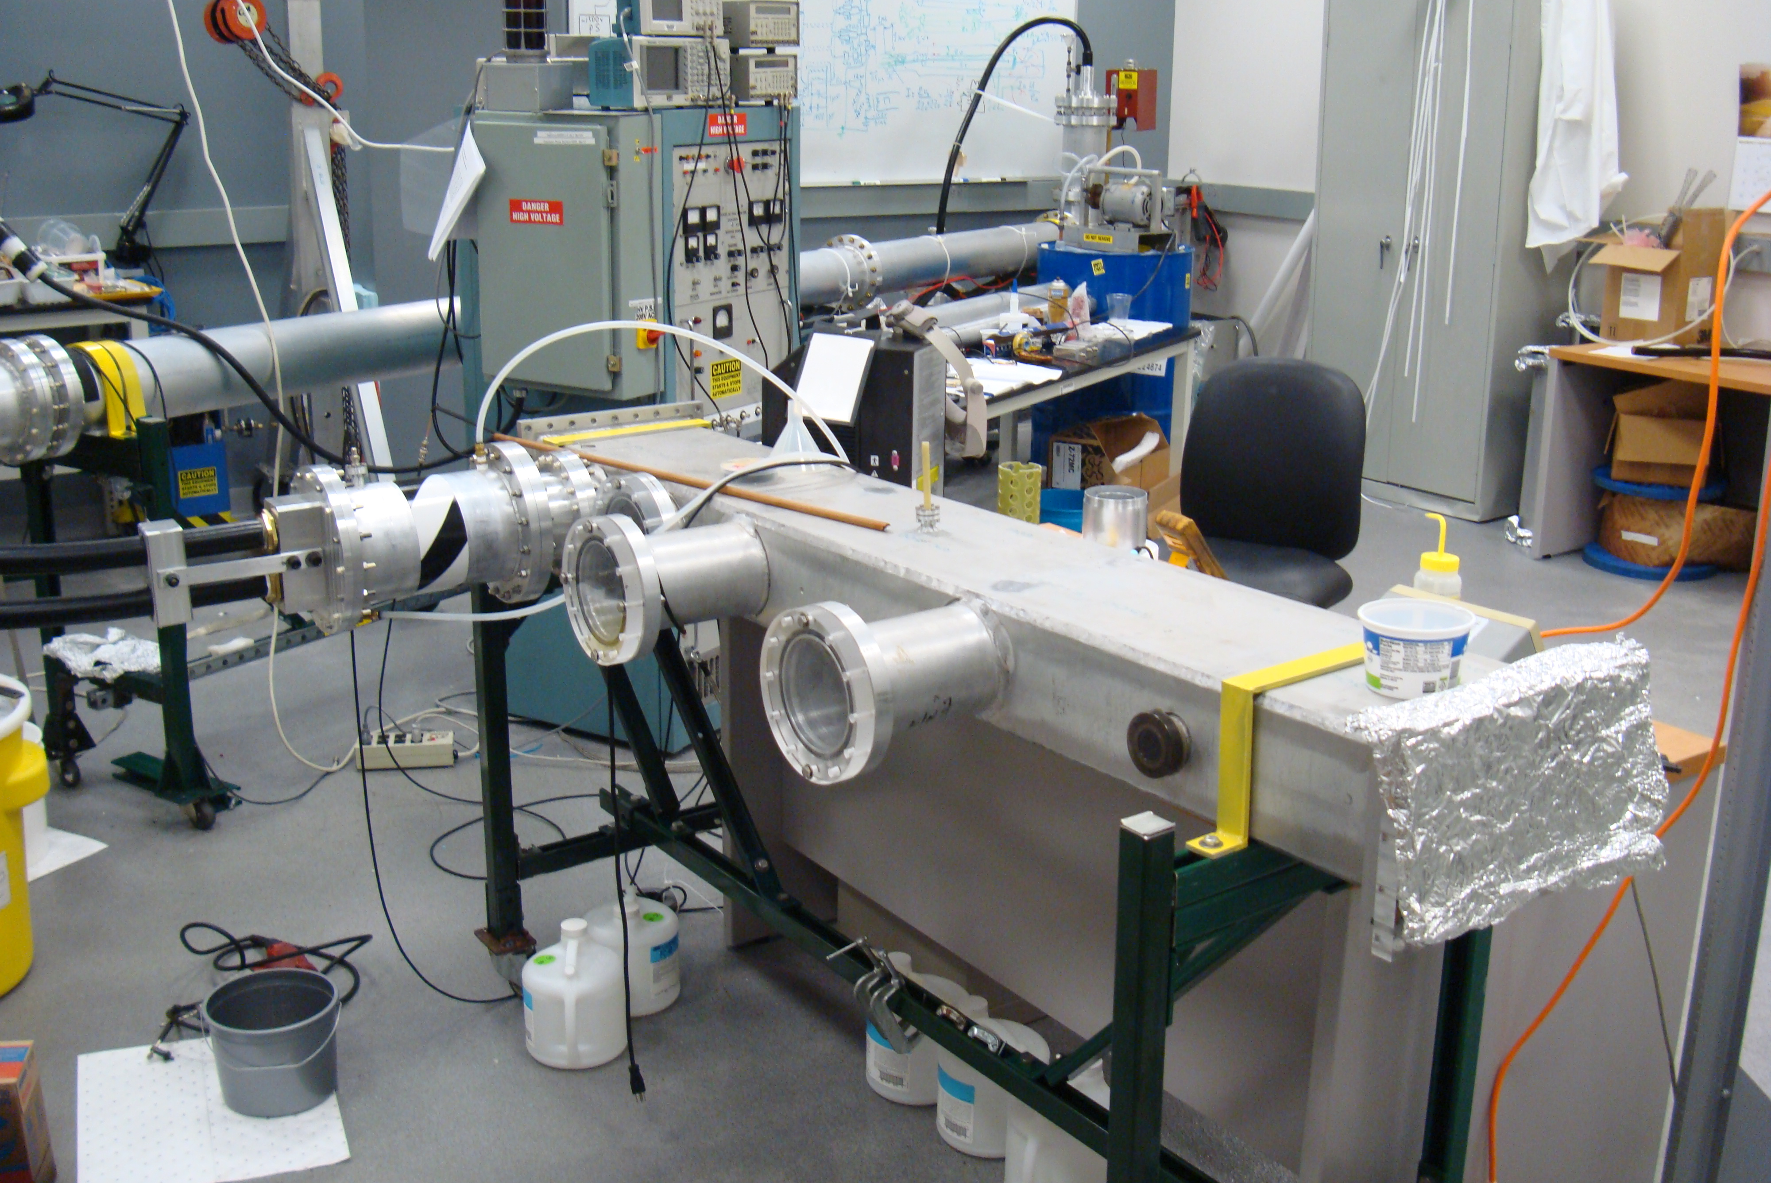
Backup

Slide 27
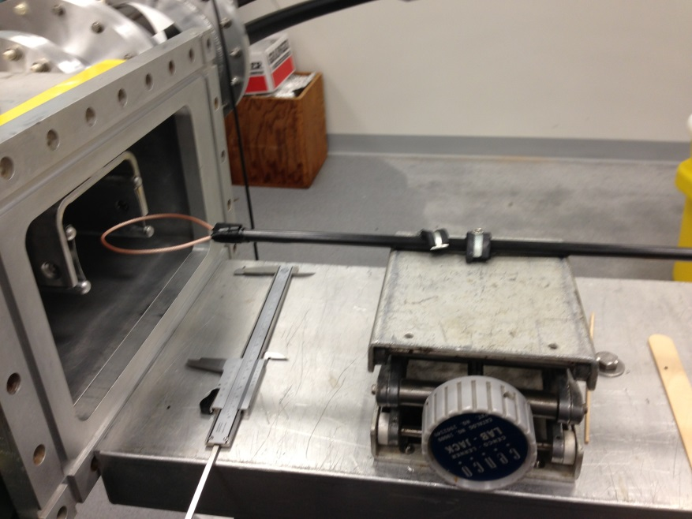
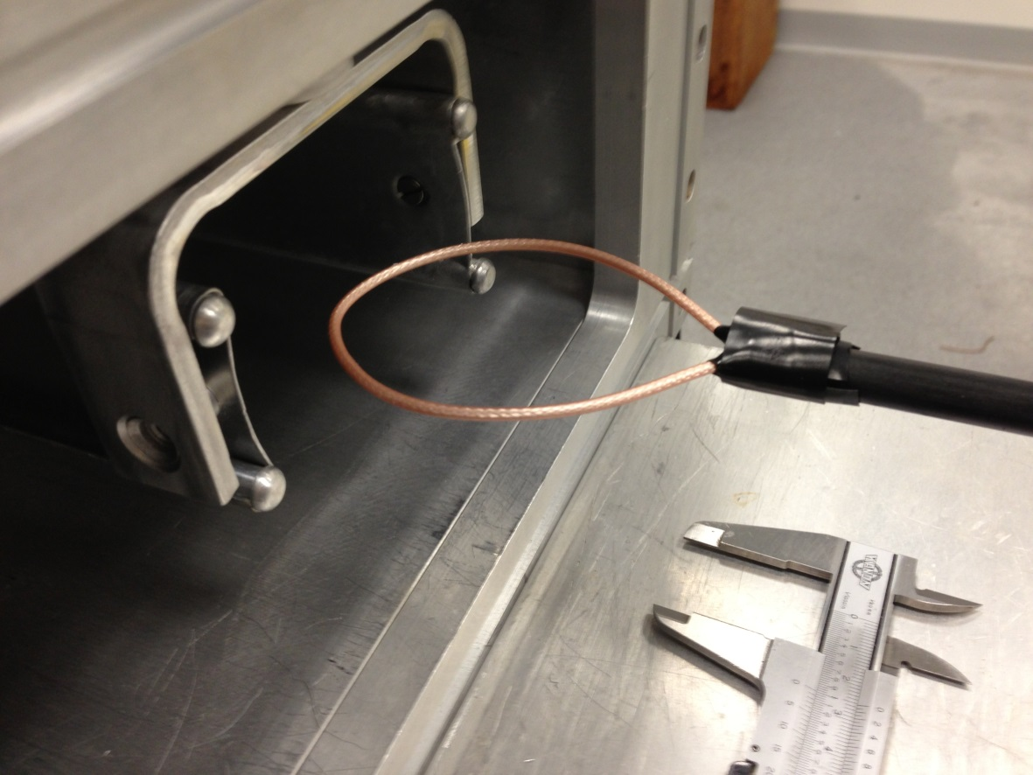
Kicker Field Measurement

Slide 28
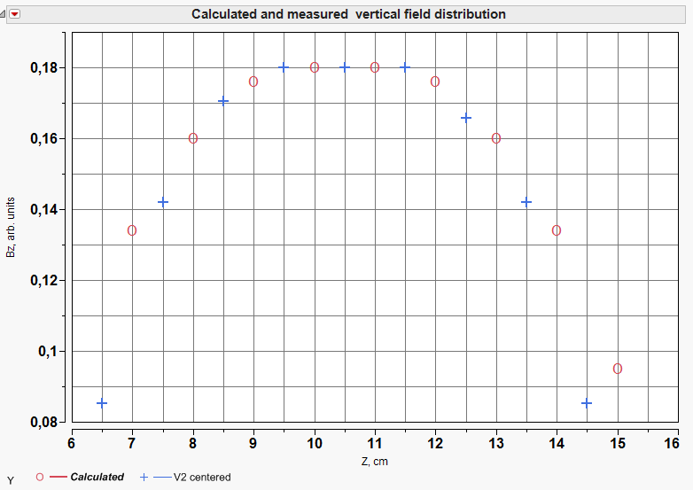
Kicker Field Measurement
measured
calculated
Center of vacuum chamber at 10.5cm

Slide 29
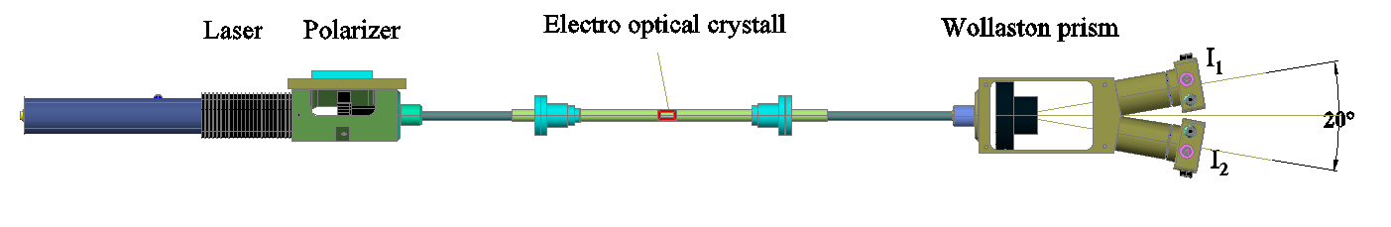
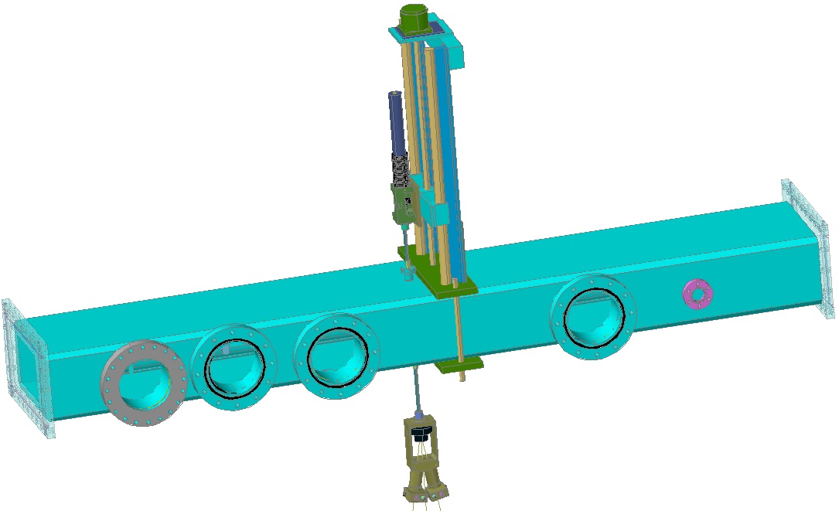
Field measurement with electro optical crystal
TGG (Terbium Gallium Garnet) crystal

Slide 30
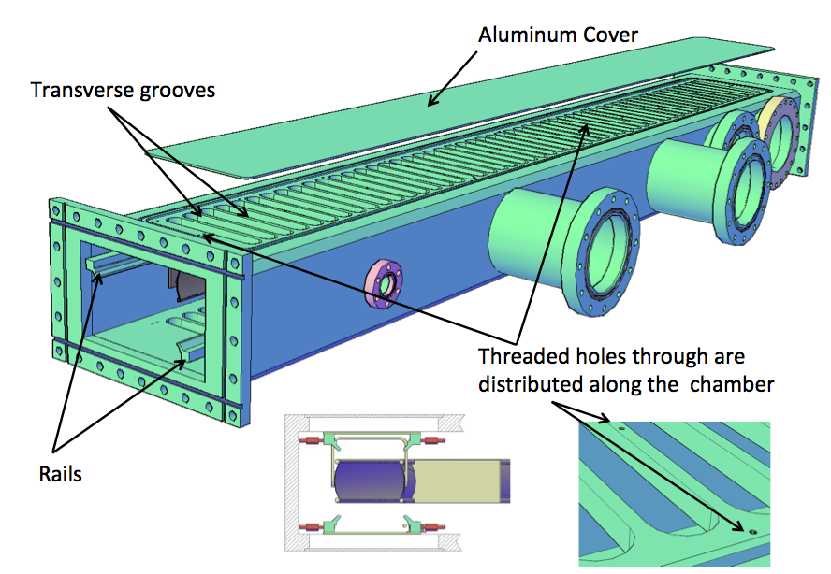
Kicker vacuum chamber
Grooves in vacuum chamber reduce eddy currents and increase field between kicker plates
Opera Studies
are underway

