Slide 1
Quad and Kicker scans with measured B-field
D. Rubin
July 7, 2017

Slide 2
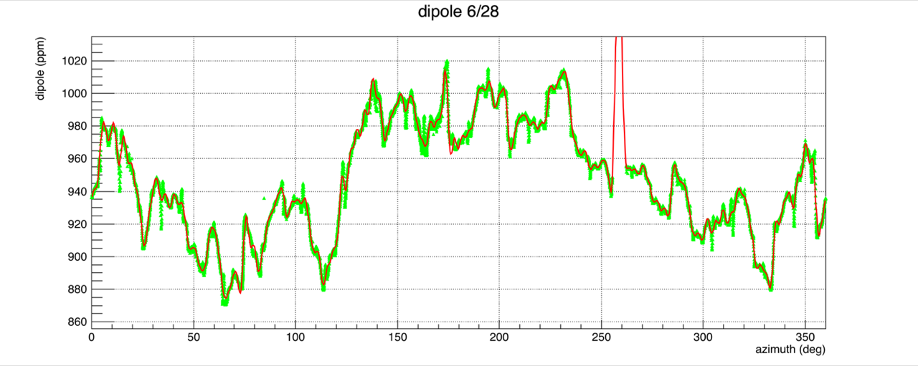
Measured fields
100 term fit
|B|
https://muon.npl.washington.edu/elog/g2/General+Field+Team/983
20 term fit
Radial field
In tracking study to follow average radial B-field is assumed to be zero
https://gm2-docdb.fnal.gov:441/cgi-bin/ShowDocument?docid=4671

Slide 3
Field measurements are assumed along magic radius.
Tracking requires fields defined everywhere.
In order that fields displaced from magic radius are consistent with Maxwell
Write solution to Laplace in cylindrical coordinates
Compute B_{z}(φ) _{and} B_{r}(φ) on the design orbit and fit to measurements
Apply boundary condition B_{z}(ρ_{backleg}) = 0

Slide 4
Closed orbits with fitted (measured) B-fields
Average radial field is assumed to be zero

Slide 5
Quad voltage scan with fitted (measured) vs perfect B-field
Average radial field is assumed to be zero

Slide 6
Kicker scan
Measured – includes measured field errors
Uniform – no field errors
Quads at 18 kV

