Slide 1
Storage Ring Kicker Update
D. Rubin and A. Mikhailichenko
Cornell University
January 11, 2012

Slide 2
Status of E821 kicker prototype
  Concept
  Components
  Configuration
  Hardware
Injection dynamics
  Trajectories
  Energy and angular acceptance
  Time dependence
Kick amplitude and width
  Pulse forming network
  Implementations
Muon beam
  Bunch length
  Energy and angular spread

Slide 3
Kickers are 90º in betatron phase from the inflector exit
Injected muons are crossing the central trajectory inside the kickers
Kick directs muons onto central orbit

Slide 4
End of inflector is displaced 7.7cm radially outward from the central orbit
Radius of central orbit = 7.112 m
Kick ~ 10 mrad on first pass and
0 on next turn
(100 kV)
Pulser circuit

Slide 5
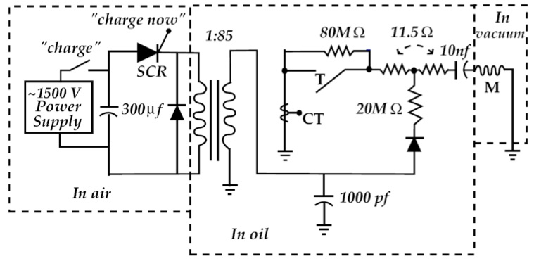
E821 – Pulser schematic

Slide 6
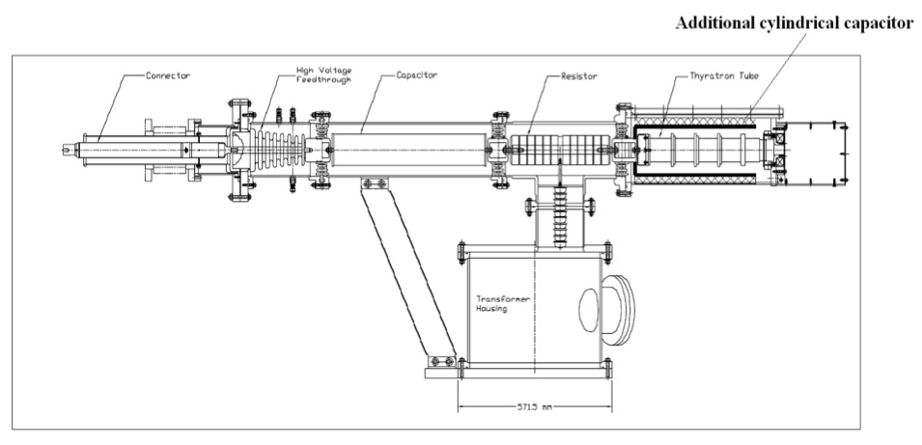
E-821 Pulser

Slide 7
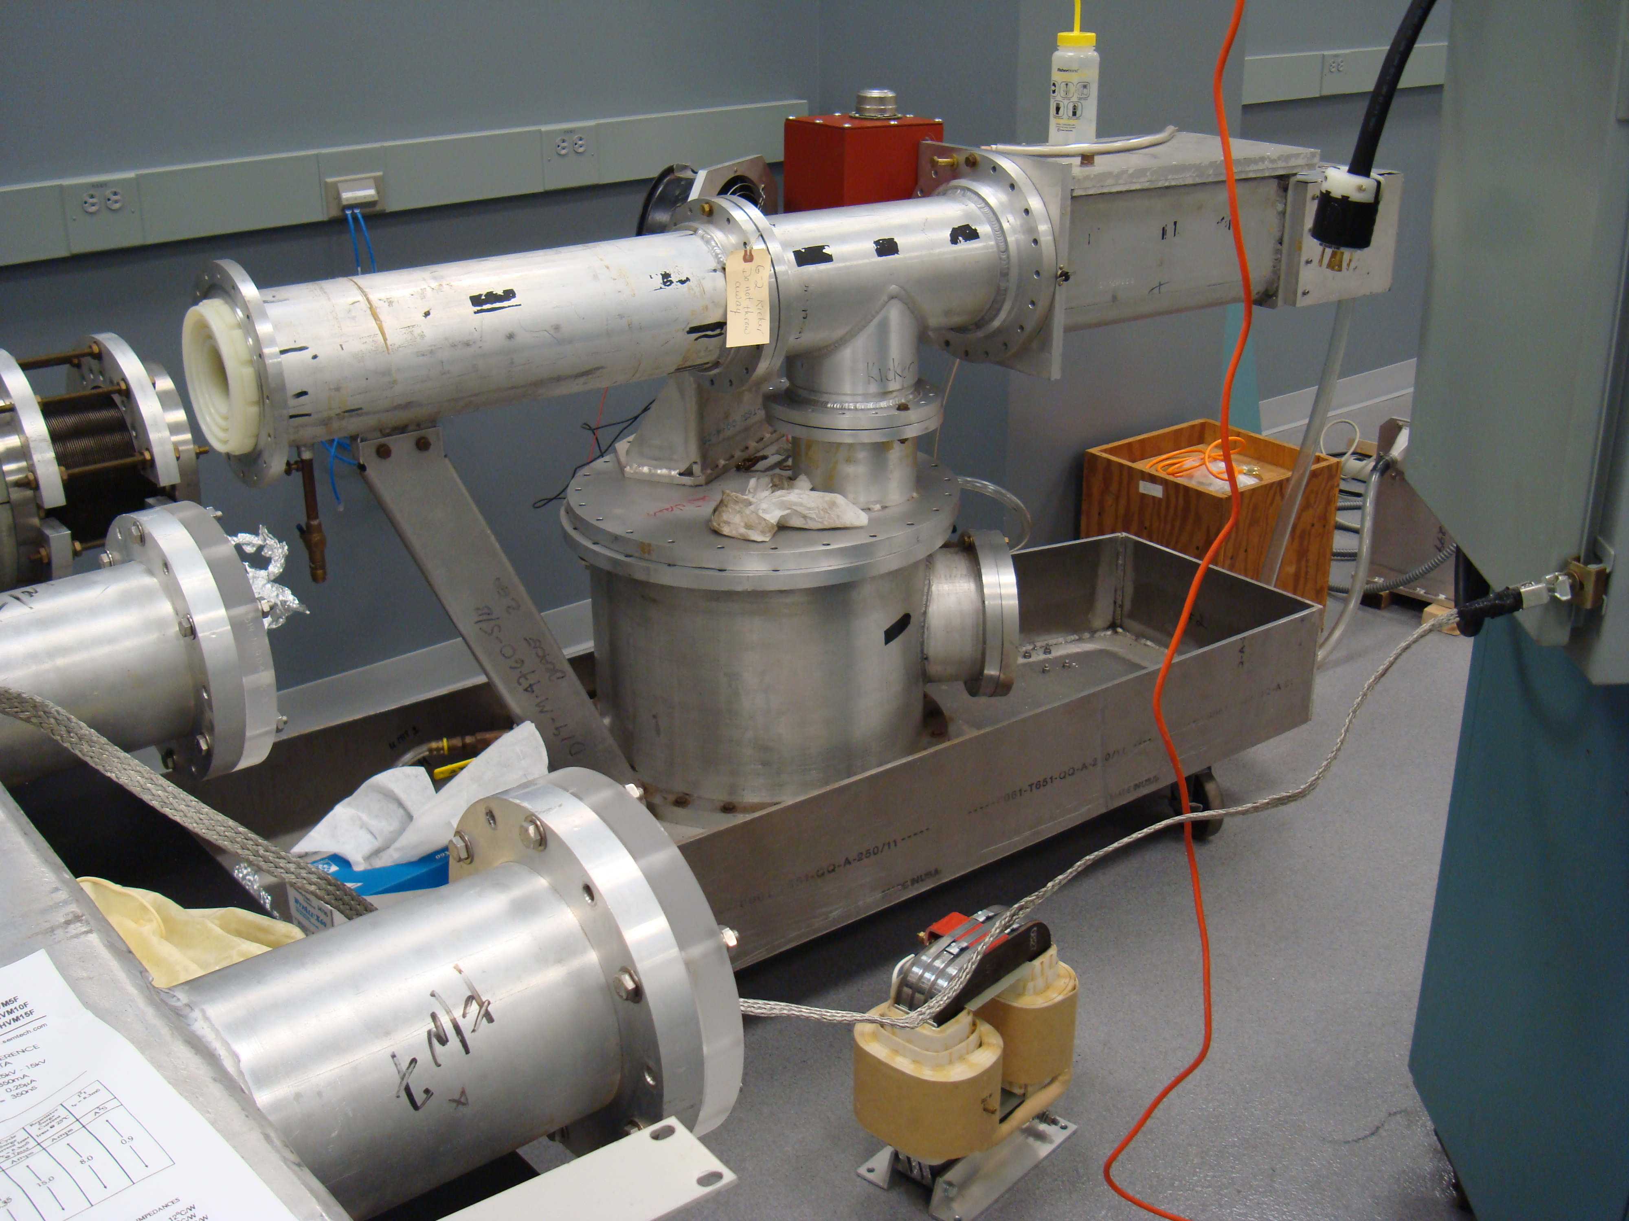
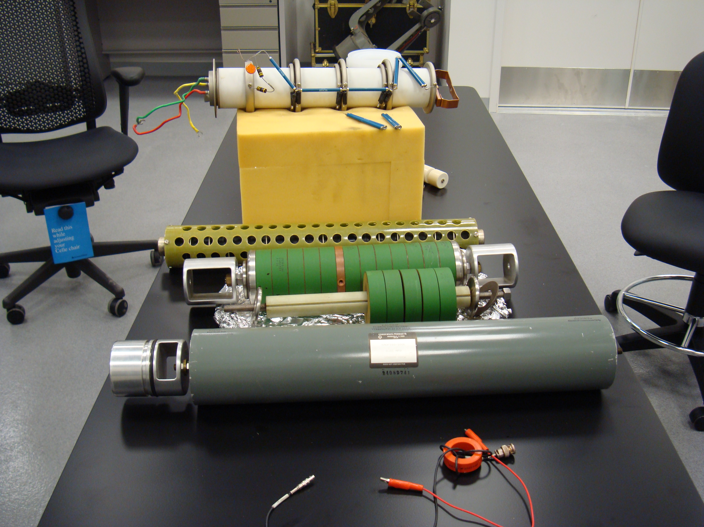
Pulser housing
HV Transformer
Thyratron
Charging Diodes
Charging resistors
Capacitor

Slide 8
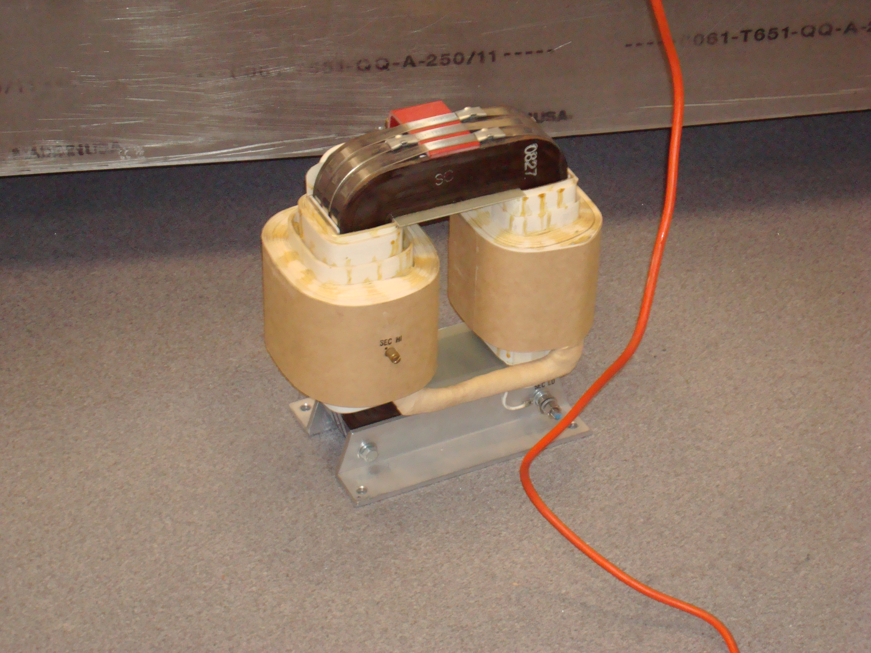
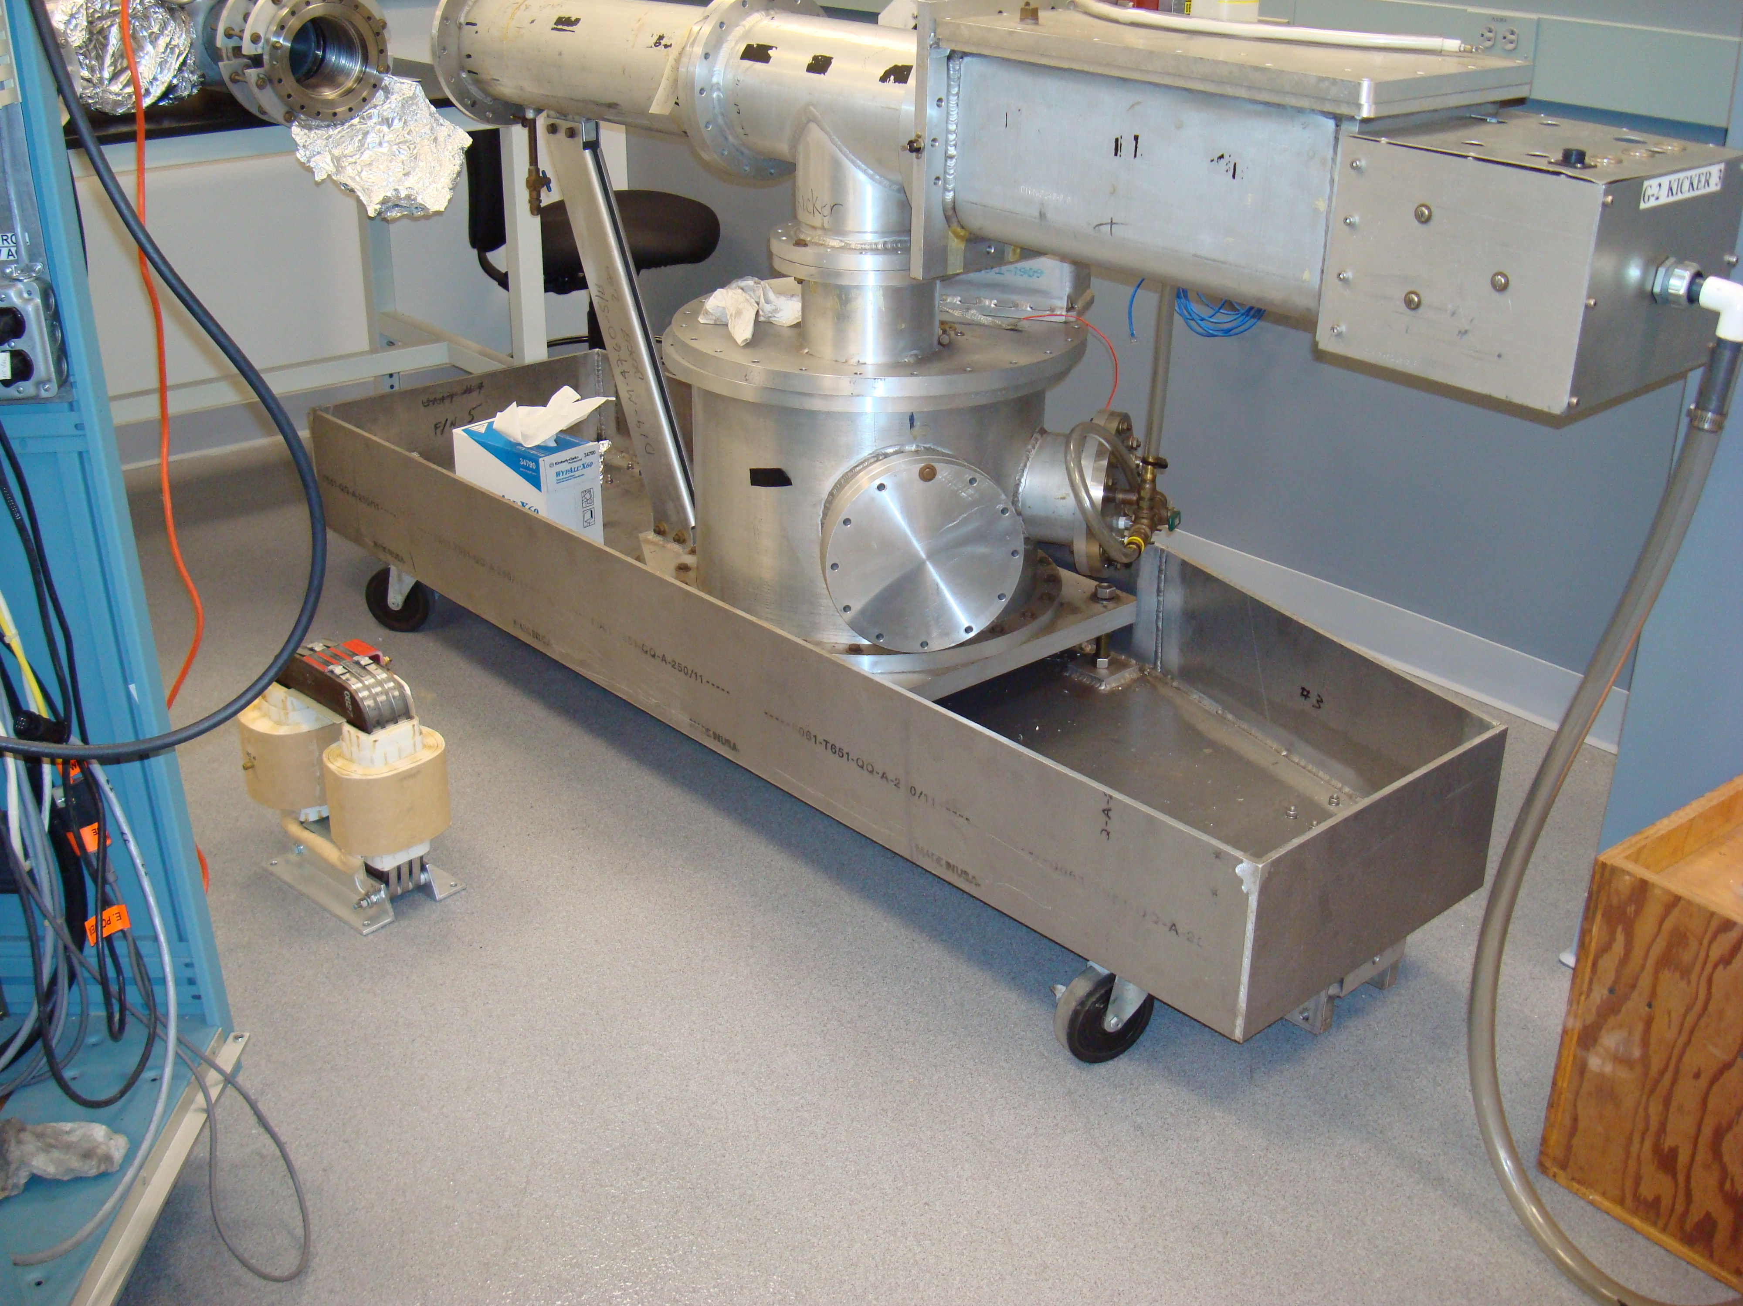
HV transformer
Overflow oil pool

Slide 9
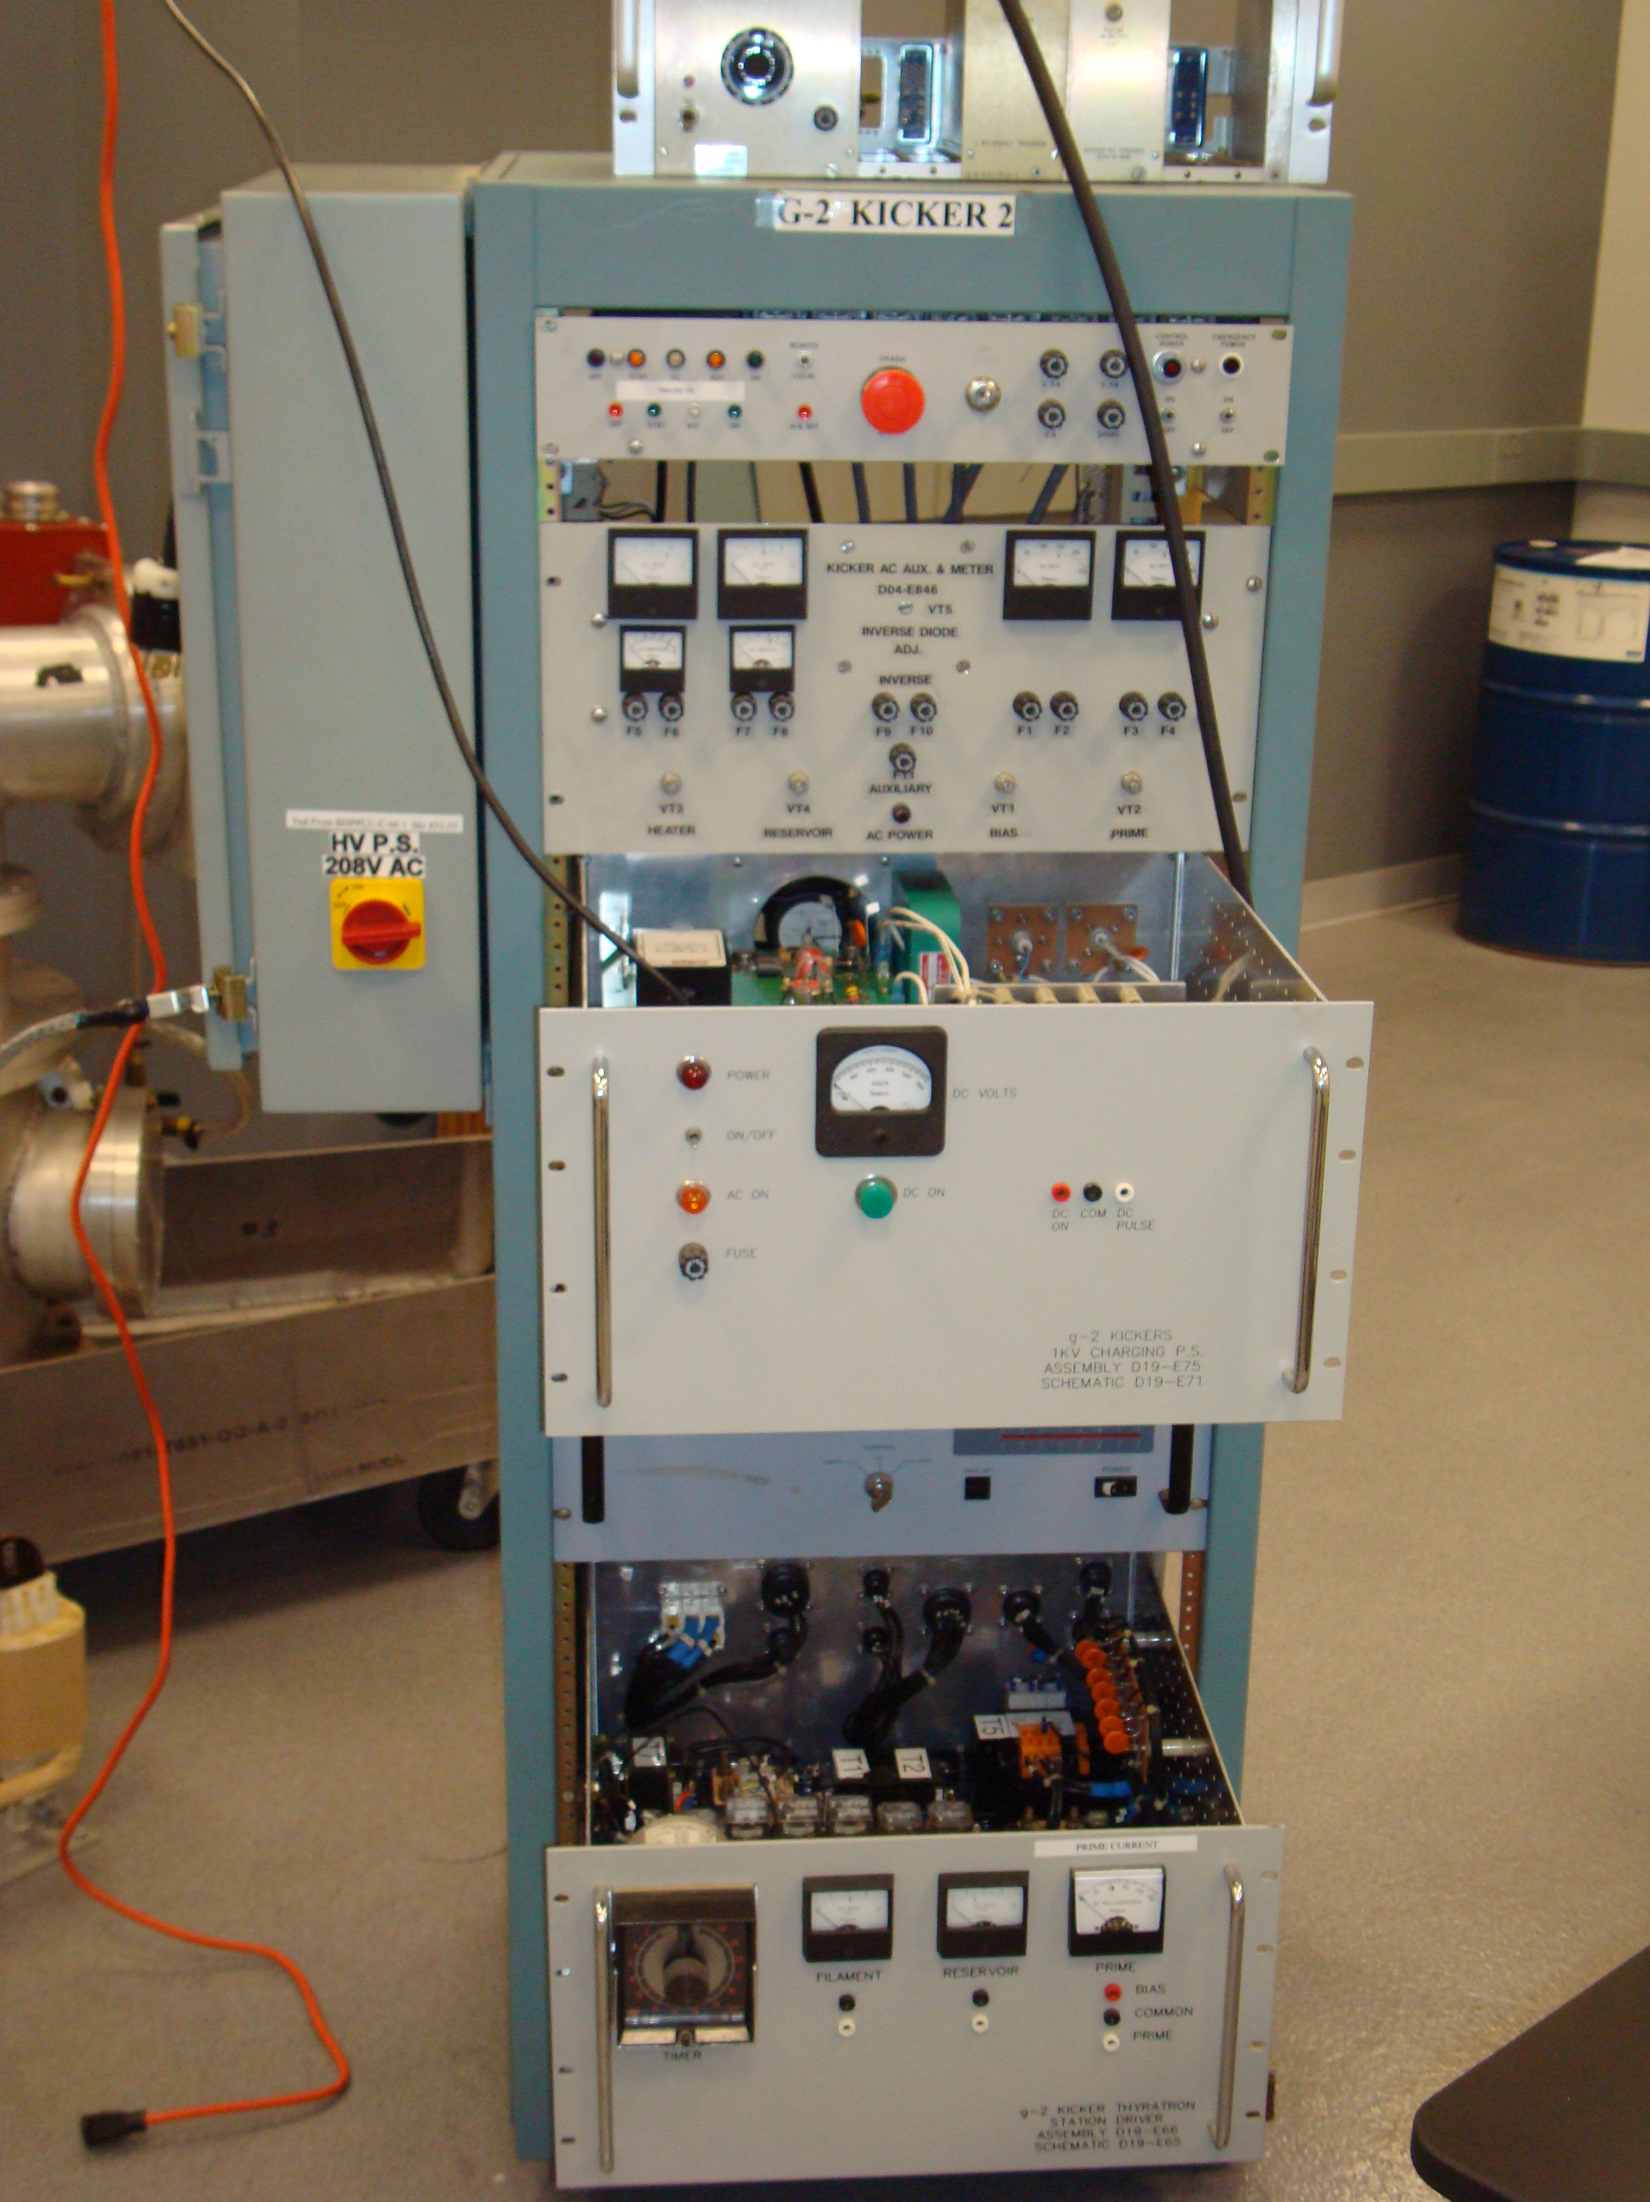
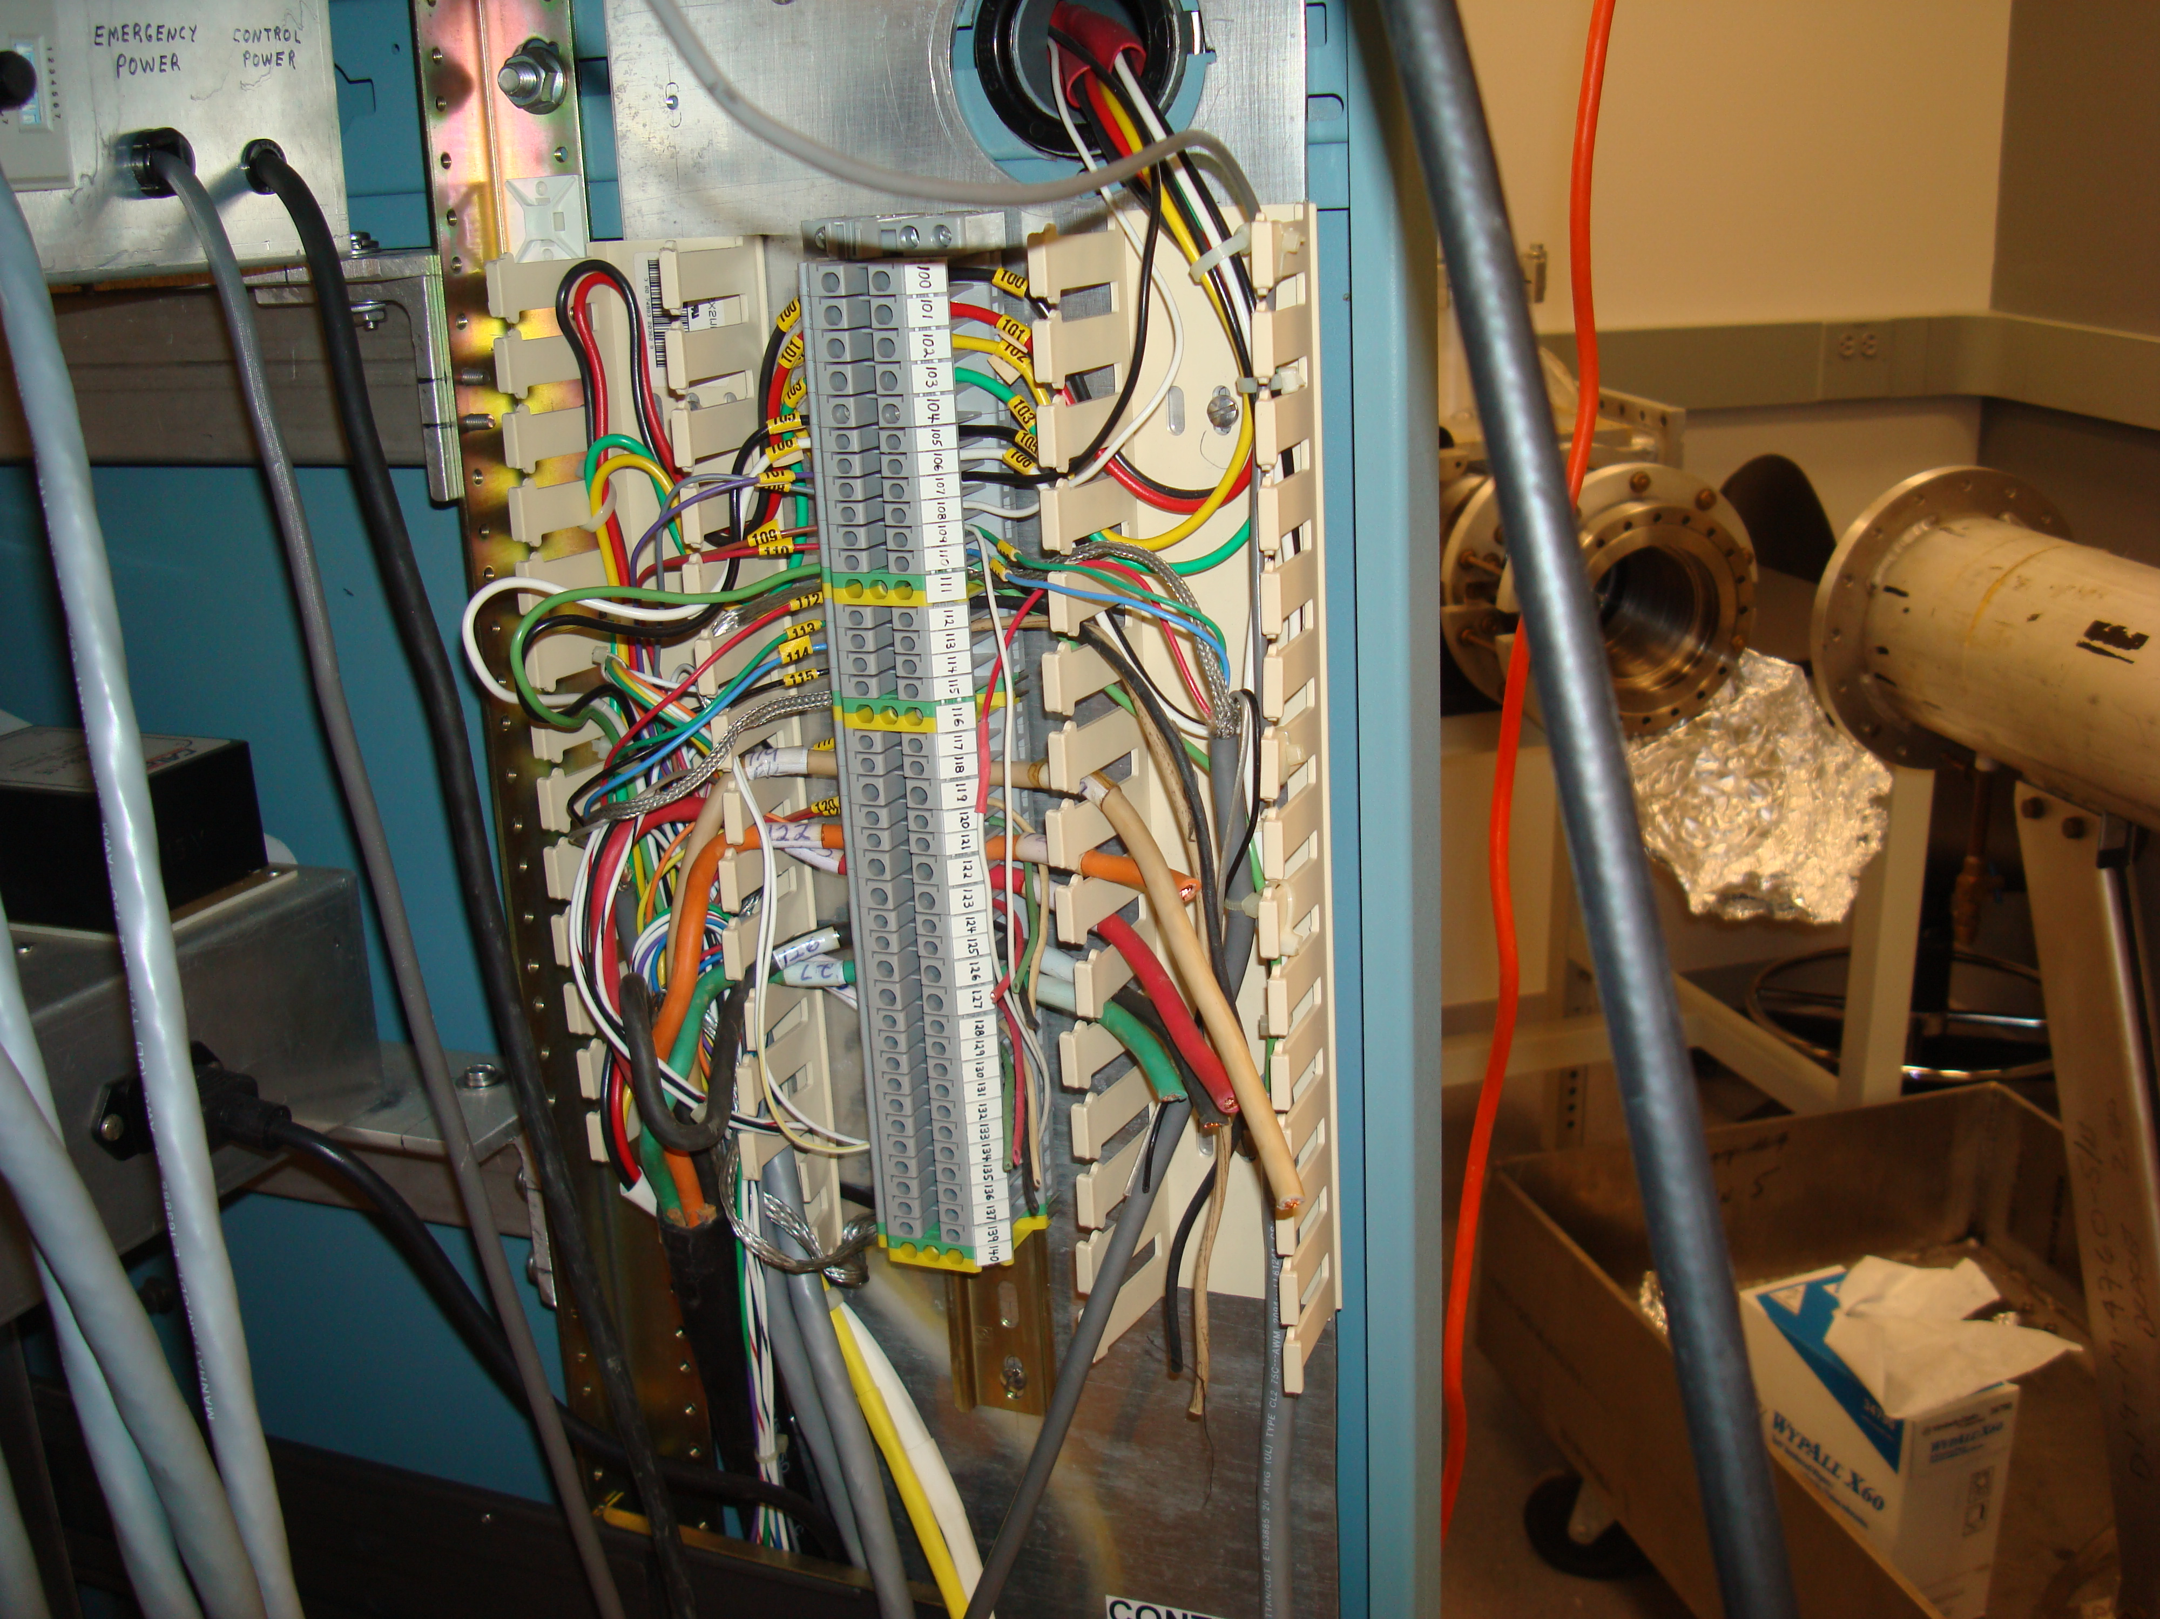
Pulser electronics

Slide 10
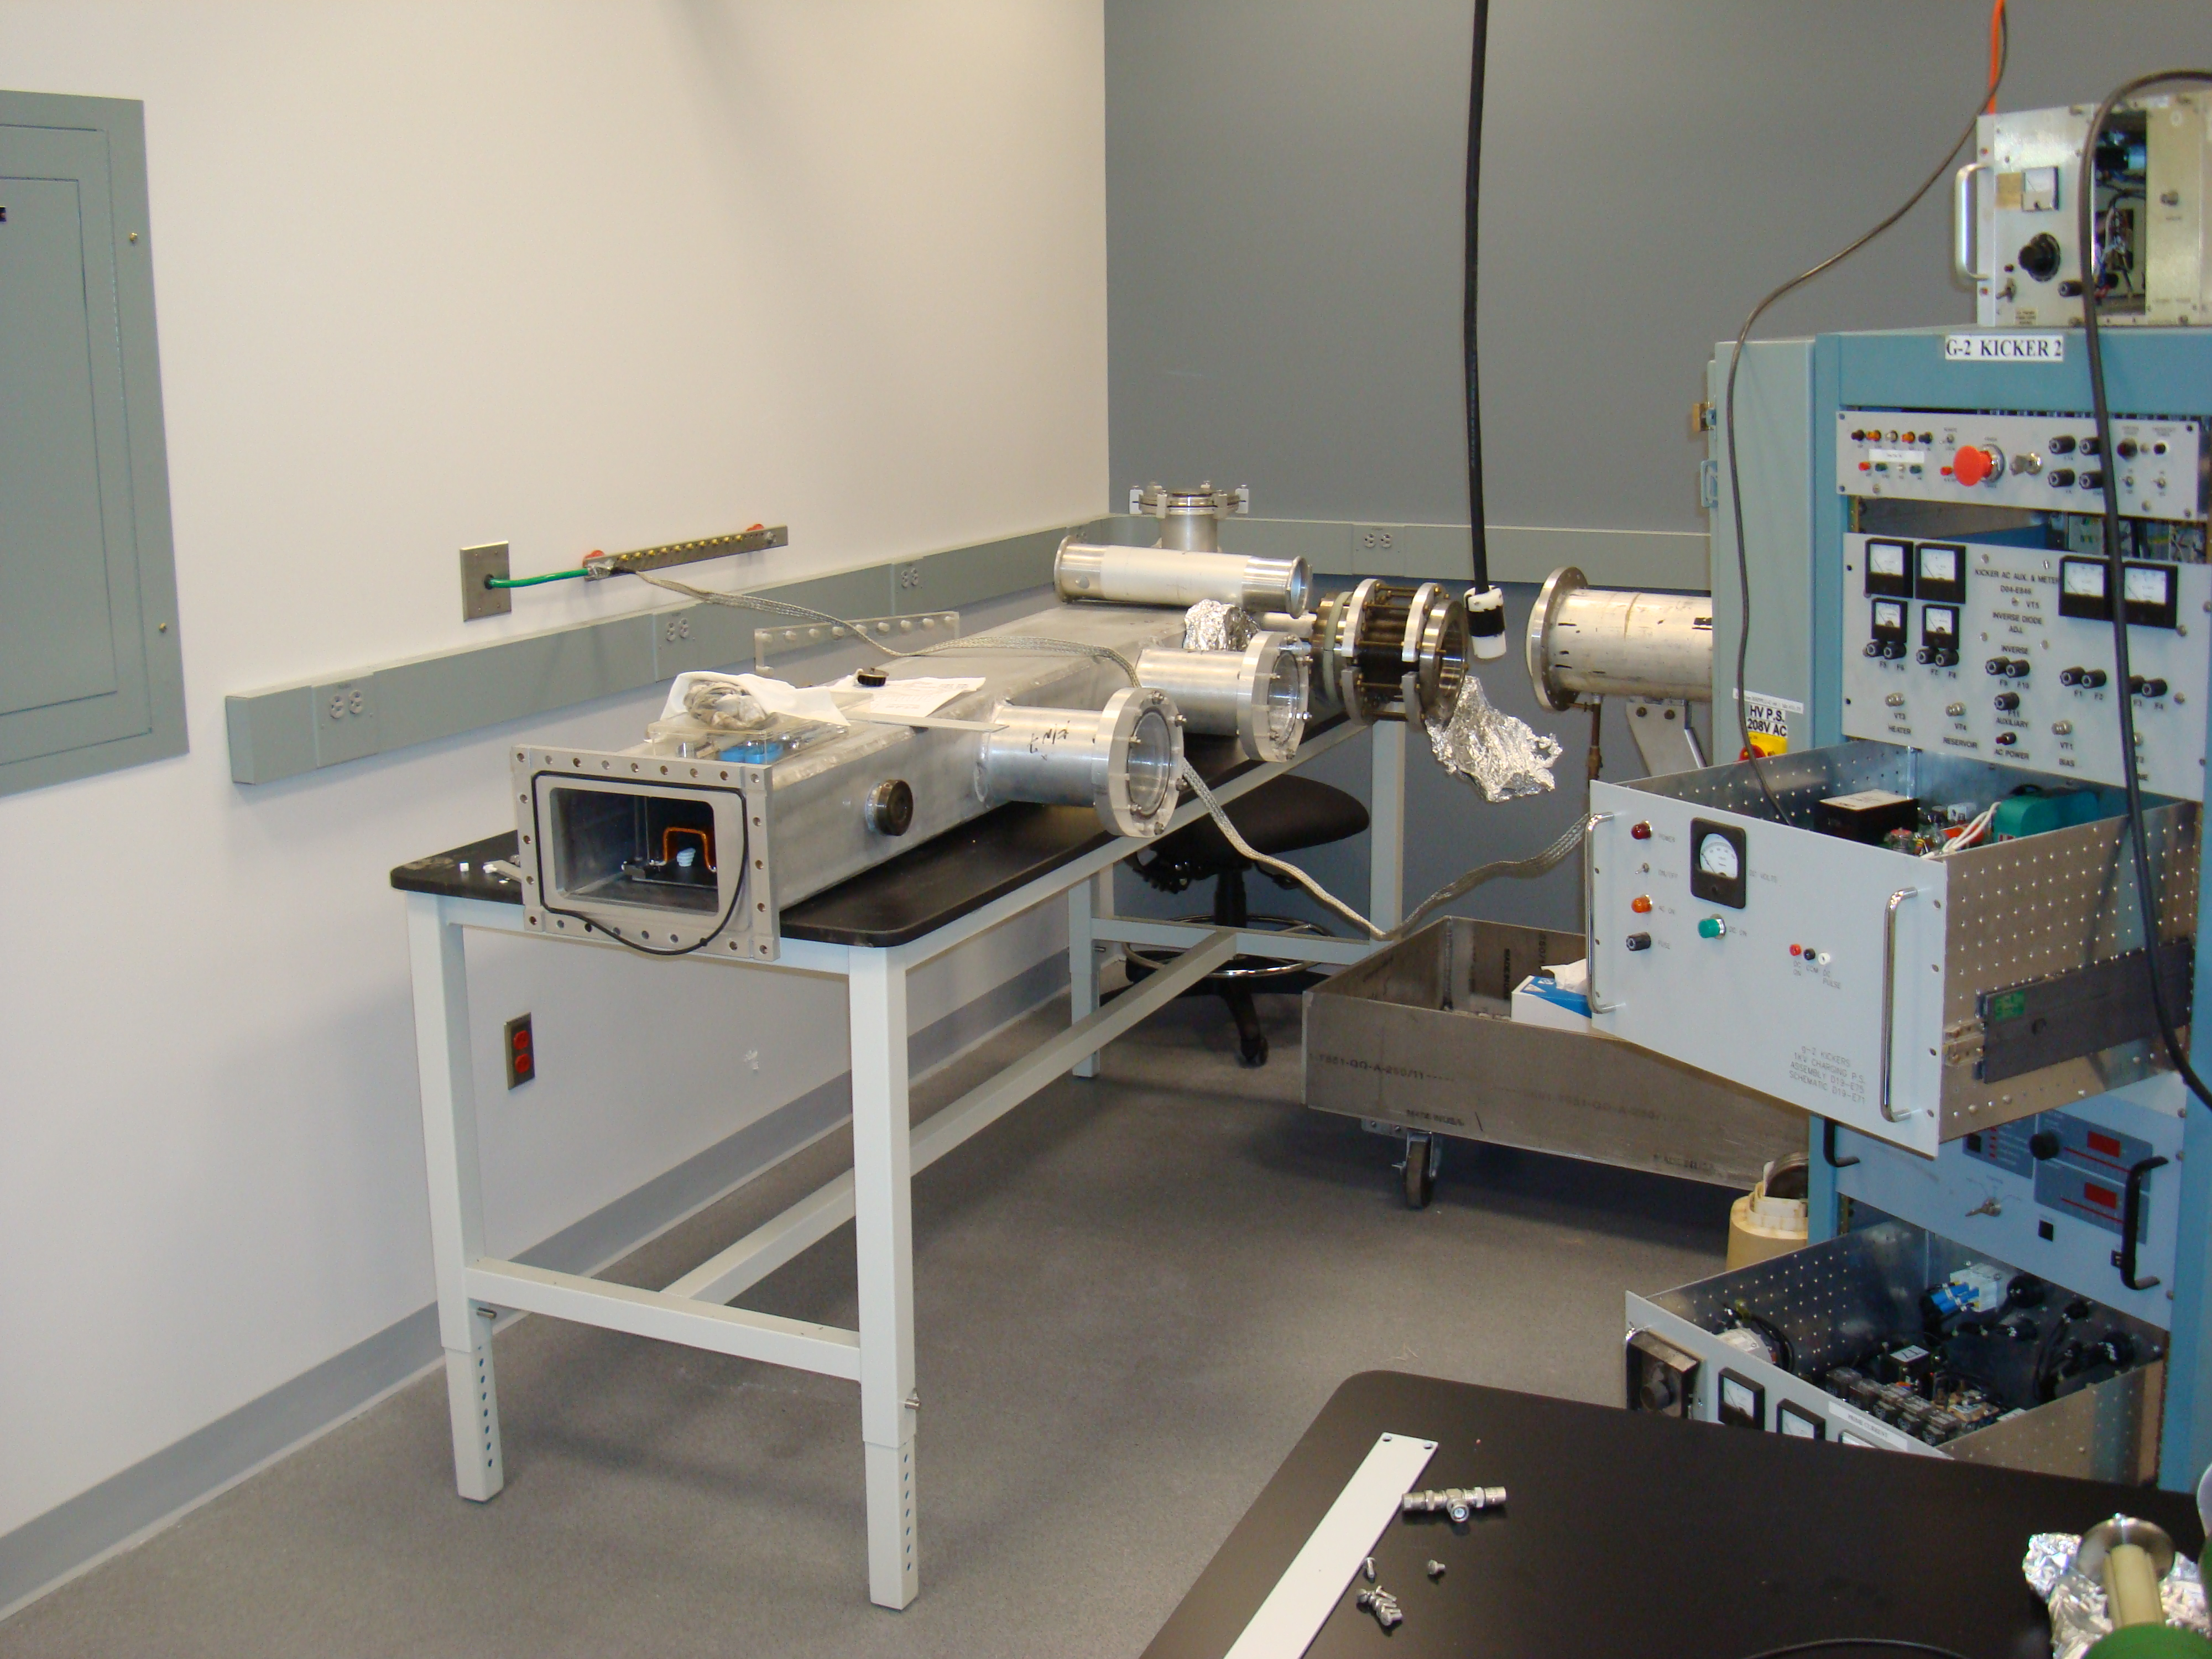
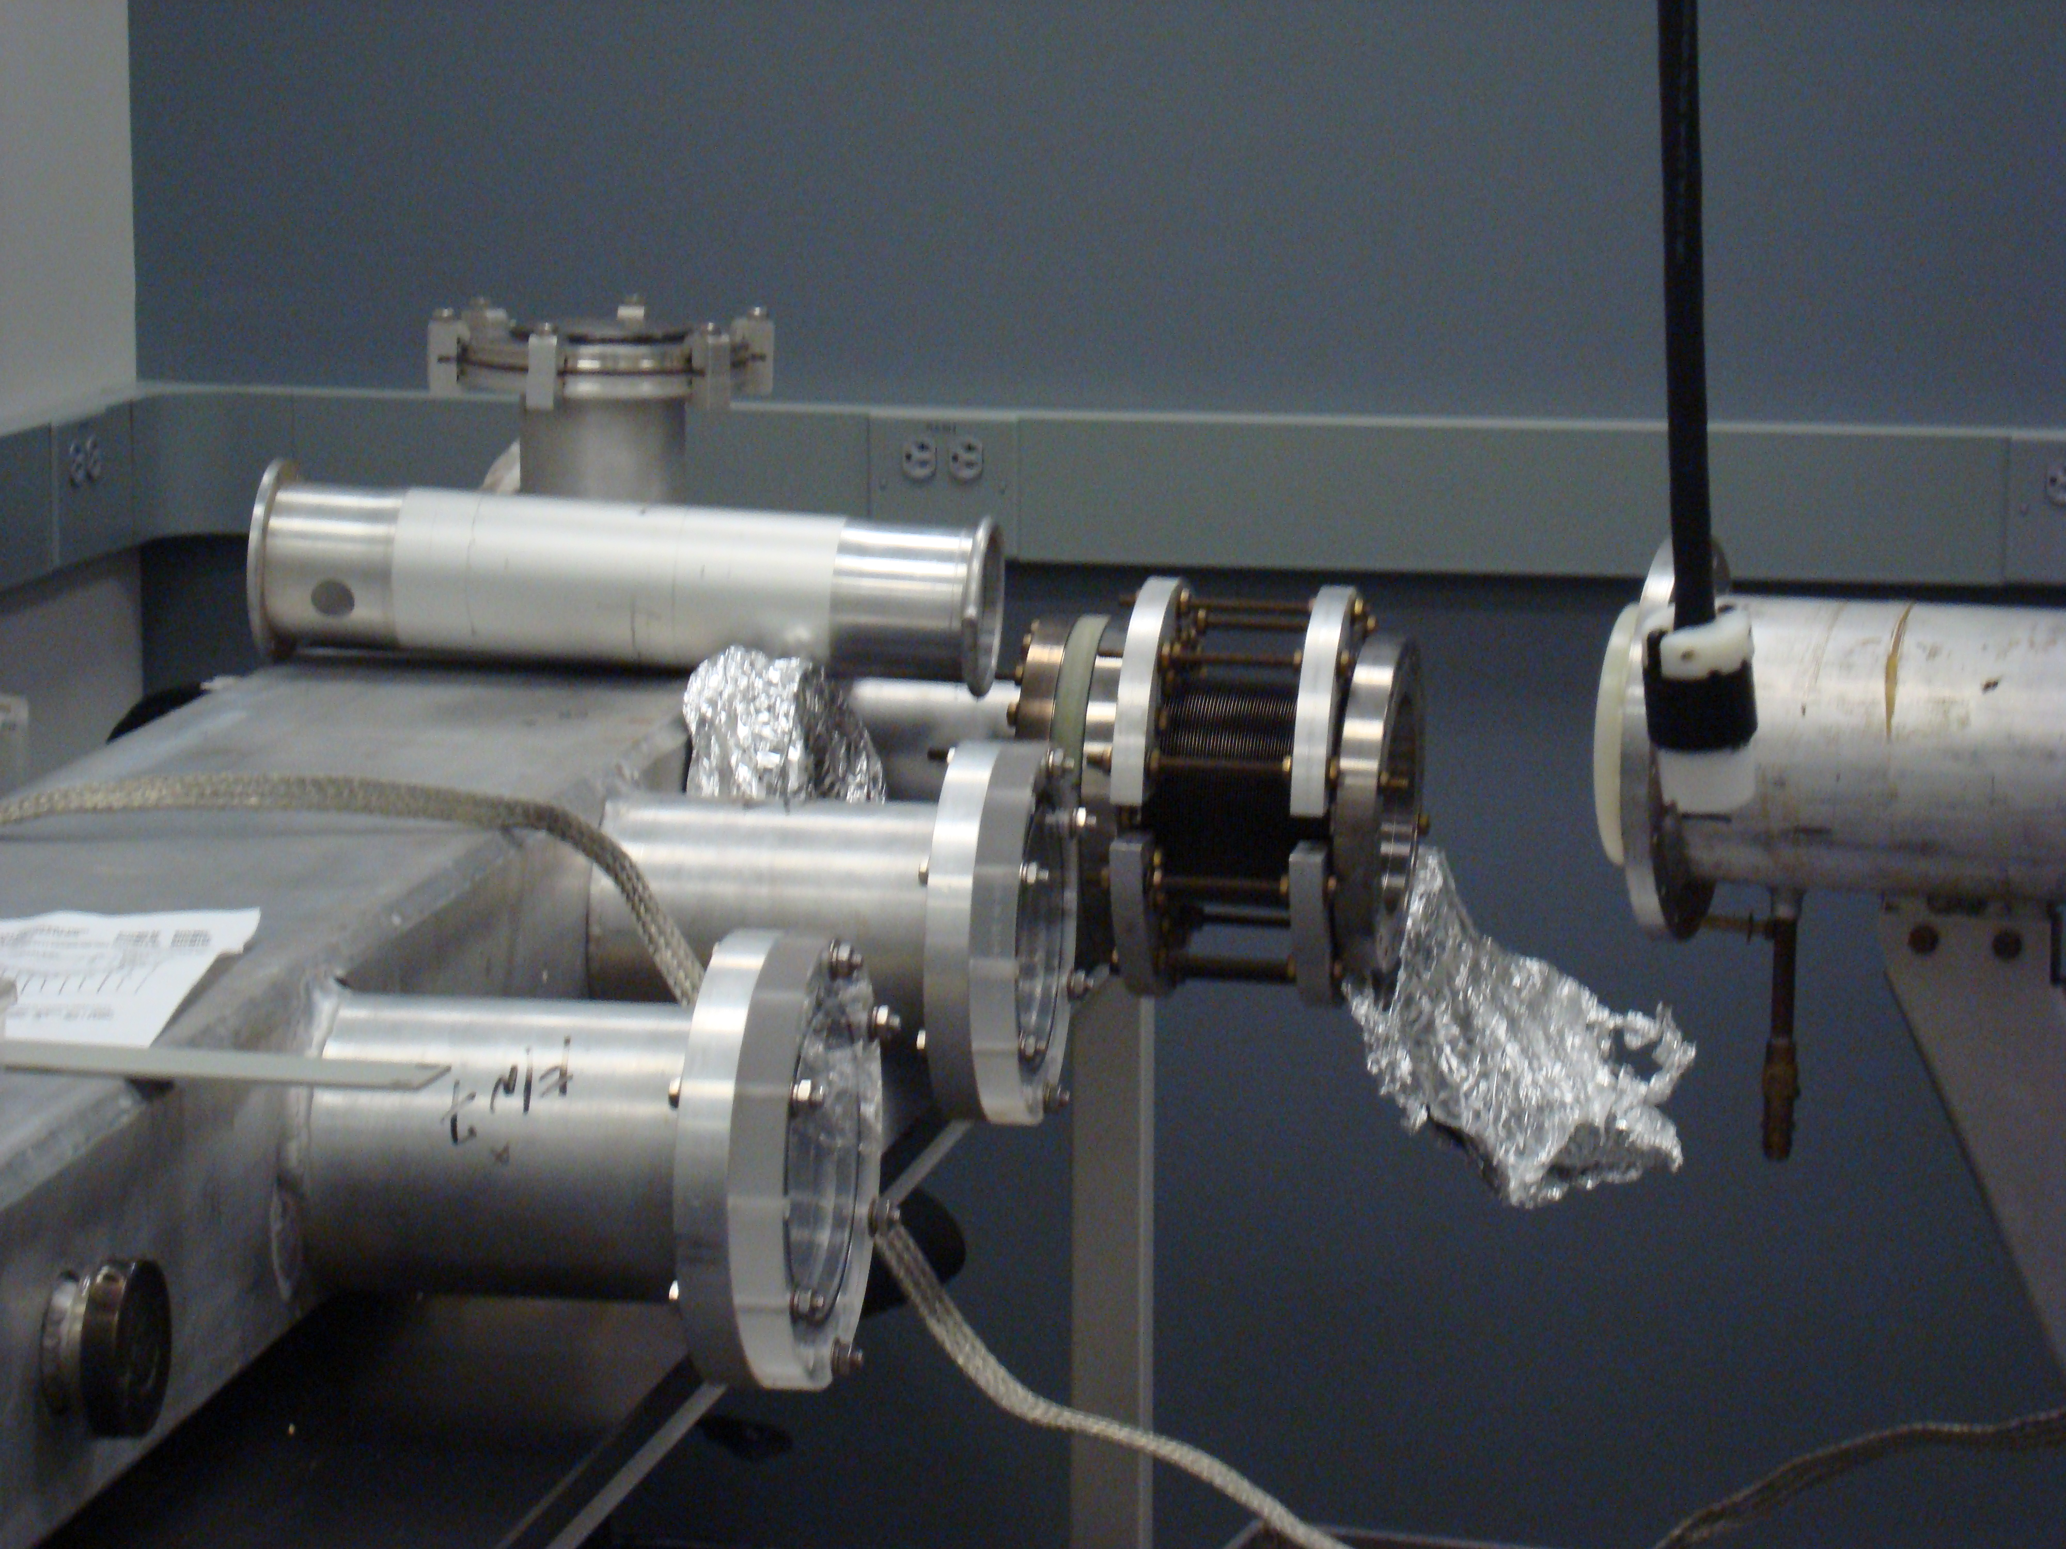
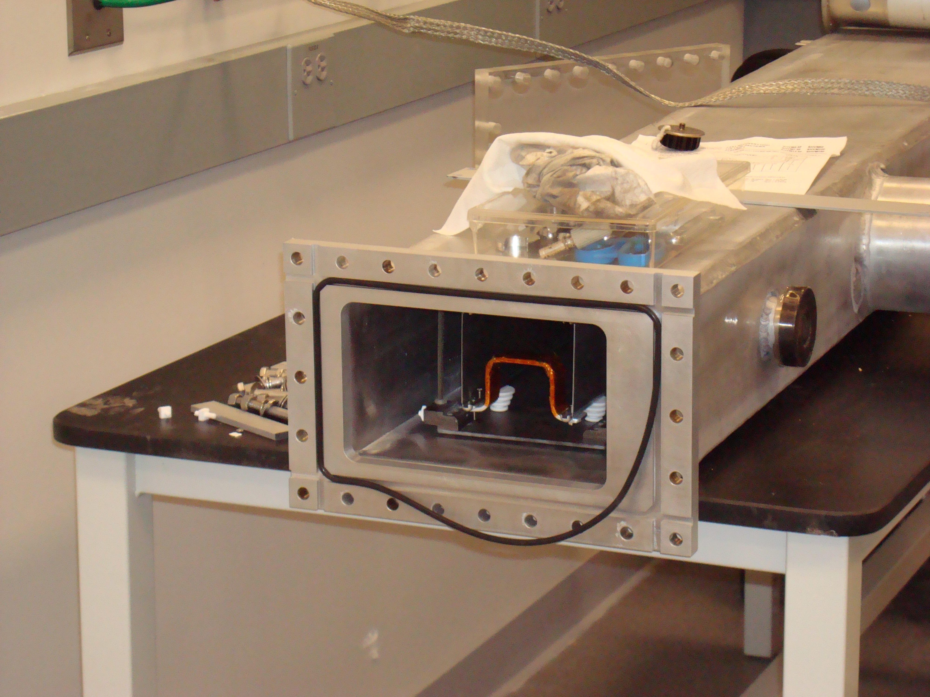
Kicker chamber
Power
Downstream end of kicker

Slide 11
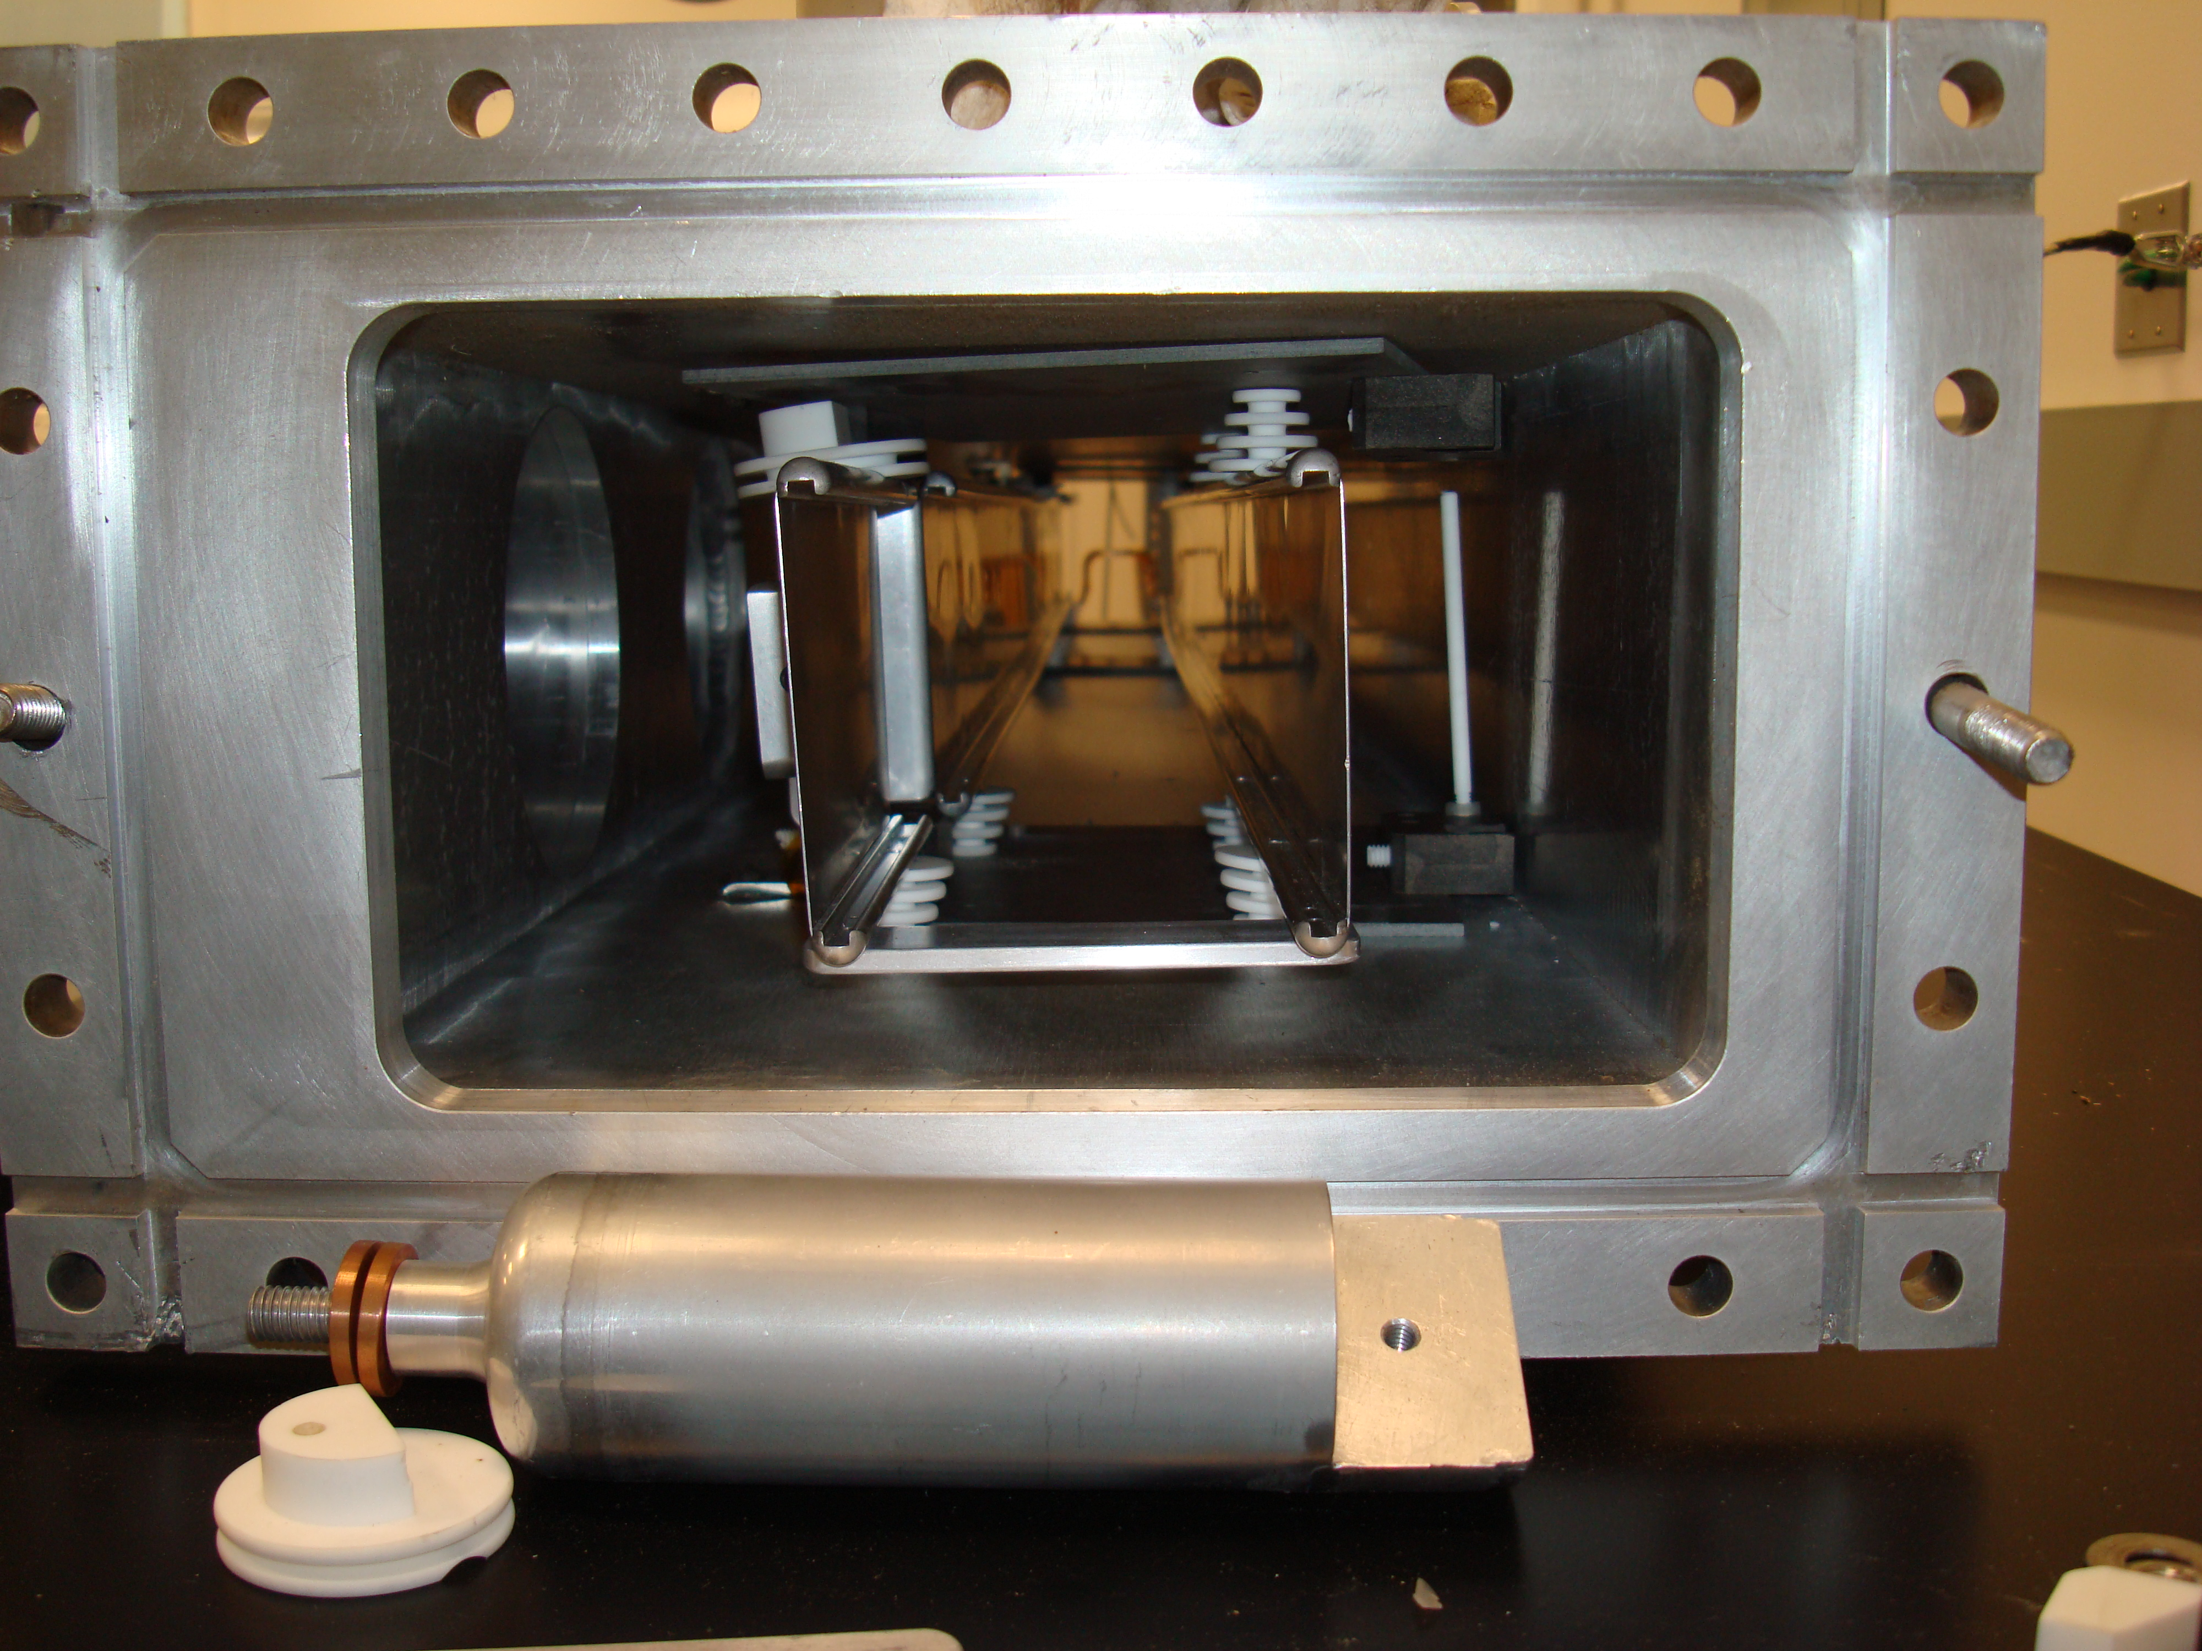
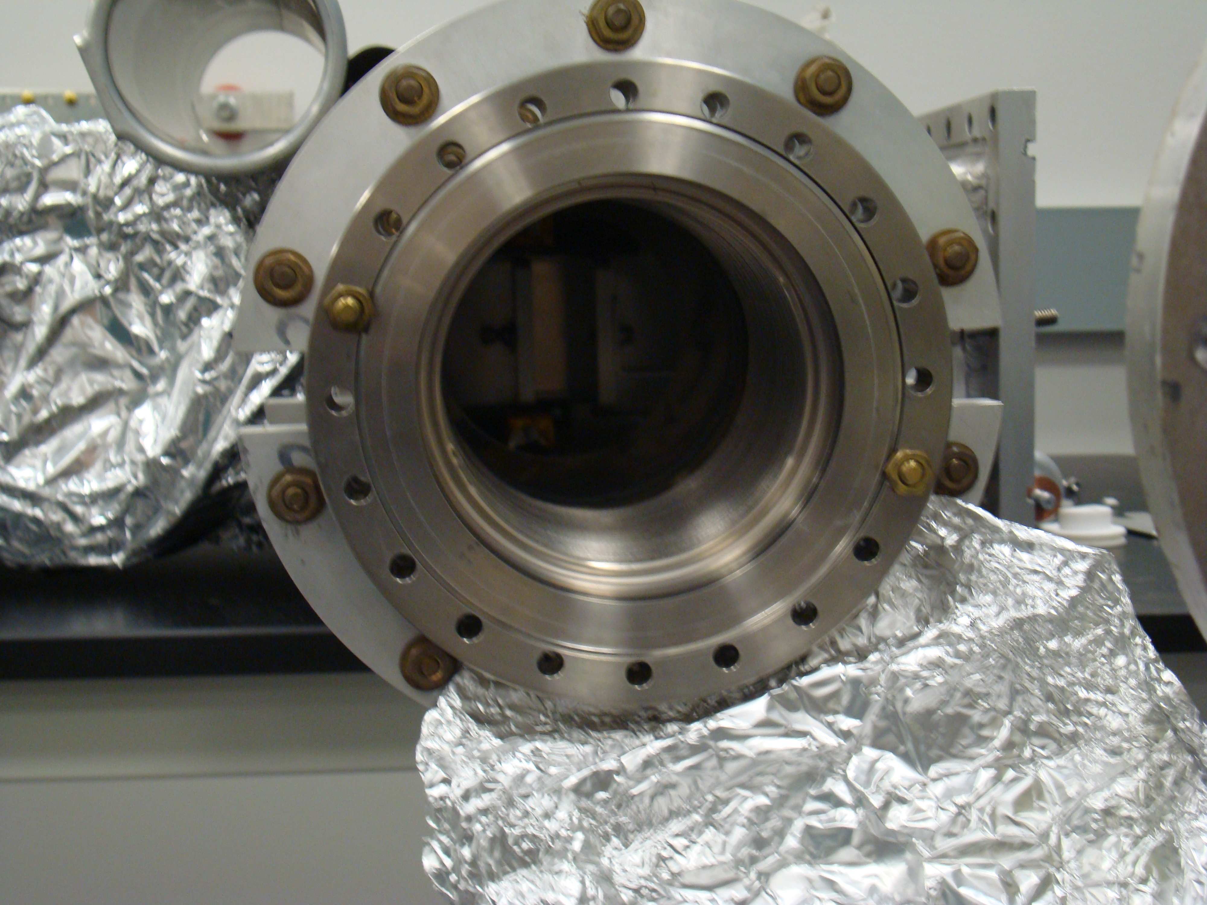
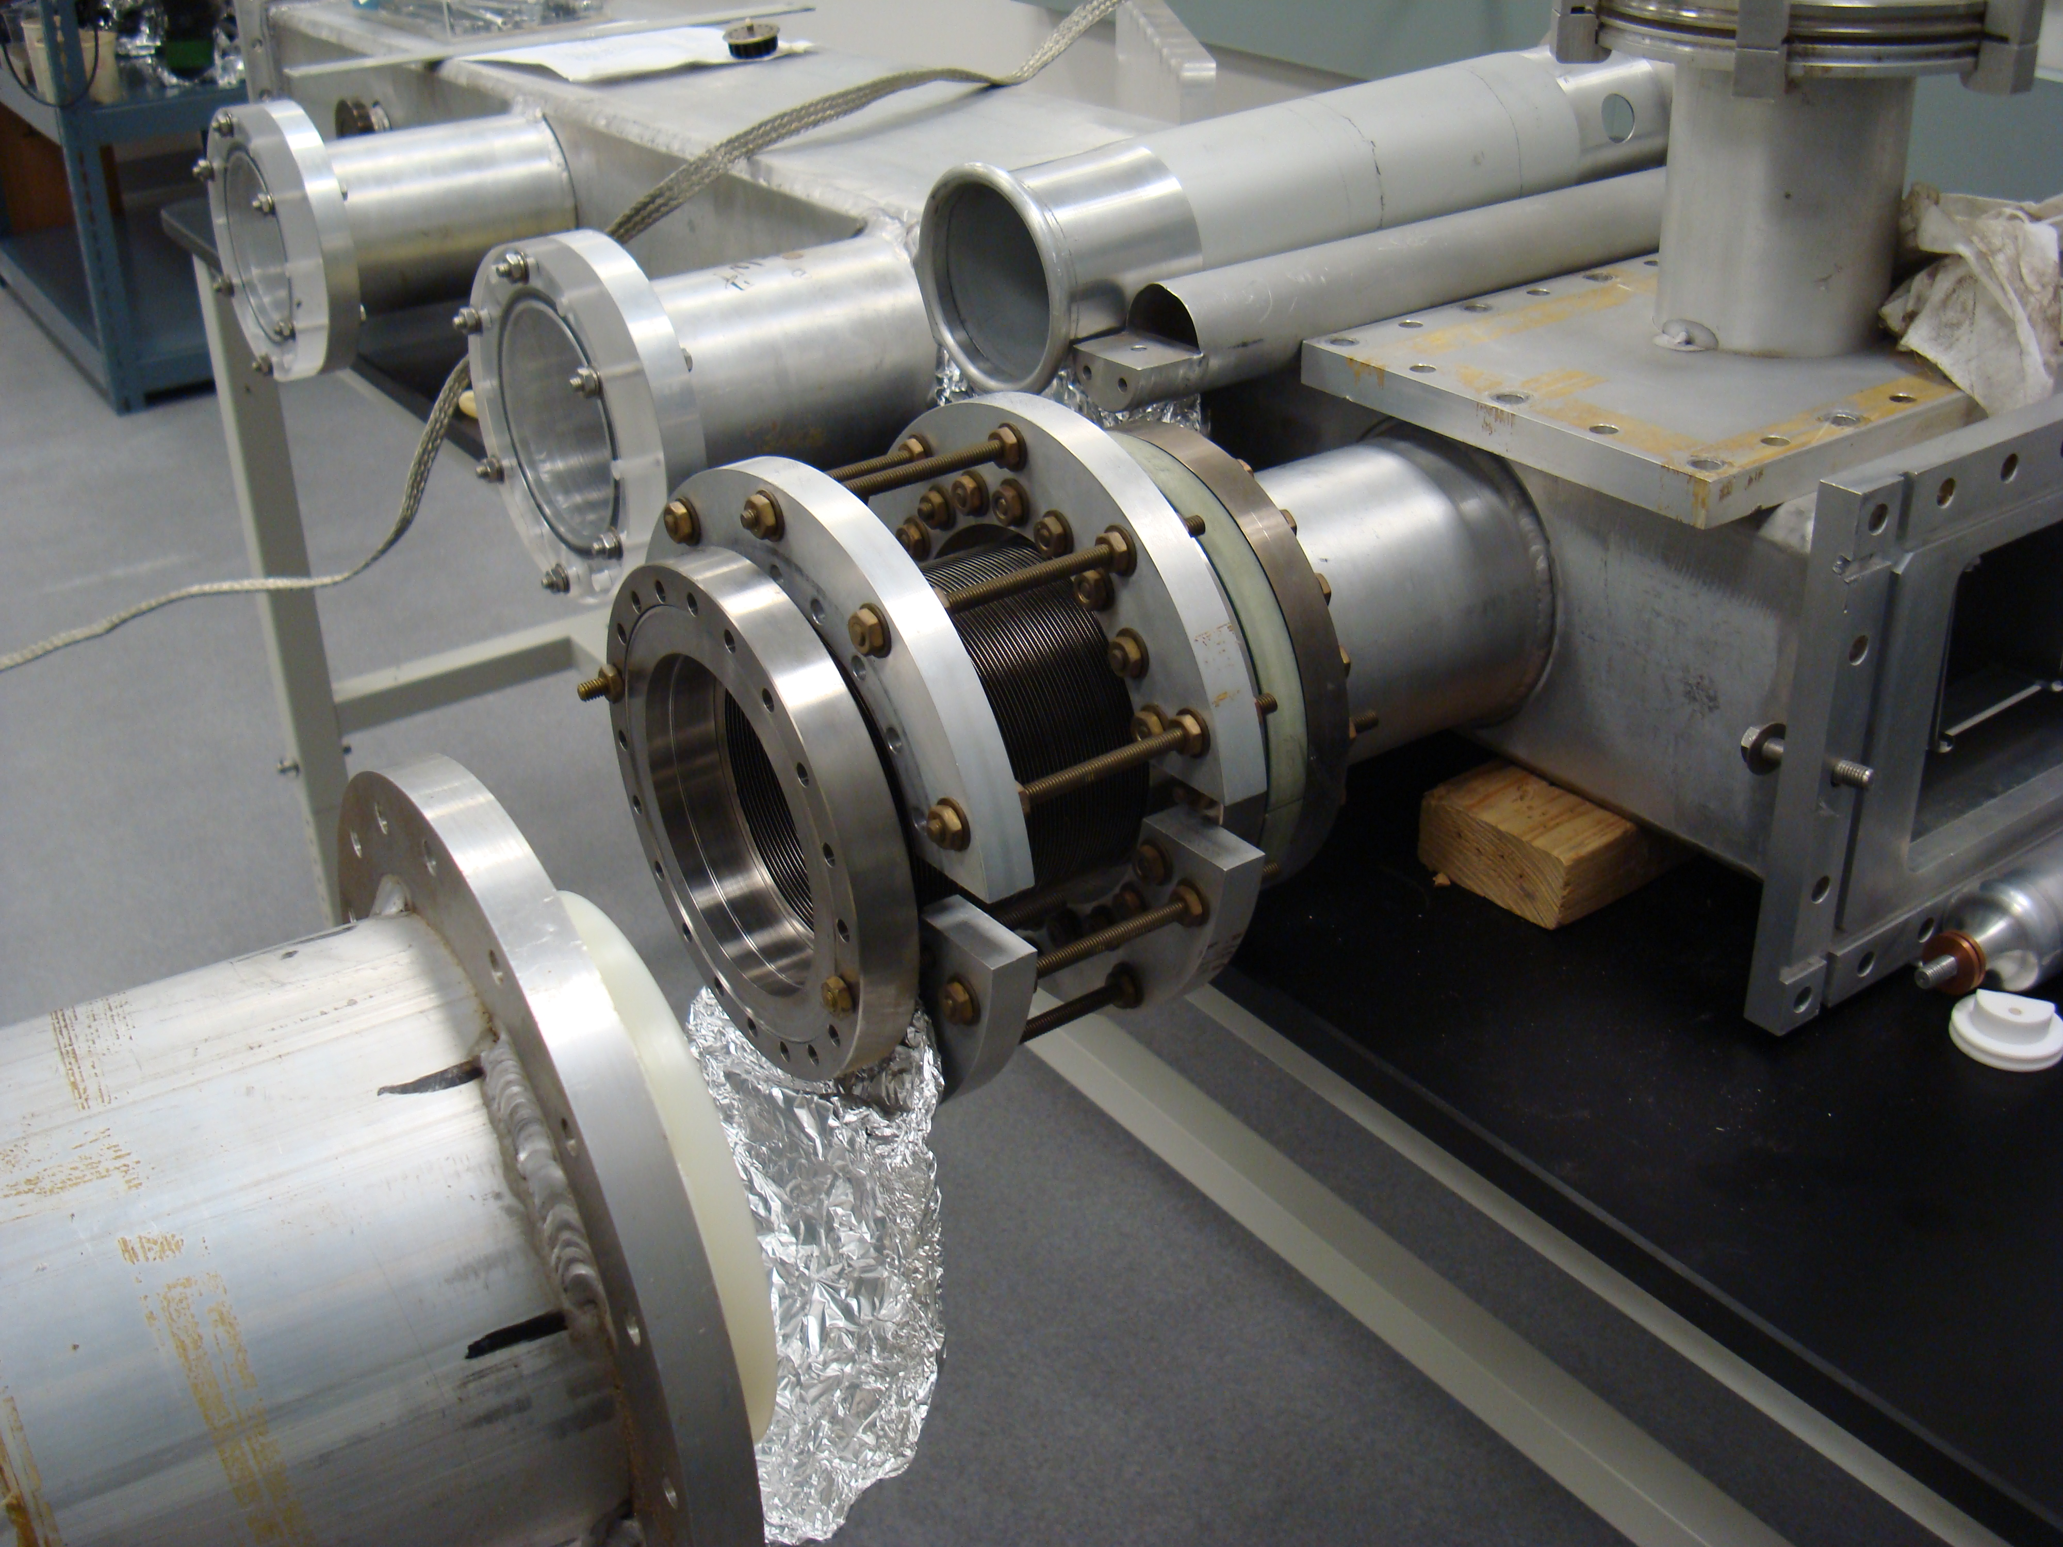
Kicker plates
Kicker chamber
Pulser feed
Pulser housing

Slide 12
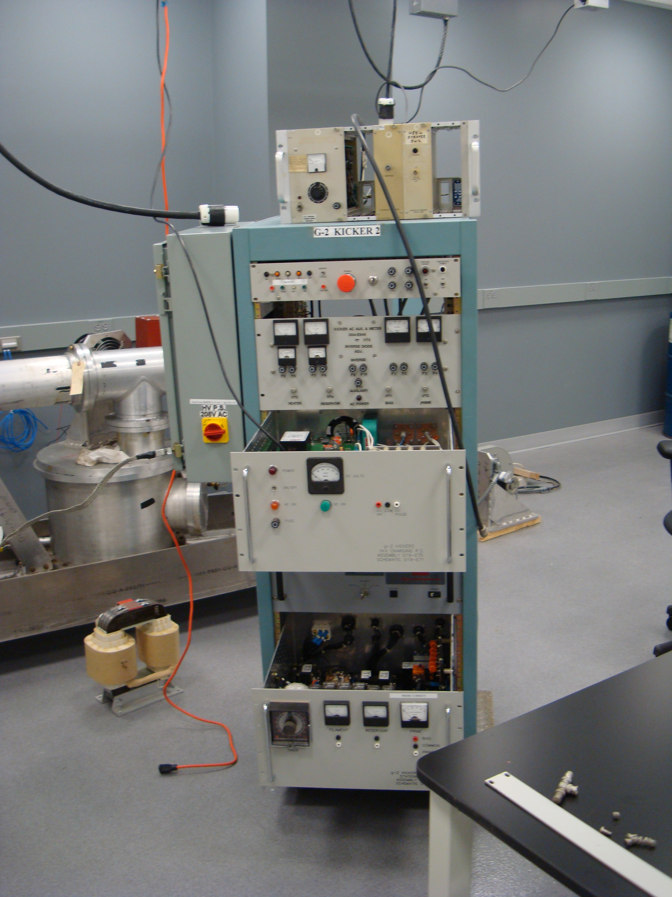
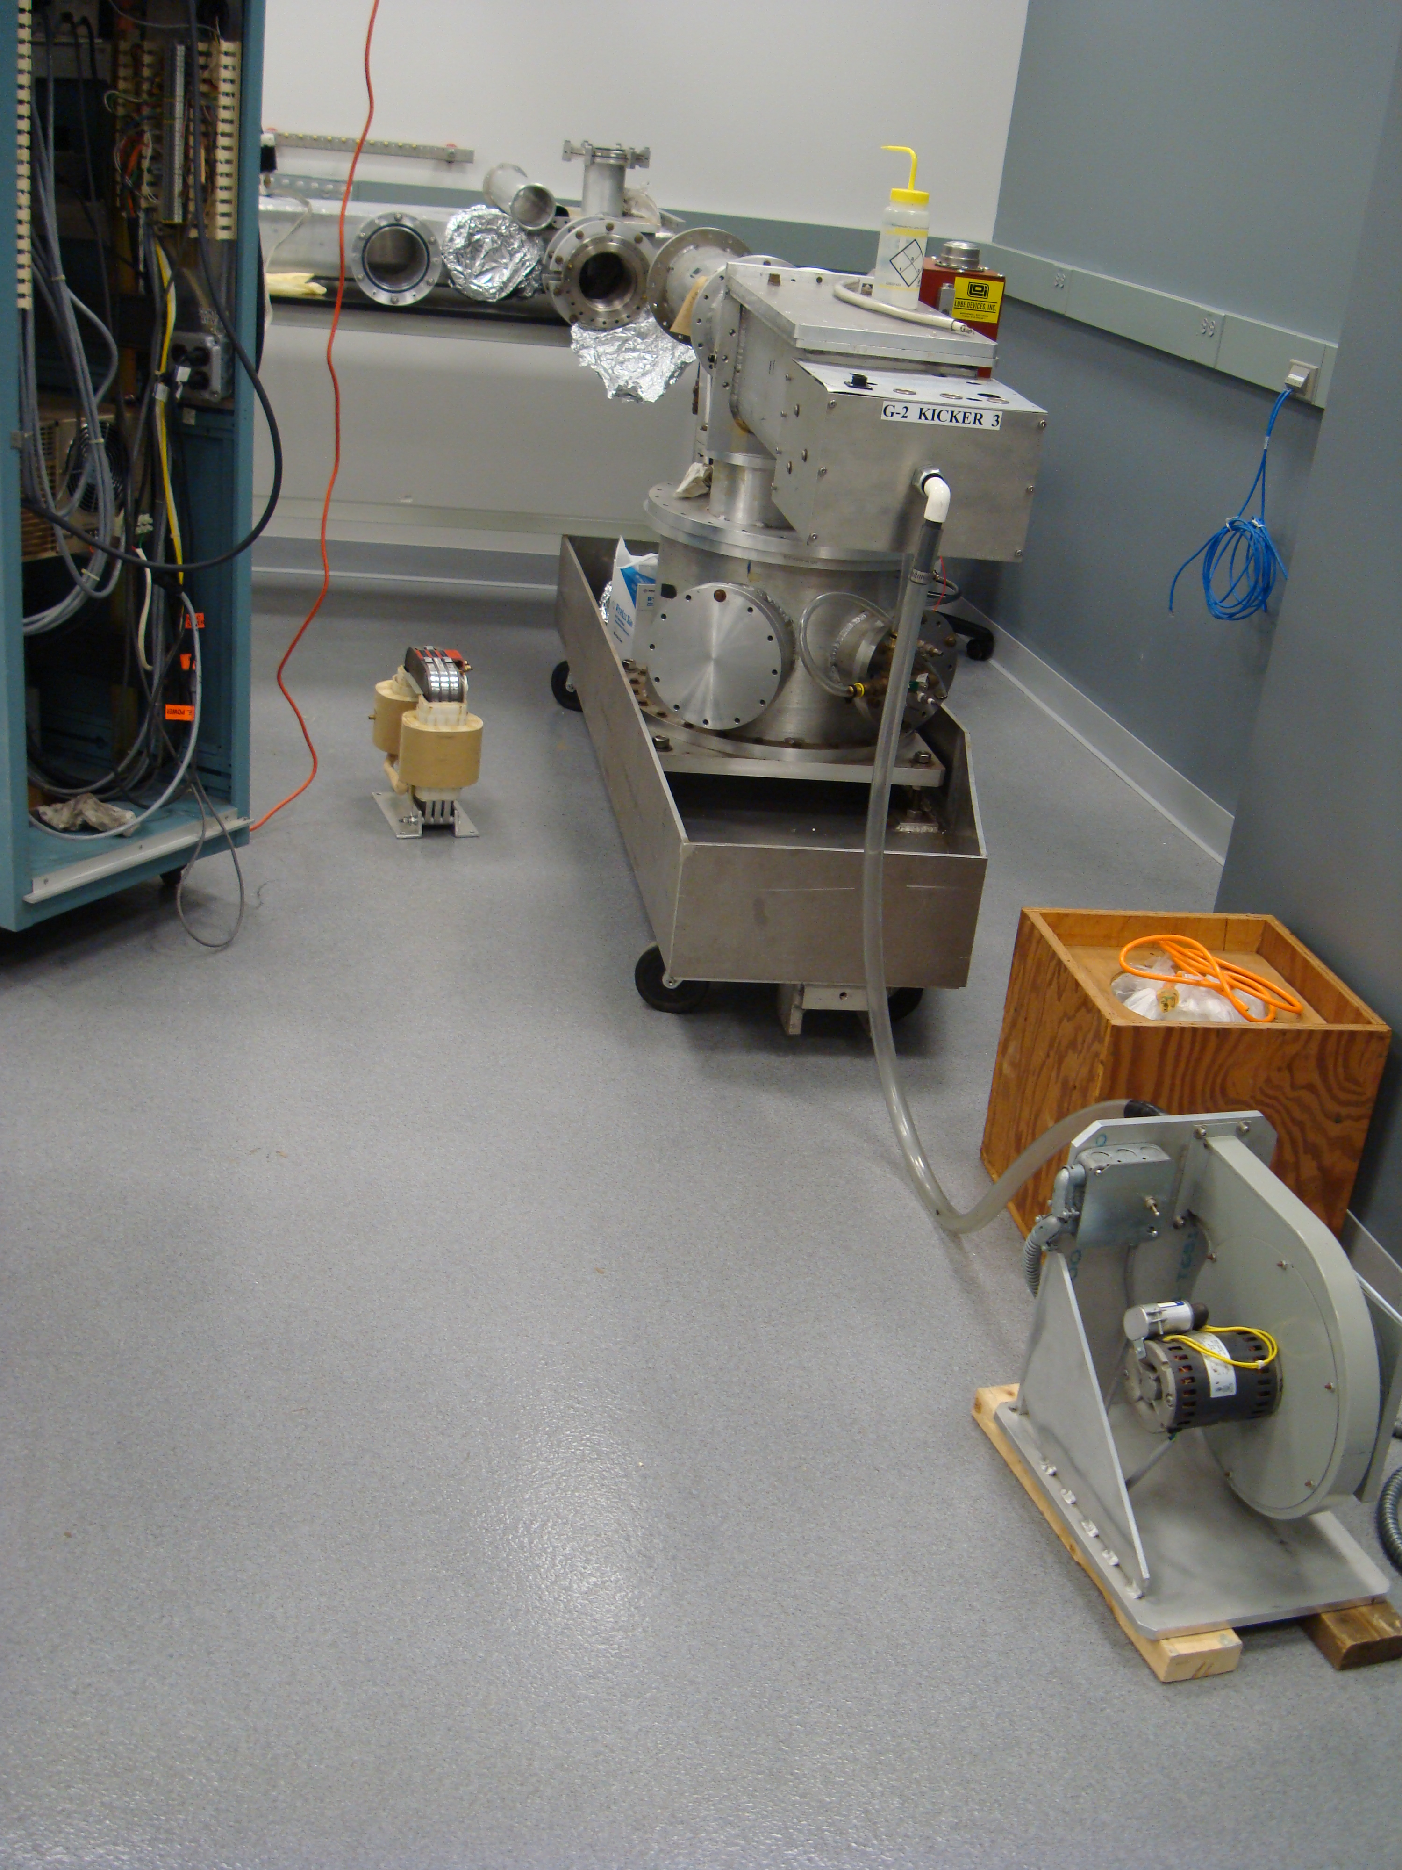
High voltage feedthrough

Slide 13
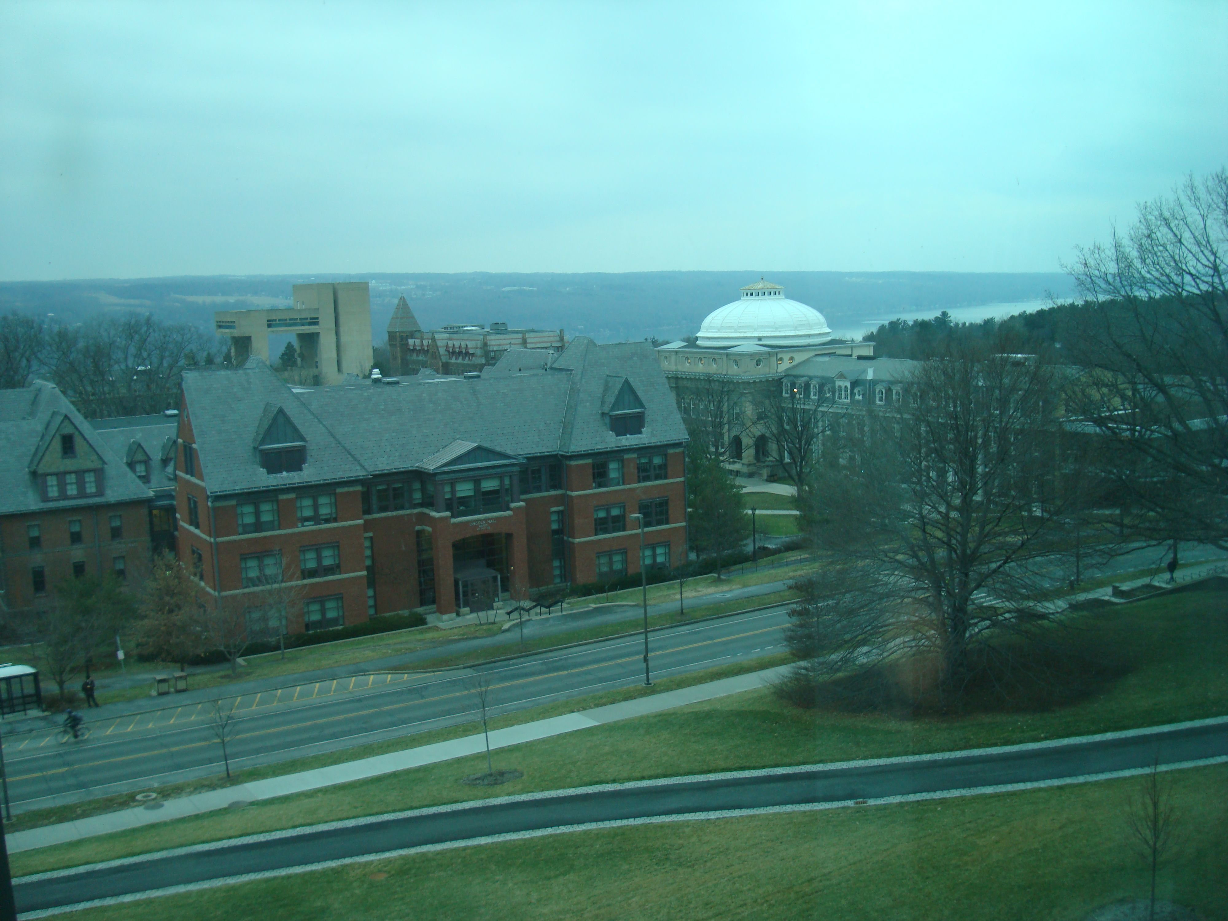

Slide 14
Plan for E-821 prototype kicker /pulser test
Reassemble
Test at low voltage (no oil) and measure field with single turn coil
Test at 100kV with high voltage components in oil

Slide 15
Injected Beam dynamics
Weak focusing – with vertical focusing from electrostatic quadrupoles
approximately uniformly distributed around ring
Field index n≈0.139

Slide 16
Kicker changes angle by θ = x_{inf}/β ≅ 10 mrad to put injected muons on central orbit
Now suppose the injected muon has fractional energy error ΔE/E = δ
The ideal kick for off energy muons is θ = (x_{inf} – x)/β

Slide 17
Vacuum chamber aperture ± 45mm
Energy dependence
x_{inj}
If the kicker field depends on displacement from central orbit according to
kick [mrad] ≈ 10(1-x/x_{inj}) then all energies kicked onto corresponding closed orbit

Slide 18
Dependence on angular distribution of injected muons
Then at Φ = π/2
There is no kick that puts the muon onto the central orbit
The best we can do is to minimize the invariant amplitude

Slide 19
Invariant amplitude
The best we can do with the kicker is to set angle to zero.
Then
If the kick is not uniform but has radial dependence to match energy offset then
We find that the kick that minimizes the betatron amplitude of off energy muons
will increase the amplitude for on energy particles with finite injection angle
Optimal kicker field profile depends on energy and angular distribution of muons exiting the inflector

Slide 20
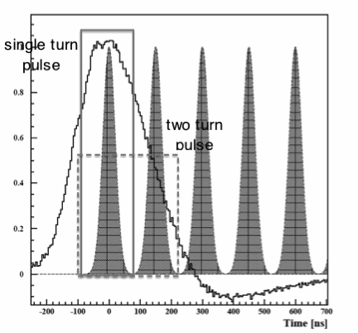
Time Dependence
RLC pulser
Kicker Pulse width
Matched line (Z₀= Z_{L})
τ = 2L/c √(μ_{r} ε_{r})

Slide 21
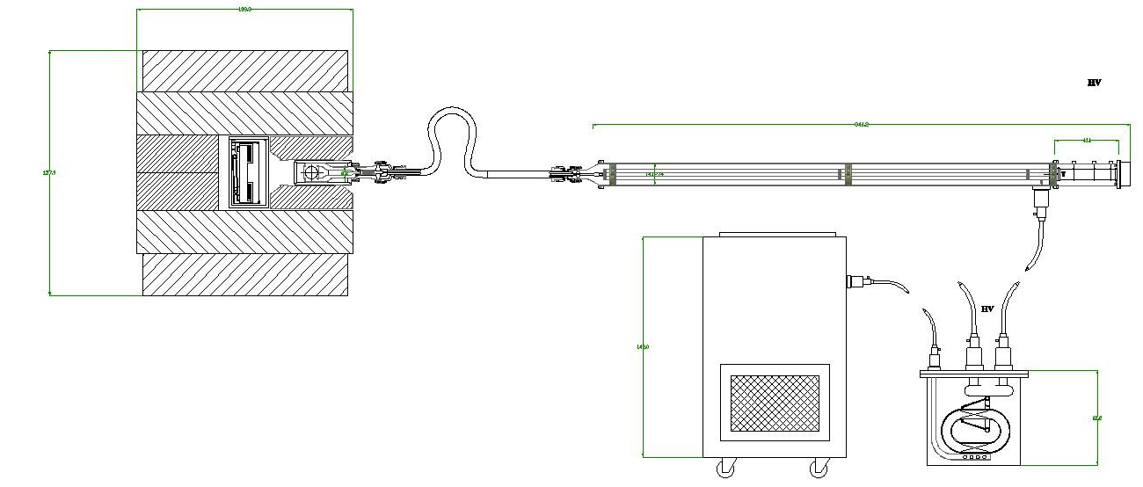

Slide 22
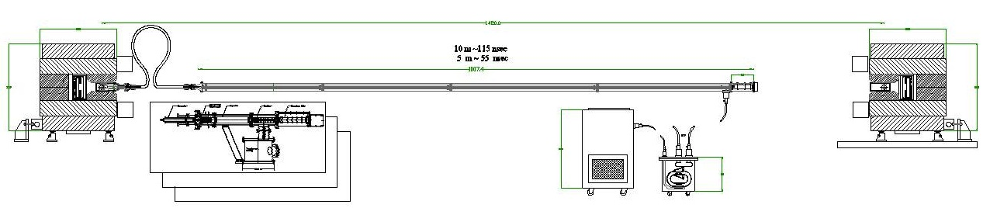
L=10m => τ = 115 ms
Rigid coaxial delay line

Slide 23
L=10m => τ = 115 ms
Rigid coaxial delay line
Flexible coax delay line in transformer oil tank

Slide 24
Matched line PFN issues
Current I = V/Z and the impedance of the kicker magnet is relatively high (Z>100Ω),
implying a high charging voltage. (Require I ≈ 4kA)
If muon bunch is long, then so is the coax
Mismatch of impedance of line and load gives reflections. Quantify ?
Voltage on kicker is half the charging voltage implying an even higher charging voltage (Blumlein ?)
We will test sensitivity to impedance match at low voltage
With flexible coax delay line
Rigid line

Slide 25
Conclusion
- Reconstruction and test of E-821 prototype kicker and pulser is underway
- Low voltage tests of delay line pulse forming network
- Explore alternative kicker plate geometry for
- lower impedance
- optimal field profile
- Investigate in simulation sensitivity to muon energy and angular distribution and
bunch length
Bunch length – shorter is easier to deal with
We can achieve good acceptance for energy spread or angular spread but not both

Slide 28
