Slide 1
Kicker pictures

Slide 2
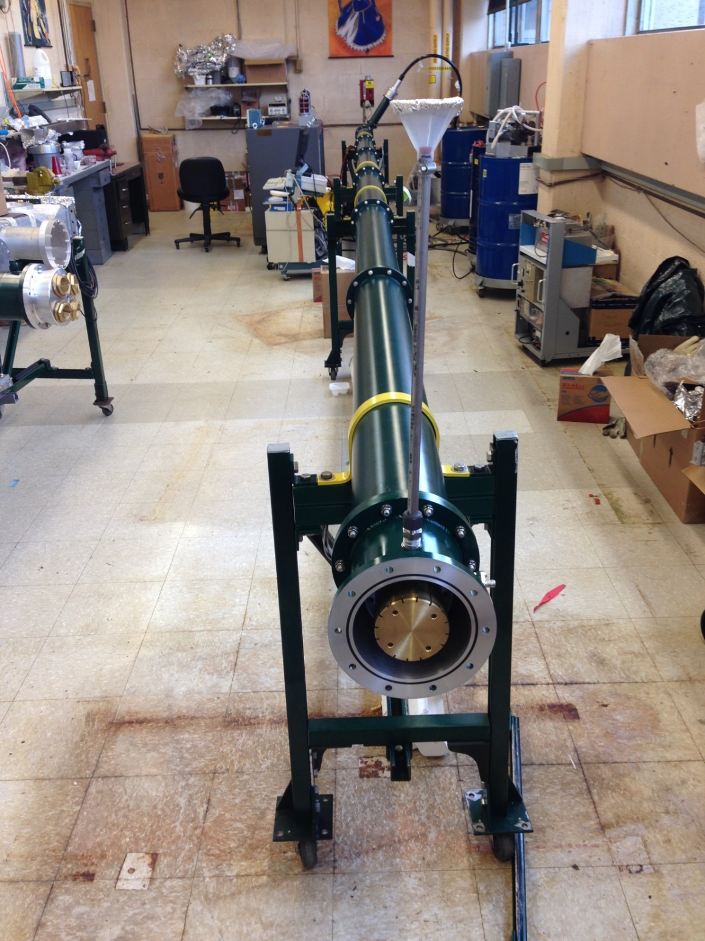
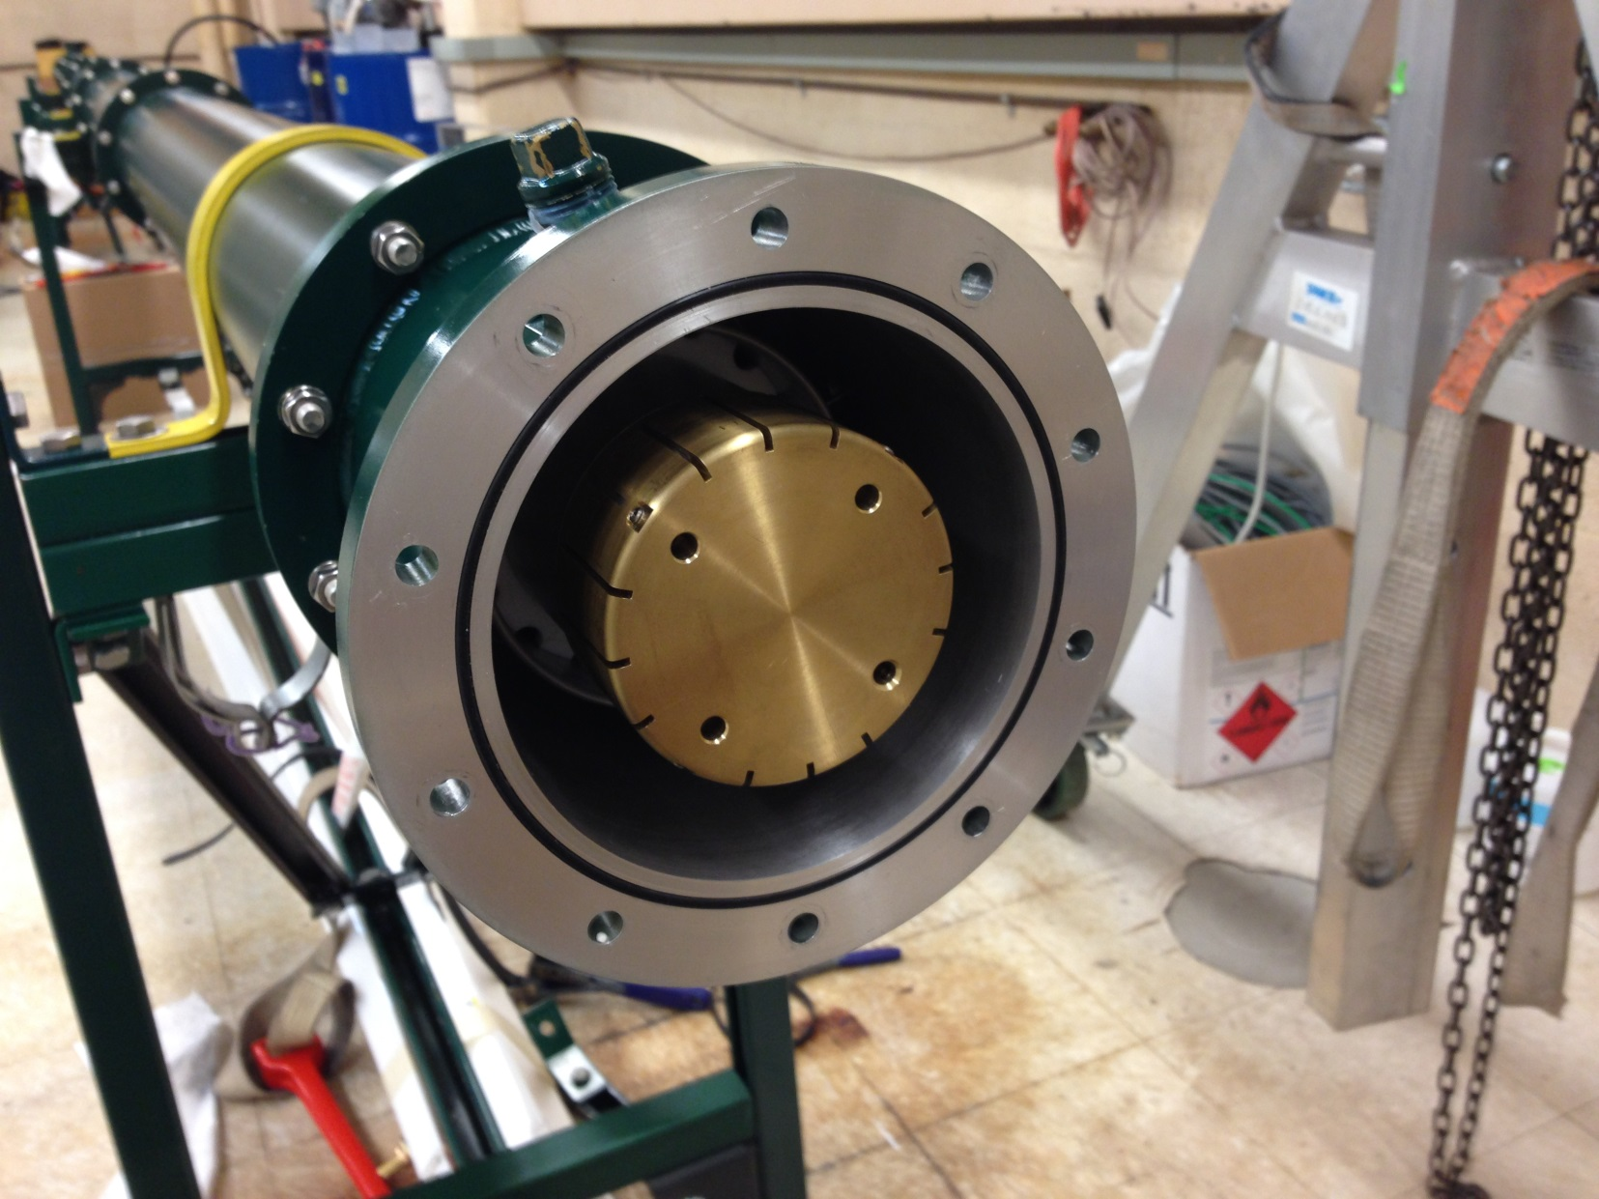
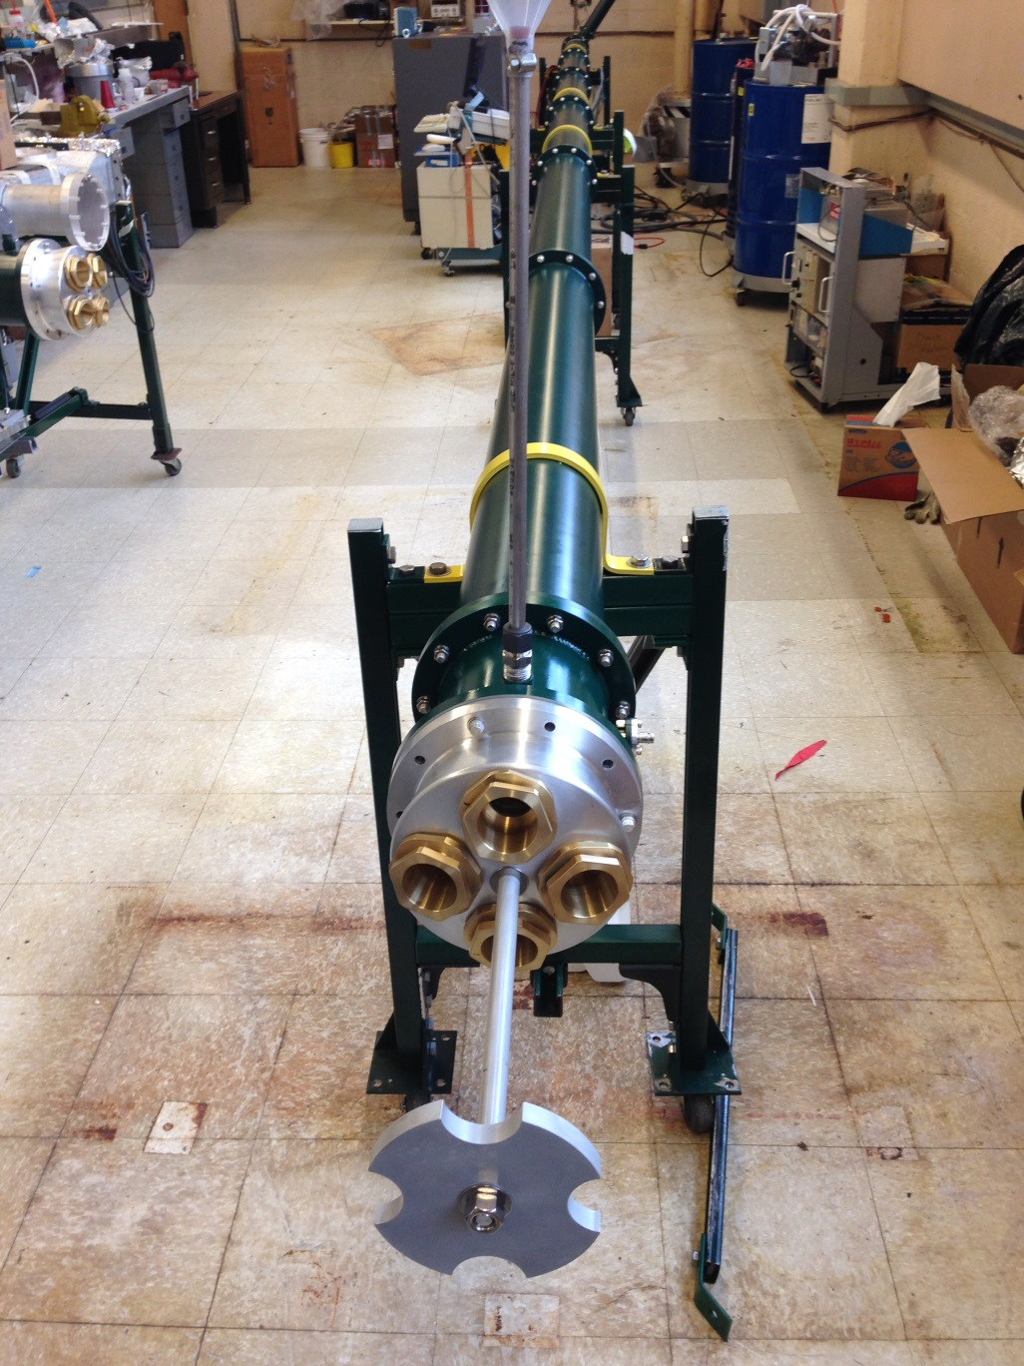
Blumlein - business end
thyratron
Coupling to 4 50Ω coax
Central conductor

Slide 3
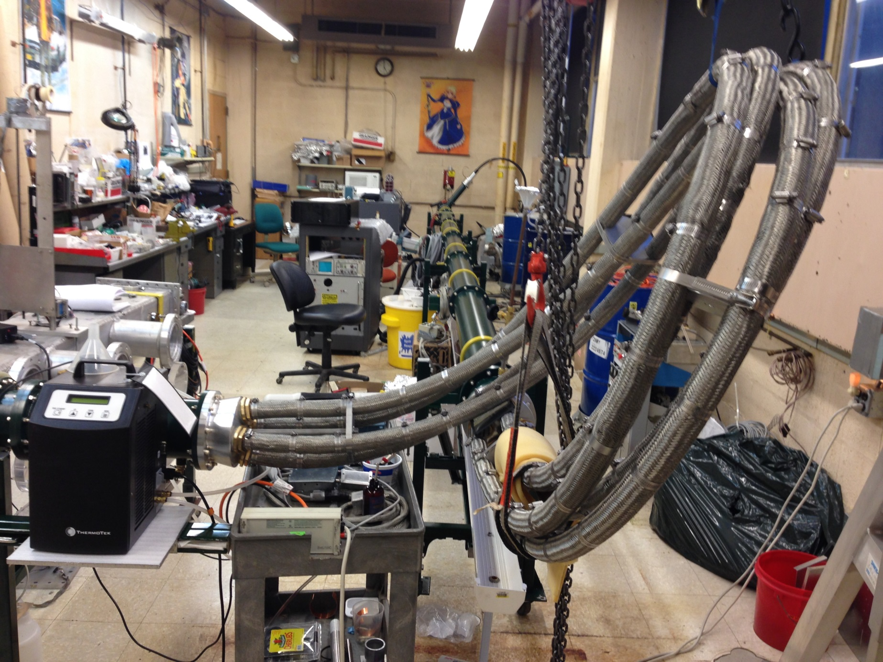

Slide 4
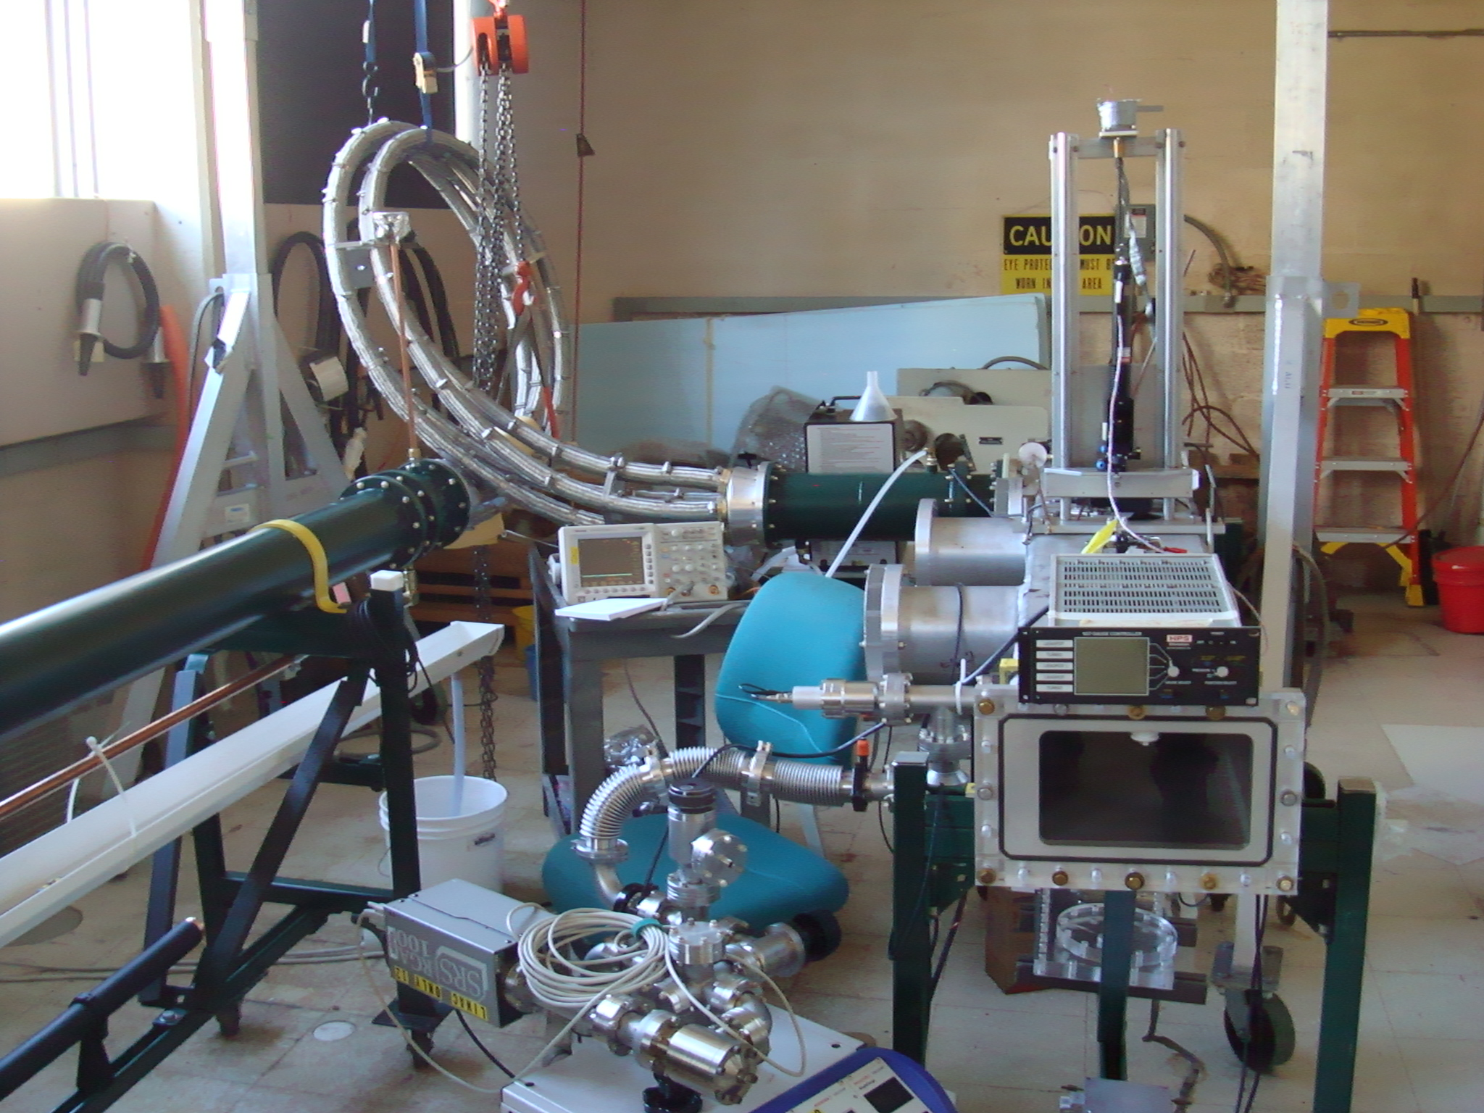
4 parallel 50Ω cables
Load resistors in flourinert
Magnetometer laser
Kicker chamber
Vacuum pump

Slide 6
12.5 Ω Blumlein triaxial transmission line

Slide 7
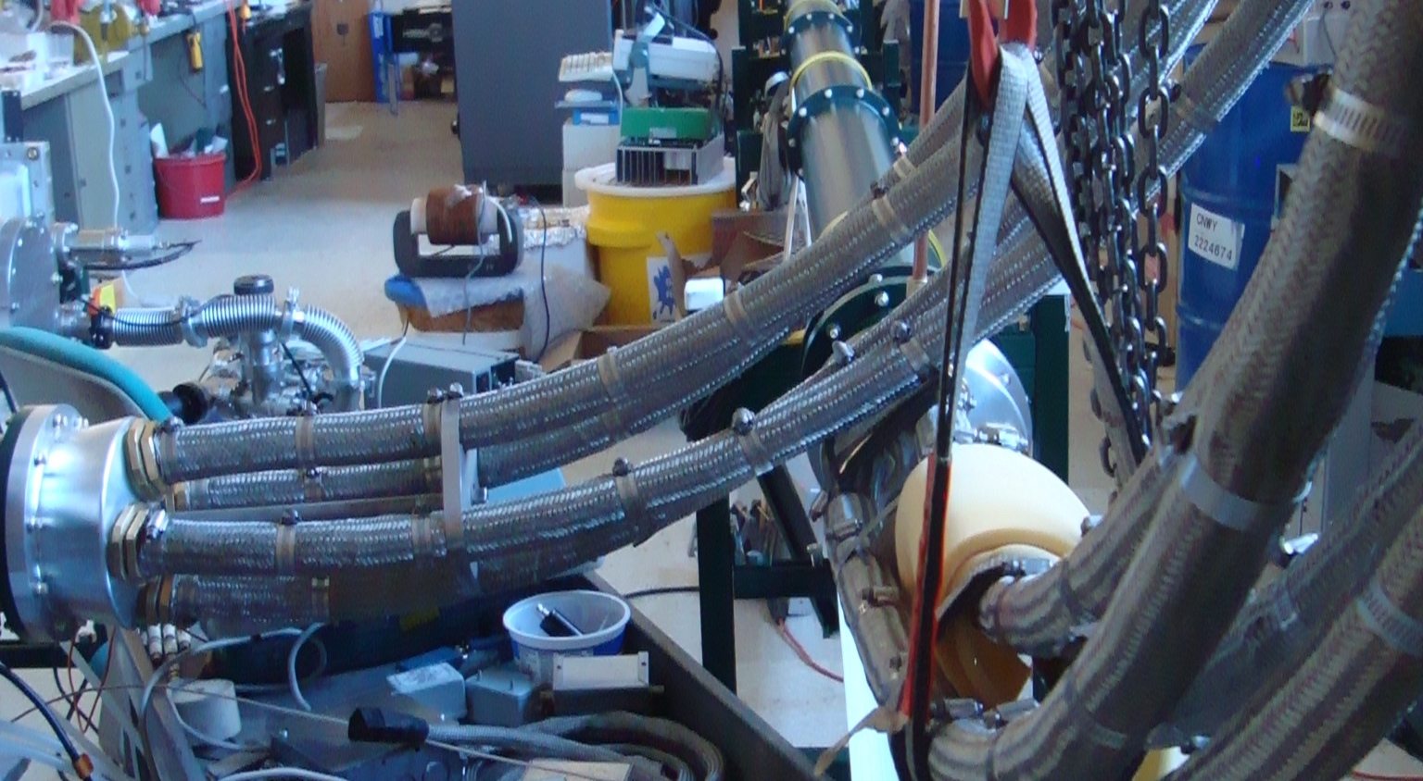
4 –parallel coax to load

Slide 8
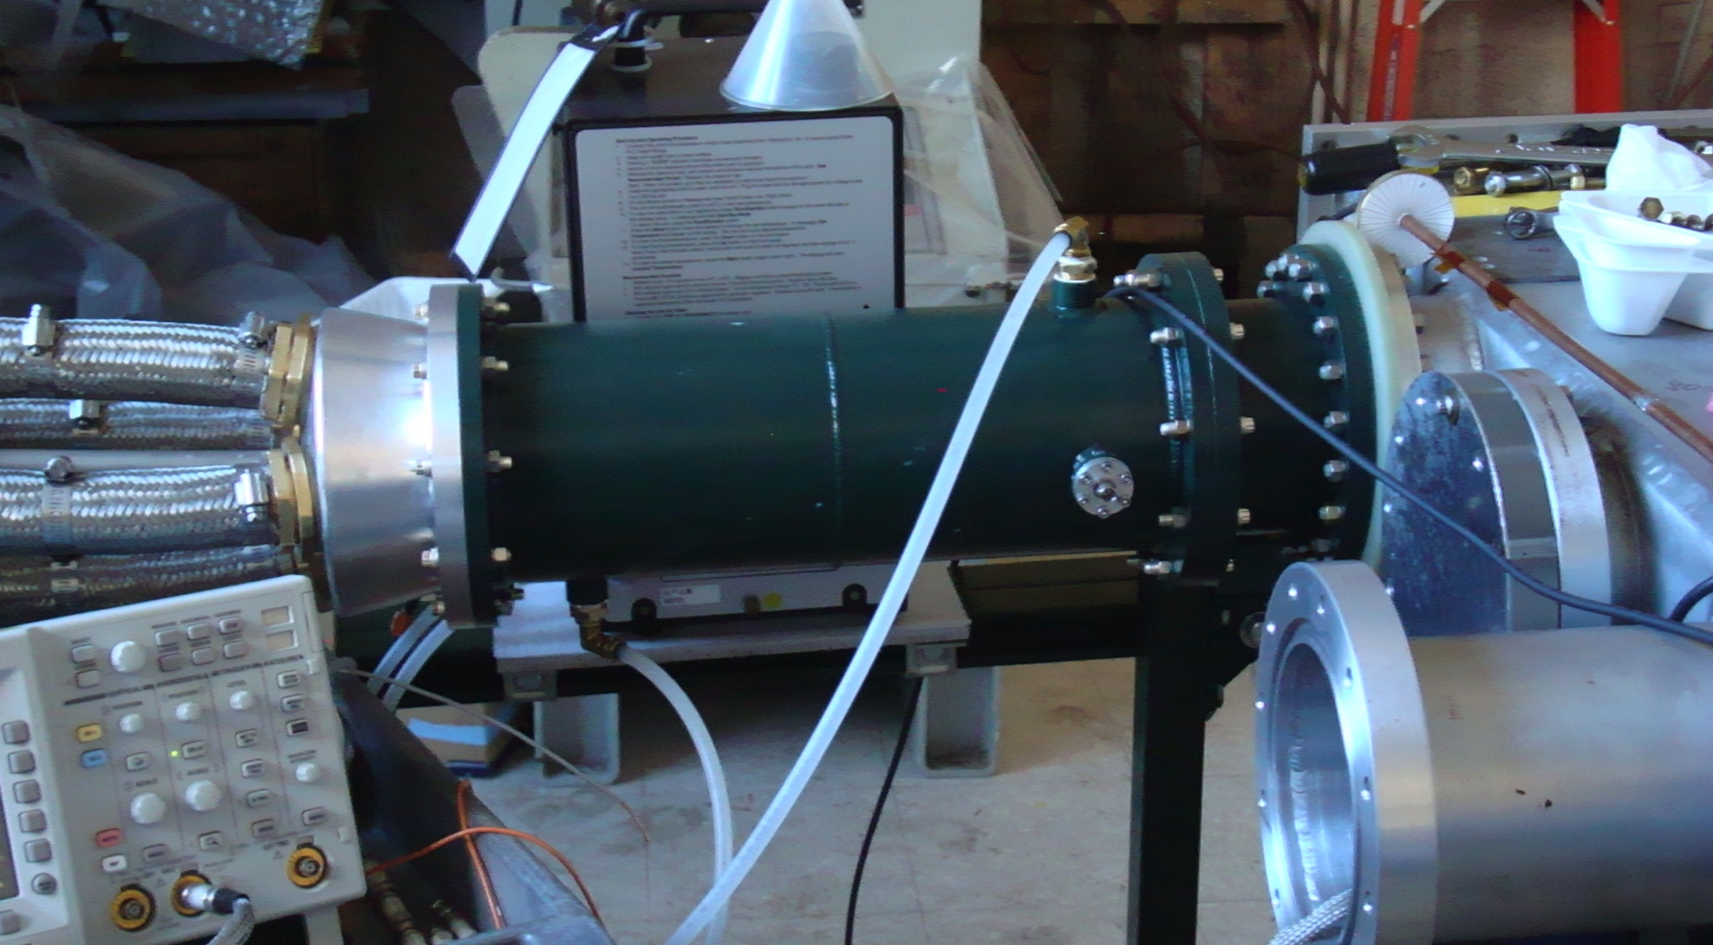
Coupling to magnet
flourinert
4 50Ω coaxial cables
4 load resistors
Vacuum chamber

Slide 9
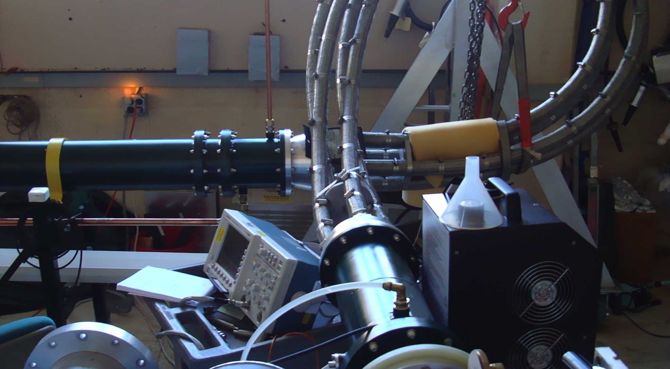
Coupling from Blumlein to Load

Slide 10
4 parallel 50Ω cables
Load resistors in flourinert
Magnetometer laser
Kicker chamber
Vacuum pump

Slide 11
Macor support
Current monitor adjacent to electrodes

Slide 12
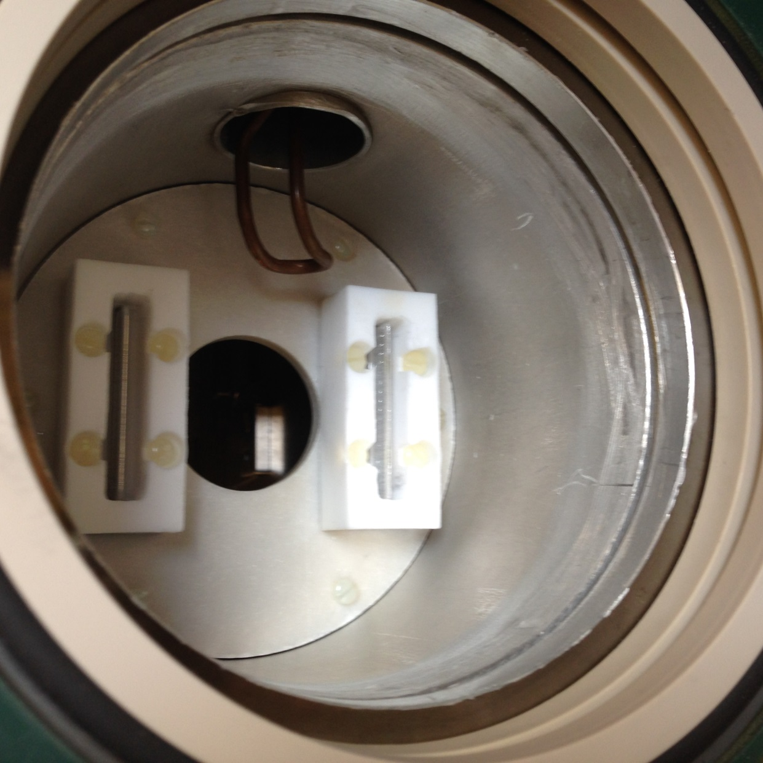
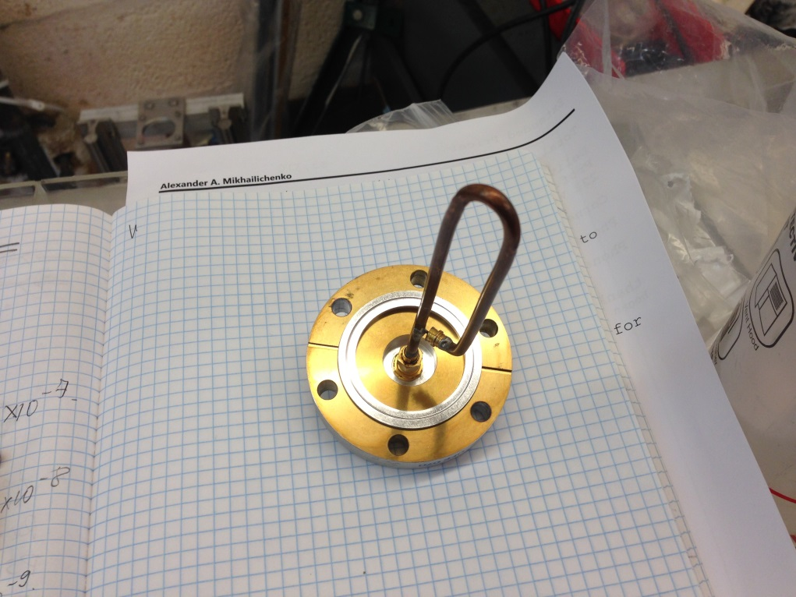
Kicker electrode coupling
Control loop

Slide 13
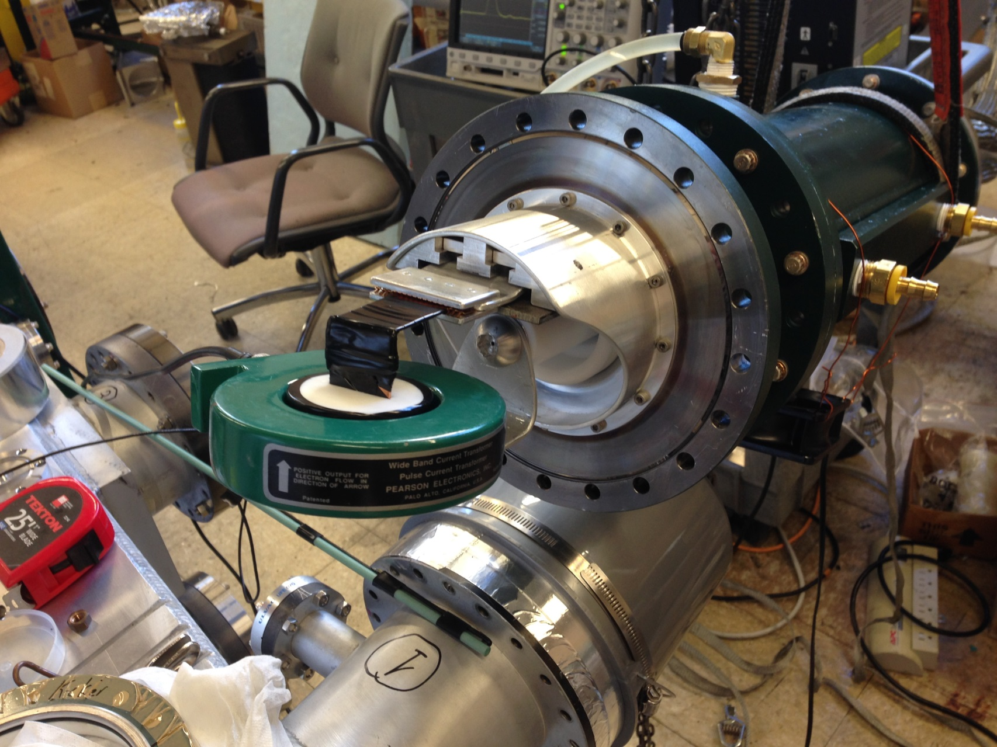
Current monitor installed at the end of Blumlein, cables and resistors

Slide 14
electrodes
Kicker plates in chamber

Slide 15
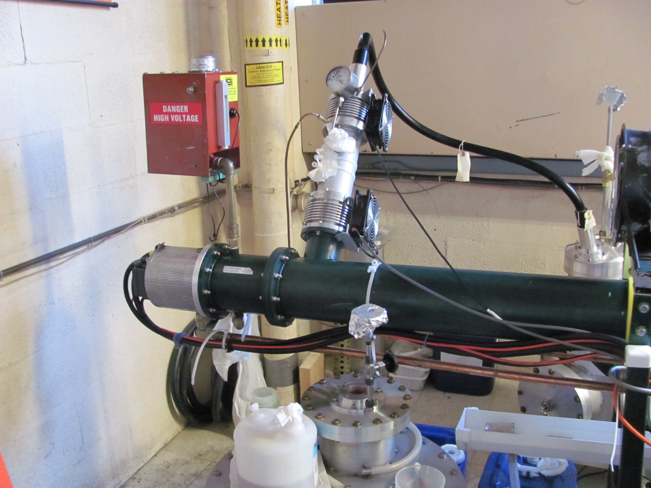
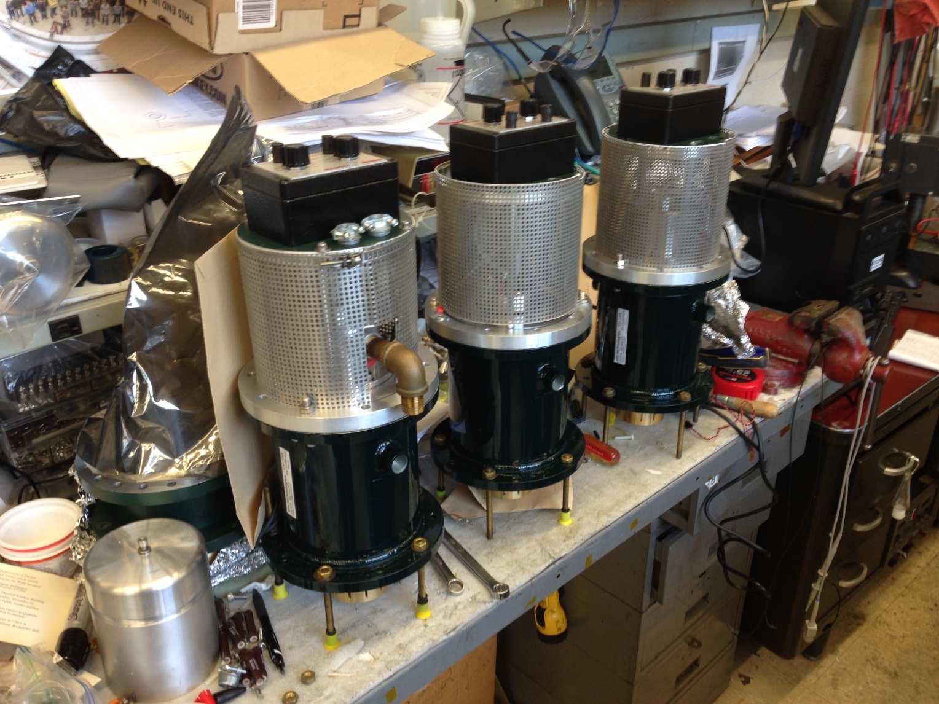
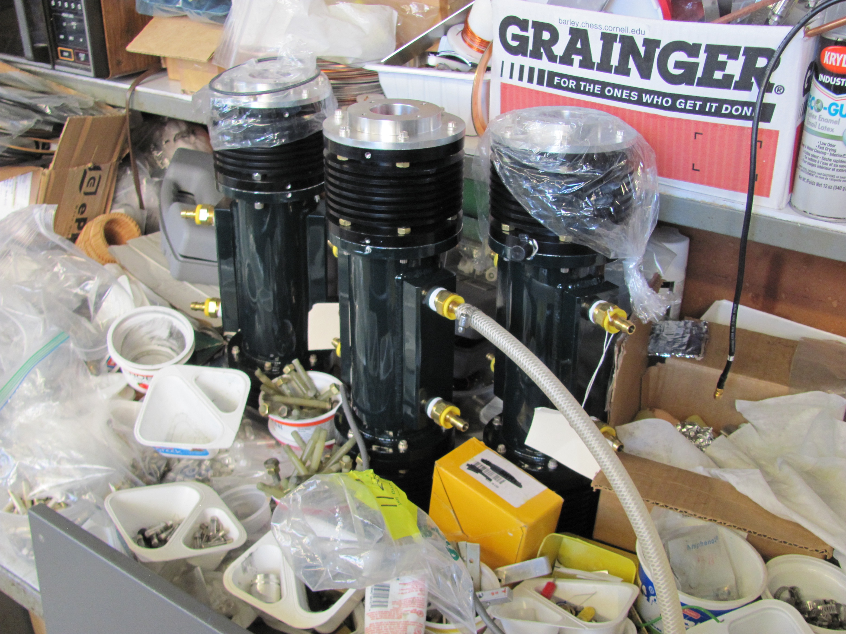
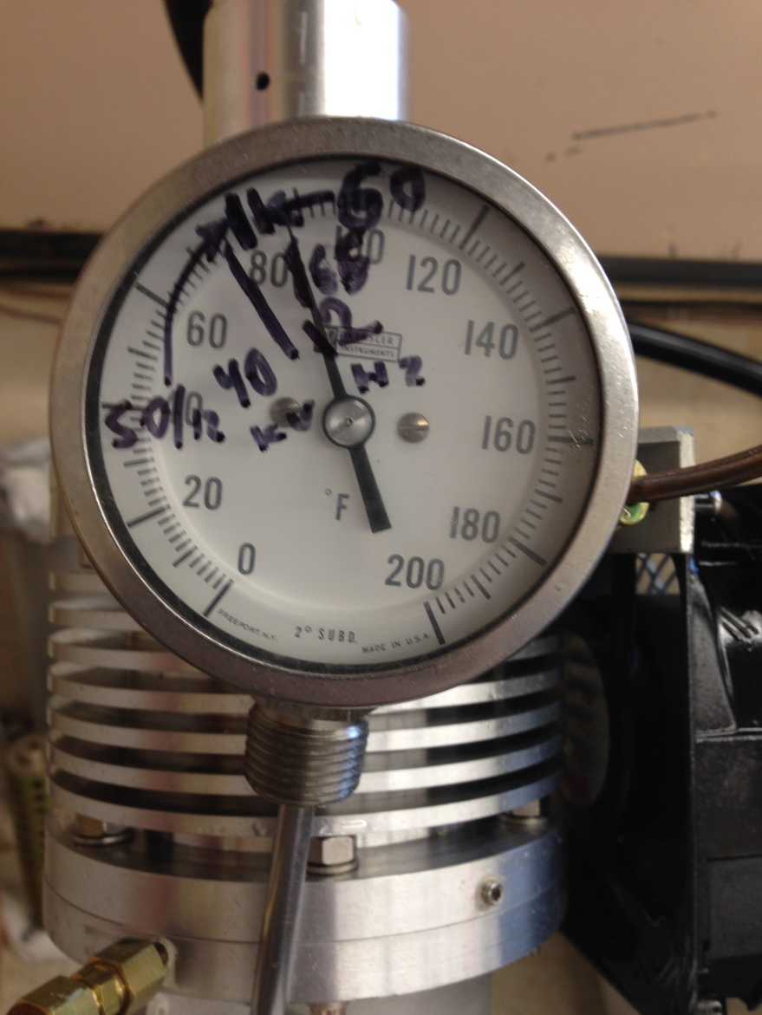
Thyratron and charging resistor assemblies; will be sent with electronics towers.

Slide 16
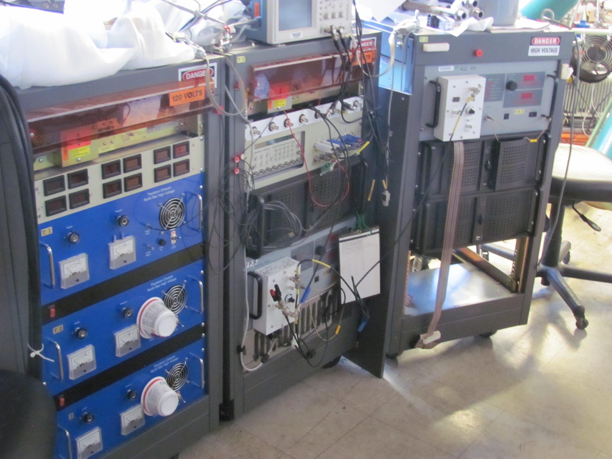
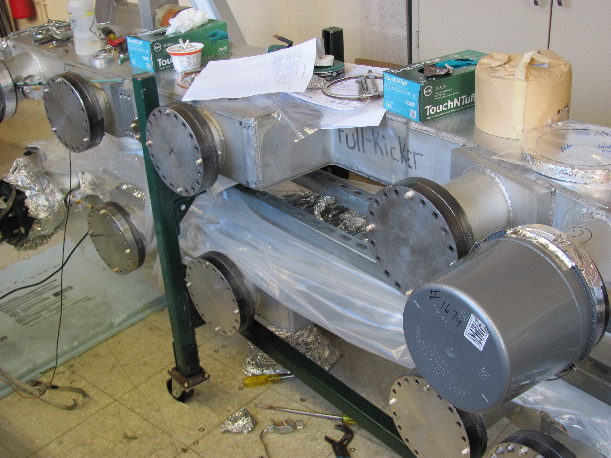
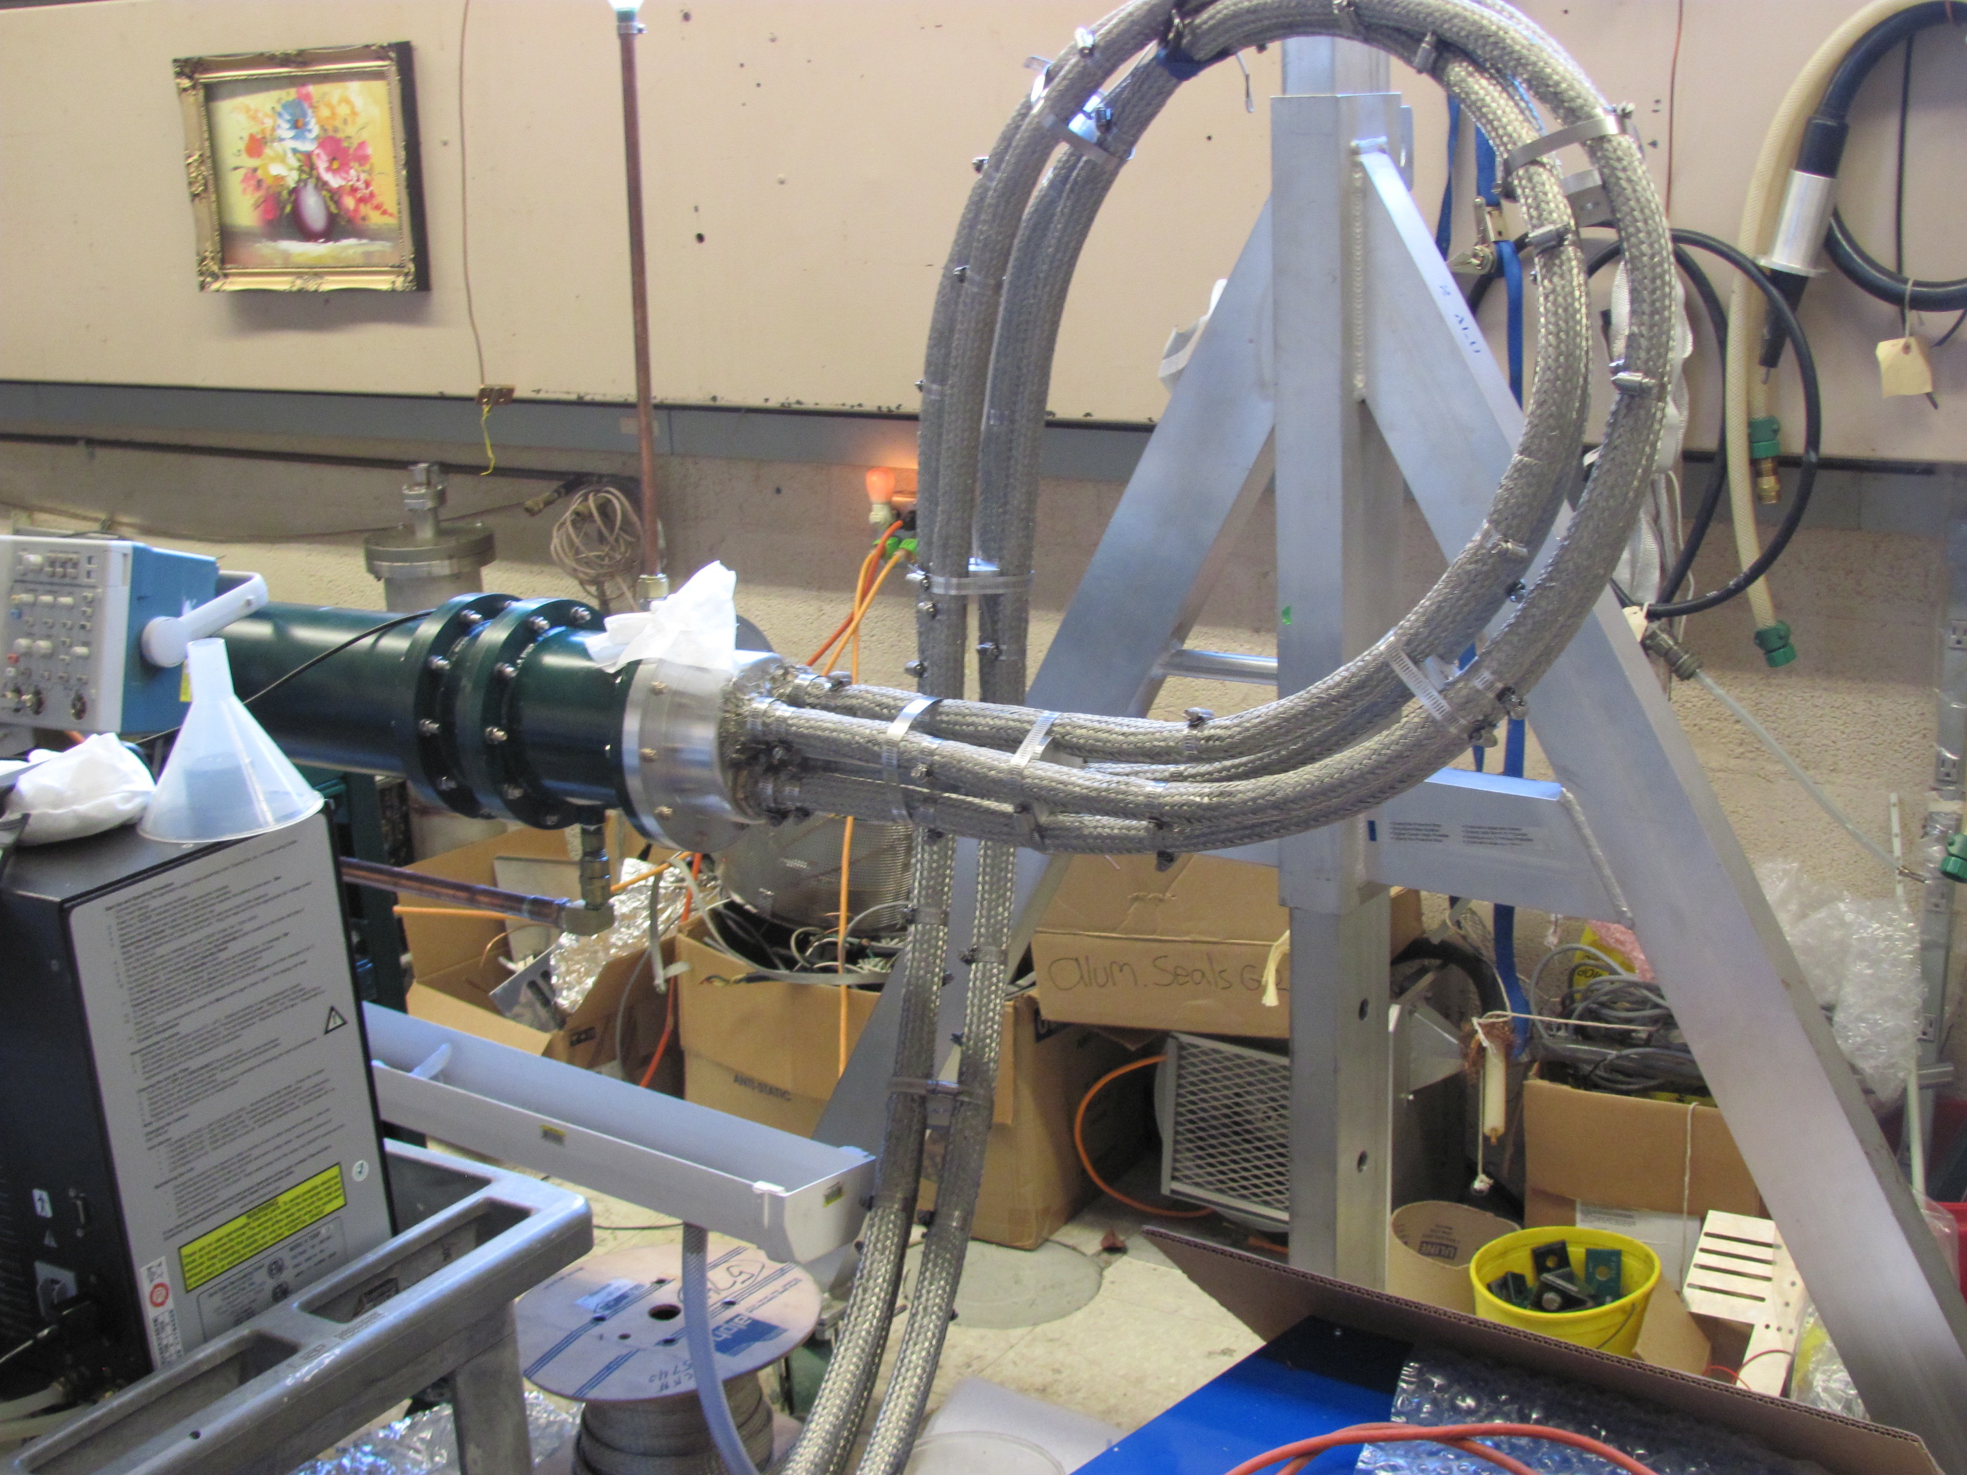
Electronics for 3 Blumleins tested

Slide 17
12.5 Ω Blumlein triaxial transmission line

Slide 18
Coupling from Blumlein to Load

Slide 19
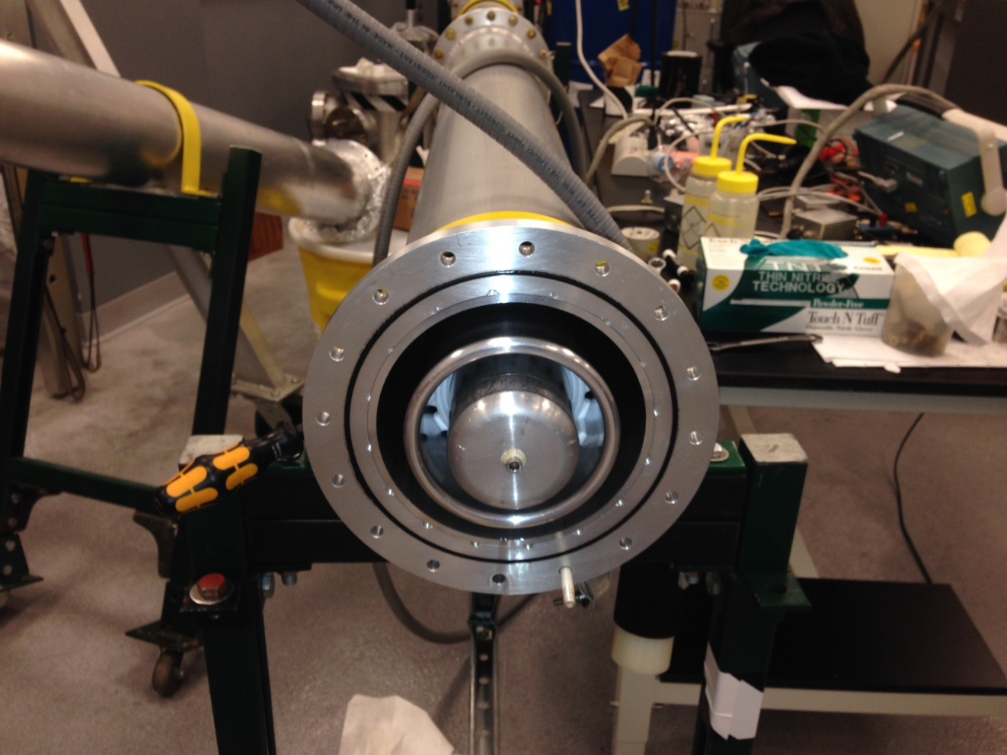
Blumlein tubing
3 concentric tubes – Middle tube charged to +HV

Slide 20
12.5 Ω Blumlein triaxial transmission line
Vacuum chamber with kicker magnet
50 Ω coax

Slide 21
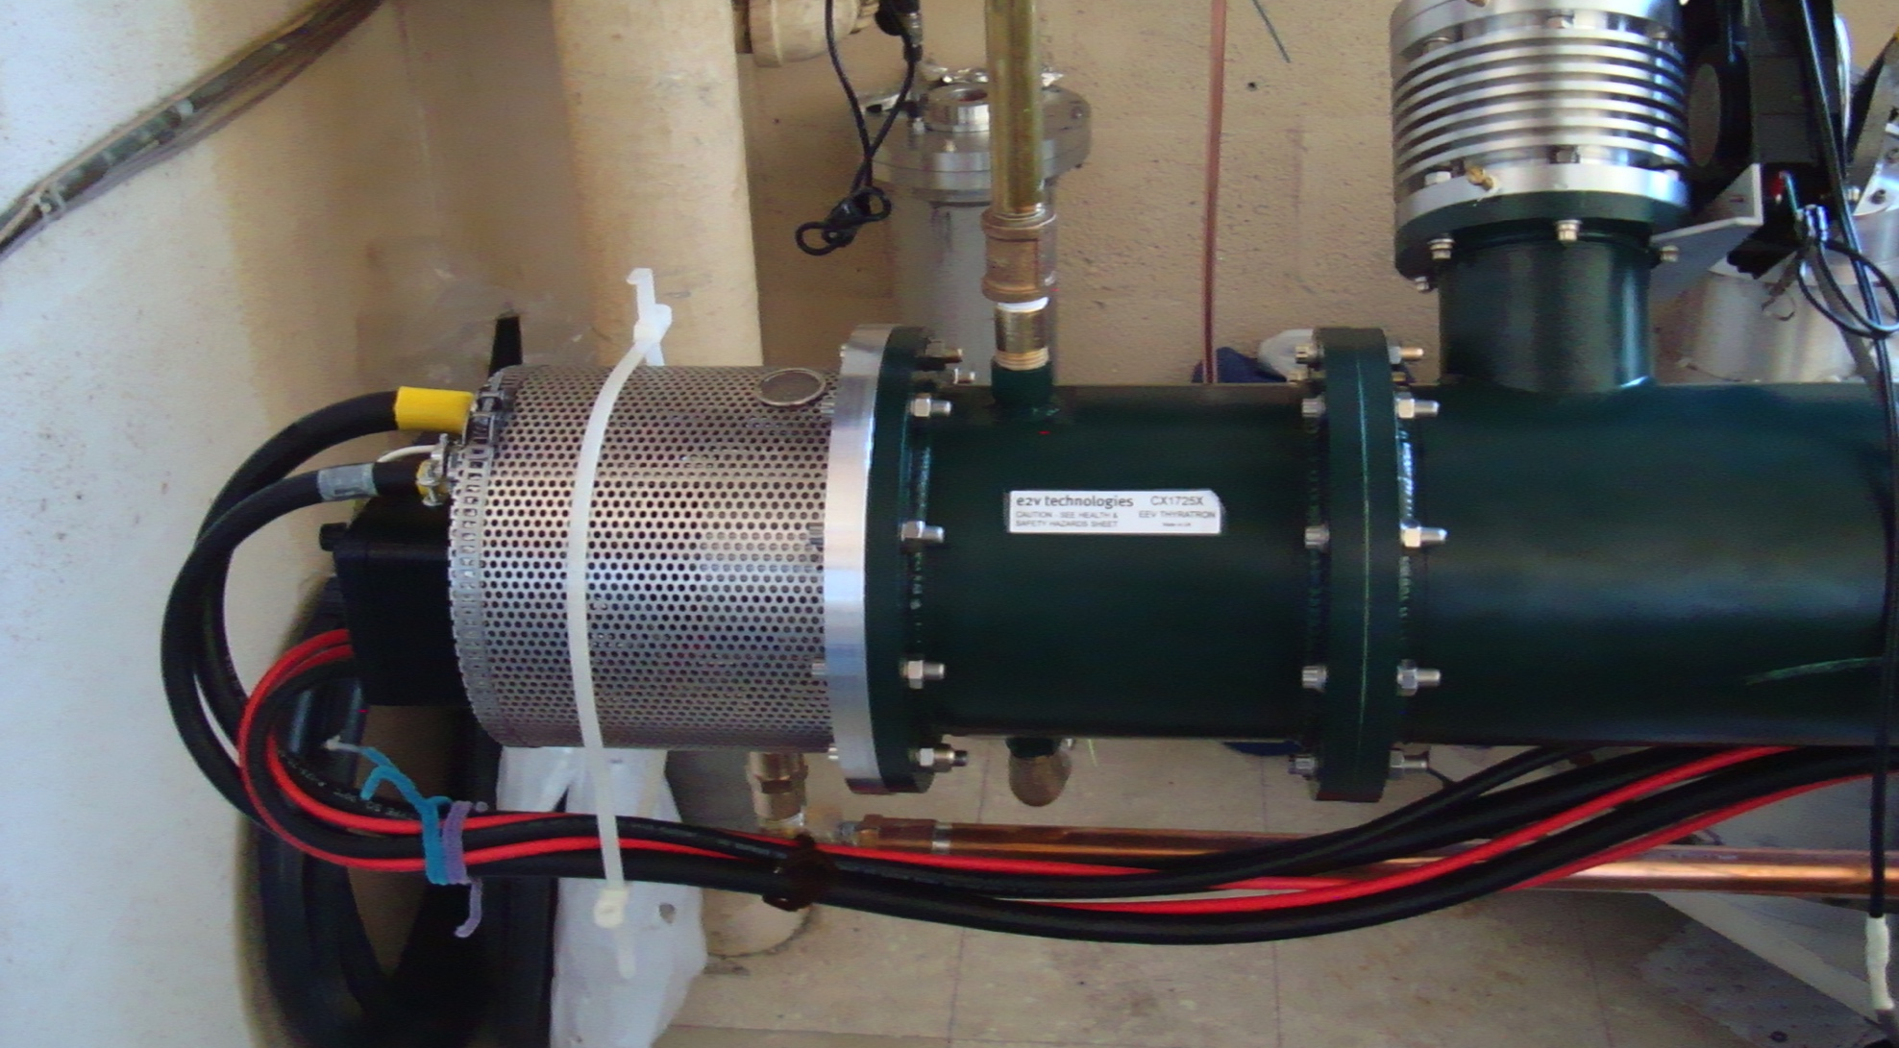
Thyratron switch

Slide 22
4 –parallel coax to load

Slide 23
Coupling to magnet
flourinert
4 50Ω coaxial cables
4 load resistors
(12.5Ω equivalent)
Vacuum chamber

Slide 24
4 parallel 50Ω cables
Load resistors in flourinert
Magnetometer laser
Kicker chamber
Vacuum pump

Slide 25
Coupling from Blumlein to Load

Slide 26
Thyratron driver
High voltage supply
Charging circuit

Slide 27
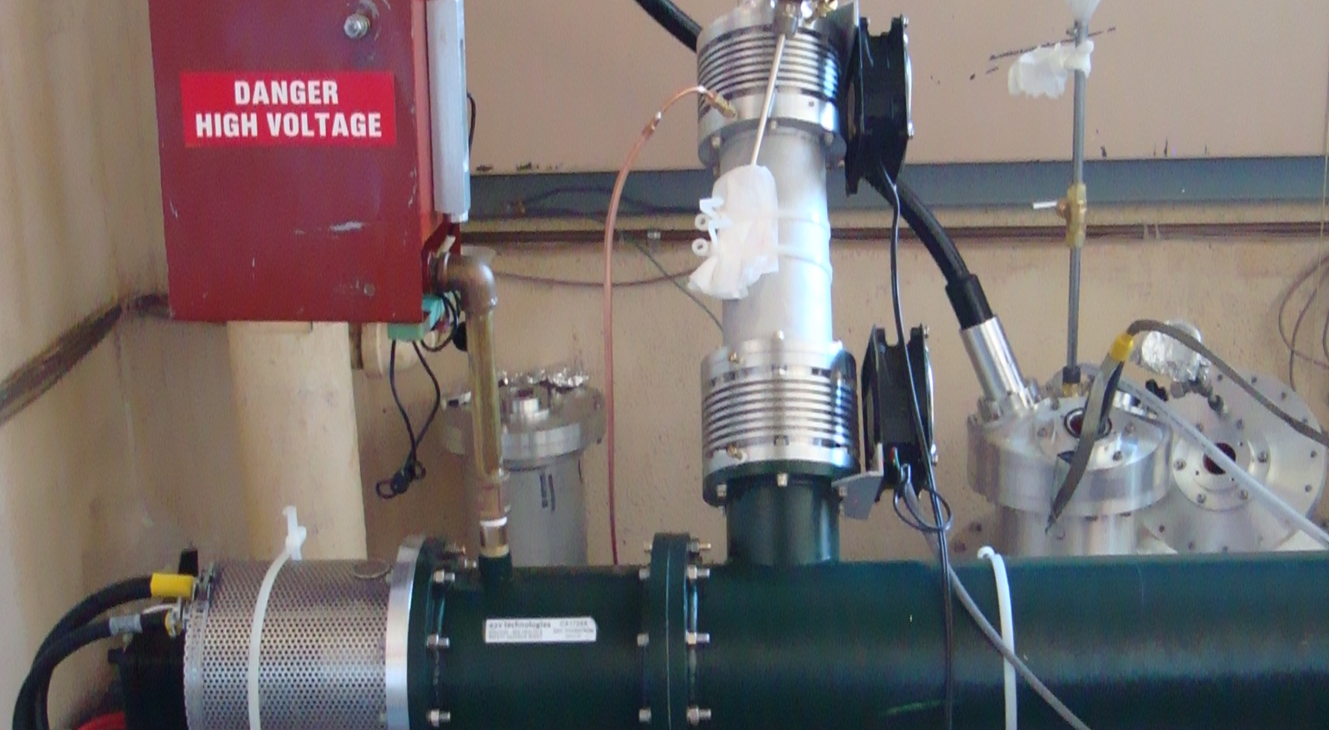
Thyratron and charging input

Slide 29
Load Resistors
Resistors at input to kicker
Each 50 Ω cable loaded to 50 Ω resistor

Slide 31
Load resistors cooled in flourinert

