Slide 1
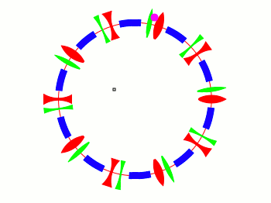

Resonant Extraction of Positrons for Dark Photon Search
Tanner Trickle with David Rubin
June 6, 2016
HD-Q
Alternating gradient guide field
HF-Q
HD-S
HF-S
Elliptical phase space
(p_{x} vs x at the end of each turn)

Slide 2
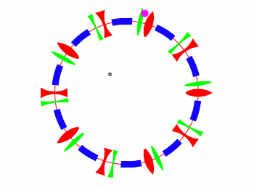

Resonant extraction
Shift tune Q_{x} to 2/3 (third integer resonance)
Alternating gradient guide field
Triangular phase space
(p_{x} vs x at the end of each turn)

Slide 3
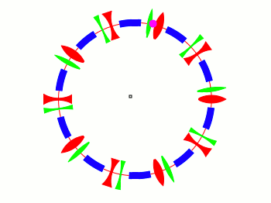

Resonant extraction
Q_{x} 2/3,
and increase sextupole moment (B_{y} = a x² )
Increase sextupole strength
Alternating gradient guide field
Triangular phase space – unstable
Horizontal displacement increases exponentially Once beyond the septum, particles are kicked into extraction channel

Slide 4
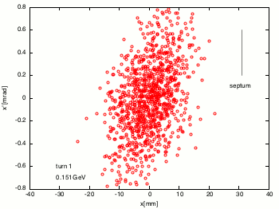

Resonant extraction
Horizontal phase space of positron beam

Slide 5
Project Goals
Specify time dependence of quadrupoles, sextupoles and bump to
  Optimize extraction efficiency (> 90 %)
  Minimize emittance of extracted beam
  Maximum uniformity of extracted beam
Measure time dependence of betatron tunes in synchrotron

