Slide 1
Resonance Extraction of Positrons for Dark Photon Search
Tanner Trickle with David Rubin
June 6, 2016

Slide 3
Cornell Storage Ring and Injector Accelerators
CESR Circumference = 768m (2.56 μs)
150 MeV e⁻
300 MeV e⁻

Slide 4
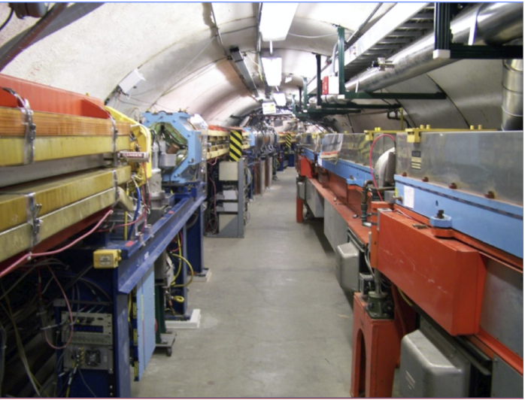
Accelerate positrons to 6 GeV in synchrotron
Synchrotron
Circumference = 755.8 m
Revolution period = 2.519 μs
Storage Ring (CESR)

Slide 6
Goal of Resonant (slow) Extraction:
- Maximize integrated positron current on the target
- Minimize peak current – to limit pile up in the detector
Extraction from synchrotron for injection into CESR
- All bunches are kicked in a single turn into the transfer line and into CESR
is not practical for this experiment
Fixed target experiments:
Slow extraction over ~ 2000 turns (2000 fold reduction in peak current)

Slide 7
Accelerator Parameters
Synchrotron
  Peak Energy ~ 6 GeV
  Magnets cycle at 60 Hz
  Magnetic field B(t) = B_{max}(1-cos ωt), ω = 2π/60
  => E = E_{max}(1-cos ωt)
  Revolution period = 2.52 μs (Circumference = 760 m)
    180 bunches, 14ns spacing
  Adiabatic damping ε = ε₀ /γ
6 GeV positrons
Energy
150 MeV positrons
3300 turns (8.3 ms)

Slide 8
Acceleration in the synchrotron
- Adiabatic damping

Slide 9
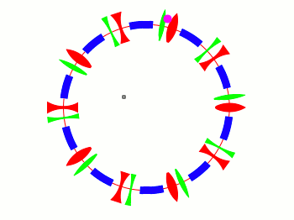

Resonant extraction -
Acceleration with stable phase space for first 2000 turns of cycle
Fractional tunes are far from resonance (irrational)
HD-Q
Alternating gradient guide field
HF-Q
HD-S
HF-S
Elliptical phase space
(p_{x} vs x at the end of each turn)

Slide 10
Resonant extraction -
Acceleration with stable phase space for first 2000 turns of cycle
Fractional tunes are far from resonance (irrational)
HD-Q
Alternating gradient guide field
HF-Q
HD-S
HF-S
Elliptical phase space
(p_{x} vs x at the end of each turn)

Slide 11
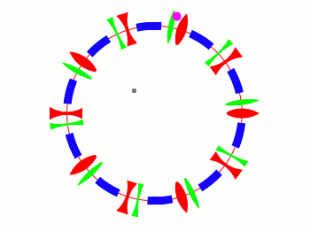

Resonant extraction
At turn 2000, begin to shift tune Q_{x} to 2/3 (third integer resonance)
Alternating gradient guide field
Triangular phase space
(p_{x} vs x at the end of each turn)

Slide 12
Resonant extraction
At turn 2000, begin to shift tune Q_{x} to 2/3 (third integer resonance)
Alternating gradient guide field
Triangular phase space
(p_{x} vs x at the end of each turn)

Slide 13
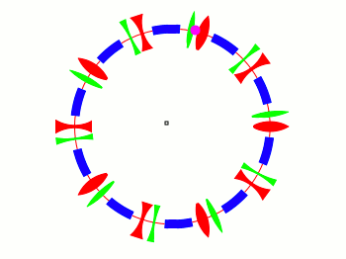

Resonant extraction
Turns > 2000, Q_{x} 2/3,
and increase sextupole moment (B_{y} = a x² )
Increase sextupole strength
Alternating gradient guide field
Triangular phase space – unstable
Horizontal displacement increases exponentially Once beyond the septum, particles are kicked into extraction channel

Slide 14
Resonant extraction
Turns > 2000, Q_{x} 2/3,
and increase sextupole moment (B_{y} = a x² )
Increase sextupole strength
Alternating gradient guide field
Triangular phase space – unstable
Horizontal displacement increases exponentially Once beyond the septum, particles are kicked into extraction channel

Slide 15
Temporal profile of extraction magnets

Slide 16
Horizontal and vertical tunes extracted from fft of turn by turn centroid position

Slide 17
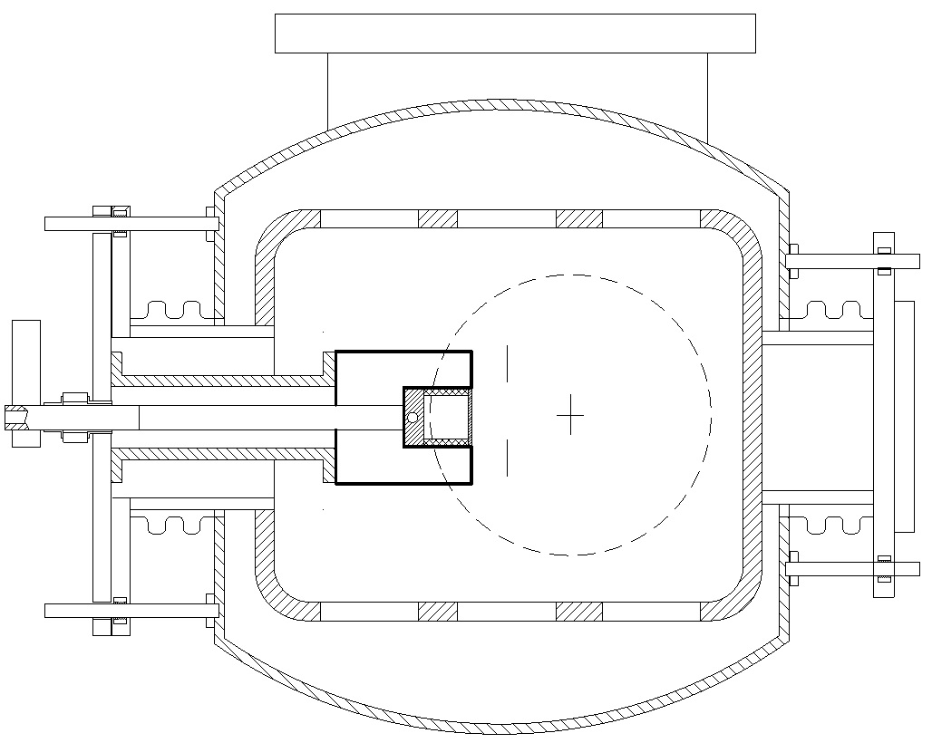
Thin extraction septum
Septum-wall 1 mm
A. Mikhailichenko

Slide 18
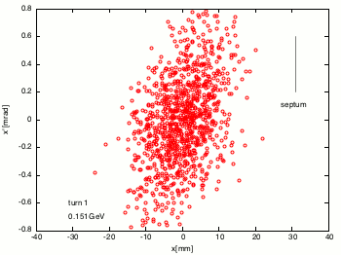

Resonant extraction
Horizontal phase space of positron beam

Slide 19
Resonant extraction
Horizontal phase space of positron beam

Slide 20
Extraction rate is sensitive to detailed adjustment of tune, strength of sextupole, and bump amplitude.
Power supplies for quads and sextupole will necessarily be programmable

Slide 21
Project Goals
Specify time dependence of quadrupoles, sextupoles and bump to
  Optimize extraction efficiency (> 90 %)
  Minimize emittance of extracted beam
  Maximum uniformity of extracted beam
Measure time dependence of betatron tunes in synchrotron

