Slide 1
Extracted Positron Beam

Slide 2
Goal:
- Maximize integrated positron current on the target
- Minimize peak current – to limit pile up in the detector
Extraction from synchrotron for injection into CESR
- All bunches are kicked in a single turn into the transfer line and into CESR
is not practical for this experiment
This experiment:
Slow extraction over ~ 2000 turns (2000 fold reduction in peak current)
Constraint:
- Zero impact on topoff injection for CHESS

Slide 3
Acceleration in the synchrotron
- Adiabatic damping

Slide 4
Resonant extraction
Third integer resonance
- driven by a sextupole field
Magnetic field of sextupole
=>
Kick due to sextupole field

Slide 5
Third integer resonance
(betatron oscillation at Q)
Kick due to sextupole
Angle at m due to sextupole kick on all previous turns

Slide 6
Third integer resonance
Sum of kicks from all previous turns
= zero unless Q is an integer or 1/3 integer
In the synchrotron with Q= 10.667, sextupole drives positrons onto unstable trajectories, with amplitude increasing every third turn
On last turn in synchrotron, positron steps across thin septum and extracted

Slide 7
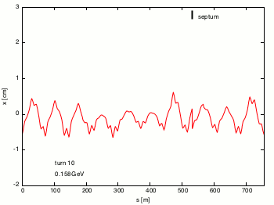

Emittance of extracted beam
scales with displacement of stable trajectory from septum
Turn on closed bump at turn 1000-2000 to shift stable trajectory close to septum
Single particle

Slide 9
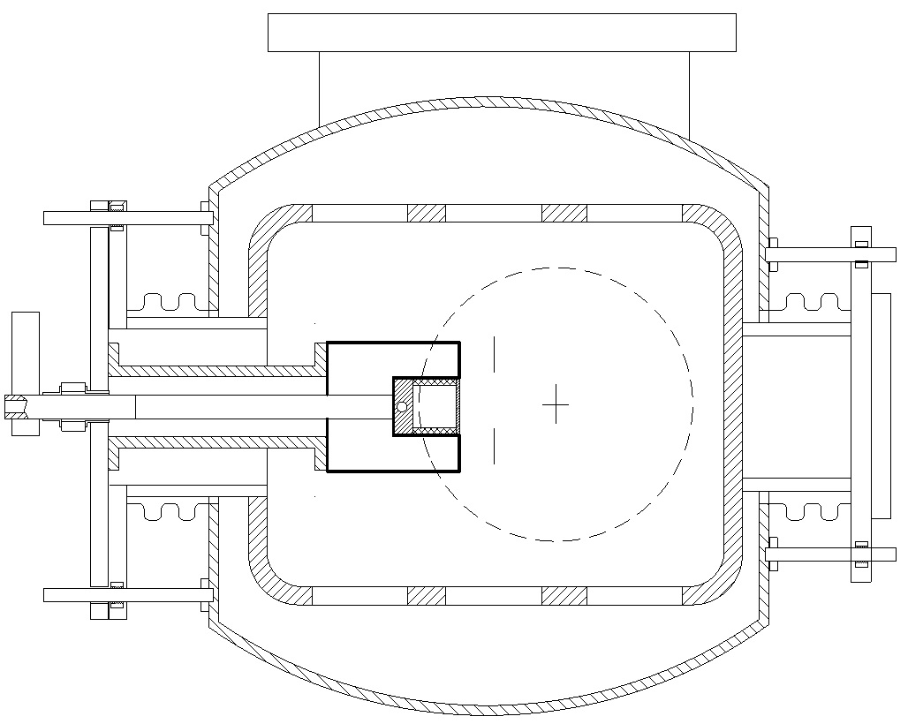
Thin extraction septum
Septum 1 mm
A. Mikhailichenko

Slide 10
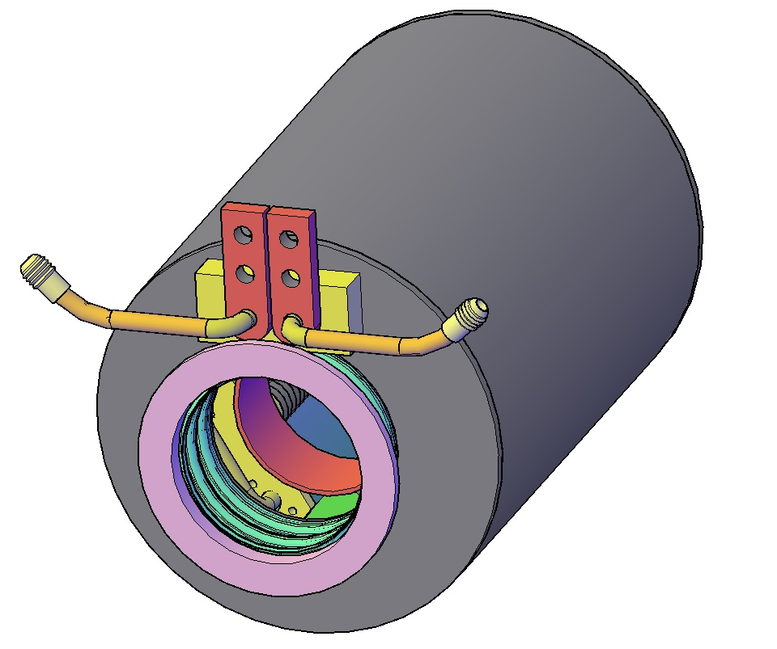
Sextupole drives resonance
- Thin laminations (limit eddy currents)
- Single turn magnet (minimizes inductance)
The sextupole will be installed in L4
A. Mikhailichenko

Slide 11
A pair of quadrupoles (L3) similarly constructed with thin laminations and a single turn, shift the tune onto the resonance

Slide 12
Temporal profile of extraction magnets

Slide 13
Horizontal and vertical tunes extracted from fft of turn by turn centroid position

Slide 14
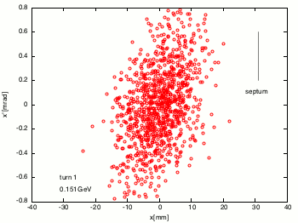

Resonant extraction
Horizontal phase space of positron beam

Slide 15
Phase space of extracted beam
required by the experiment

Slide 16
Extracted beam energy
determined by turn (B-field) to within 1%
and further restricted to 0.1% by turn by turn position measurement in synchrotron

Slide 17
Dark Photon experiment
- Accelerate ~16 bunches, 98 ns spacing in each cycle and slow extract over 2000 turns
Synchrotron cycles for dark photon experiment are interleaved with CESR top off

Slide 18
Extraction rate is sensitive to detailed adjustment of tune, strength of sextupole, and bump amplitude.
Power supplies for quads and sextupole will necessarily be programmable

Slide 19
Fixed target experiments with the synchrotron used resonant extraction
½ integer resonance driven by octupole
0.78 mm septum => 1 mrad kick up to 10 GeV

Slide 20
Pulsed quads - L3
Pulsed sextupole - L4

Slide 21
Instrumentation
Turn by turn beam position monitors in synchrotron
  Betatron tunes
  Energy (orbit offset)
Turn by turn capable position detectors in extraction line
  Average 4-momentum of incident positrons
Turn by turn intensity detector in extraction line
  Guides tuning of quad,sextupole, bump for spill

Slide 22
Outstanding questions
Fixed target experiments with synchrotron in the 1960s used resonant extraction,
but at ½ integer and with an octupole. Why?
Third integer is attractive because
  Nominal horizontal tune of 0.61 which is closer to 0.66 than 0.5 so required tuneshift is smaller
Perhaps there is a significant sextupole moment in the synchrotron that we cannot control – (combined function bends include sextupole component)
Or is there a head tail instability when the pulsed sextupole drives vertical chromaticity to ~ -4.
½ is linear resonance. All orbits are unstable. 1/3 is nonlinear resonance and we may leave low amplitude particles behind?
Characterization of synchrotron is essential
What are the tunes, chromaticities, emittance ?

