Slide 1
Evaluating the effect of biotemplate size on the properties of biotemplated TiO₂ particles
Nicole Santiago-Zambrana
Lymari Fuentes-Claudio, Ph.D.
Department of Sciences and Technology
Universidad Ana G. Méndez Cupey Campus
Funded by NSF Award# DMR-1827622

Slide 2
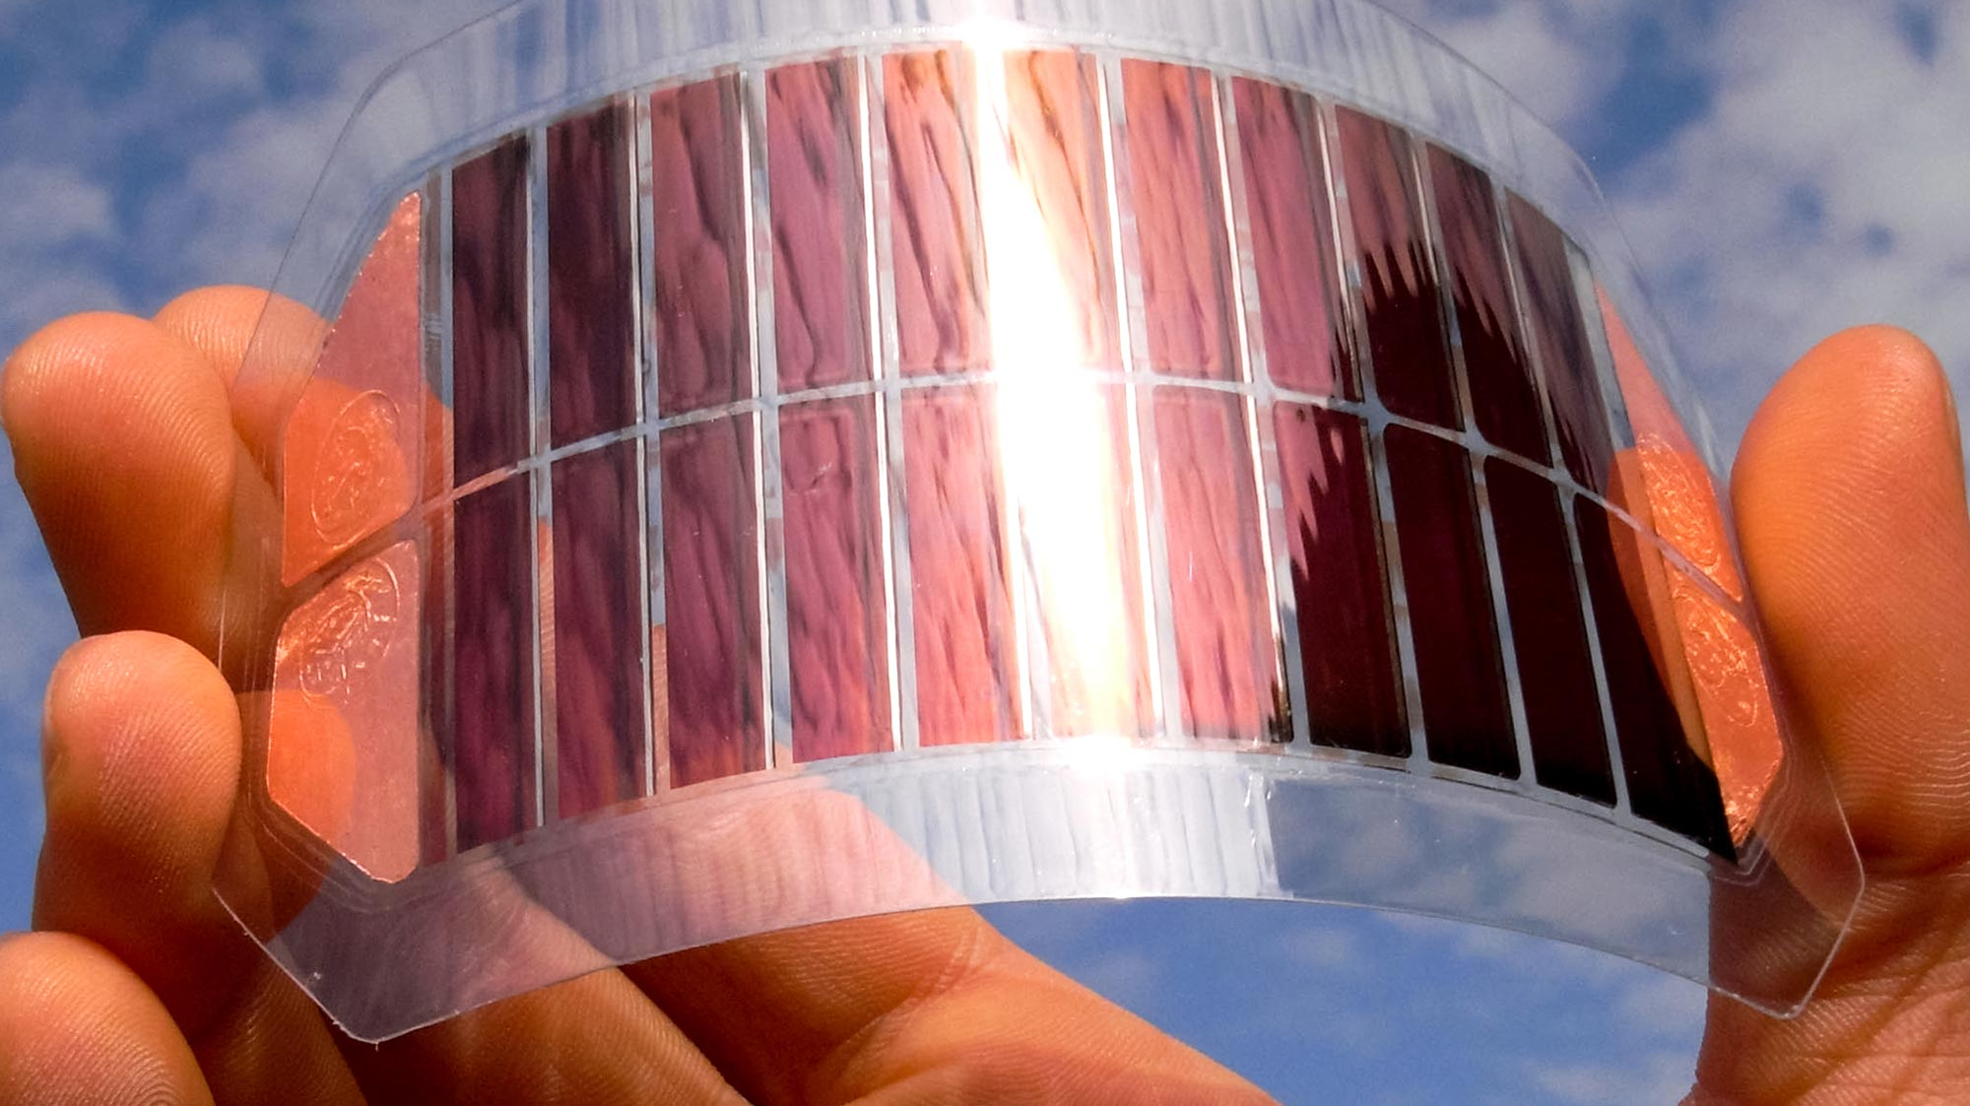
Main goals
Determine the effect of template size on the photoconductive properties of Biotemplated TiO₂ particles.
Analyze the data of TiO₂ samples obtained at the PIPOX beamline at
CHESS on spring 2021.
https://www.google.com/url?sa=i&url=https%3A%2F%2Fscitechdaily.com%2Ftwo-layers-are-better-than-one-for-efficient-solar-cells-affordable-thin-film-solar-cells-with-34efficiency%2F&psig=AOvVaw0uRCUW894mOeMjjAO5NviD&ust=1627088510794000&source=images&cd=vfe&ved=0CAsQjRxqFwoTCLCf1Jj_9_ECFQAAAAAdAAAAABAX

Slide 3
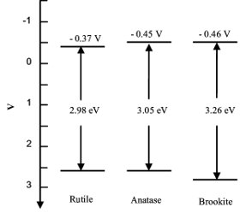
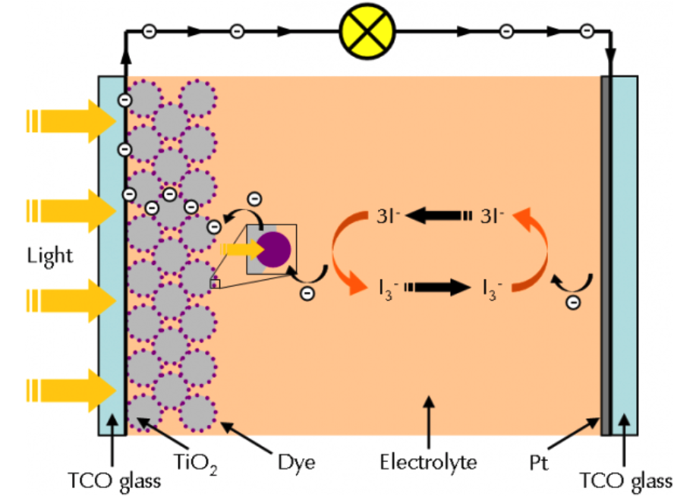
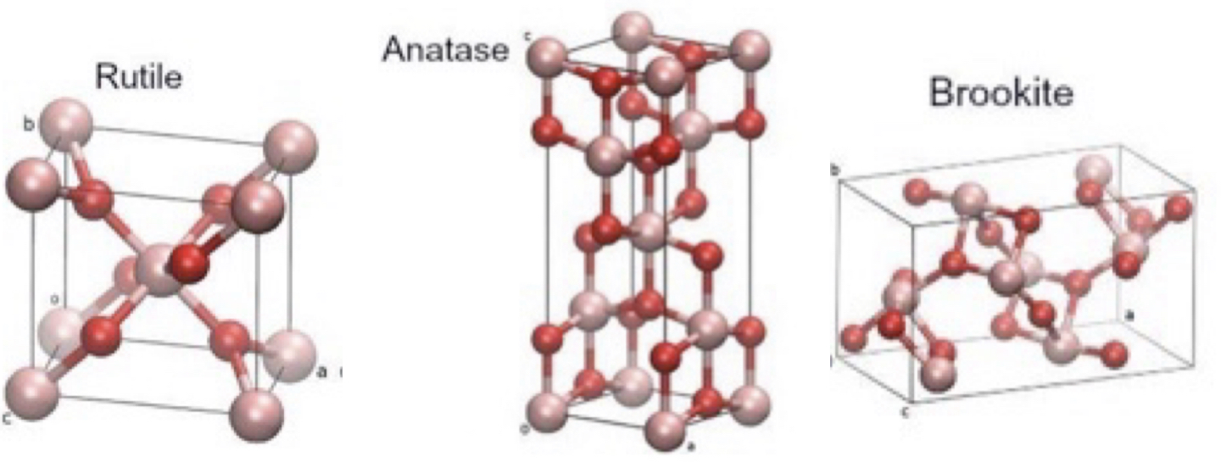
Dye Sensitized Solar Cell using TiO₂
https://www.gamry.com/application-notes/physechem/dssc-dye-sensitized-solar-cells/
https://www.researchgate.net/profile/Yasmeen_Janzeer/publication/303315590/figure/fig3/AS:670033114066950@1536759751314/Crystal-structure-of-titanium-dioxide-phases-of-rutile-brookite-and-anatase-adapted.jpg

Slide 4
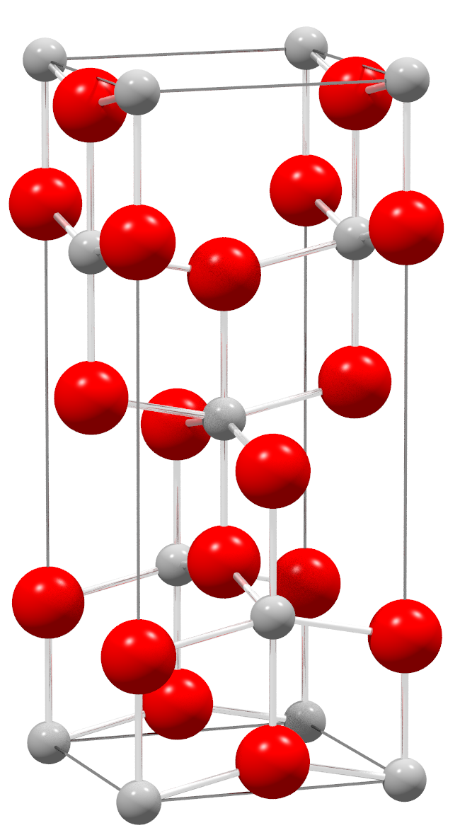
The main benefits of improving the synthesis of TiO₂
Photocorrosion resistance
Low cost
Long lifespan
Excellent photocatalytic properties
This Photo by Unknown Author is licensed under CC BY-SA

Slide 5
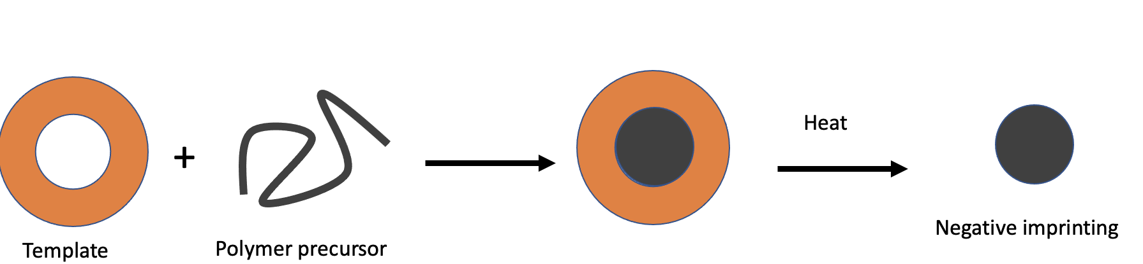
Using
oregano leaves as a
biotemplated material

Slide 6
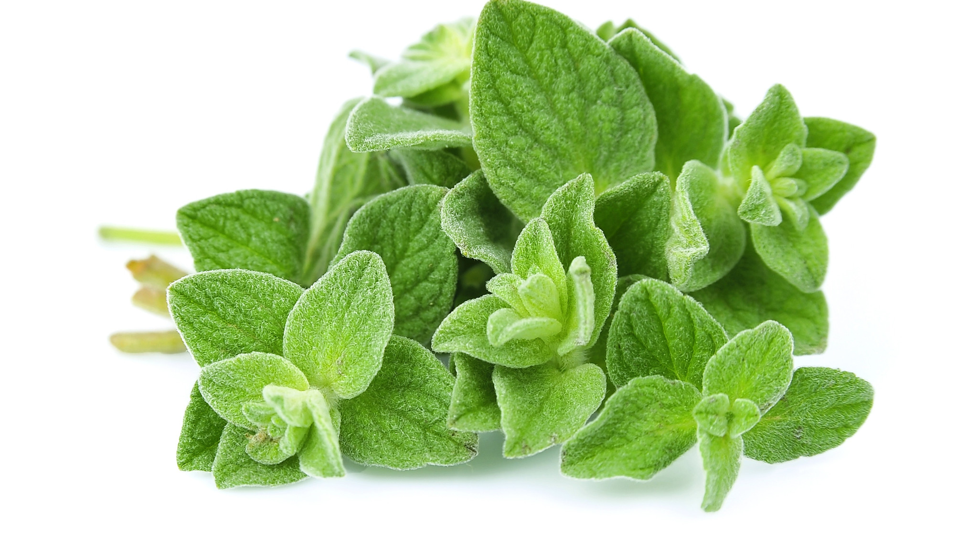
Why we choose to use oregano leaves as a biotemplate?
Cost effective
Ecofriendly
Easy to remove with temperature

Slide 7
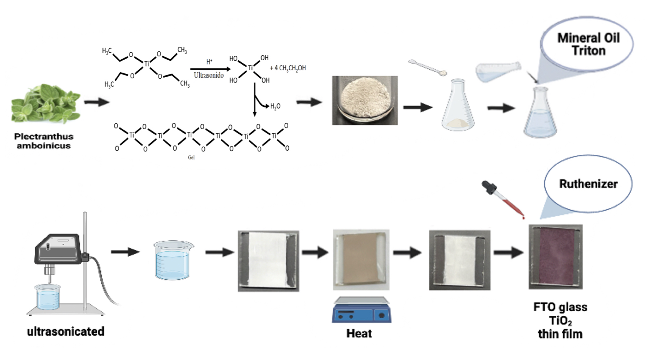
Assemble of Dye Sensitized Solar Cell Model

Slide 8
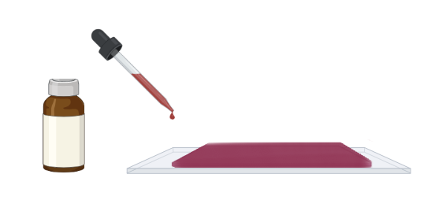
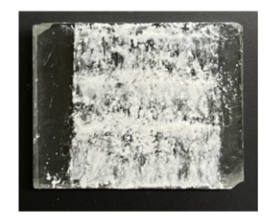
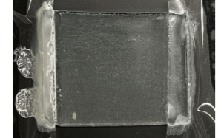
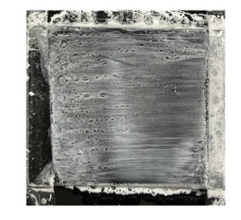
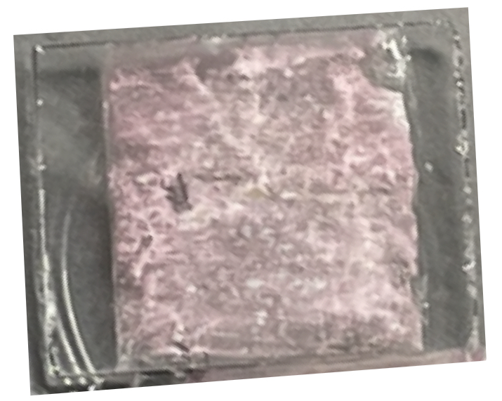
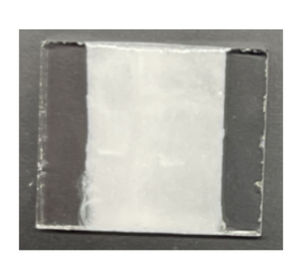
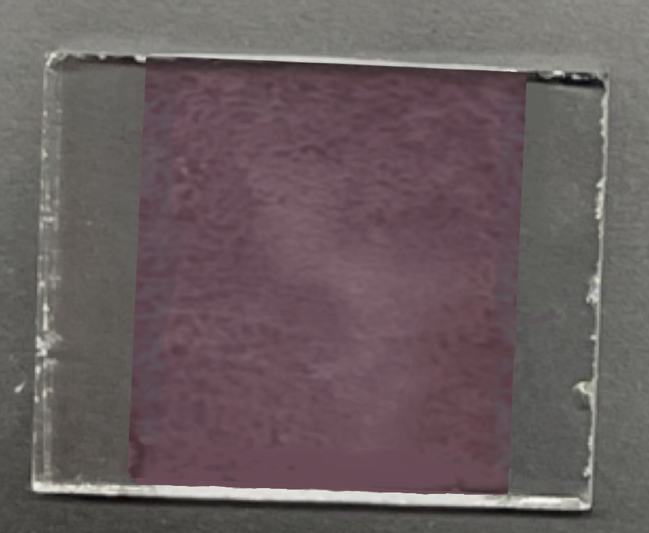
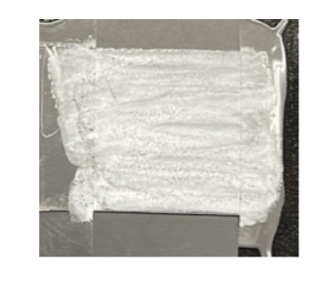
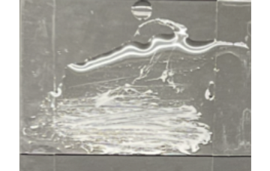
The evolution of the slurry
First Slurry
Sencond Slurry
Third Slurry
Slurry A
Slurry B
Slurry C

Slide 9
DDSC model

Slide 10
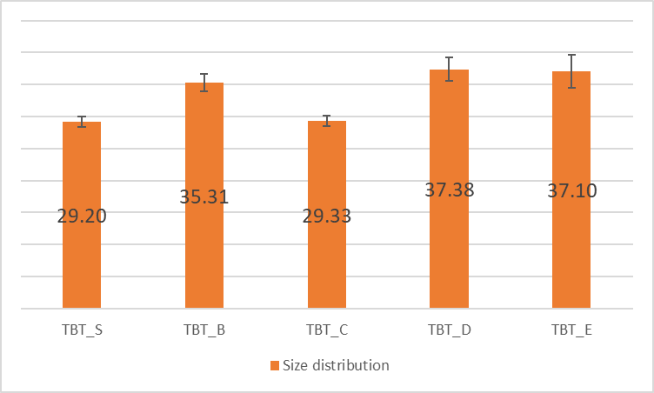
Preliminary Results
Anatase synthesized in the laboratory without biotemplation
Anatase commercial
(nm)
Anatase biotemplated
Figure 1. Size distribution results of TiO₂ with and without biotemplation. Biotemplated samples shows a slightly larger size that those without biotemplation

Slide 11
Preliminary Results CHESS PIPOX Beam line

Slide 12
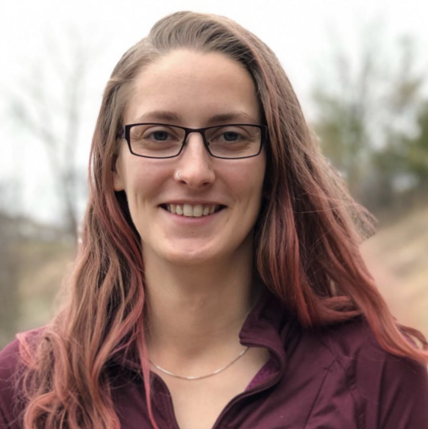
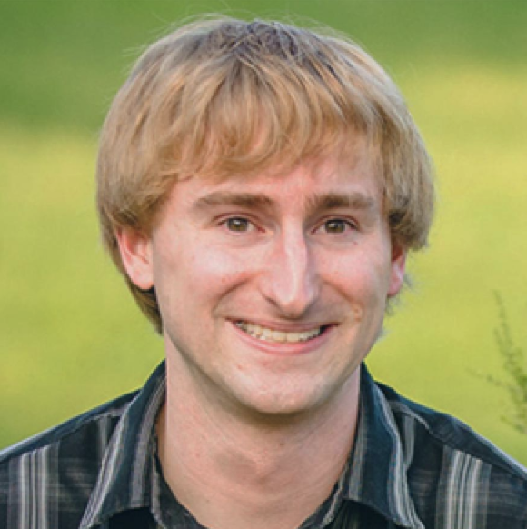
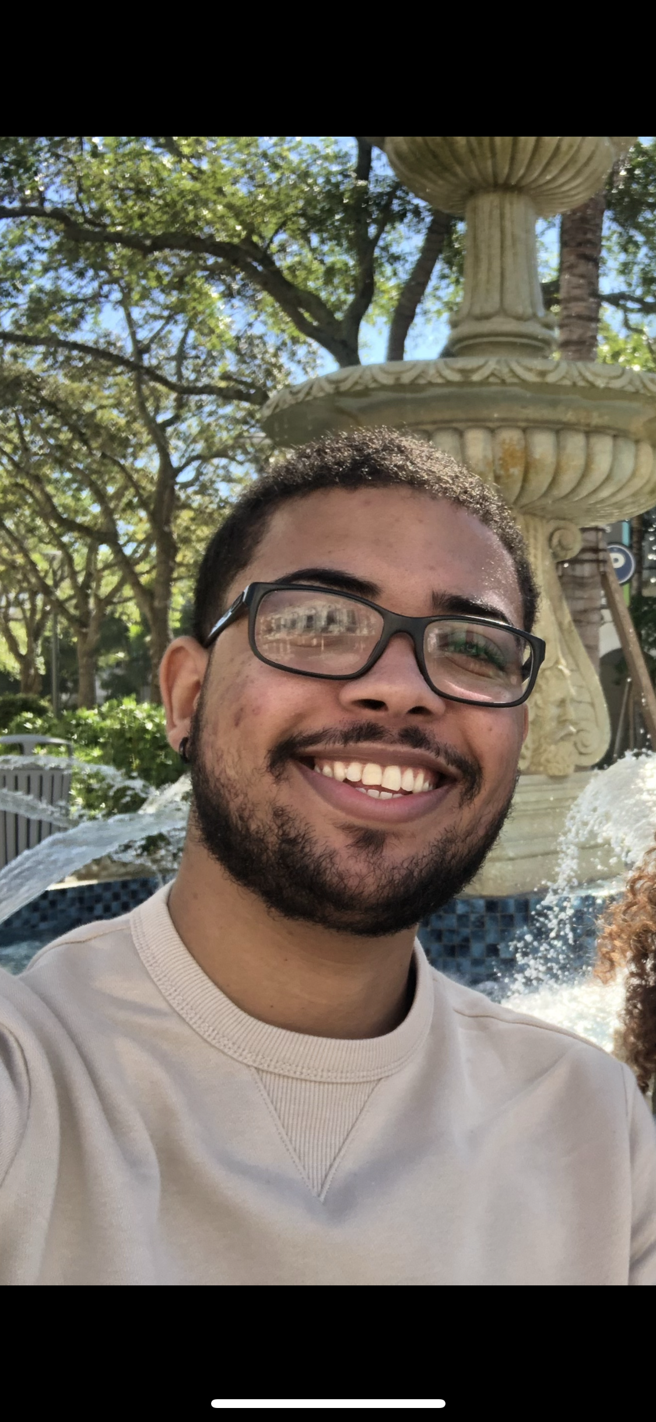
Special thanks
Louise Debefve
Post Doc - PIPOXS
Chris Pollock
Staff Scientist - PIPOXS
Marisol Figueroa, B.S in Chemistry
Ángel F. Ruiz-Guerrero, B.S.
Pharmaceutical Sciences Ph.D. Student

Slide 13
Questions?

