Slide 1
Elena Echeverria Accelerator Physics Journal Club October 20/2022
PHOEBE
Current status and future work

Slide 2
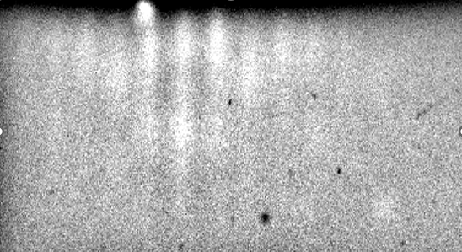
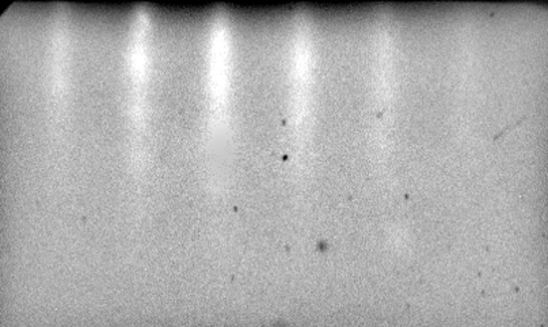
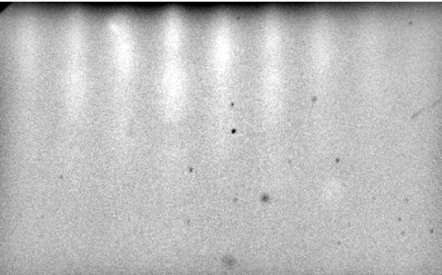
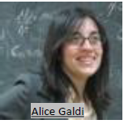
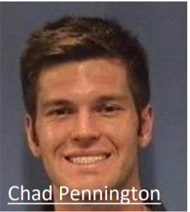
BIG THANKS!
Provide most of the information I will be presenting

Slide 3
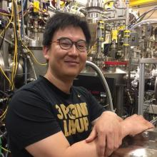
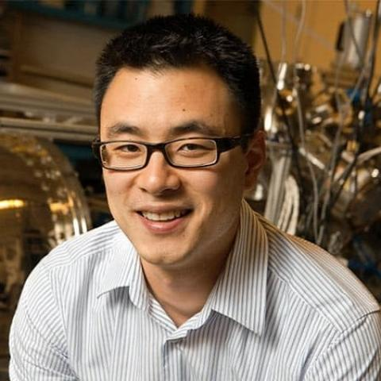
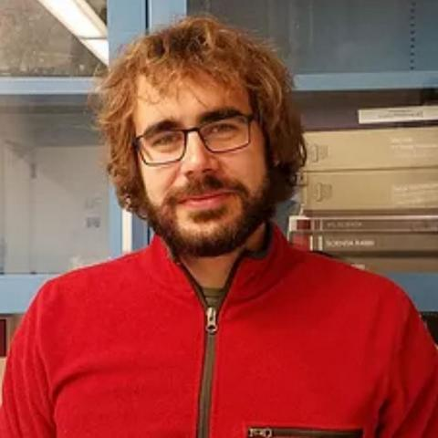
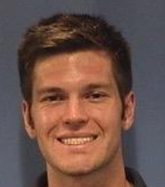
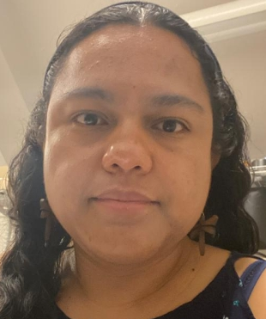
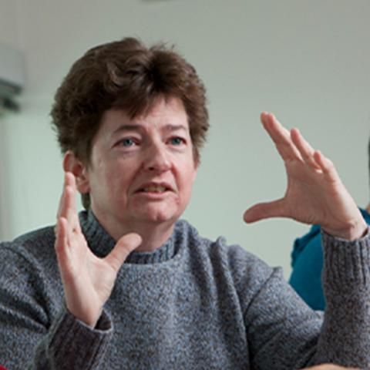
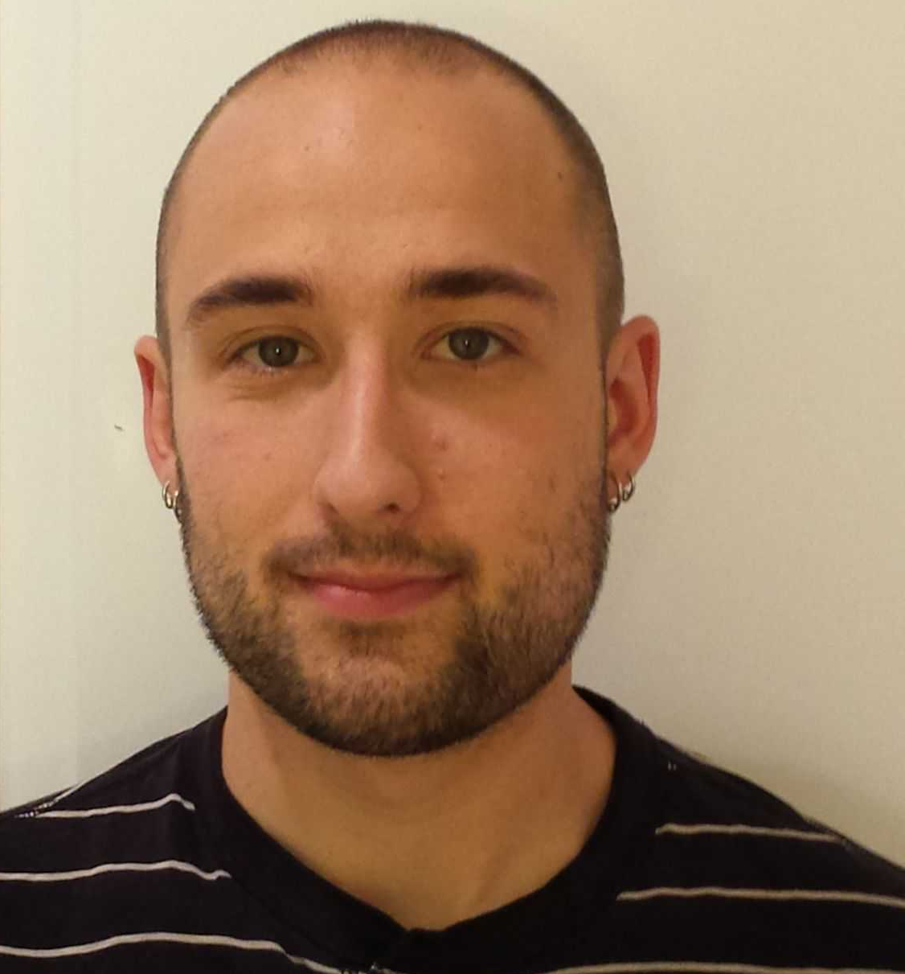
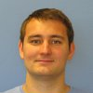
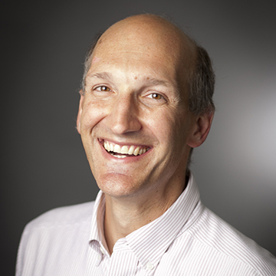
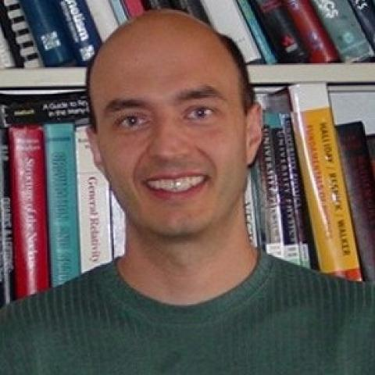
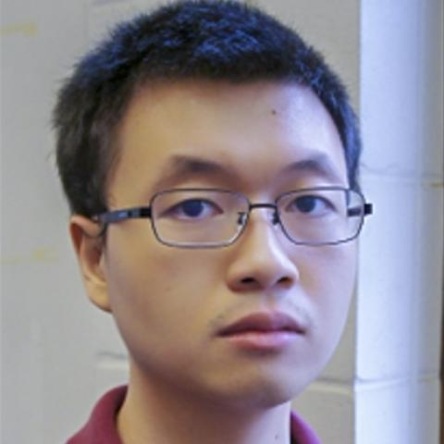
People
Maxson group
Shen group
Hanjong Paik
Brendan Faeth
Jared Maxson
Alice Galdi
Kyle Shen
Chris Parzyck
Vivek Anil
Hines group
Cheng Hu
Luca Moreschini
Chad Pennington
Elena Echevarria
Arias group
Mellissa Hines
Will DeBenedetti
Jan Balajka
Darrel Schlom
Tomàs Arias
J. Kevin Nangoi
https://cbb.cornell.edu/ https://www.paradim.org/

Slide 4
Why?
To integrate the growth, characterization, and testing of these alkali photocathodes in vacuum
GENERAL NEEDS
PHOEBE GOALS
Reduce roughness of the alkali photocathodes
MTE measurements of single digit meV range
Photocathodes that work at ambient conditions
Better understanding of the effect of certain growth parameters on the alkali photocathodes performance
Epitaxial growth of alkali antimonide compounds
MTE measurements on alkali antimonide compounds
Study the effects of protective coatings for photocathodes
Study the effect of the stoichiometry, crystal structure and/or temperature on the MTE measurements

Slide 5
Why Epitaxy?
Single crystalline photocathodes: epitaxy
Epitaxy is the growth of a crystal layer with one or more well-defined orientations with respect to an underlying crystal seed layer (usually a single crystal substrate)
Epitaxial single-oriented films would allow:
Roughness control
Orientation control → surface potential control
Measurements of intrinsic properties (optical constants, band structure, intrinsic MTE…)
Cs
flux
Sb
flux
Choose the method: MBE
Select suitable substrates
Identify suitable growth conditions
adsorption
re-evaporation
Epitaxial
layer
diffusion
nucleation
Substrate
reaction-interdiffusion

Slide 6
Choosing the method
Typical photocathode growth: Photocurrent monitored
Quantum efficiency oriented
Our growth method:
RHEED monitored
Structure oriented
heater
heater
Substrate
Current
Substrate
QMB
RHEED
QMB
Cs
Sb
Cs/In
Sb
Light source
Light source

Slide 7
Choosing the substrate
Jack and Wachtel (1957)
$$Fd\overline{3}m$$
4x Cs
Based on previous studies, 3C-SiC has been the selected substrate (but also tested: TiO₂ , MgF₂)
A Galdi, et al. Applied Physics Letters 118 (24), 244101
<100>
2x Sb +2x Cs
4x Cs
2x Sb +2x Cs
Sb³⁻
Cs⁺
1 X Cs₃Sb (a=0.9165 nm)
4 X SiC (a=0.436 nm)
≈
Some work from John Medley and Mengjia Gaowei at BNL has shown better reproducibility on Gr/4H-SiC…Something to explore in the future

Slide 8
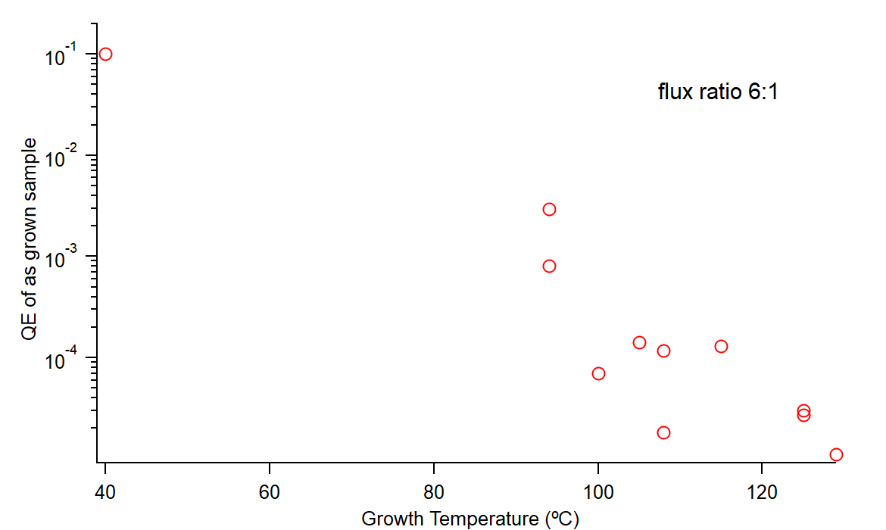
Growth Conditions: Temperature
Cs-Sb co-deposition on SiC substrate
λ=504 nm
Polycrystalline
Rough
Fiber texture
Flat
Low crystallinity
Rough
High Growth Temperature
Lower Growth Temperature
Improved Crystal Order
OOP Film Orientation
Reduced Surface Roughness
Reduced Quantum Efficiency
Improved Quantum Efficiency
Polycrystalline Films

Slide 9
Solid Phase (Molecular Beam) Epitaxy
Low Deposition temperature to take advantage of improved Cs sticking coefficient
High temperature Cs anneal to improve crystallinity
Temp
T=85°C
T=40°C
Cs
Sb
Time
Deposition
Annealing
Crystall.
Cooling

Slide 10
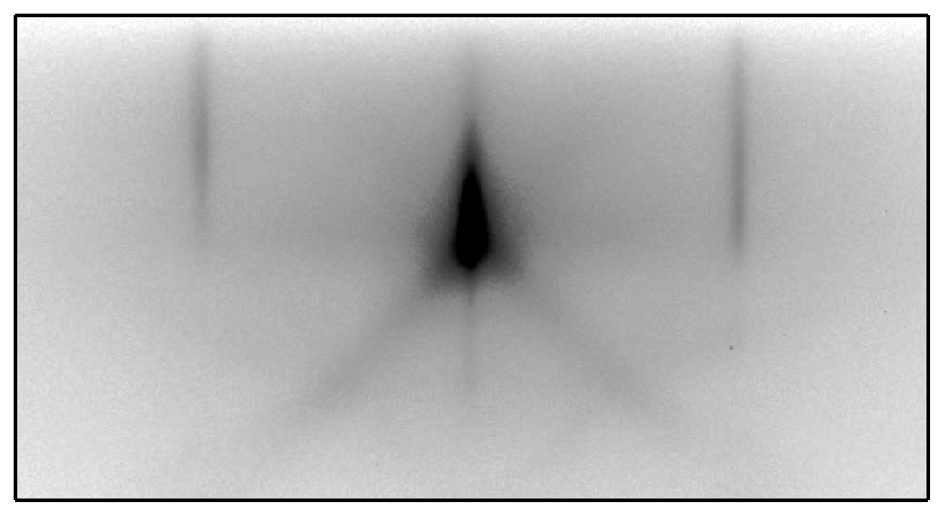
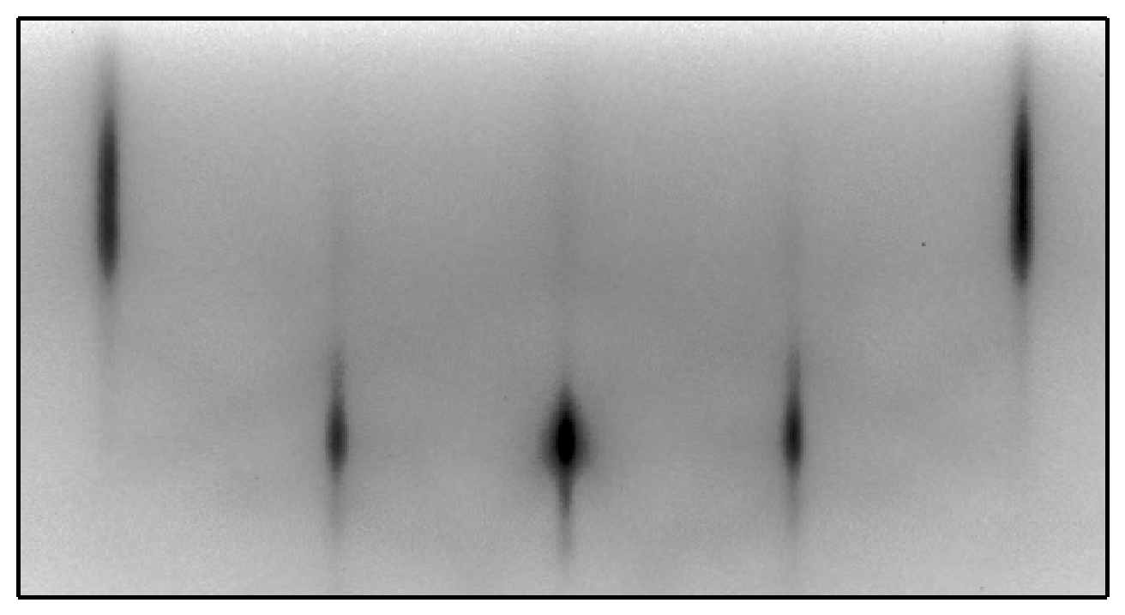
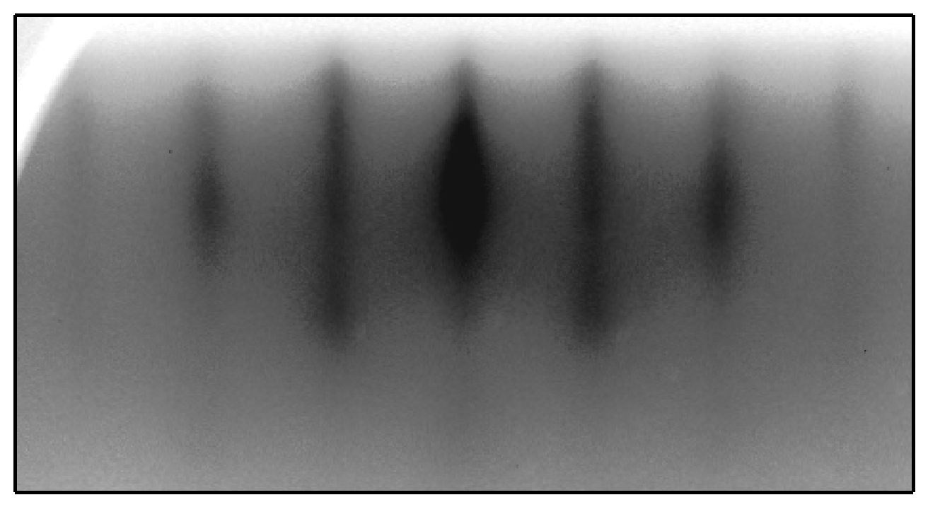
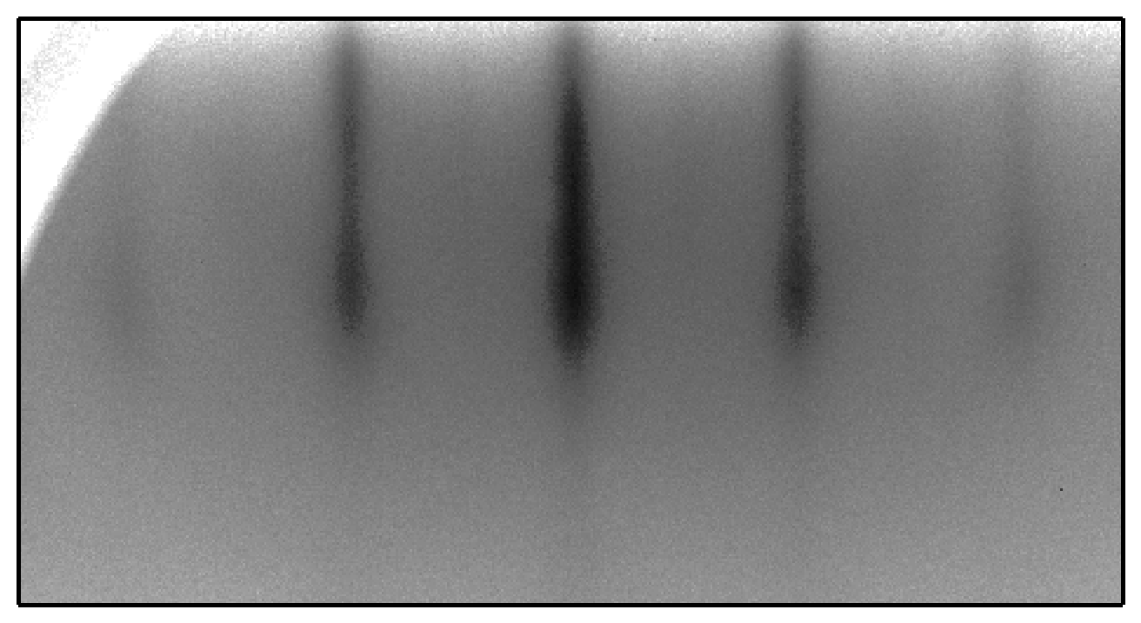
Results: Epitaxial Cs3Sb Growth!
SiC [10]
SiC [11]
Cs₃Sb [10]
Cs₃Sb [11]
Φ=0°
Φ=45°
e⁻
e⁻

Slide 11
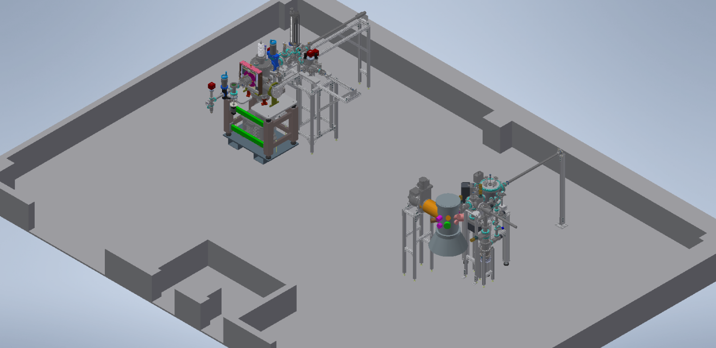
PHOBE Design in Newman
New Laser room!
Cryogenic TE meter
Glove Box
Fume Hood
Photocathode MBE
The cryogenic TE meter is in the same room as the growth system
A laser system is hosted in the adjacent room and light is delivered to the TE meter
Fume Hood and glove box in the same room for sample/sources preparation

Slide 12
Compatible sample holders
Universal sample holder:
Cryogenic TE meter (Maxson group)
STM/XPS (Hines group)
MBE/ARPES ( PARADIM, Shen group)
Crossplatform sample holder:
STM/XPS (Hines group)
MBE/ARPES (PARADIM, Shen group)
Standard Omicron with pocket:
STM/XPS (Hines group)
Currently working on a design for the gun miniplug holder

Slide 13
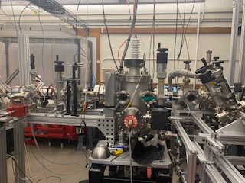
What do we have?
TE-Meter
Solenoid Scans
Cryogenic capabilities
Emittance Measurement System (EMS)

Slide 14
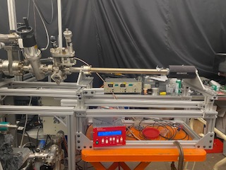
What do we have?
Suitcase
Sample carrier with 4 slots for omicron plates style holders
Easy sample transfer between systems
QE measurements setup

Slide 15
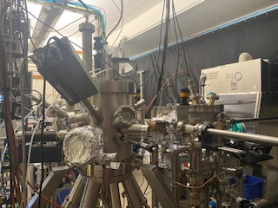
What do we have?
MBE System
Vacuum suitcase connection cross
Storage chamber
QE meas. station
Transfer chamber
Loadlock
RHEED
Sources: Cs, Sb, Mg, Cr
RHEED
Storage chamber with room to keep up to 10 samples
QE measurements and spectral response
Co-deposition and epitaxial growth
Growth module with 8 source ports

Slide 16
Epitaxial Cs3Sb at PHOBE
Epitaxial growth demonstrated at PHOBE… not surprising but it also lead to the discovery of a new phase of Cs-Sb photocathode…

Slide 17
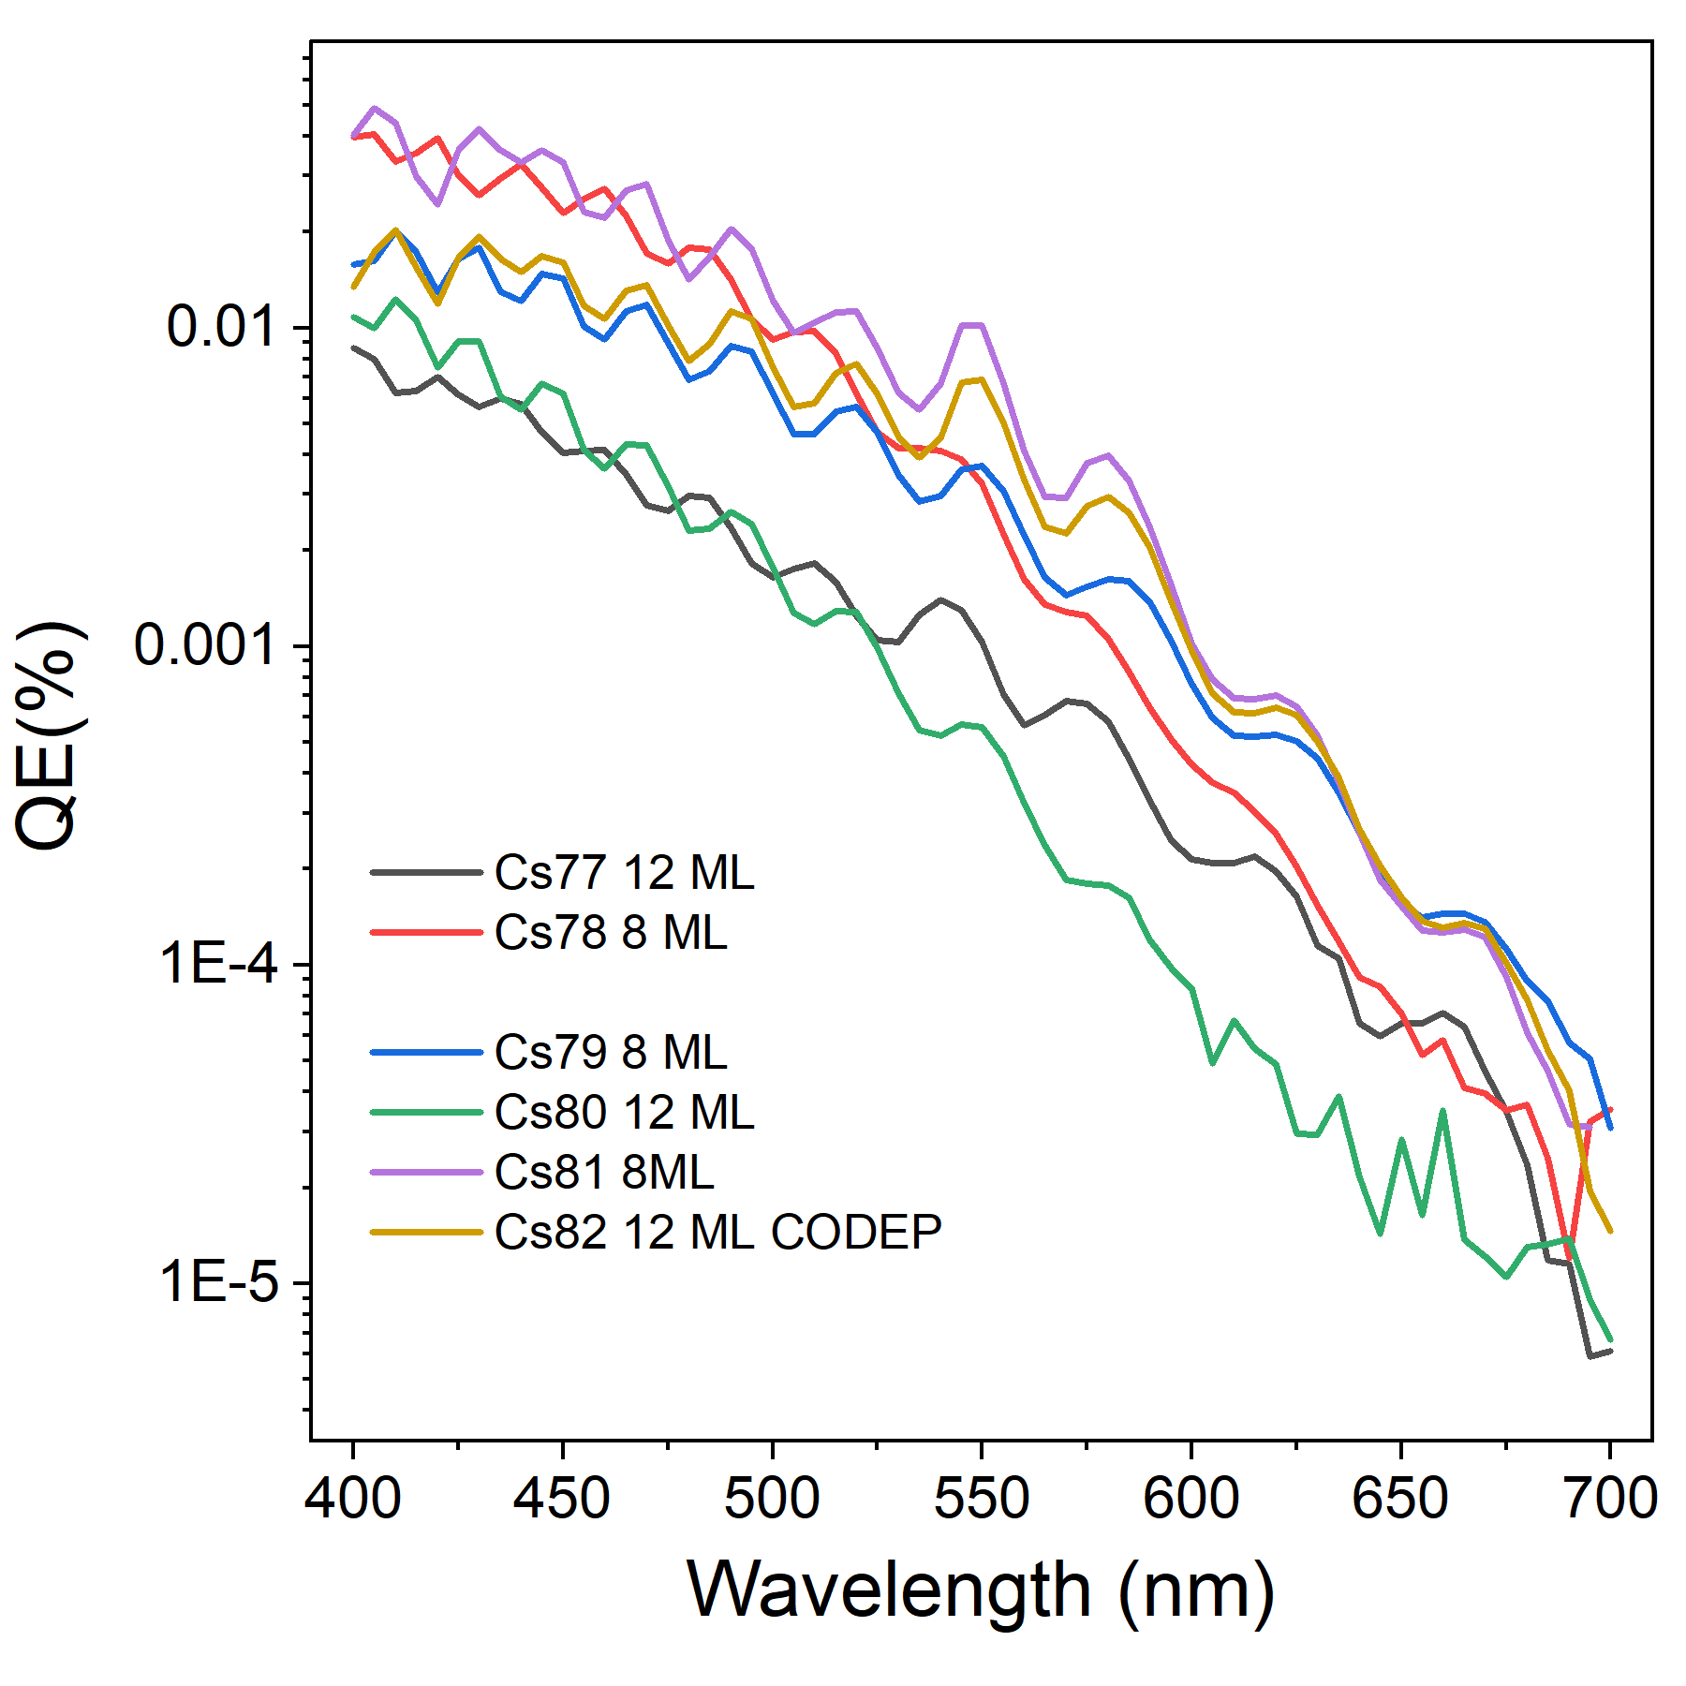
Optical interference in the substrate
Photocathode film: <10 nm thickness
3C-SiC(100) ~ 1.3 um
Si ~ 0.5 mm
How can we exploit interference effects to improve cathode performance?
Enhanced photocathode performance through optimization of film thickness and substrate
Journal of Vacuum Science & Technology B 35, 022202 (2017); https://doi.org/10.1116/1.4976527

Slide 18
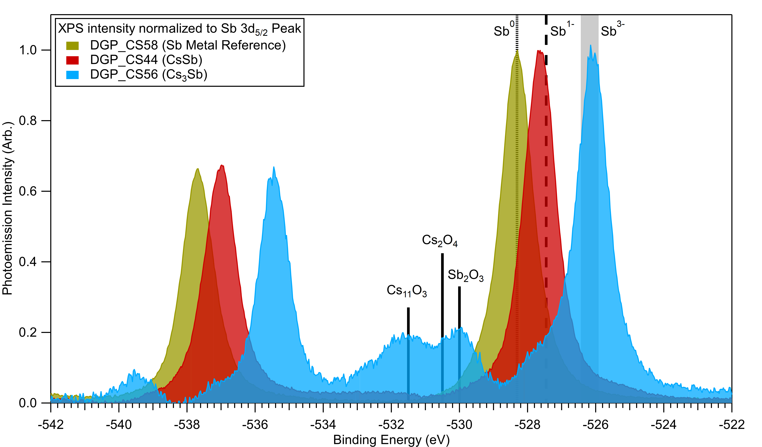
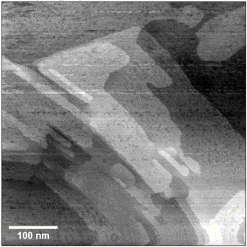
CsSb photocathode
RHEED pattern which is different from Cs3Sb
Not angle dependence – fiber textured surface with flat regions
Scanning Tunneling Microscopy (STM) shows roughness of 0.8 nm
X-ray Photoemission Spectroscopy (XPS) confirms the presence of CsSb phase

Slide 19
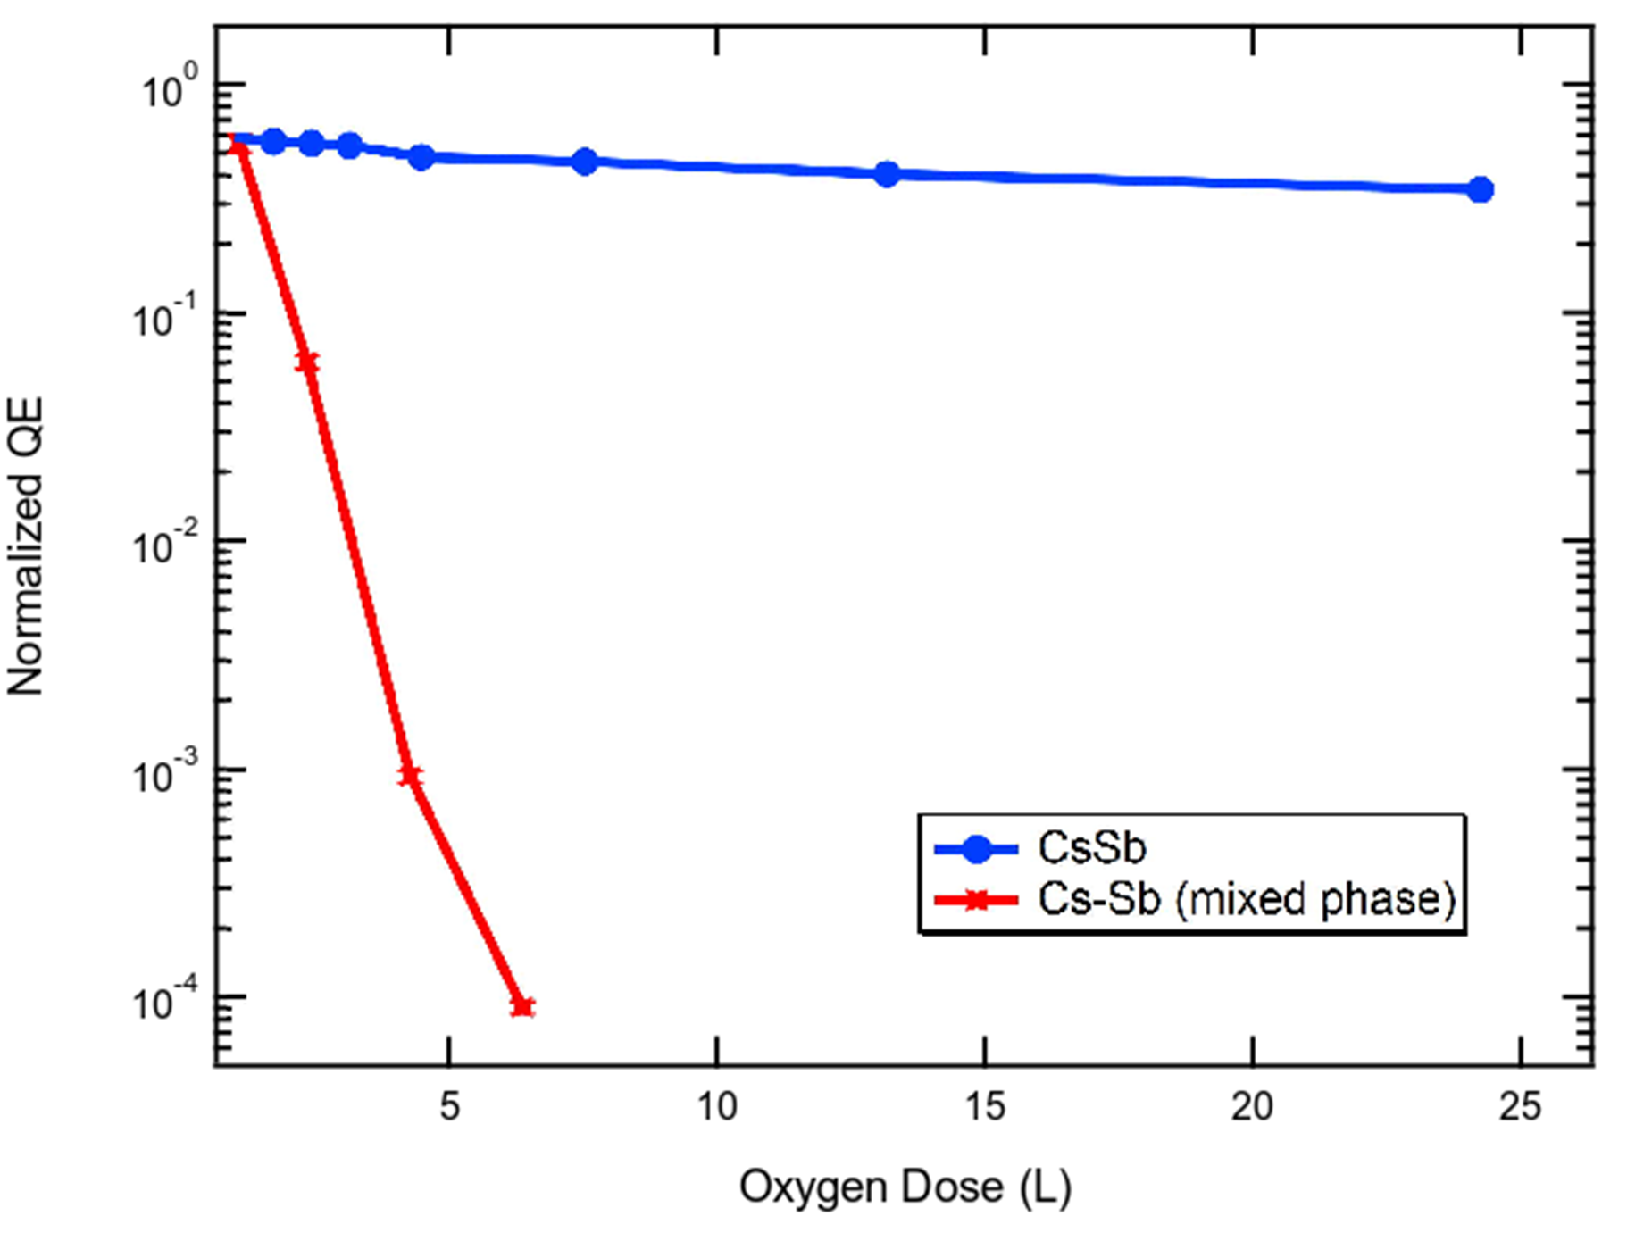
Why we care about CsSb?
Spectral response of CsSb reveals an emission threshold near 580 nm and QE of 1% at 400 nm
CsSb is very robust to oxygen exposure by over two order of magnitude compared to other Cs-Sb compounds.

Slide 20
Conclusions
Lab up and running ⇒ Plenty of work to do!
PHOEBE can produce photocathodes by co-depositon or molecular beam epitaxial methods with high throughput
PARADIM experiments: 59 samples grown in 27 days (operating 24/7)
PHOBE: 92 Cs-Sb samples grown from October 2021 (+ Other photocathodes 120 total)
A new Cs-Sb phase has been identified (CsSb) which is robust under oxygen conditions

Slide 21
Future Directions
New sources (Na, K…)
Stoichiometry dependence on the MTE (CsSb vs Cs₃Sb)
Temperature dependence measurements on the TE-Meter system
Epitaxial vs Co-deposition for MTE measurements (Crystal dependence studies)
Better characterization of the cathodes at the beginning of the growth (Do we have CsSb and then Cs₃Sb?)

Slide 22
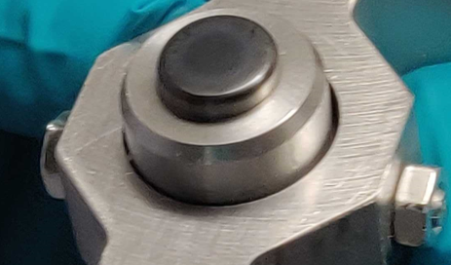
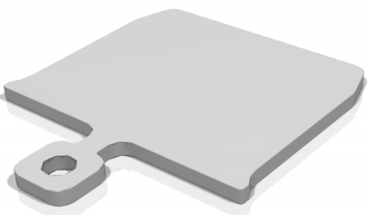
Holders

